Slide 1
IoT Network Attack Detection
Using Neural Networks
I organised the full pipeline and focused on training experiments
Yang Yu
CSIP5103D / 21 October 2026
Notes:
0:20
Our question: normal or attack?
My part: full pipeline; training settings
Today: what changed; what I learned
Source: ../presentation-plan.md, personal contribution confirmed by user.

Slide 2
We need to catch attacks and avoid false alarms
Real traffic | Model says normal | Model says attack
Normal | Correct | False alarm
Attack | Missed attack | Correct
Aim: recognise normal and attack traffic with an MLP
Build a repeatable pipeline. Compare training settings. Measure both mistakes.
02
Notes:
1:00
Think of a smoke alarm / 烟雾报警器
Fire, no alarm: missed attack
No fire, alarm: false alarm
Aim: classify IoT traffic
Objectives: build; compare; evaluate
Source: Project scope and evaluation definitions in notebooks/iot_attack_detection.ipynb, test_model.

Slide 3
We study training choices on an IoT dataset
Study | Main idea | How we use it
Sharmila & Nagapadma, 2023 | Quantised autoencoder for IoT edge devices | RT-IoT2022 data
Rumelhart et al., 1986 | Backpropagation | Calculate gradients
Kingma & Ba, 2015 | Adam optimiser | Compare training updates
Our focus: a supervised MLP and controlled training experiments
03
Notes:
0:50
Dataset paper: autoencoder; edge resources
Backpropagation: calculate gradients
Adam: adapt updates
Our question: training choices; missed attacks; false alarms
Source: Sharmila & Nagapadma (2023), https://doi.org/10.1186/s42400-023-00178-5
Rumelhart, Hinton & Williams (1986), https://doi.org/10.1038/323533a0
Kingma & Ba (2015), https://arxiv.org/abs/1412.6980

Slide 4
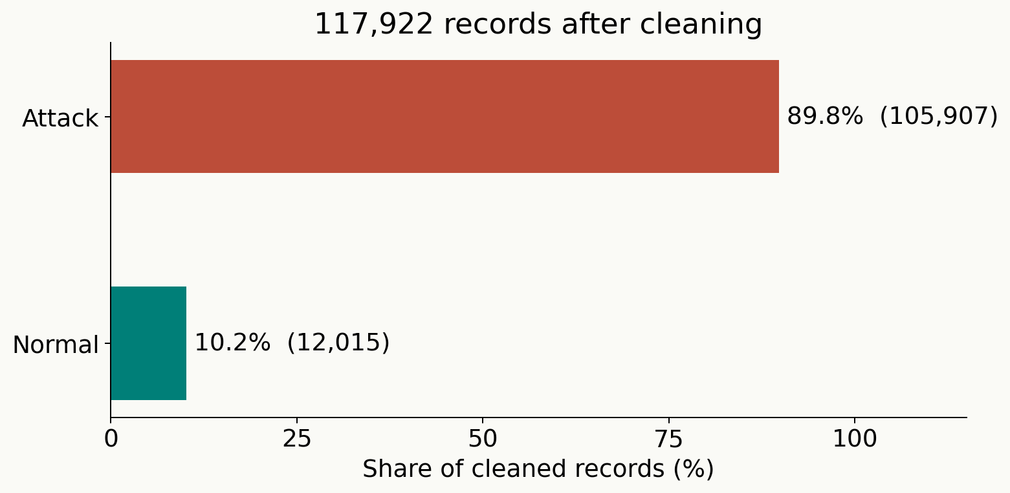
About 90% of the records are attacks
123,117
raw flows
117,922
after cleaning
Accuracy alone hides the false alarms
04
Notes:
0:50
Raw: 123,117 flows; 83 features
After cleaning: 117,922 flows
Always say attack: about 90% accuracy
So: detection rate AND false alarms
Source: Colab metadata counts and raw_rows. Dataset: https://archive.ics.uci.edu/dataset/942/rt-iot2022. Counts refer to the project CSV after cleaning.

Slide 5
I connected cleaning, training and evaluation
1 Clean
2 Split
3 Scale
Remove duplicates
70% / 15% / 15%
Fit on train only
4 Train
5 Validate
6 Evaluate
MLP + optimiser
Keep best weights
Misses + false alarms
The panel reports test metrics after each run
05
Notes:
1:10
My part: organised implementation; one notebook
Clean before split
Train 70%; validation 15%; test 15%
Fit scaler on training rows only
Same split and seed
Honest limit: panel shows test metrics after each run
Source: Project notebook Steps 1–7; Colab metadata. Current run_experiment calls test_model after every experiment. Validation chooses early-stopping weights; the test was visible during exploration, so it is not an untouched final benchmark.

Slide 6
Cleaning prevents misleading results
Problem | Action
A row counter called no | Drop it
5,195 exact duplicate rows | Remove before splitting
Hidden whitespace in labels | Strip label text
Features on very different scales | Standardise using training data
Clean first, then split
06
Notes:
0:55
no: counter, not a traffic feature
Duplicates: remove before split
Hidden label spaces: strip
Large numbers: scale
Same row in train and test: unfairly easy
Source: Notebook Steps 1–3; Colab cleaned counts. Duplicate count = 123117 - 117922. Large numeric scale is documented in the notebook; not a new Colab measurement.

Slide 7
A small MLP learns through a short training loop
Input | Hidden layer | Output
94 values | 64 units + ReLU | 1 score
83 original features become 94 numeric inputs after encoding
forward loss zero_grad backward step
Batch 256 Adam lr 0.001 At most 30 epochs
07
Notes:
1:10
83 raw features; one-hot encoding gives 94 inputs
64 hidden units; ReLU
One output score
Sigmoid inside BCEWithLogitsLoss during training
Demo: forward; loss; zero gradients; backward; step
Source: Notebook build_mlp and train_model. Colab baseline features=94. PyTorch code in the notebook uses BCEWithLogitsLoss, then sigmoid and threshold 0.5 for evaluation.

Slide 8
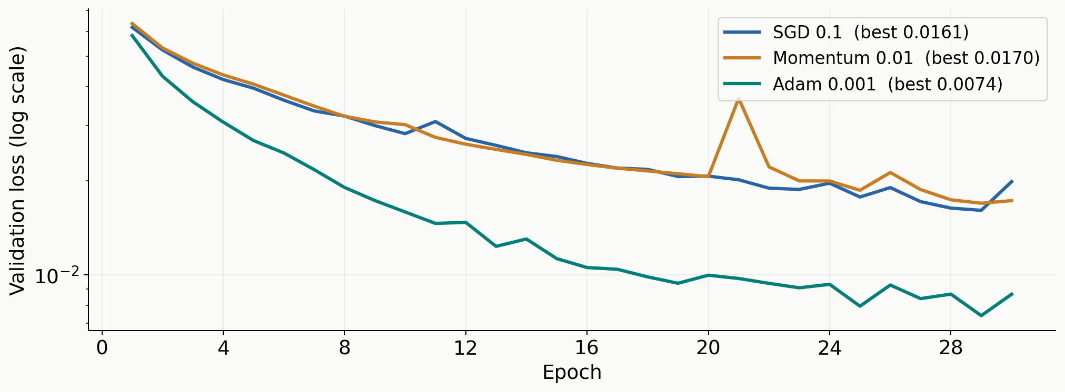
Adam reaches the lowest loss in this comparison
SGD lr 0.1 Momentum lr 0.01 Adam lr 0.001
08
Notes:
1:20
Same data; same network; same seed
Three configurations; different learning rates shown
Momentum: a rolling ball / 惯性
Adam: adaptive step per weight
This experiment only; not a universal winner
Source: Colab export, 18 October 2026. Seed 42. Local assets/colab-results.json.

Slide 9
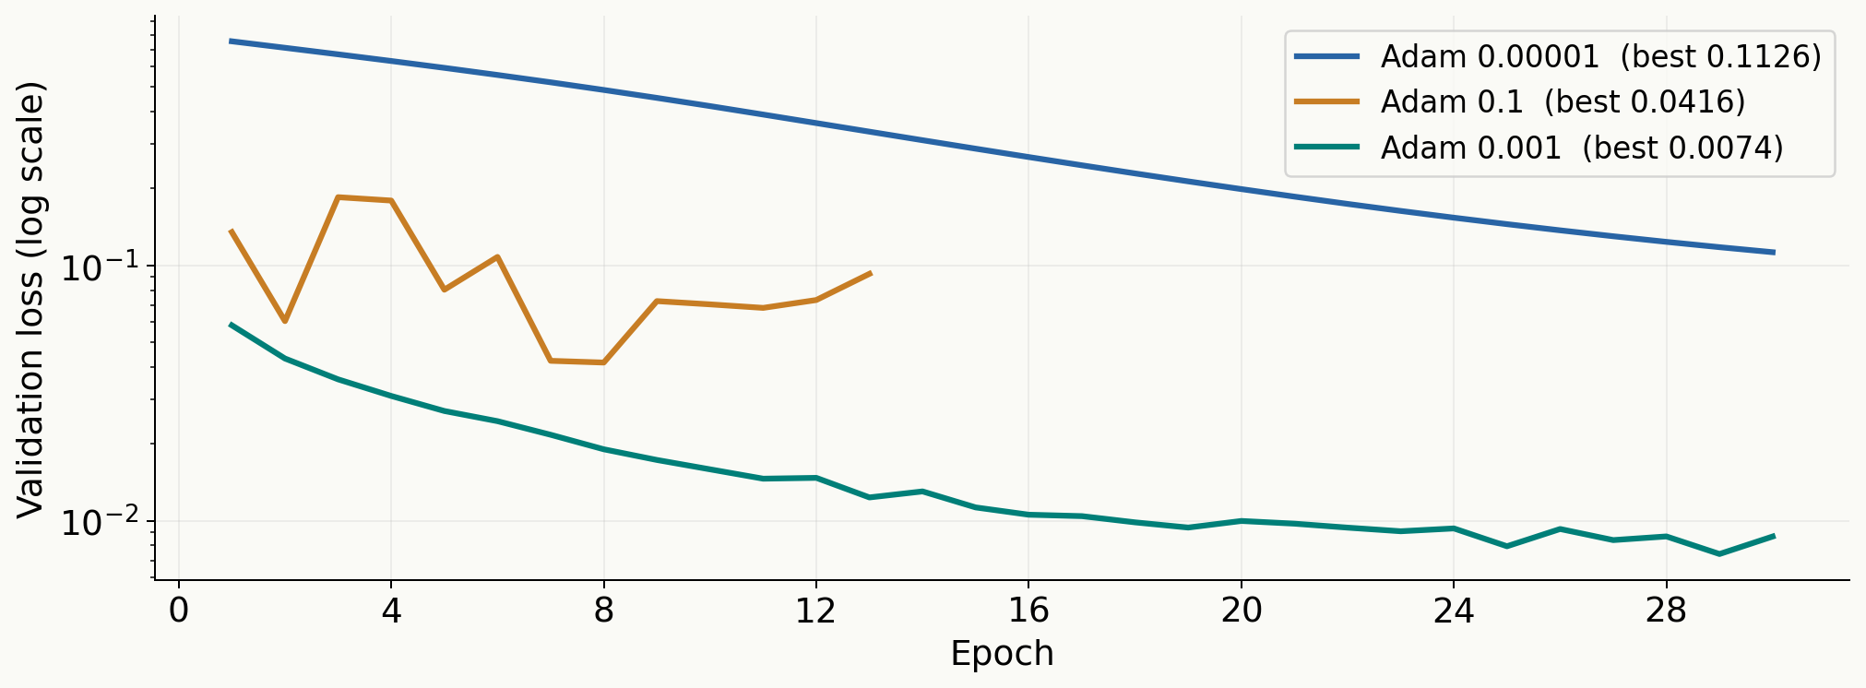
The learning rate changes how well Adam learns
Same model and data. Only the learning rate changes.
09
Notes:
1:10
Step size down a hill / 下山步长
0.00001: slow within 30 epochs
0.001: lower validation loss
0.1: unstable here
Same optimiser; change only learning rate
Source: Colab export, 18 October 2026. Seed 42. Local assets/colab-results.json.

Slide 10
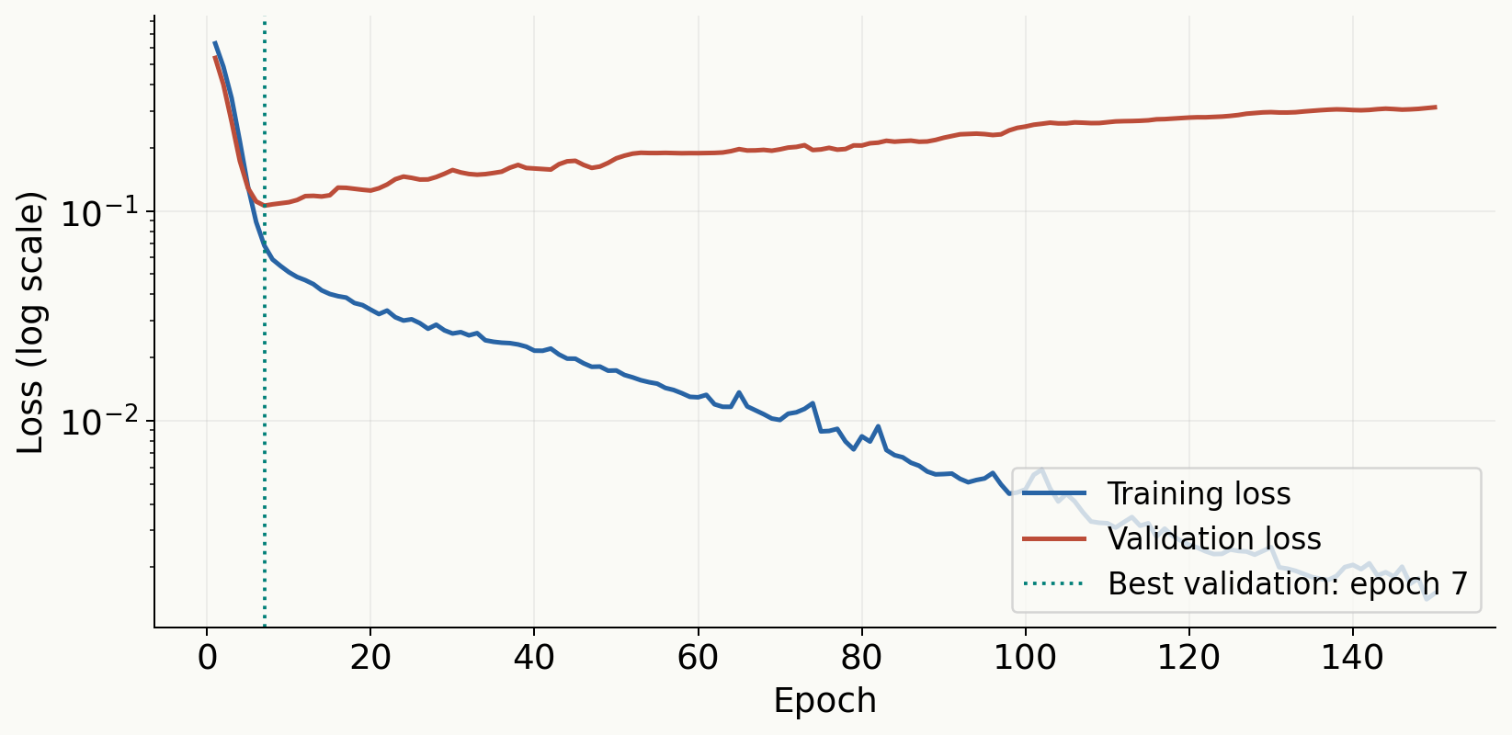
Validation shows when more training stops helping
Best epoch
7
Early stop at
12
1% of training rows. Hidden layers 256 and 128. Adam lr 0.001.
10
Notes:
1:20
826 training rows; larger MLP
Training loss down; validation loss up
Mock exam / 模拟考
Best epoch 7; stop after 5 worse checks
Restore best weights
More data is a separate comparison
Source: Colab export, 18 October 2026. Seed 42. Local assets/colab-results.json.

Slide 11
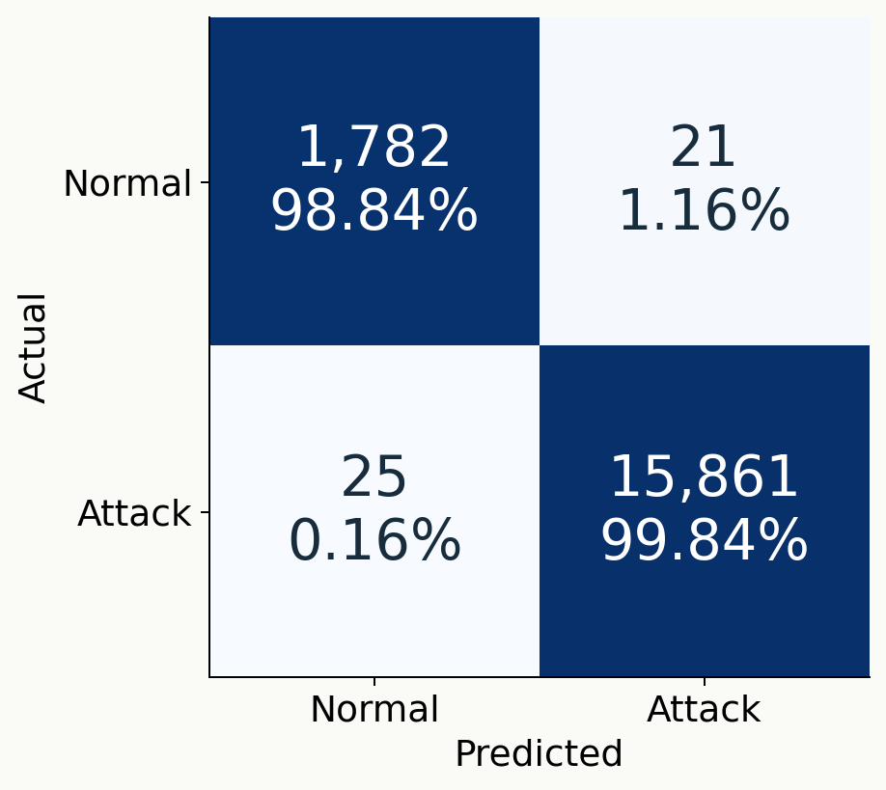
The baseline catches 99.84% of attacks
1.16%
false alarms
25
missed attacks
Baseline Adam lr 0.001. Test set: 17,689 flows. Threshold: 0.5.
11
Notes:
1:00
Read rows: actual traffic
False alarms: 1.16% of normal traffic
Misses: 25 attacks
Threshold 0.5
Baseline checkpoint from validation
One seed; this dataset; exploratory test result
Source: Colab export, 18 October 2026. Seed 42. Local assets/colab-results.json.

Slide 12
I learned to check the data and the training process
Learned | Limits | Next
Training settings change the result | One seed and one random split | Repeat across seeds
Validation helps decide when to stop | Only normal / attack labels | Check each attack type
The full pipeline must be explainable | Test results visible while exploring | Use a fresh final evaluation
Thank you. I can show the notebook live.
12
Notes:
0:50
My contribution: organised pipeline; training comparisons
Learned: data first; curves explain failures
Limits: one seed; binary labels; random split
Test results visible during experiments
Next: multiple seeds; fresh evaluation; attack-level recall
Thank you. Notebook demo.
Source: Personal reflection from current experiments. Suggested next steps, not completed work.

Slide 13
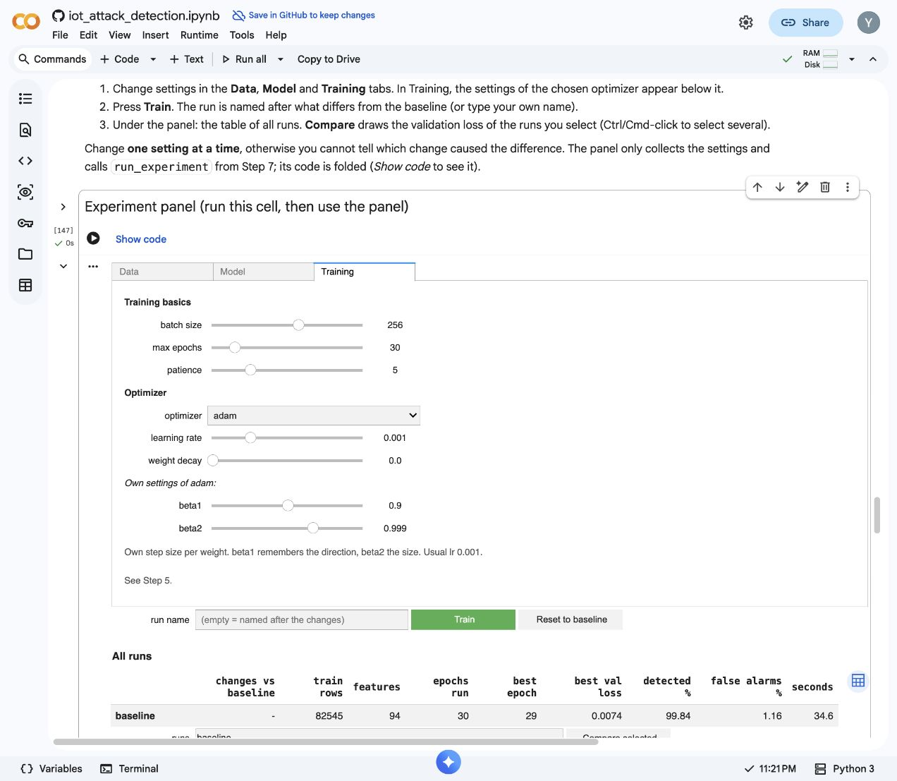
The demo changes one training setting at a time
1 Run all before the talk
2 SGD, lr 0.001
3 Adam, lr 0.001
B1
Notes:
Backup
Before talk: Run all
Reset baseline
Training: SGD, lr 0.001; Train
Reset baseline
Training: Adam, lr 0.001; Train
If unavailable: show saved Colab results
Source: Colab export, 18 October 2026. Seed 42. Local assets/colab-results.json.

Slide 14
The comparison uses saved Colab runs
Run | Epochs | Best val | Last val | Detected % | False alarms %
Adam 0.001 | 30 | 0.0074 | 0.0087 | 99.84 | 1.16
SGD 0.1 | 30 | 0.0161 | 0.0199 | 99.78 | 2.11
Momentum 0.01 | 30 | 0.0170 | 0.0173 | 99.83 | 2.22
SGD 0.001 | 30 | 0.0996 | 0.0996 | 98.82 | 35.27
Adam 0.00001 | 30 | 0.1126 | 0.1126 | 99.02 | 34.89
Adam 0.1 | 13 | 0.0416 | 0.0926 | 99.97 | 16.75
Overfit | 150 | 0.1059 | 0.3119 | 99.14 | 3.55
Early stopping | 12 | 0.1059 | 0.1177 | 97.92 | 6.05
Weight decay | 150 | 0.0983 | 0.1228 | 98.24 | 4.33
More data | 150 | 0.0307 | 0.1058 | 99.76 | 2.05
Single seed 42. Settings and full histories accompany the deck.
B2
Notes:
Backup
All rows: Adam, SGD, momentum, learning rates
Small-data runs: 826 rows, larger network
Best val is not last val
Patience 0: last weights
Patience 5: best weights
Different data/model rows are separate comparisons
Source: Colab export, 18 October 2026. Seed 42. Local assets/colab-results.json.

Slide 15
Each batch follows five simple steps
scores = model(X["train"][batch]).squeeze(1)
loss = loss_fn(scores, y["train"][batch])
optimizer.zero_grad()
loss.backward()
optimizer.step()
BCEWithLogitsLoss includes sigmoid during training
Early stopping saves a copy of the best validation weights
B3
Notes:
Backup
scores: forward pass
loss: compare scores with labels
zero_grad: clear previous gradients
backward: calculate current gradients
step: update weights
Validation: eval + no_grad
Best weights: deepcopy; load_state_dict
Source: Exact operations from notebook train_model; shortened formatting for presentation.

Slide 16
These sources support the data and methods
Sharmila, B. S. & Nagapadma, R. (2023)
Quantized autoencoder (QAE) intrusion detection system for anomaly detection in
resource-constrained IoT devices using RT-IoT2022 dataset. Cybersecurity 6, 41.
doi:10.1186/s42400-023-00178-5
Rumelhart, D. E., Hinton, G. E. & Williams, R. J. (1986)
Learning representations by back-propagating errors. Nature 323, 533–536.
doi:10.1038/323533a0
Kingma, D. P. & Ba, J. (2015)
Adam: A Method for Stochastic Optimization. ICLR.
https://arxiv.org/abs/1412.6980
RT-IoT2022 dataset, UCI Machine Learning Repository
https://doi.org/10.24432/C5P338
B4
Notes:
Backup
Dataset and three papers checked 18 October 2026
Source: Links shown on slide; checked against publisher, arXiv and UCI pages.

