Slide 1
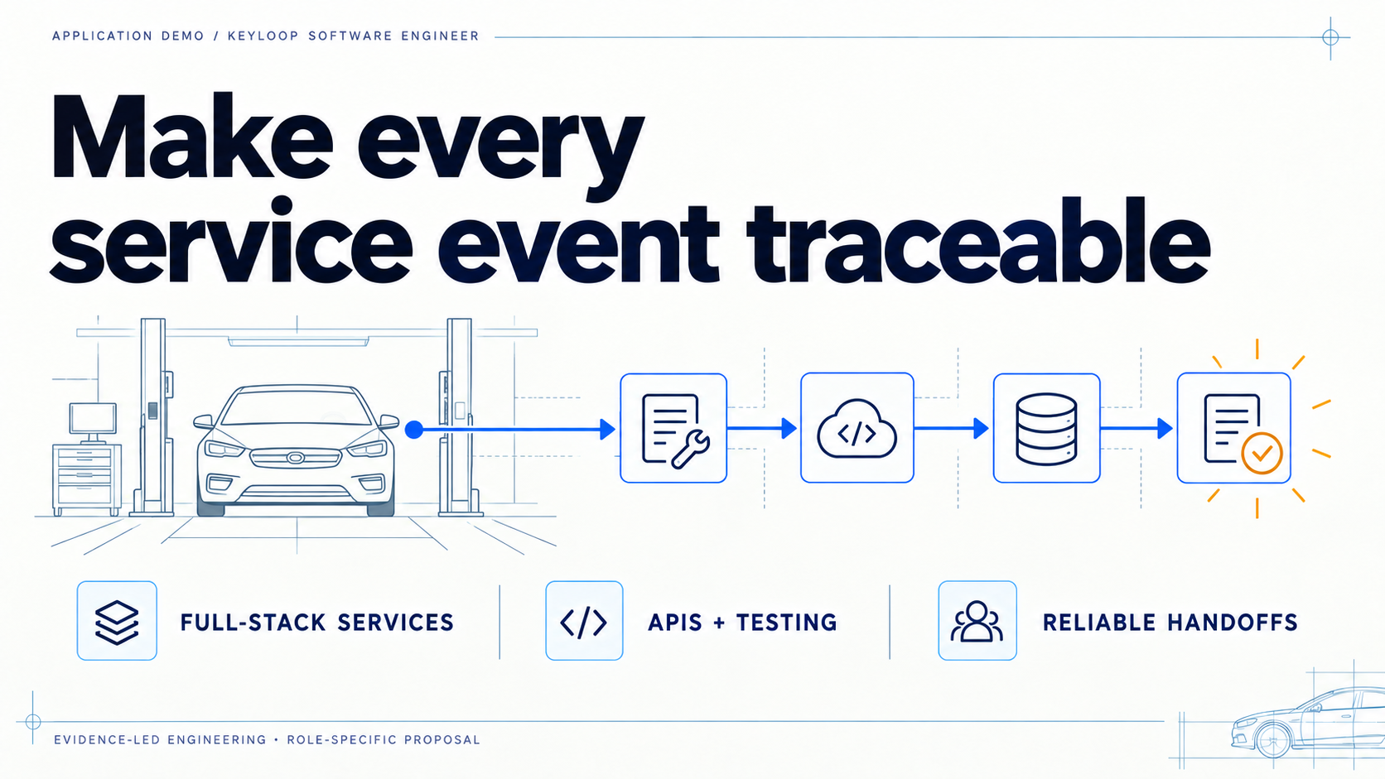
Notes:
This deck is a small application demo for the Keyloop Software Engineer role. My focus is the boundary between an operational event and the next system that has to trust it: the API, the validation, the test path, and the handoff. I will keep the distinction clear between work I have already done and the way I would apply that thinking here.

Slide 2
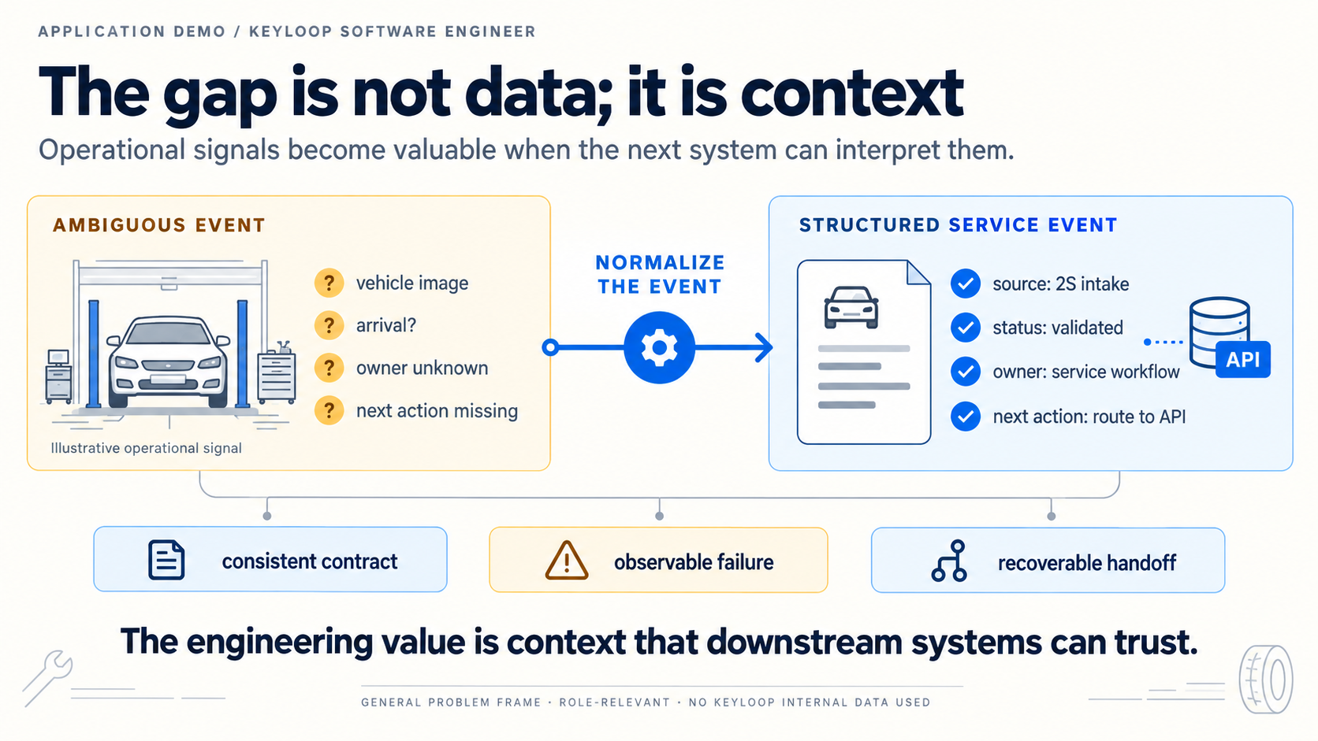
Notes:
An event can exist and still be hard to use. If the source, status, owner, or next action is unclear, the downstream service has to guess. The engineering opportunity is to make that context explicit, then make failures observable and recoverable. This is a general service-operations problem, not a claim about Keyloop's internal systems.

Slide 3
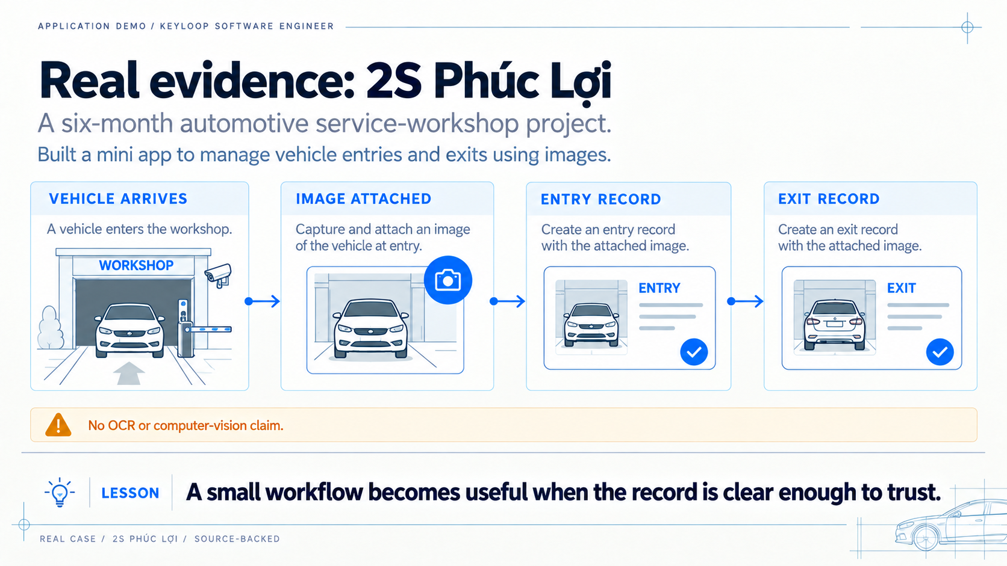
Notes:
At 2S Phúc Lợi, I built a mini app to manage vehicle entries and exits using images. The important evidence here is the workflow: a physical event becomes an organized record that someone can use. I am not claiming OCR or computer-vision recognition, and I am not adding adoption or performance figures that were not measured.

Slide 4
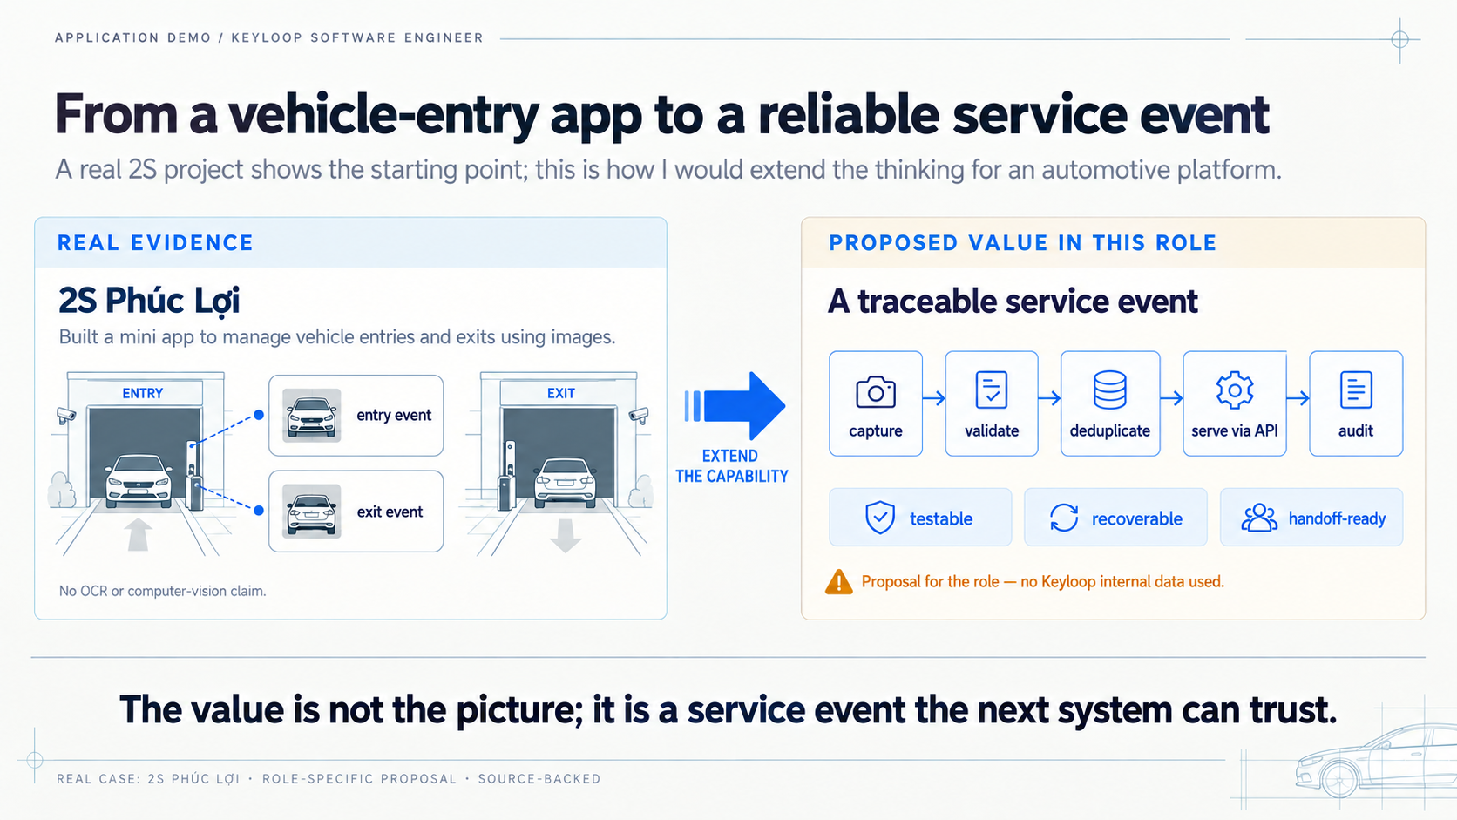
Notes:
This is the bridge from the real case to the role. The vehicle image is only the starting signal. In a larger service platform, I would want a traceable event path: capture it, validate it, prevent duplicates, expose a clear API boundary, and preserve an audit trail. The right-hand side is a proposal for this role, not a description of an existing Keyloop system.

Slide 5
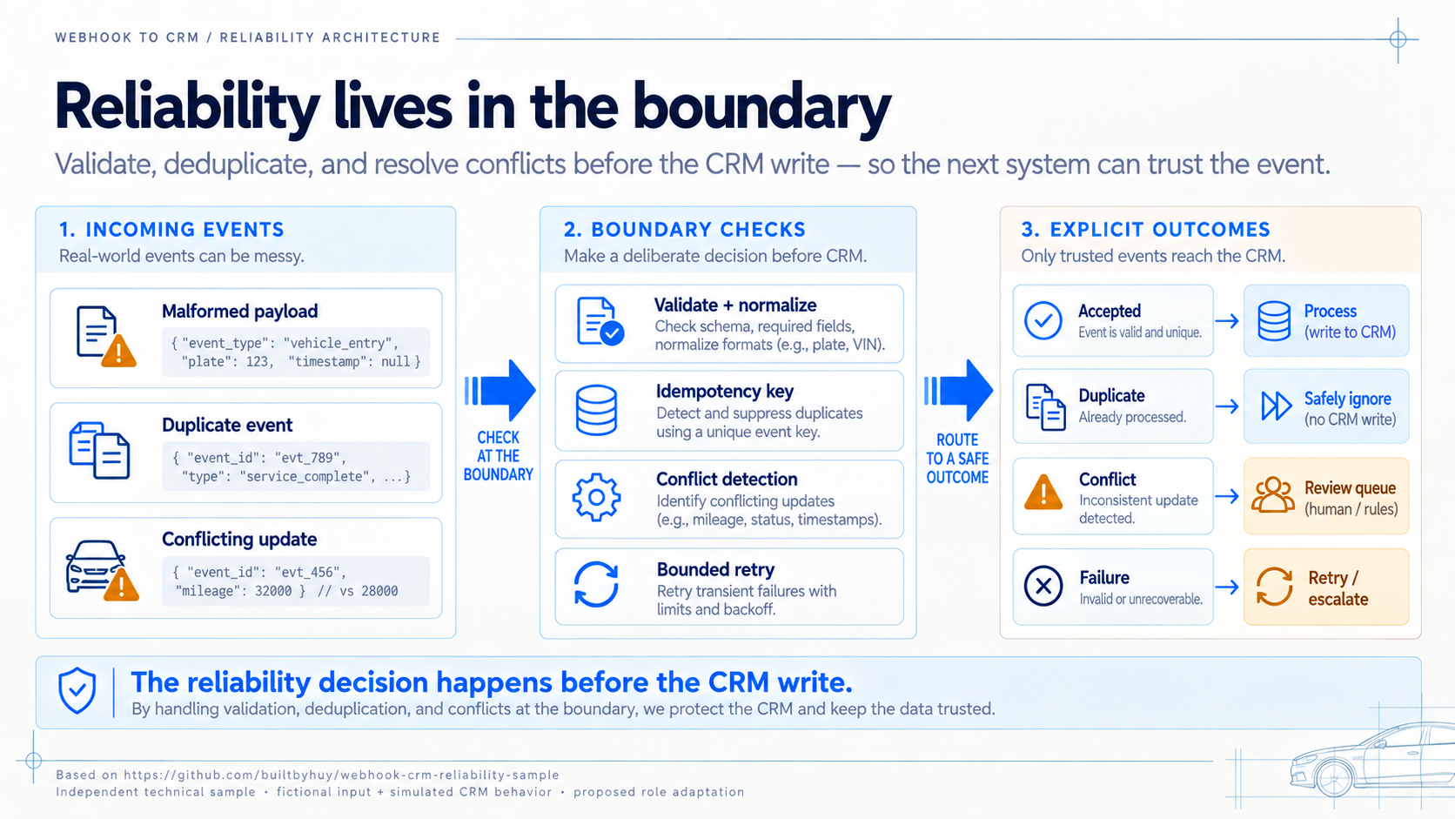
Notes:
My independent webhook reliability sample shows how I approach that boundary. It validates and normalizes input, suppresses duplicates, detects conflicting changes, retries within bounds, and makes failure explicit. The sample uses fictional input and simulated CRM behavior, so it is evidence of engineering practice rather than a client production claim.

Slide 6
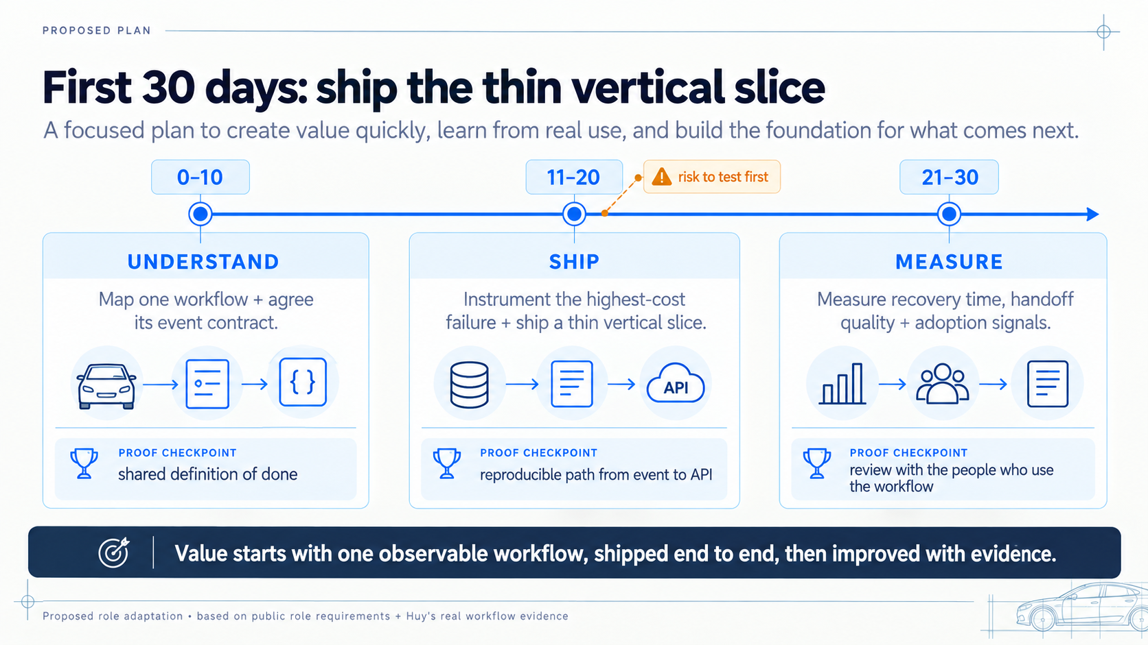
Notes:
My first month would be deliberately bounded. I would map one workflow and agree its event contract, instrument the failure that costs the team the most time, ship a thin vertical slice with a recovery path, and measure whether the handoff becomes easier to operate. This is a proposed plan that shows how I would turn the evidence in this deck into useful delivery.

