Slide 1
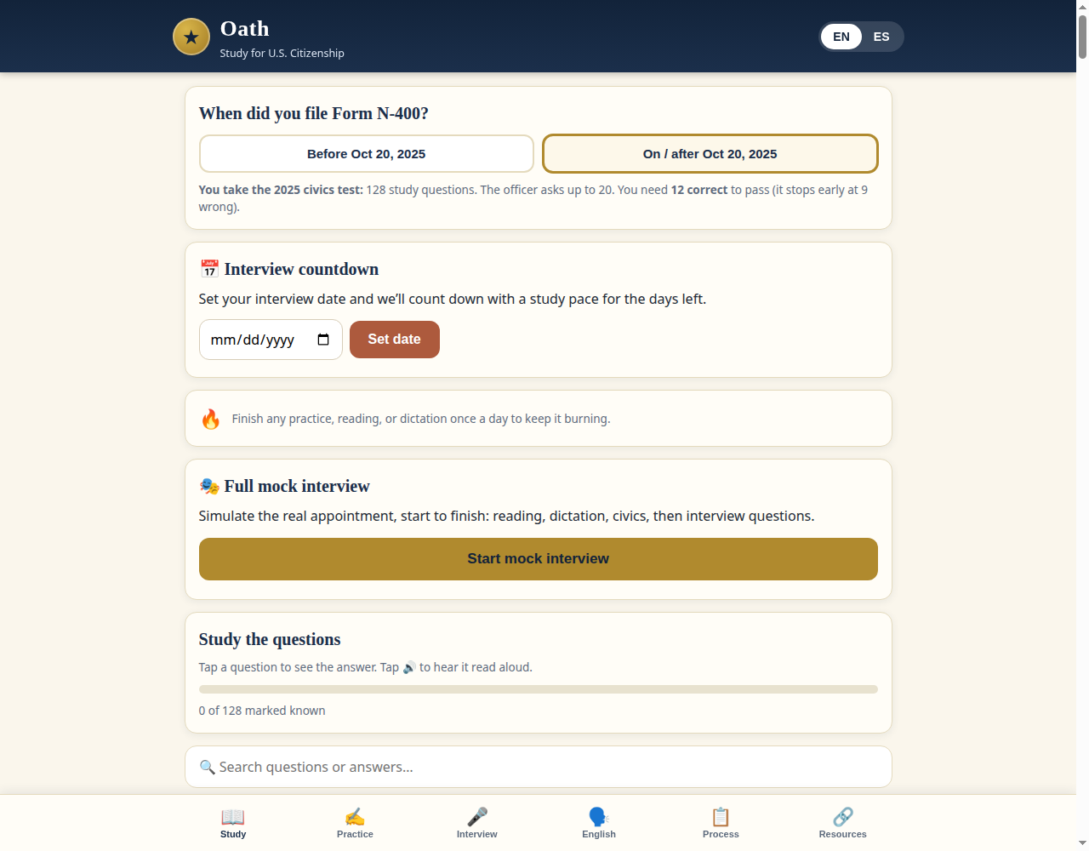
Oath Citizenship — before · 53% slop

Slide 2
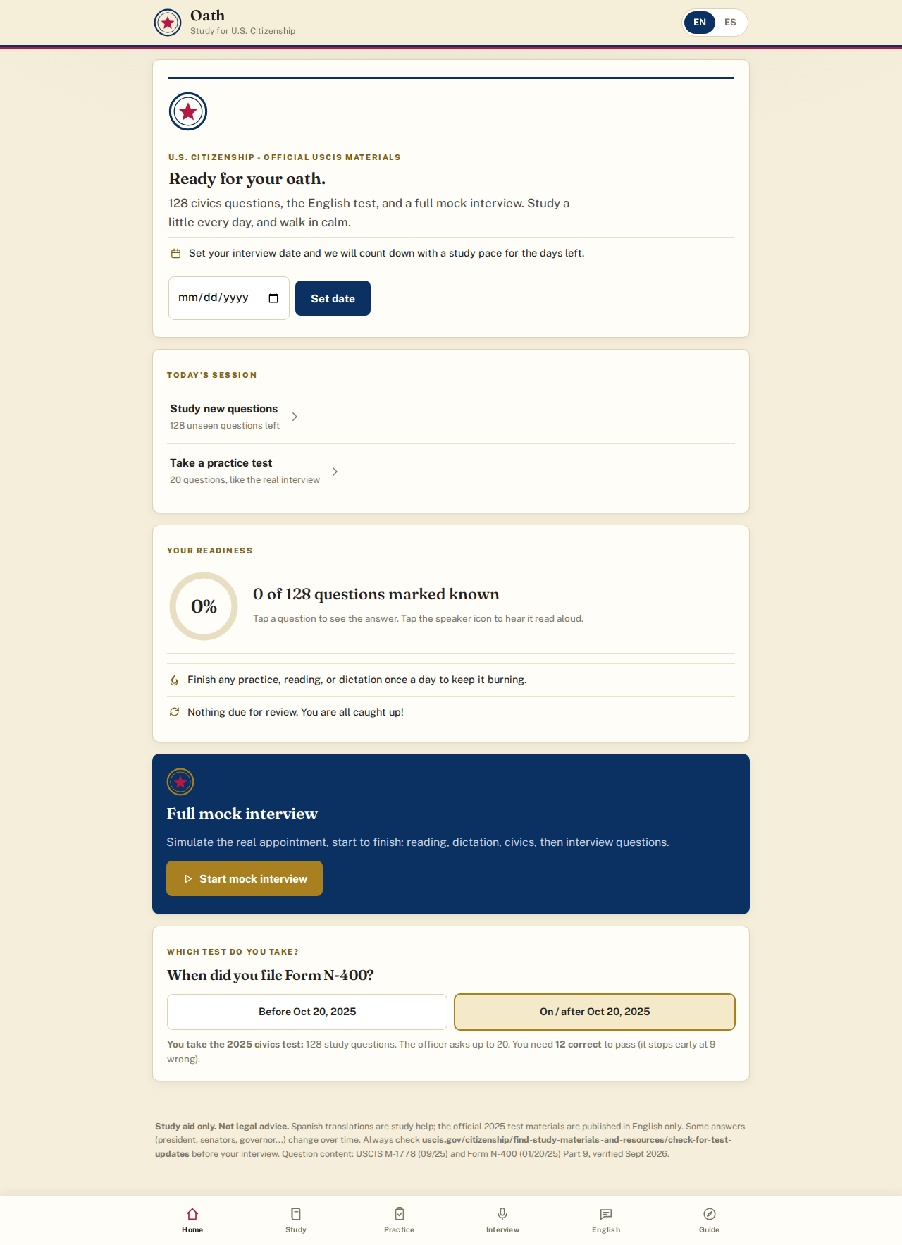
After · 3% slop · merged into original
https://builtbysai.github.io/oath-citizenship/

Slide 3
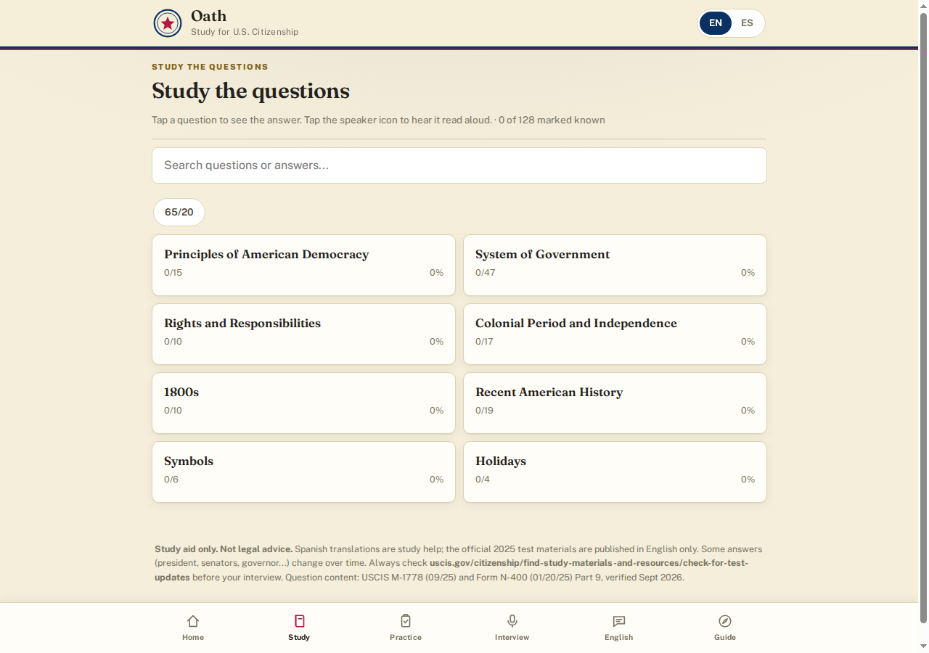
After · study view · sticky filters
https://builtbysai.github.io/oath-citizenship/

Slide 4
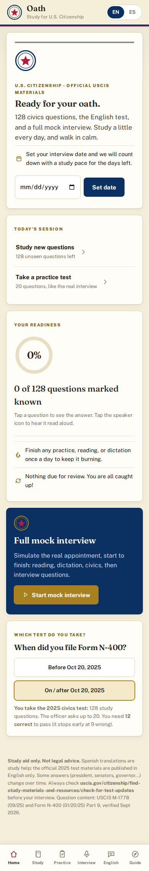
After · mobile
https://builtbysai.github.io/oath-citizenship/

