Slide 1
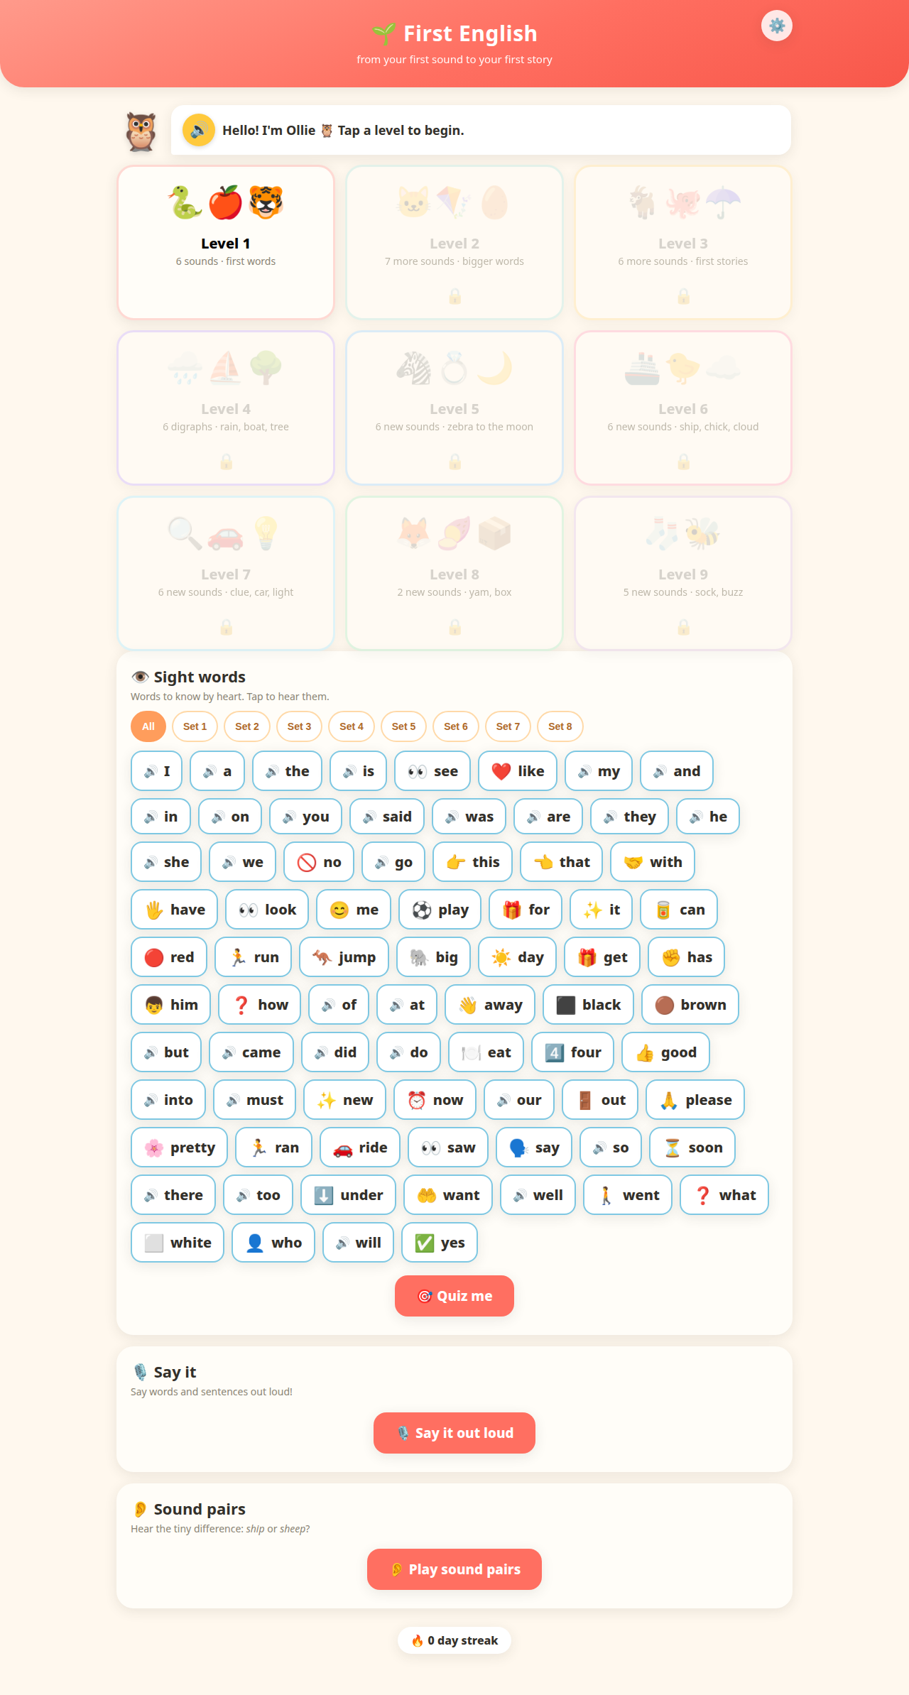
Before — 29% slop

Slide 2
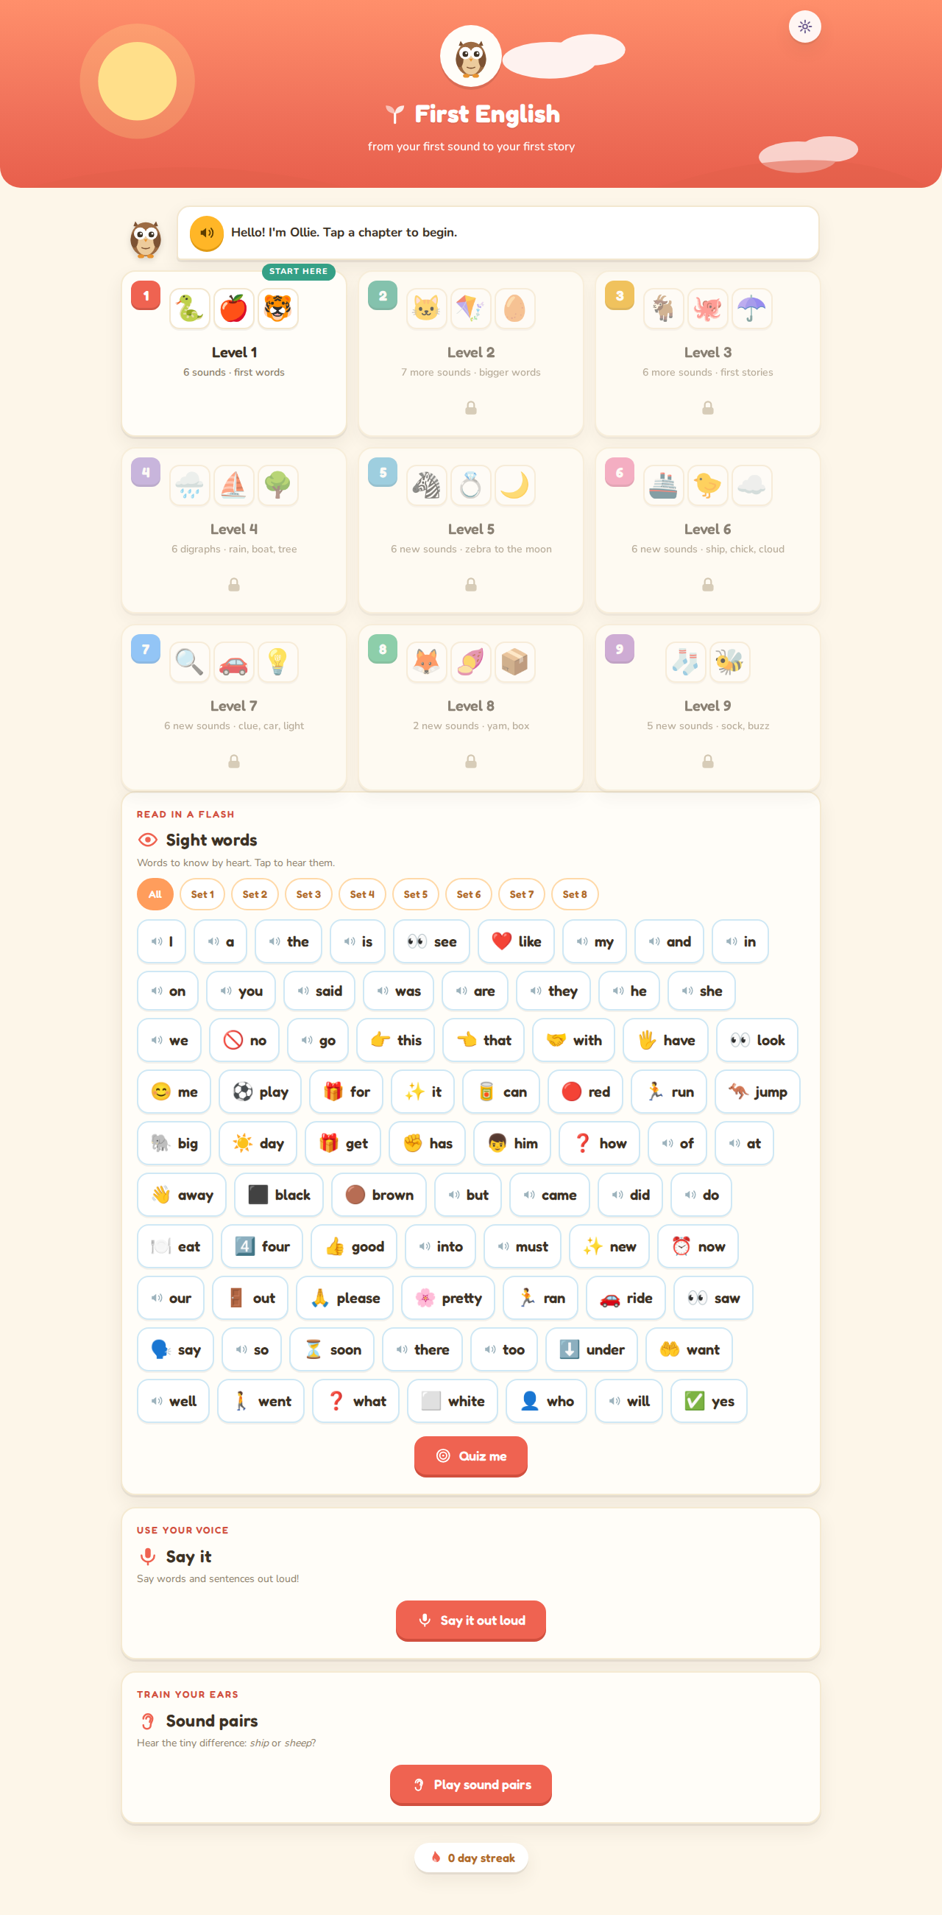
After — storybook edition

Slide 3
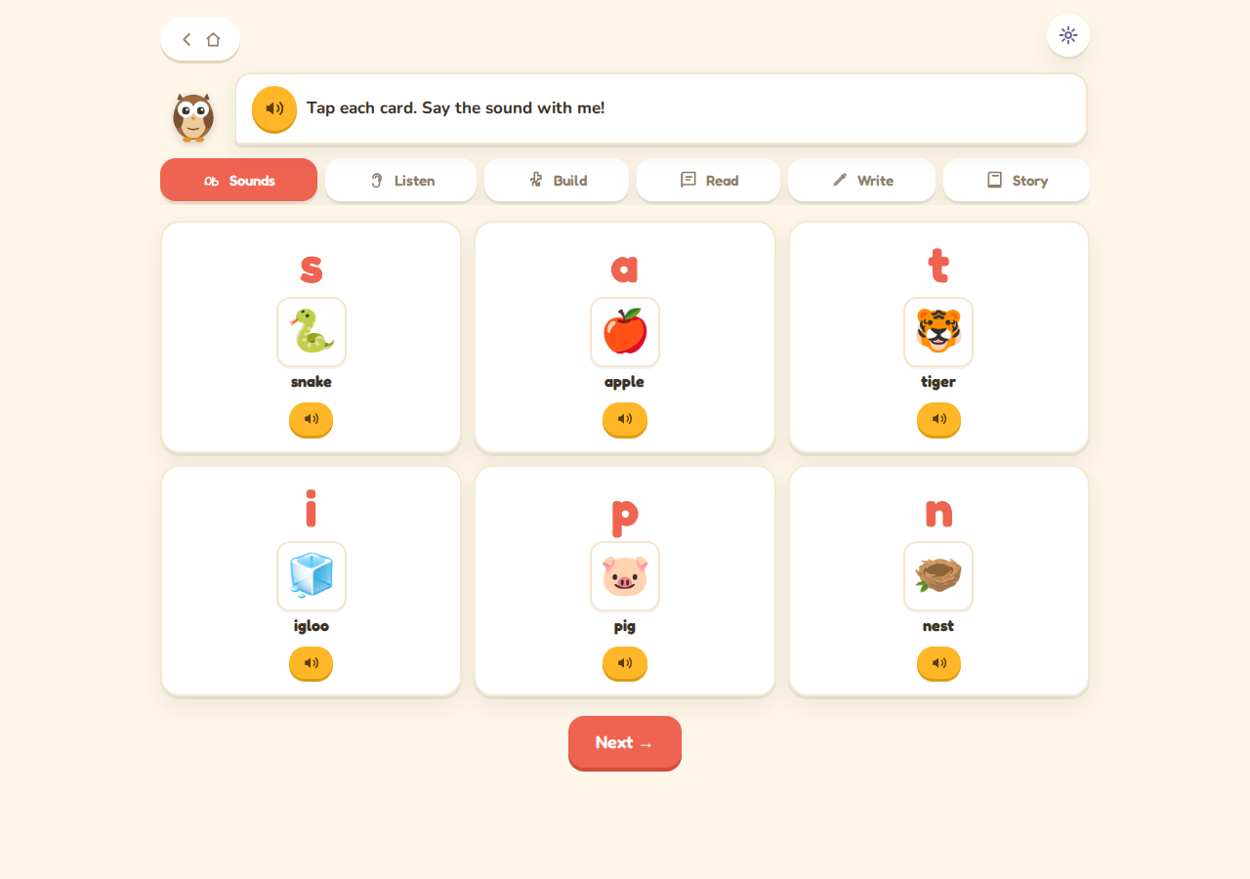
After — chapter

Slide 4
After — mobile

