Slide 1
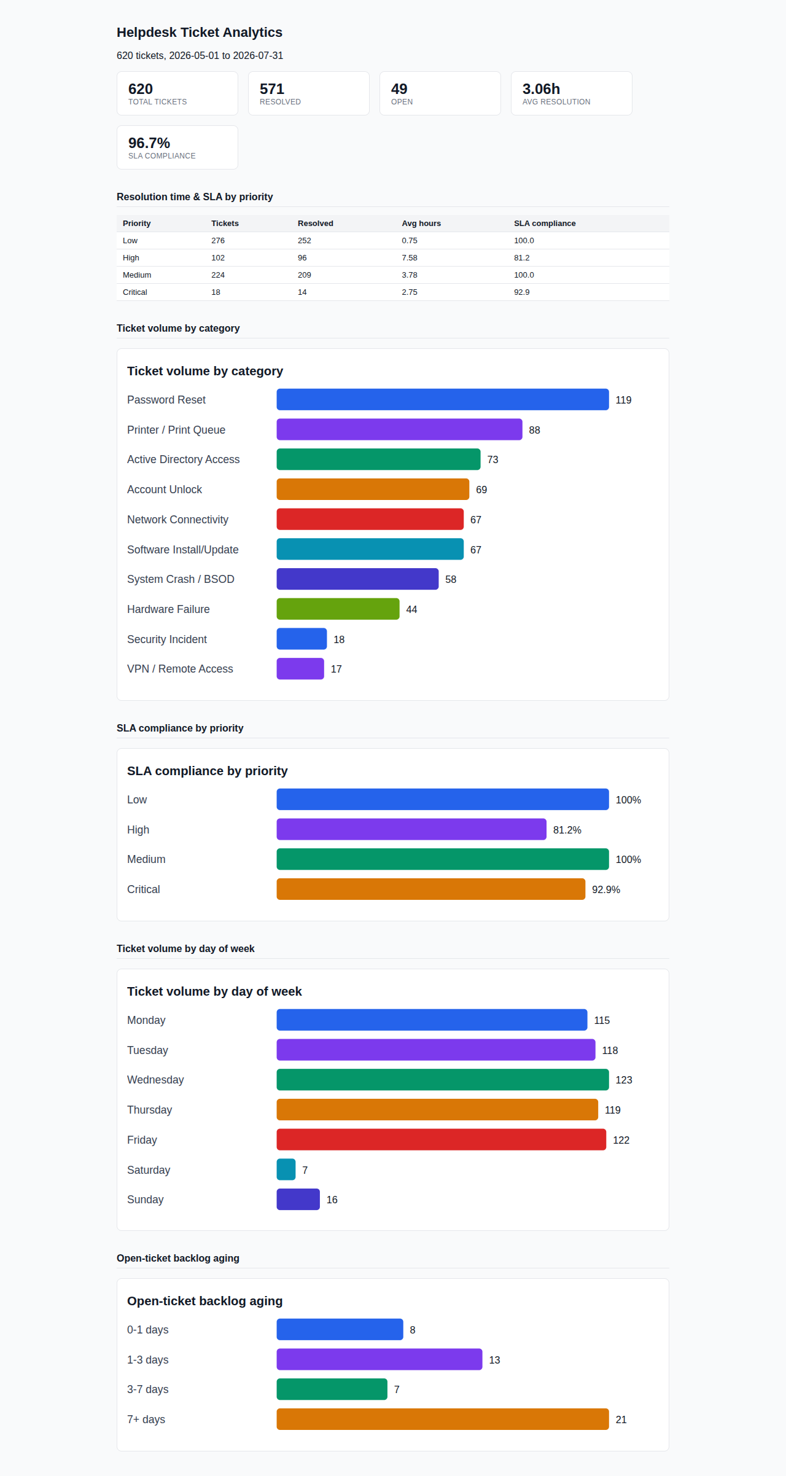
Before

Slide 2

After — The Weekly Ops Review

