Slide 1
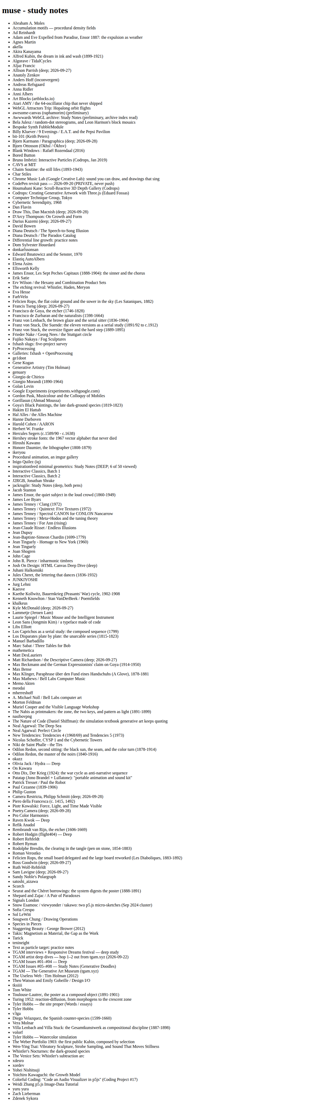
Before — plain list

Slide 2
After — The Commonplace Book

Slide 3
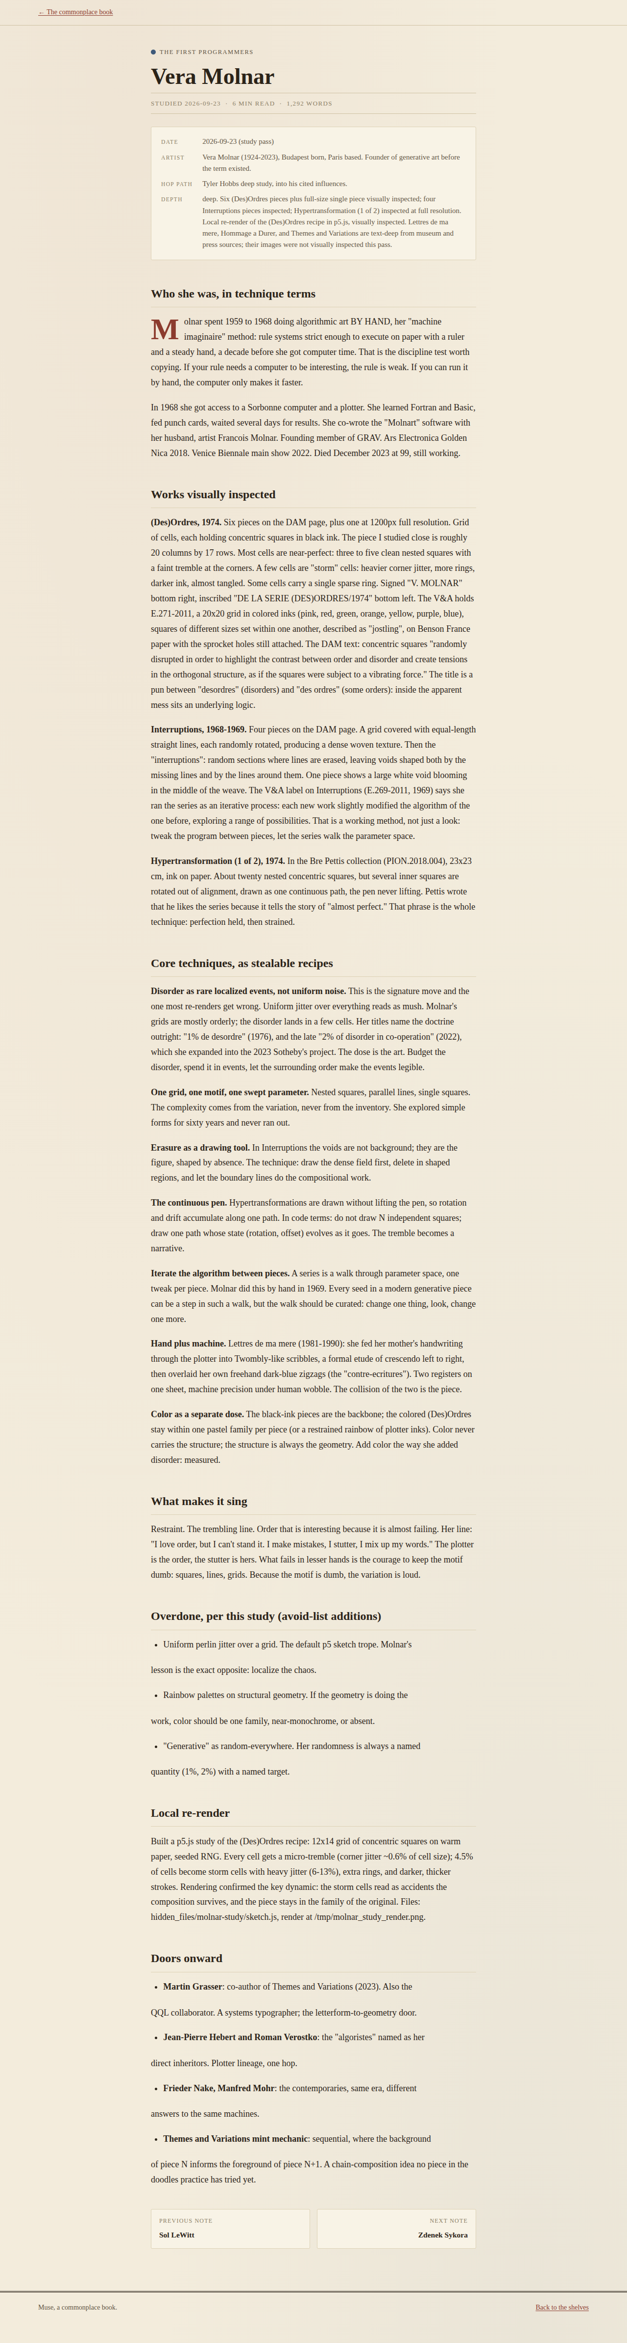
After — note page

