Slide 1
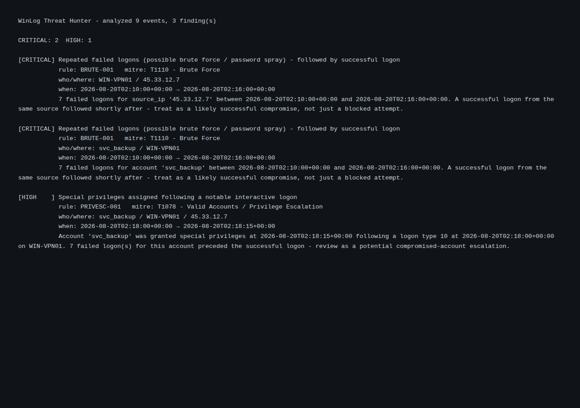
Before — console output

Slide 2
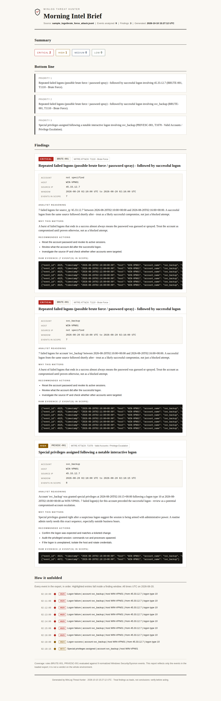
After — The Morning Intel Brief (new HTML report)

