Slide 1
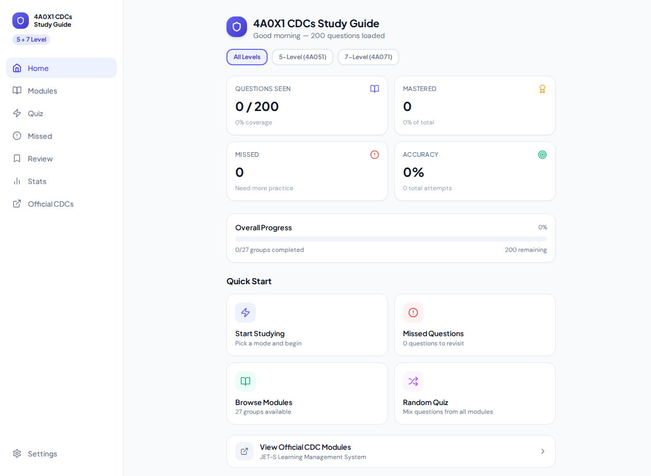
Before — 54% slop

Slide 2
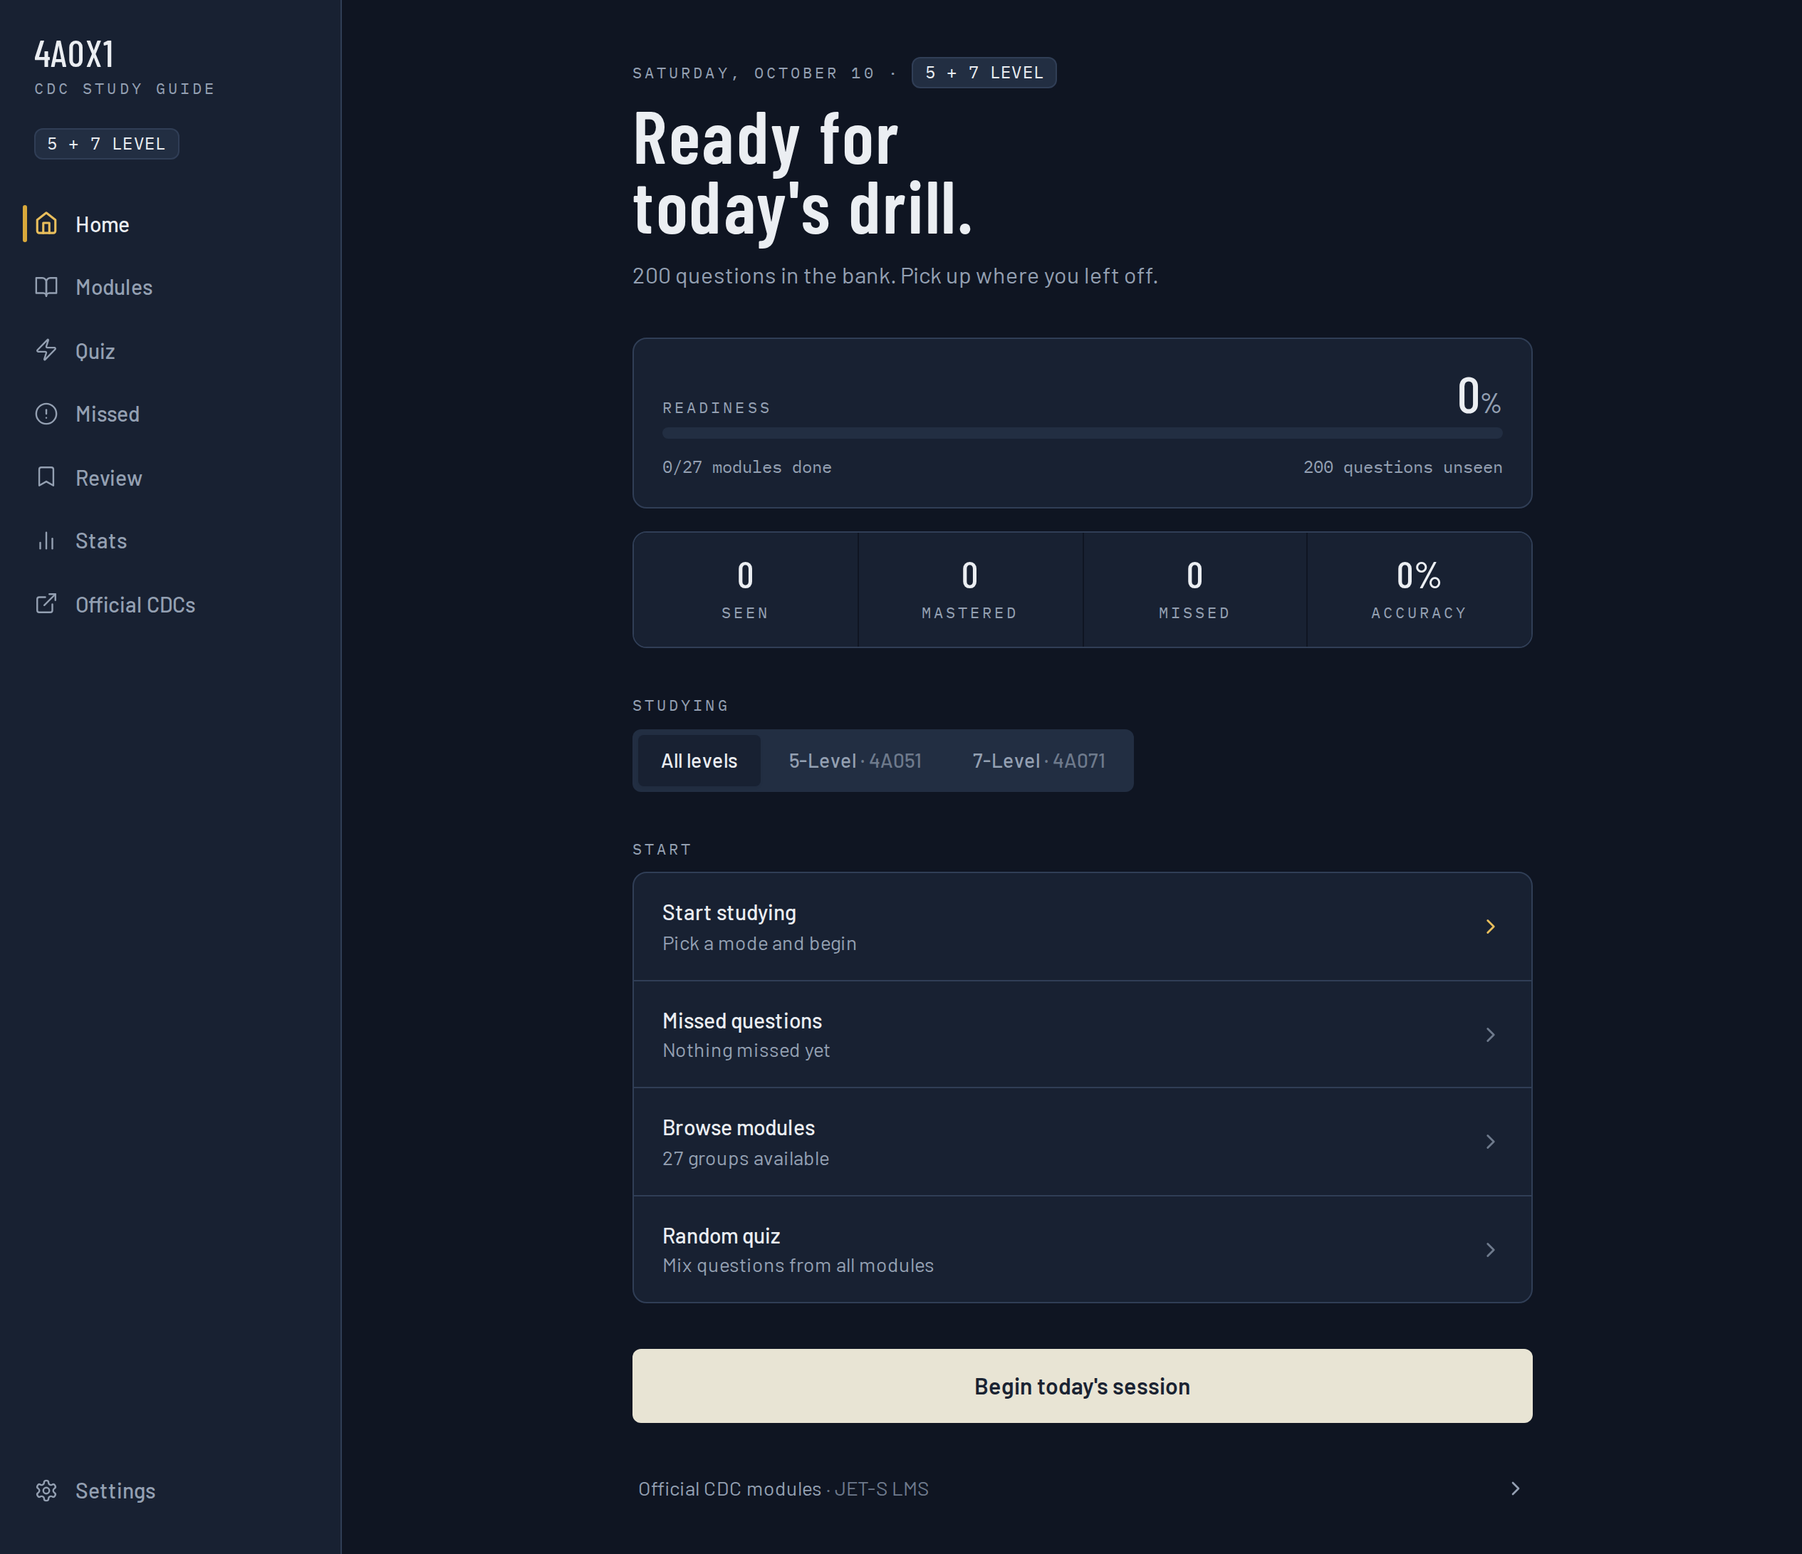
After — 20% slop, hand-drawn icons

Slide 3
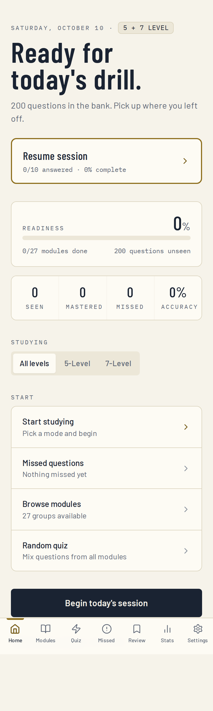
After — mobile

