Slide 1
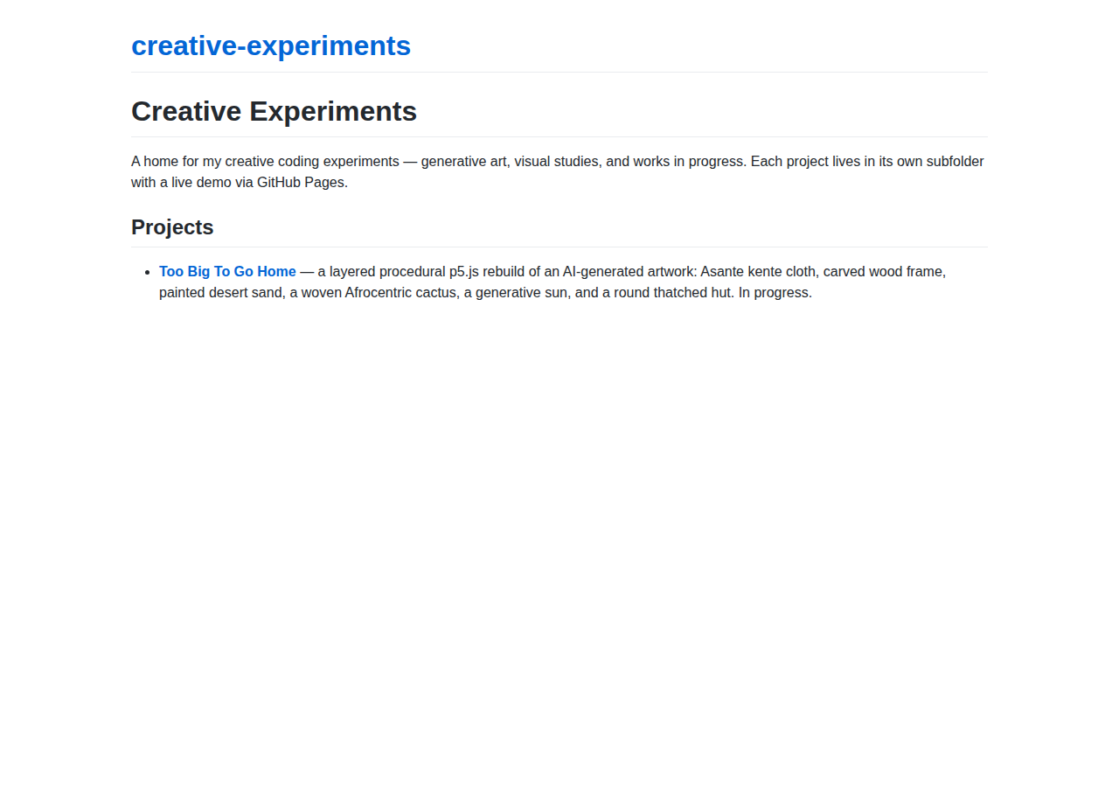
Before — 22% slop

Slide 2
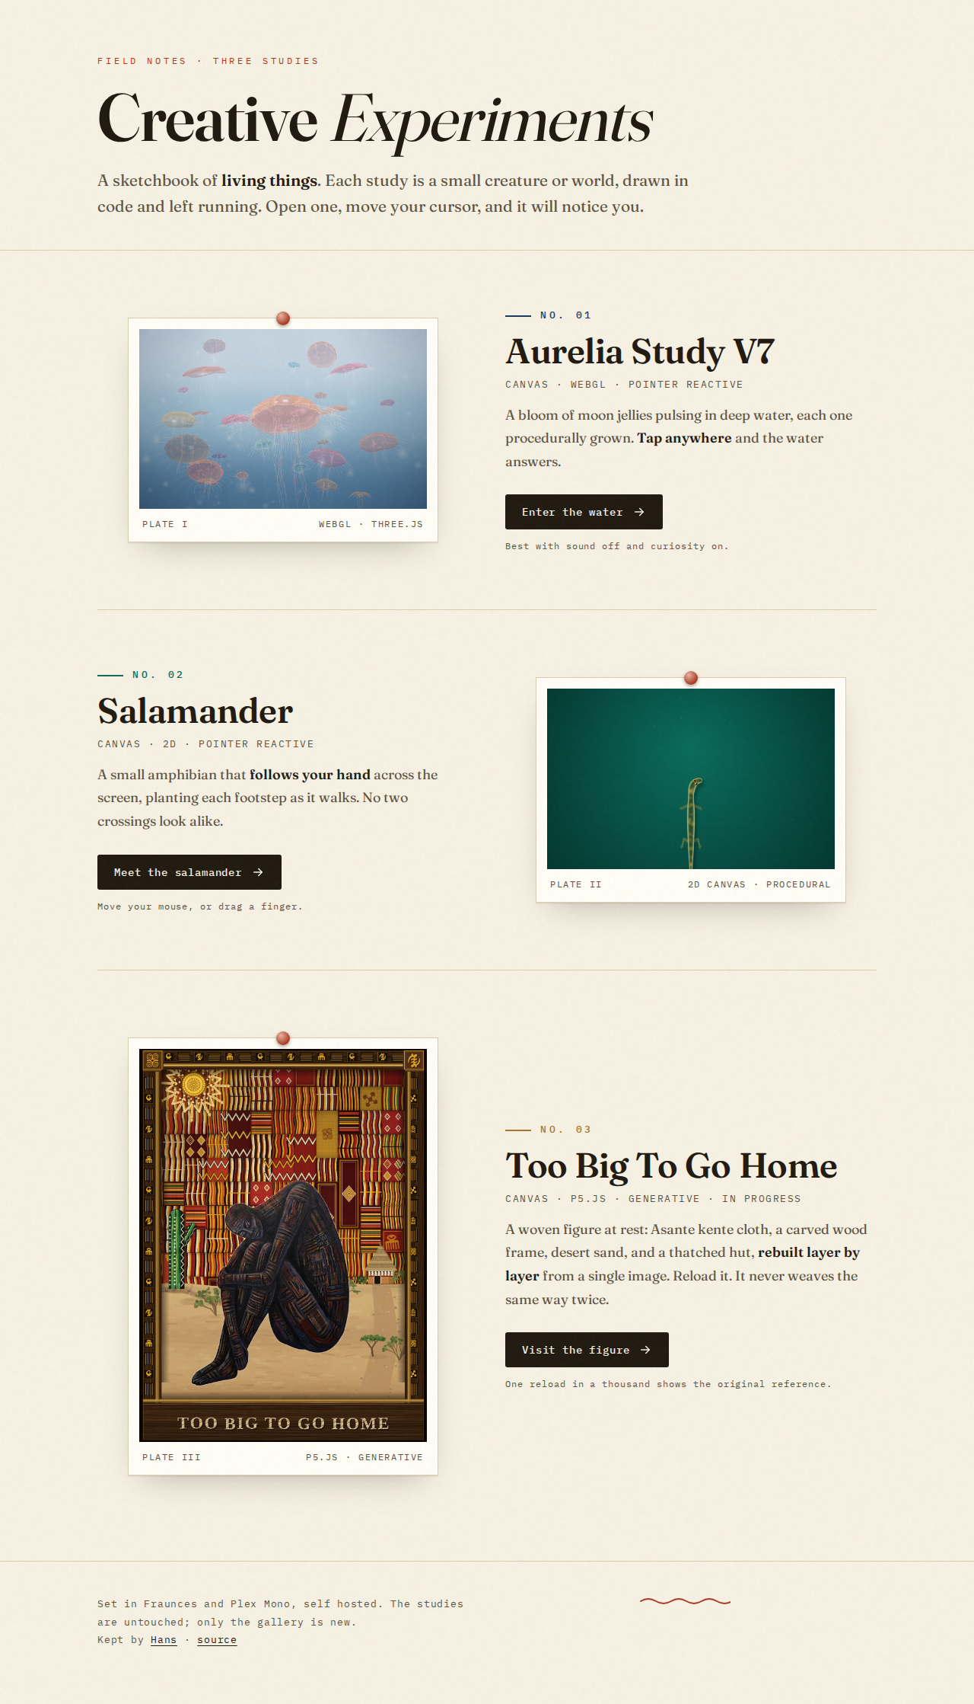
After — 3% slop

Slide 3

After — mobile

