Slide 1

Before — 51% slop

Slide 2
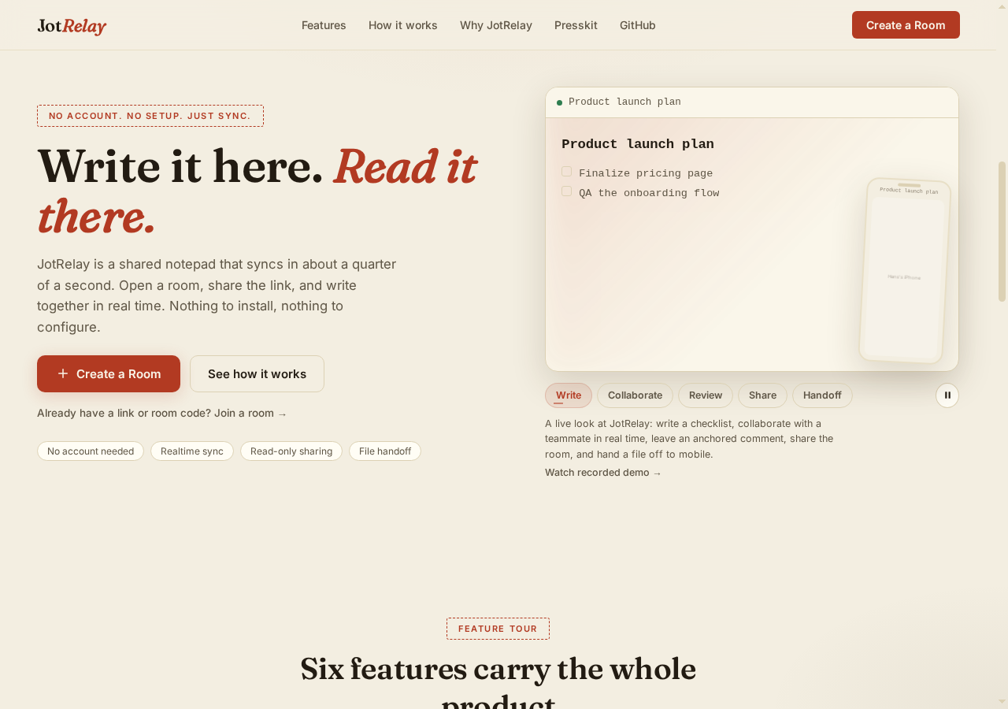
After — paper & ink, hand-drawn icons

Slide 3
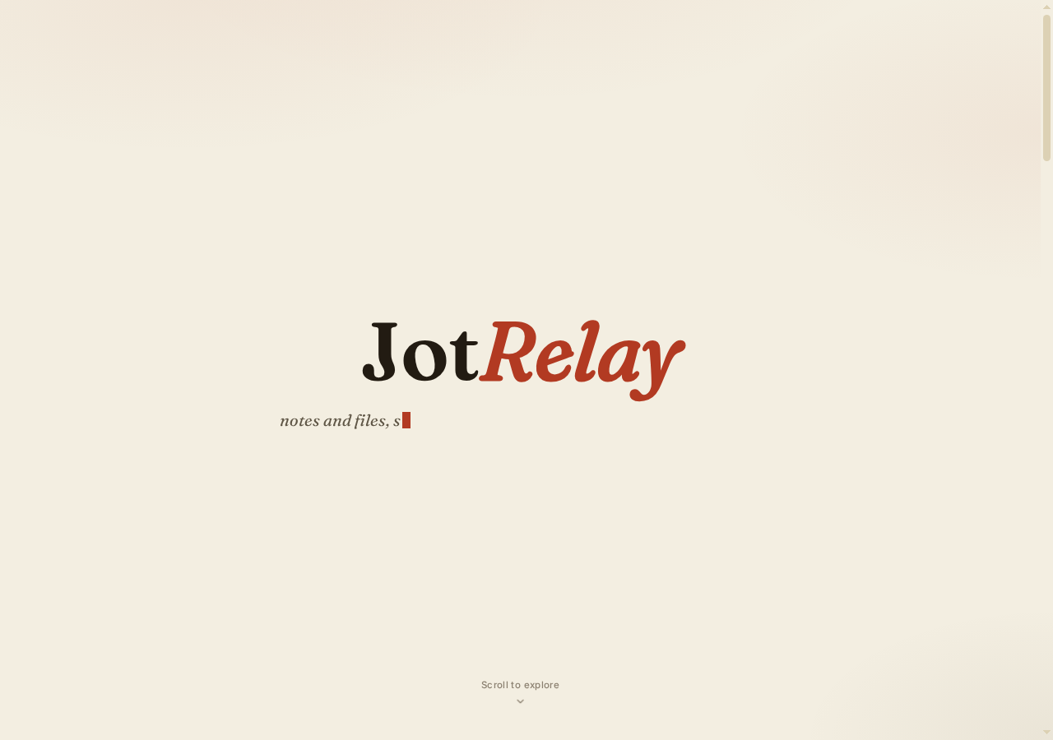
After — landing

Slide 4

After — mobile

