Slide 1
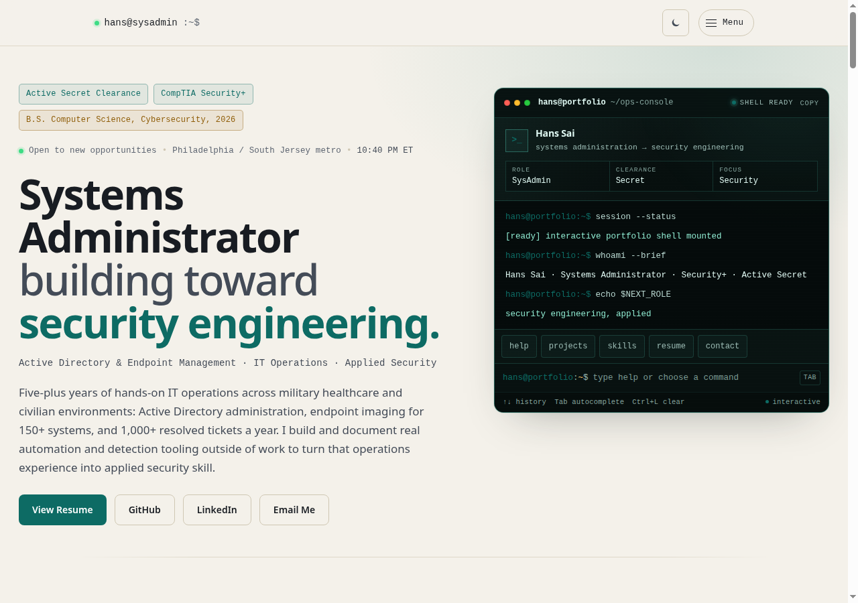
Before
builtbysai.com
slop checker: 61%
"synthetic terminal styling
trying very hard to look gritty"

Slide 2
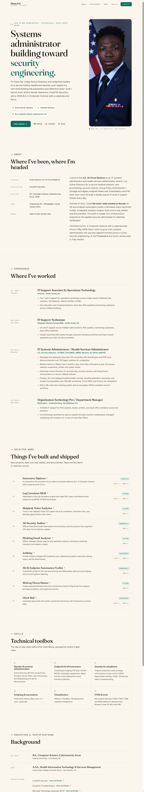
After
redesign/unslop
slop checker: 17%
zero patterns flagged
"nothing. suspiciously clean"

Slide 3

After · mobile
390px · responsive verified

