Slide 1
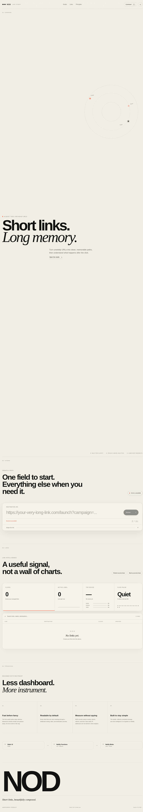
Before — 31% slop

Slide 2
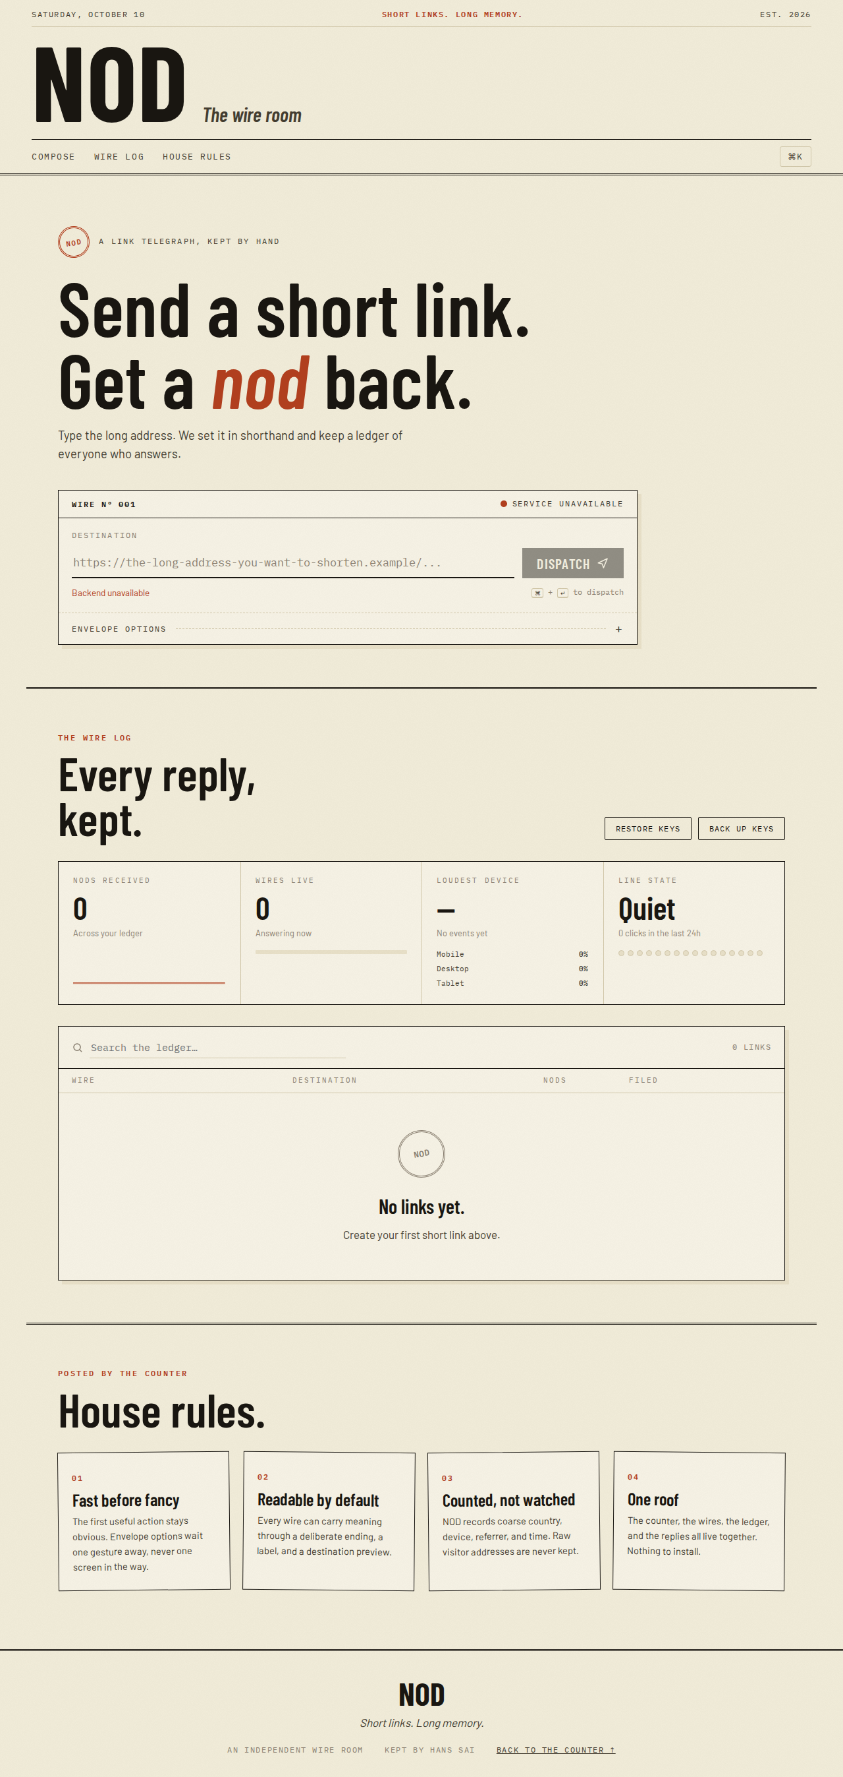
After — 17% slop, theme-toggle remnants removed

Slide 3
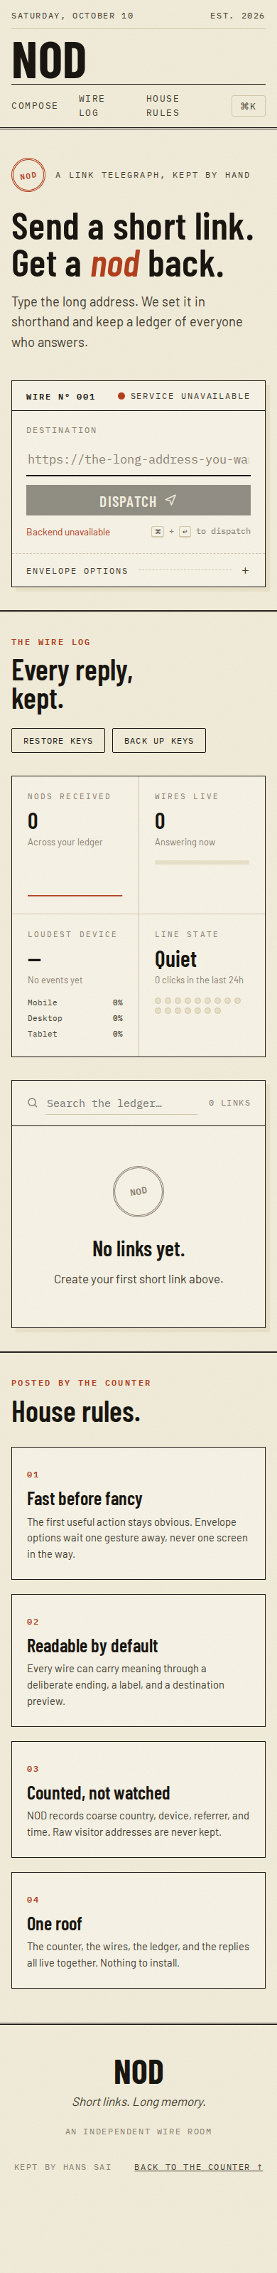
After — mobile

