Slide 1
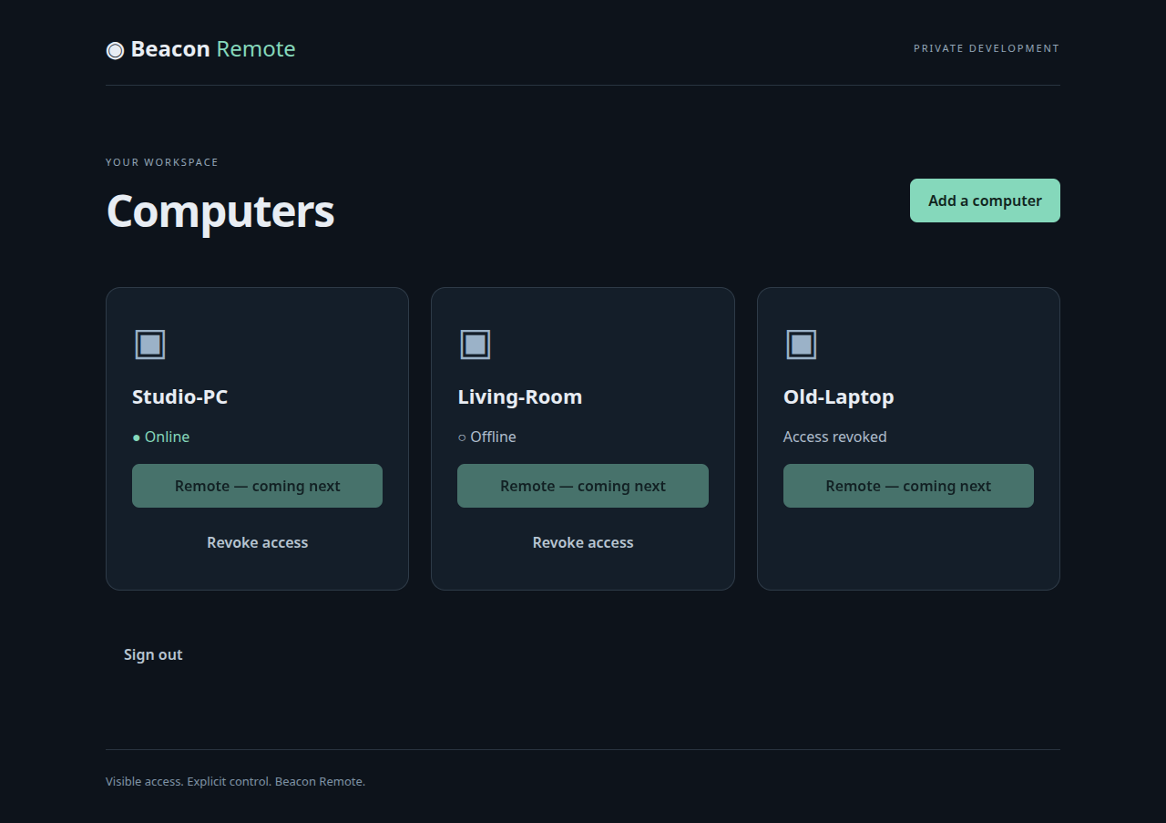
Before

Slide 2
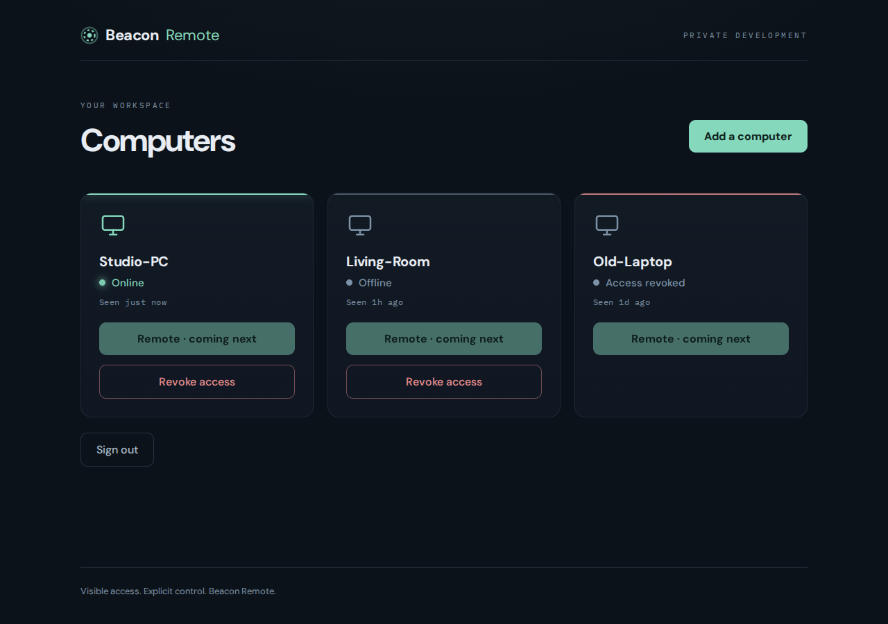
After — 3% slop — Mission Control, elevated

