Slide 1
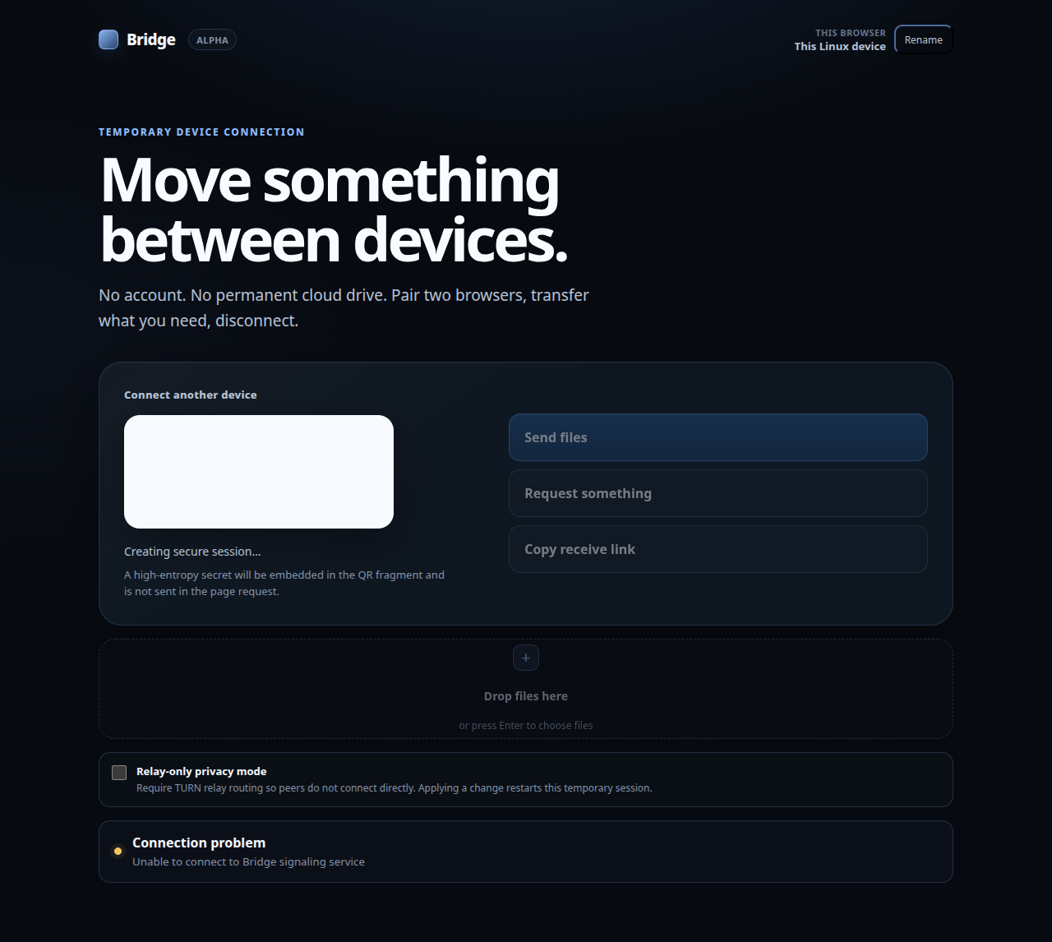
Before

Slide 2
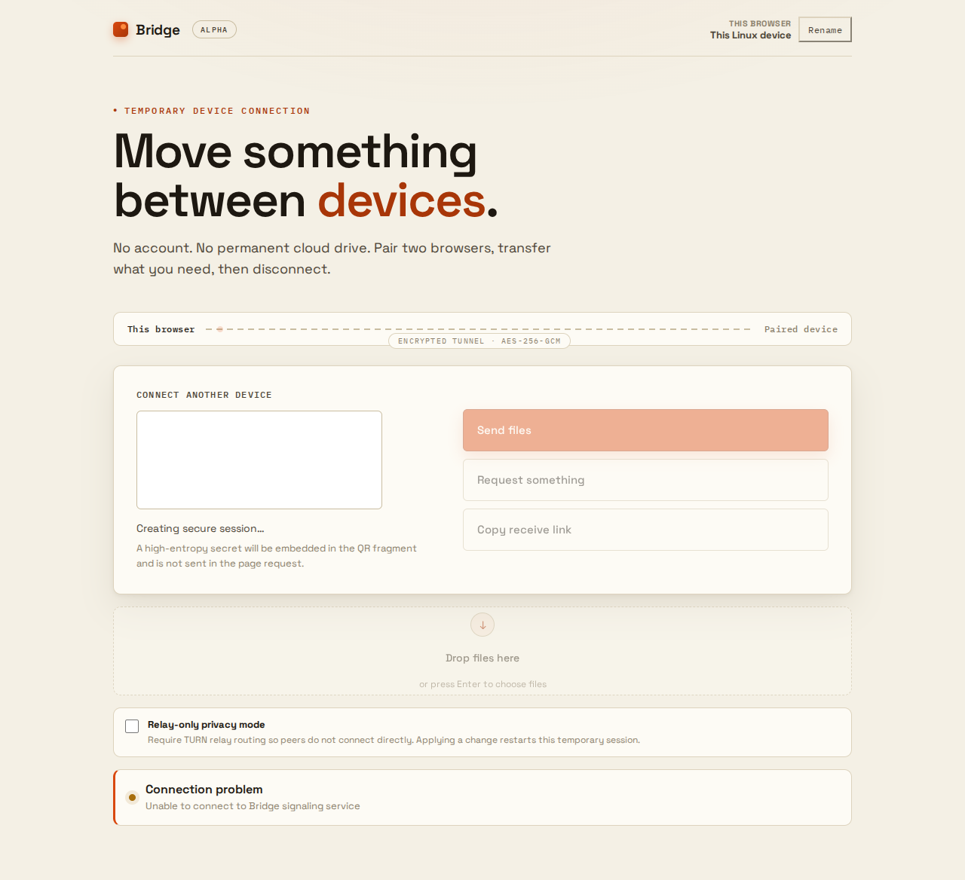
After — 17% slop, zero flags — The Signal Room

