Slide 1
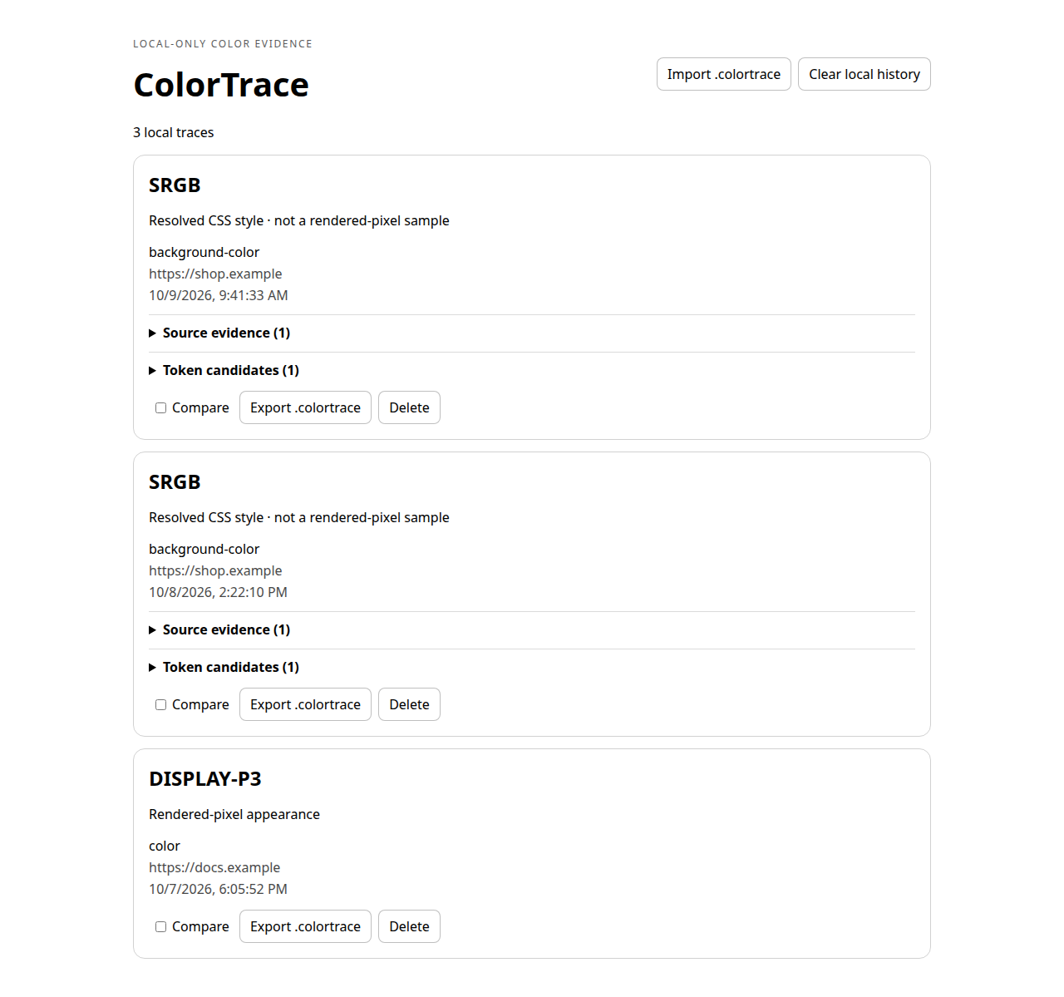
Before

Slide 2
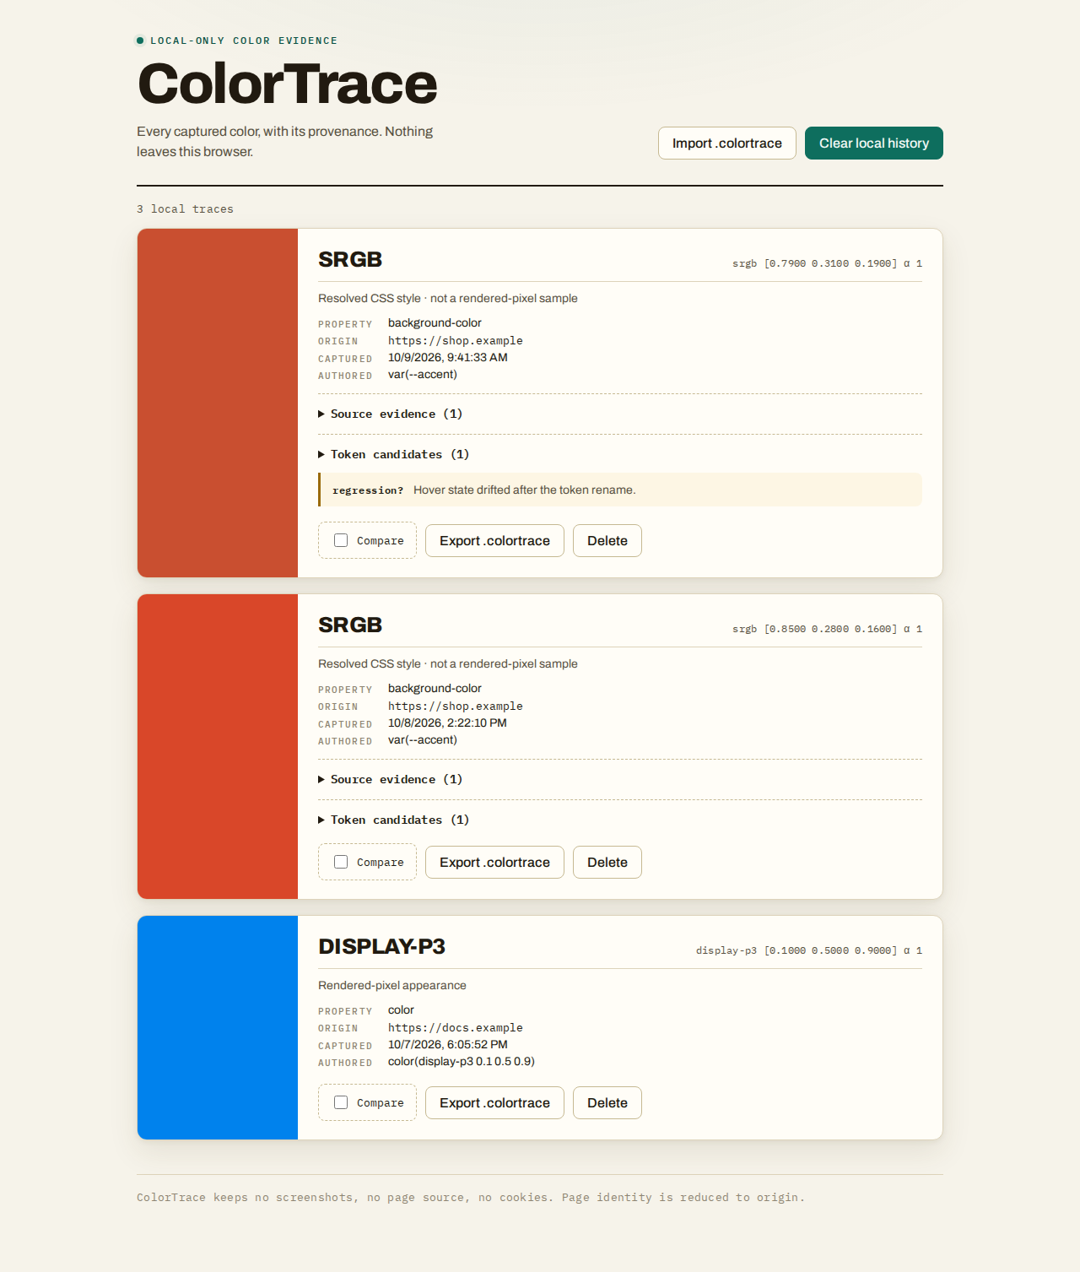
After — 3% slop — The Lab Notebook

