Slide 1
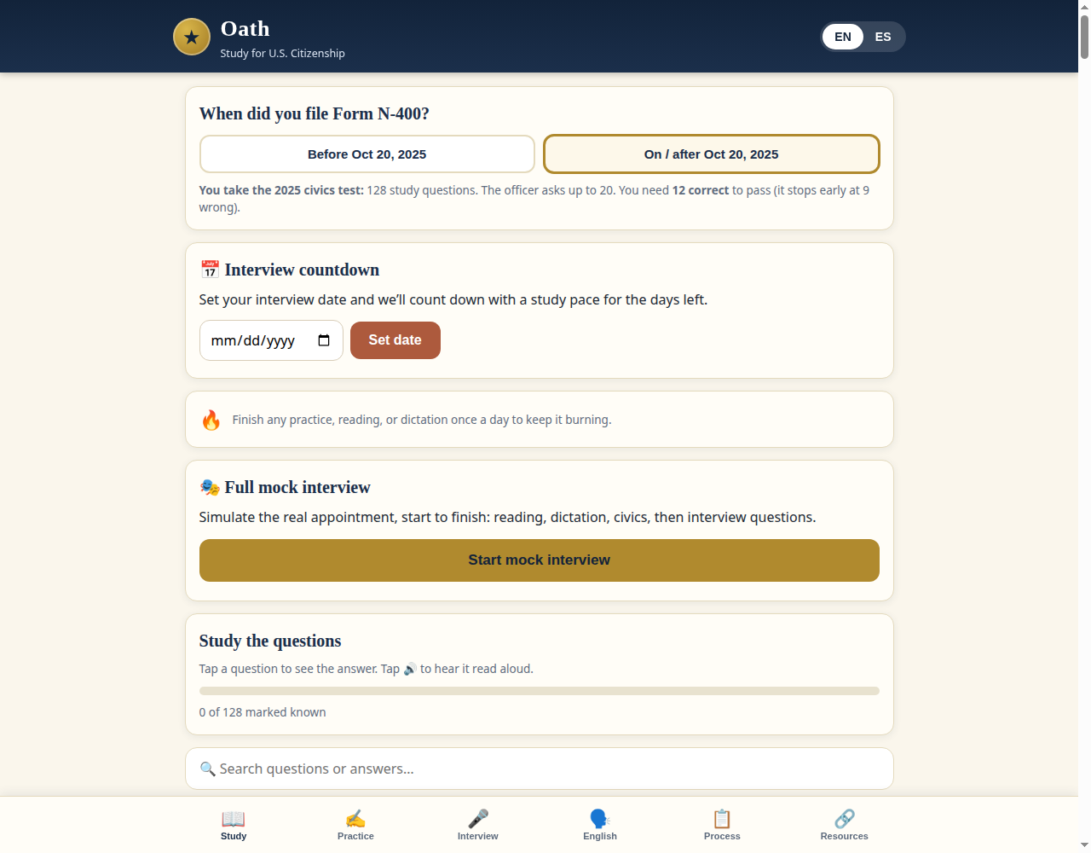
Before — 53% slop

Slide 2
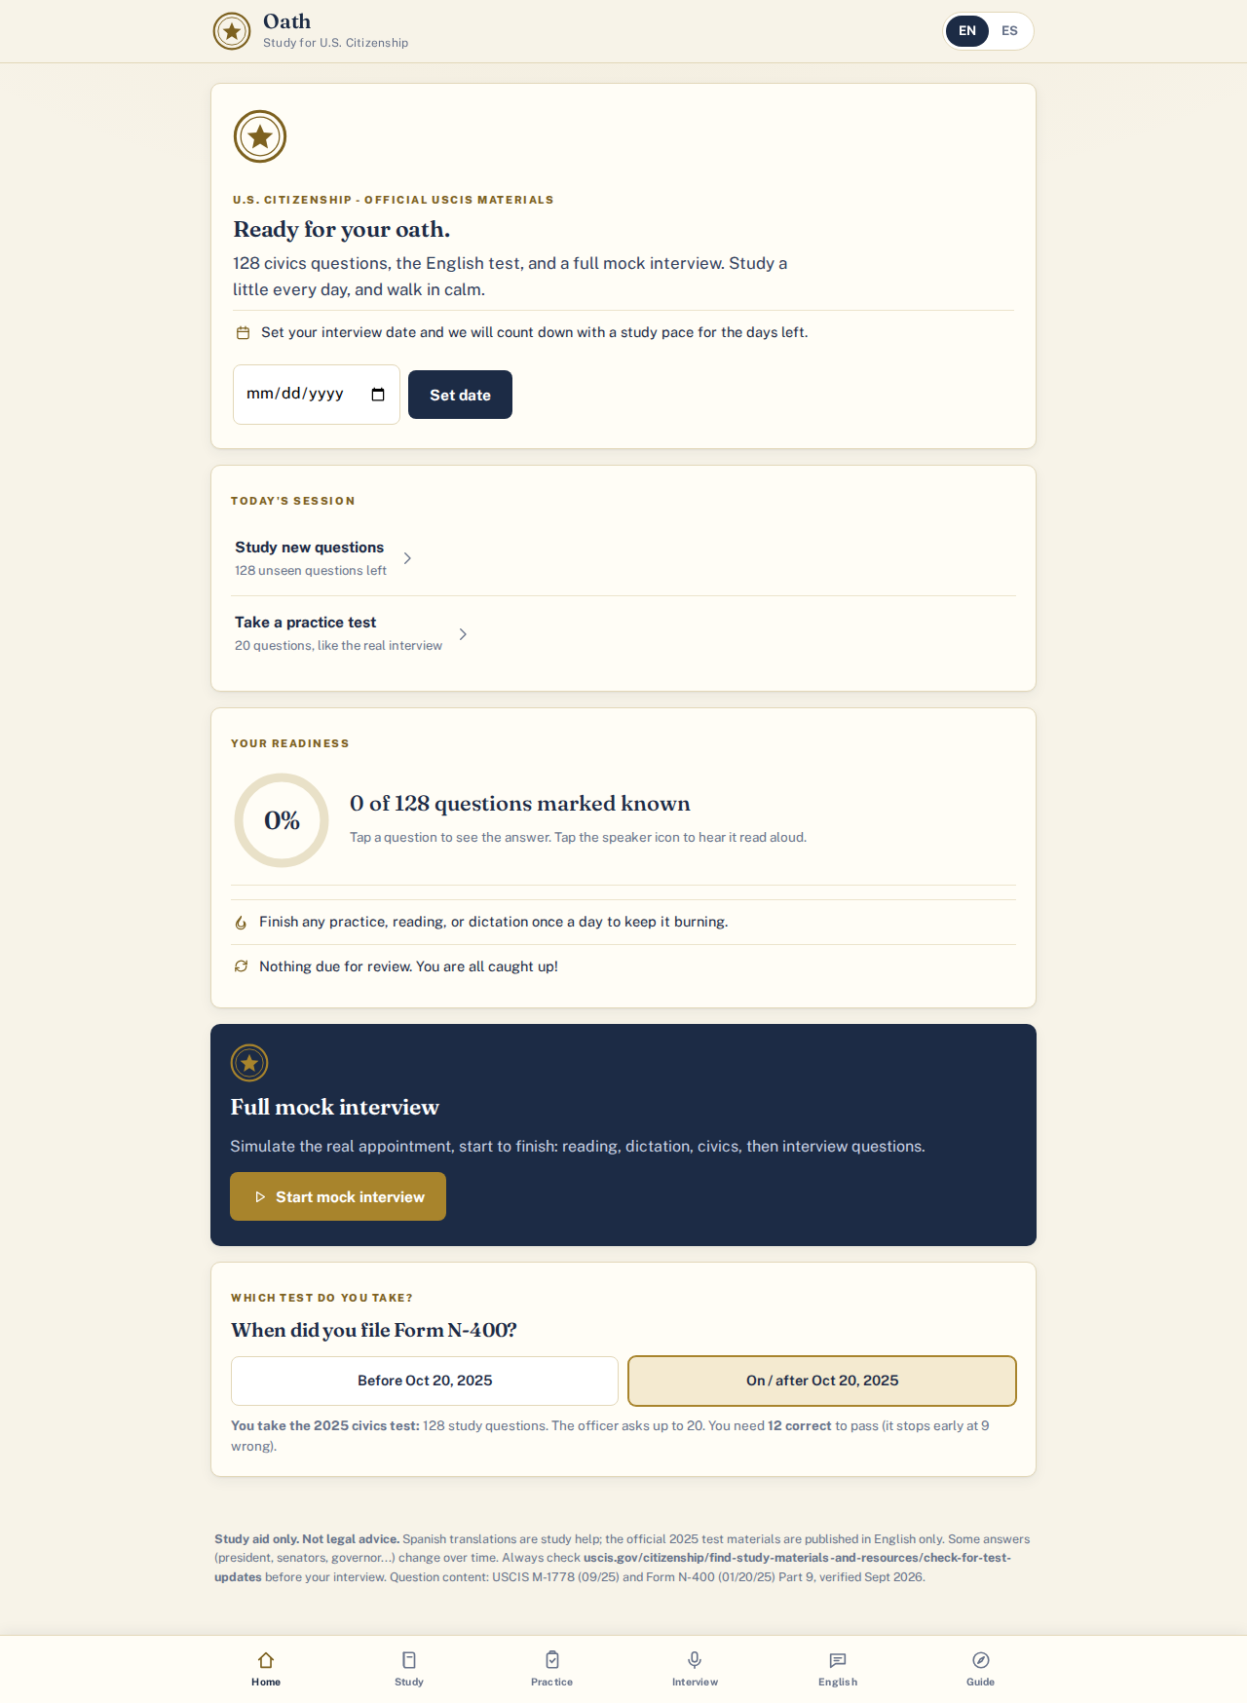
After — 3% slop

Slide 3
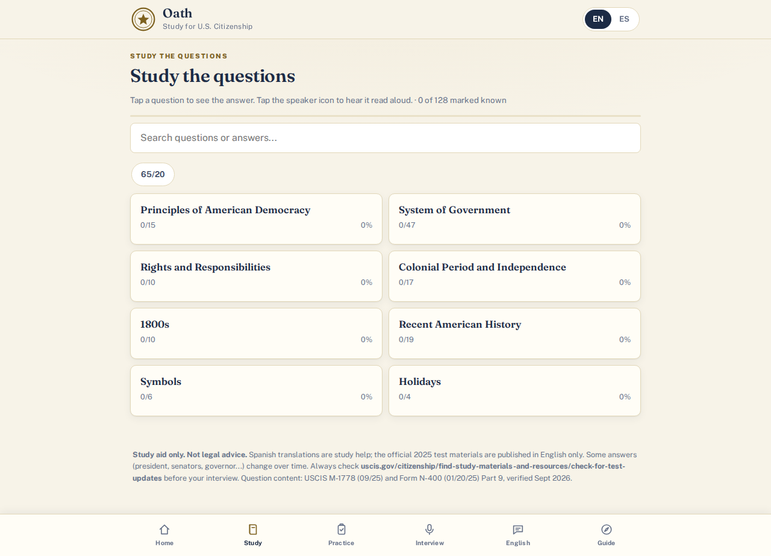
After — study

Slide 4

After — mobile

