Slide 1
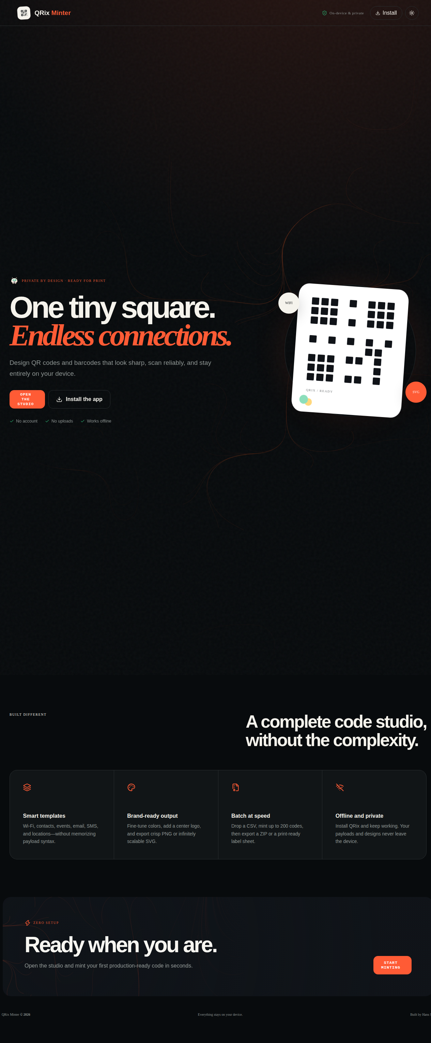
Before — 43% slop

Slide 2
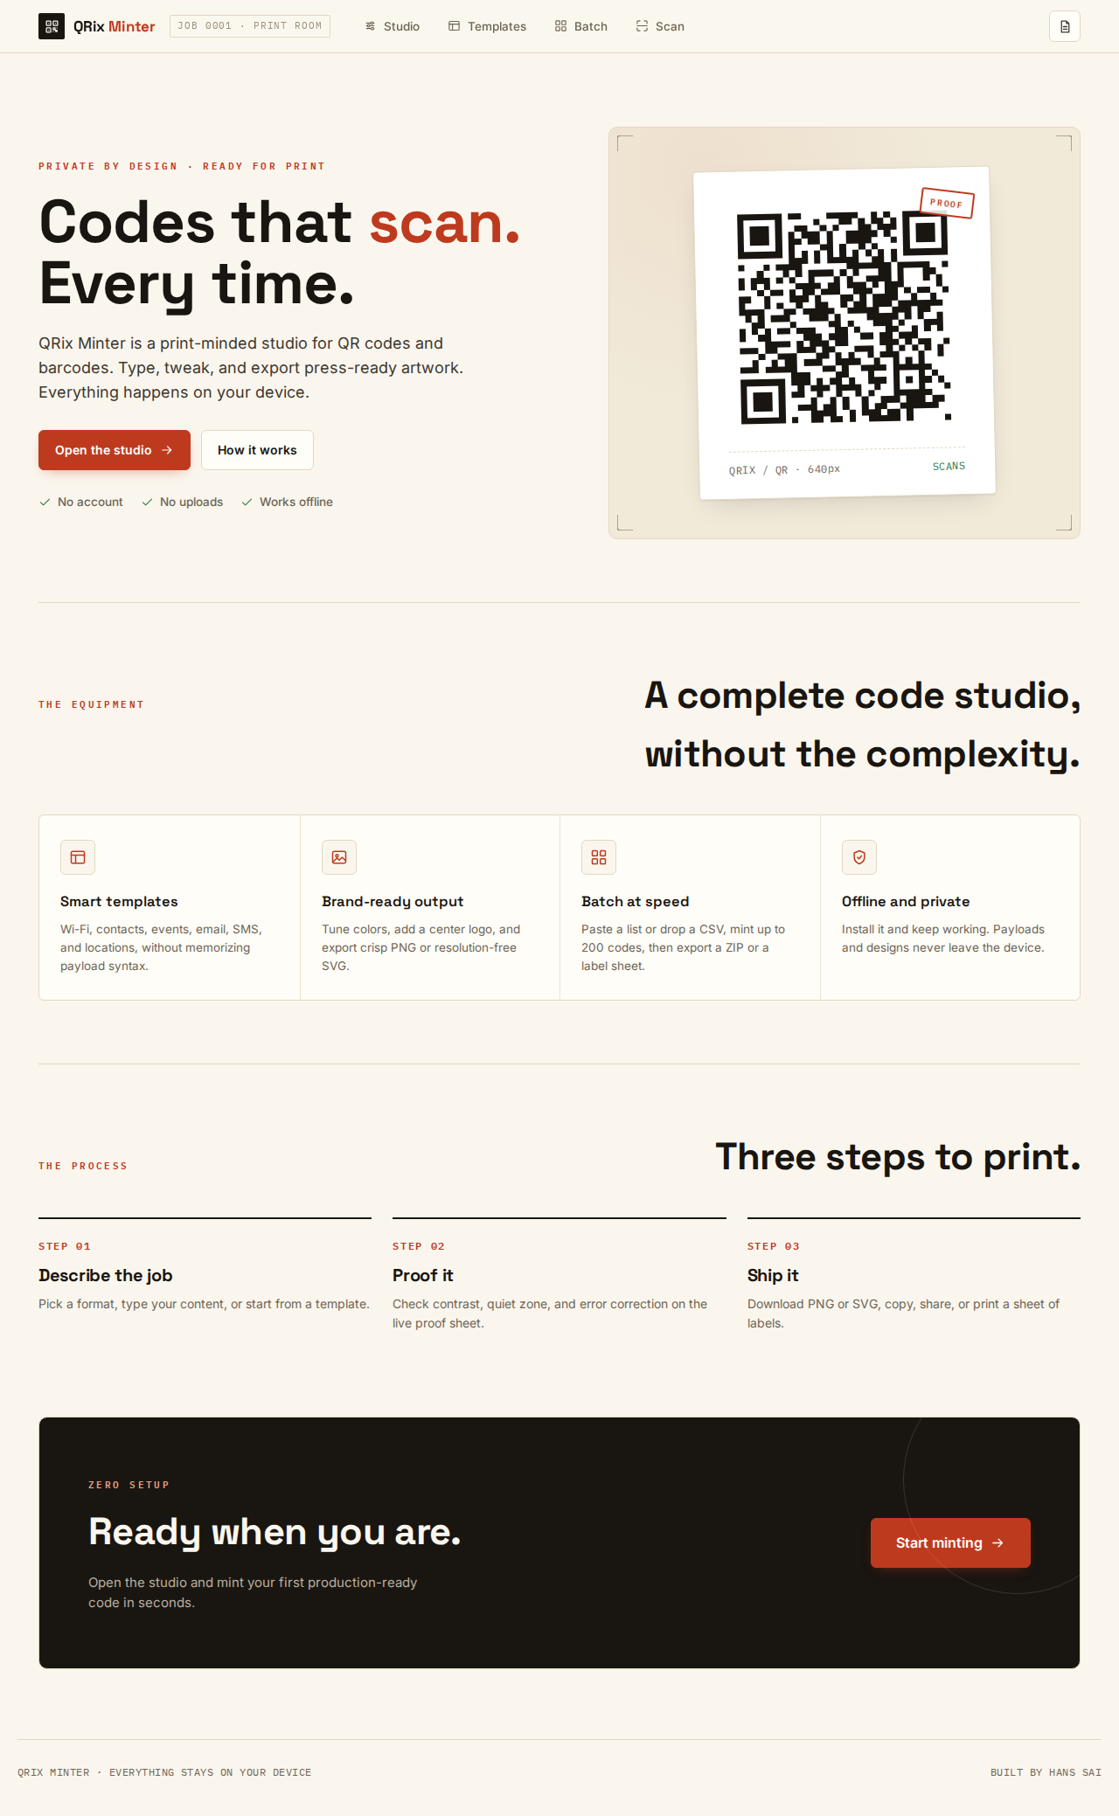
After — 3% slop

Slide 3
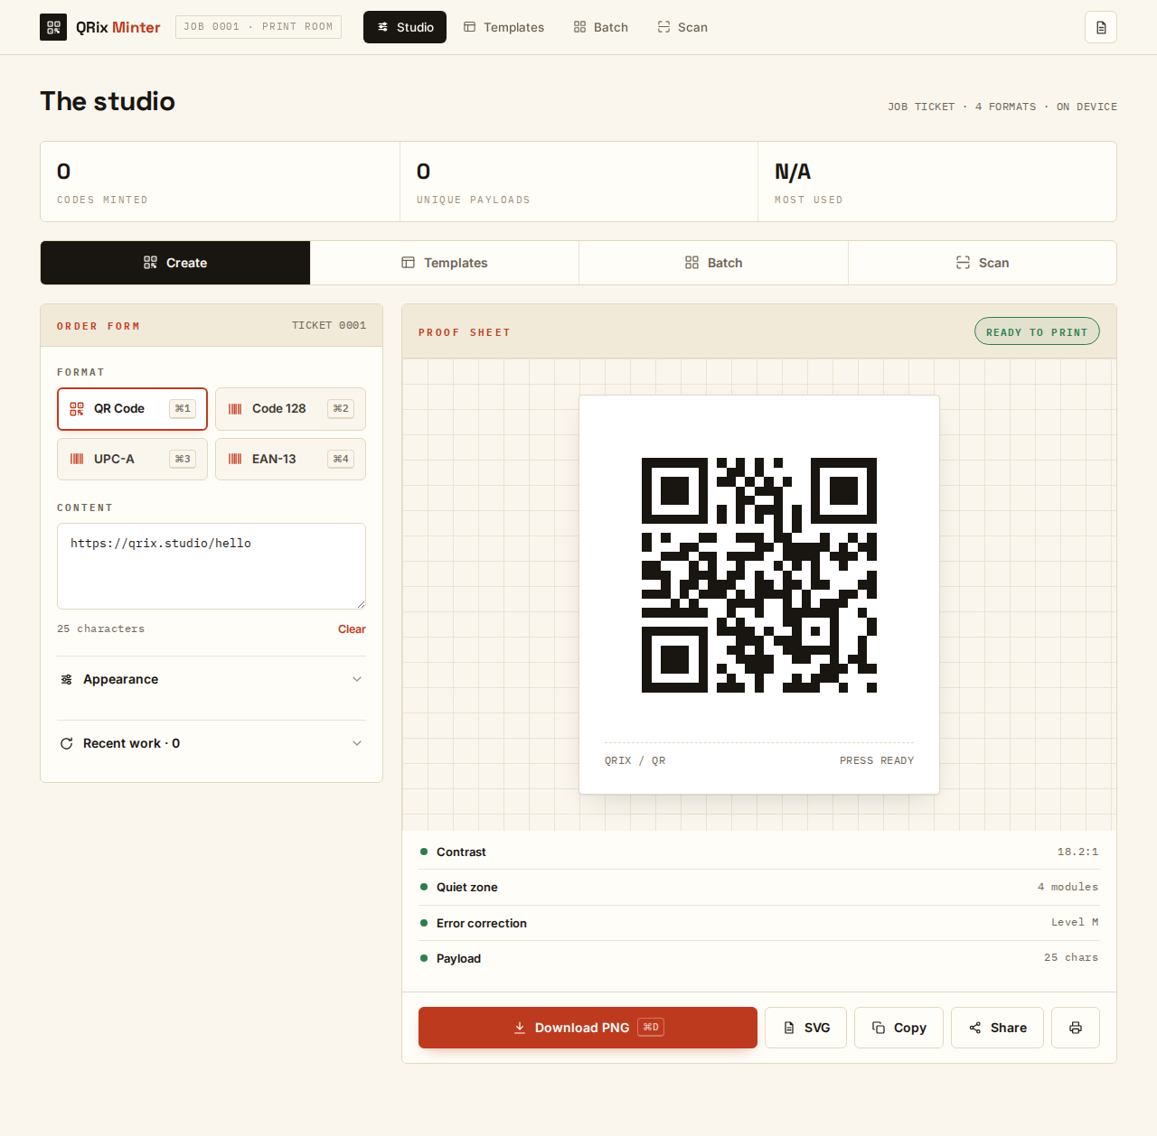
After — studio

Slide 4

After — mobile

