Slide 1
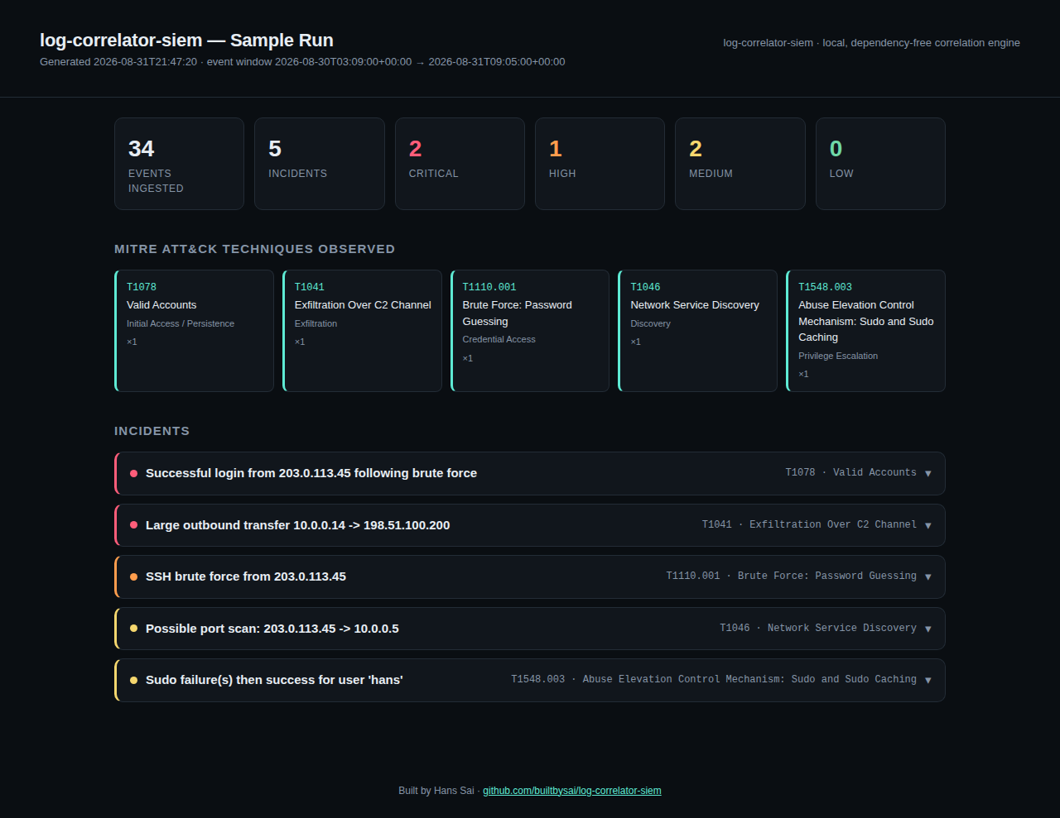
Log Correlator SIEM — before

Slide 2

Log Correlator SIEM — polished

Slide 3
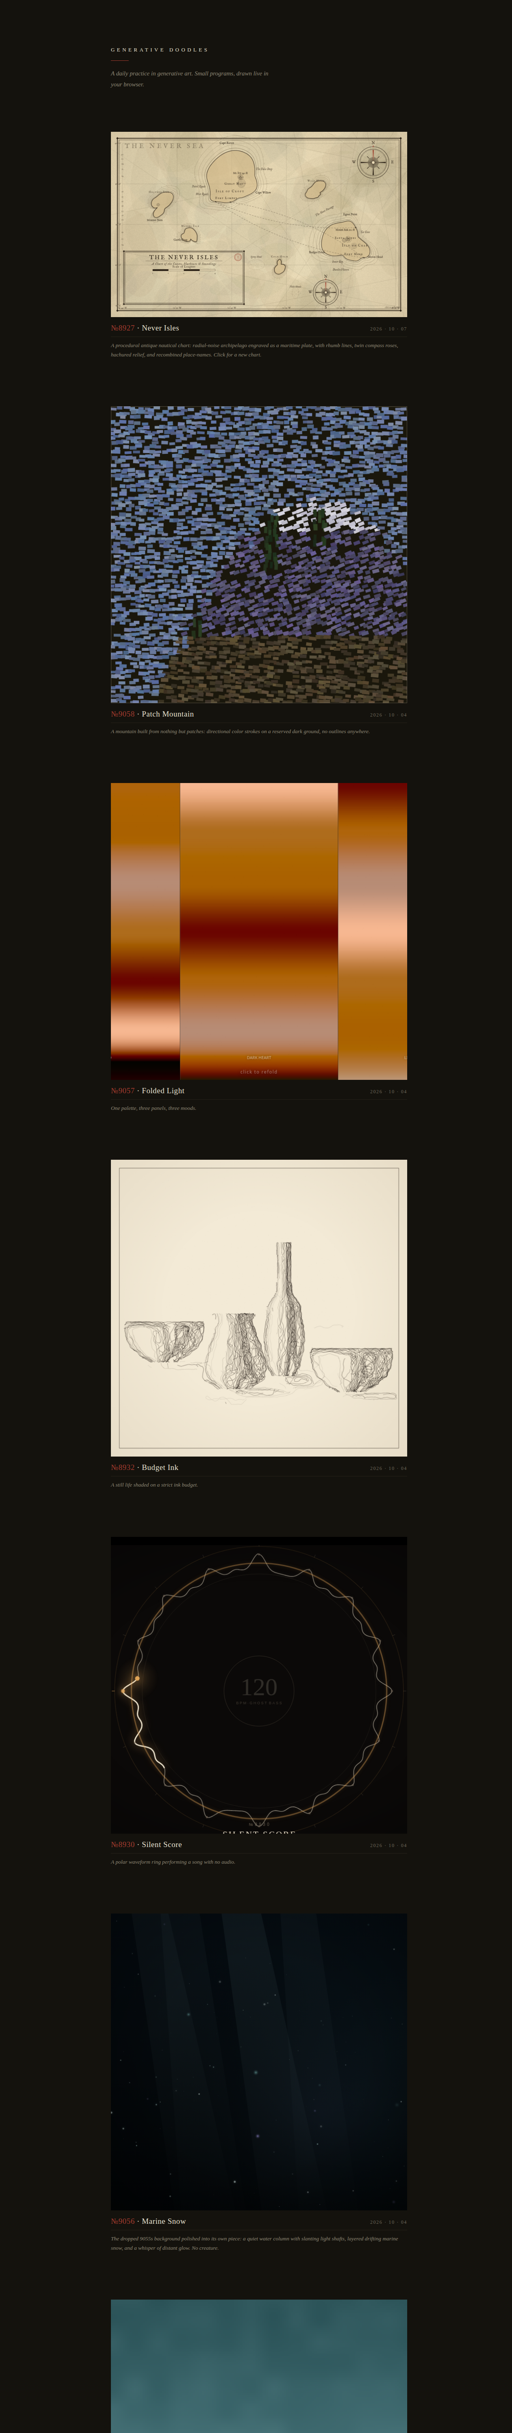
Generative Doodles — before

Slide 4
Generative Doodles — polished

Slide 5
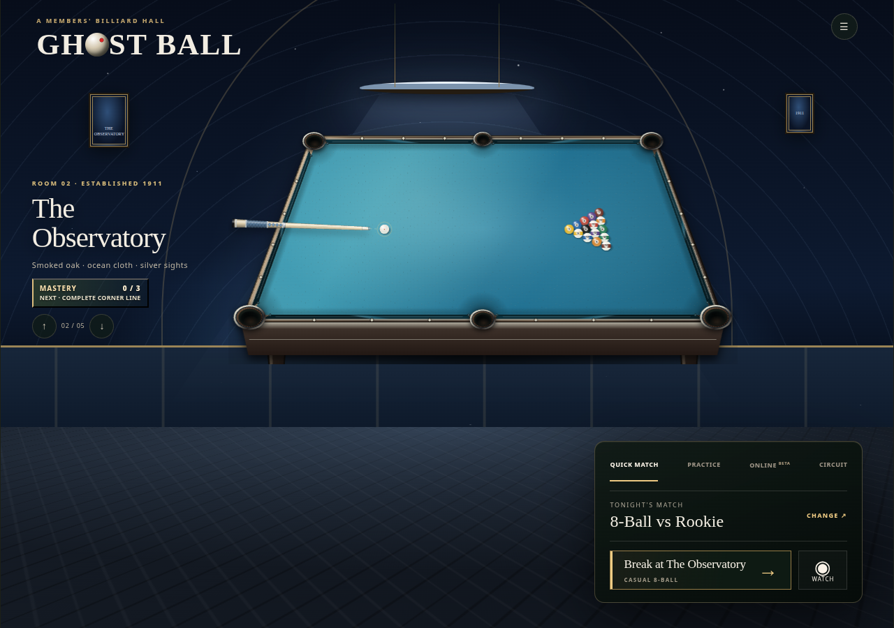
Ghost-Ball — before

Slide 6

Ghost-Ball — polished

Slide 7
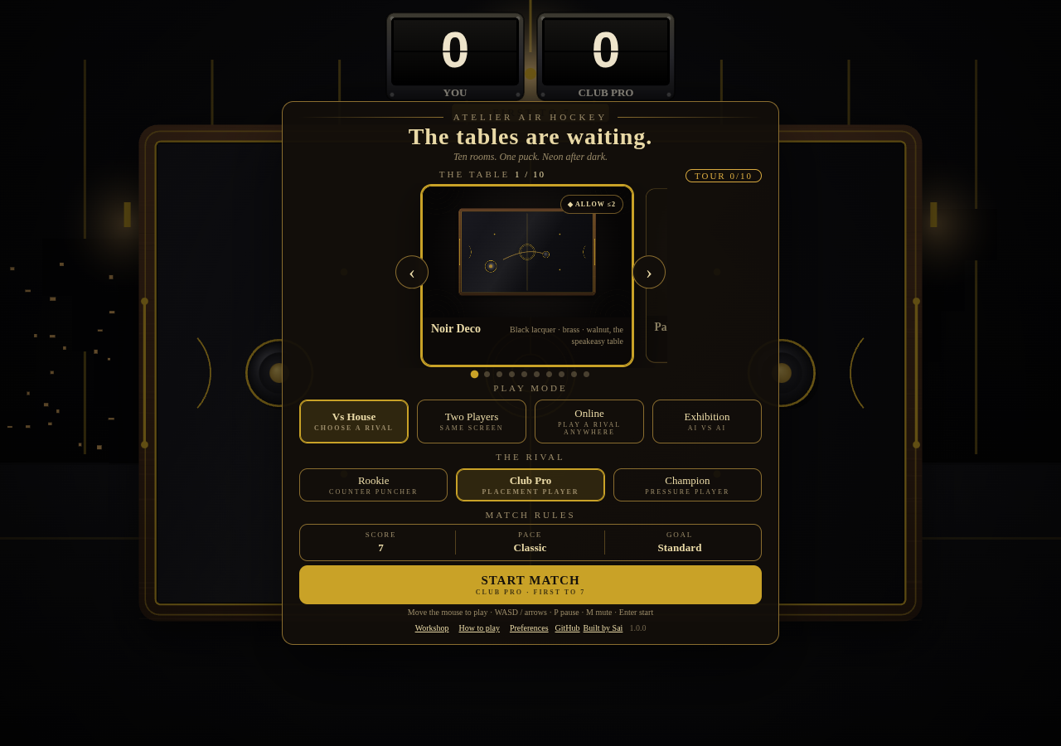
Air Hockey Online — before

Slide 8
Air Hockey Online — polished

Slide 9

Atelier Air Hockey — before

Slide 10
Atelier Air Hockey — polished

Slide 11
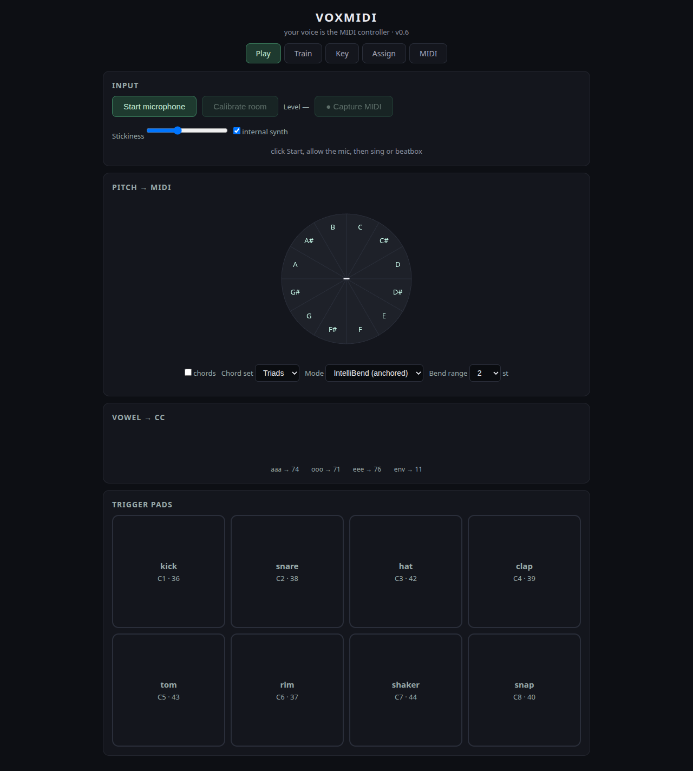
Whistlebox — before

Slide 12
Whistlebox — polished

Slide 13
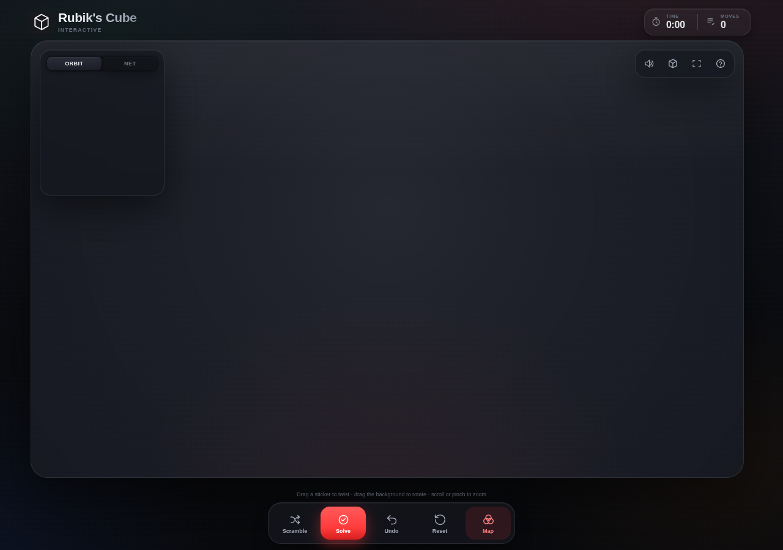
Rubik's Cube — before

Slide 14

Rubik's Cube — polished

Slide 15
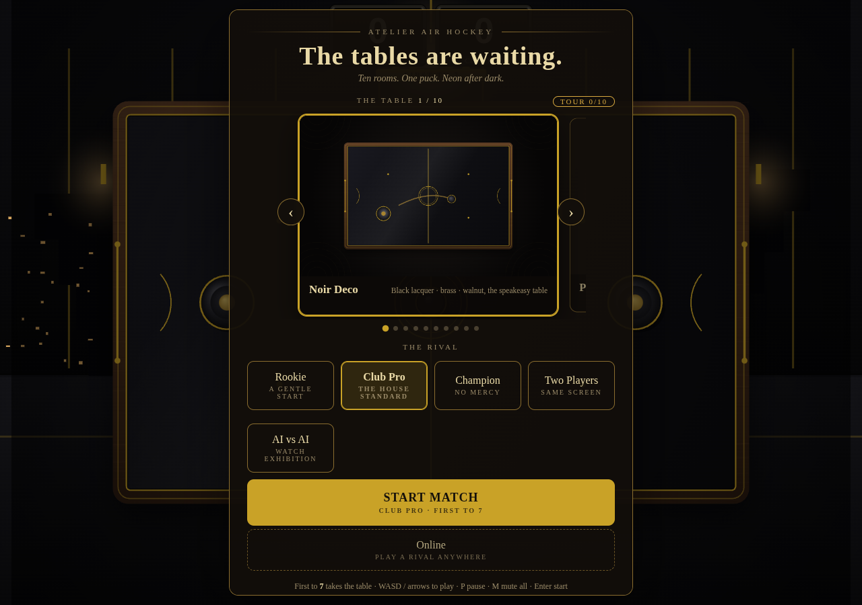
Atelier AH 2.5D — before

Slide 16

Atelier AH 2.5D — polished

Slide 17
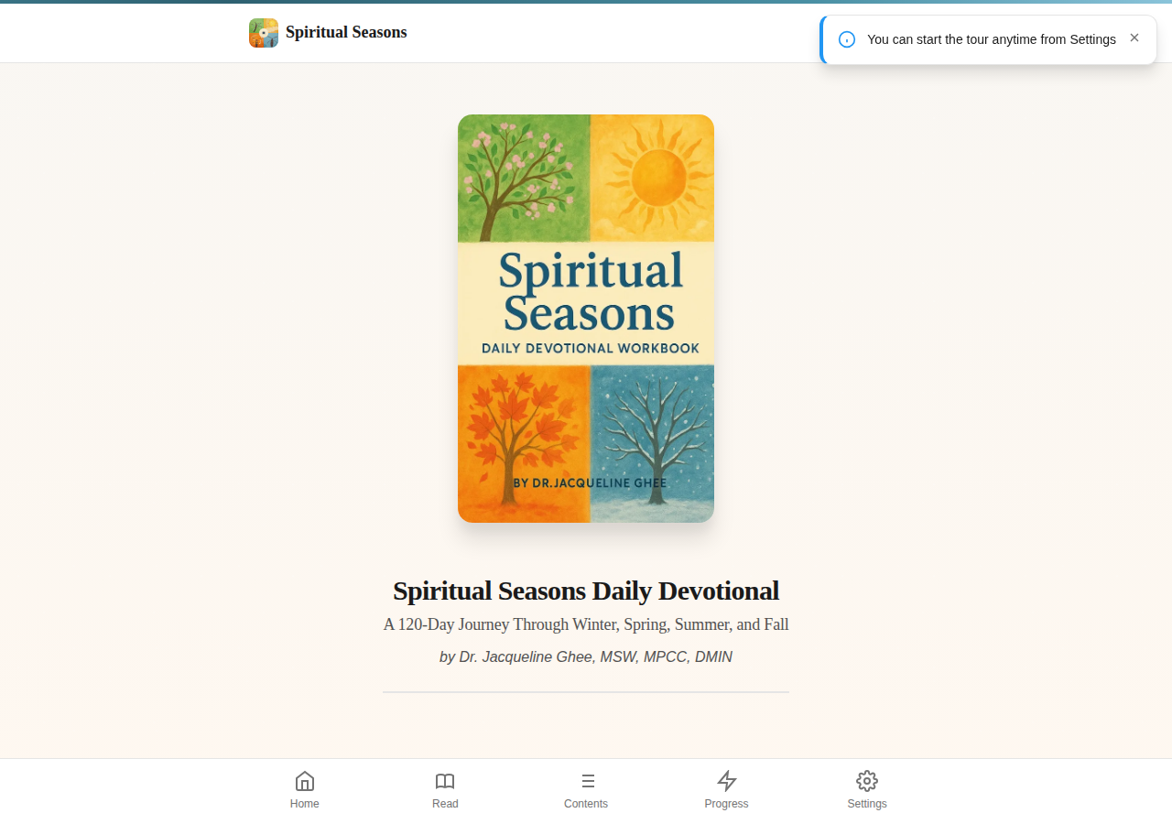
Spiritual Seasons — before

Slide 18

Spiritual Seasons — polished

Slide 19
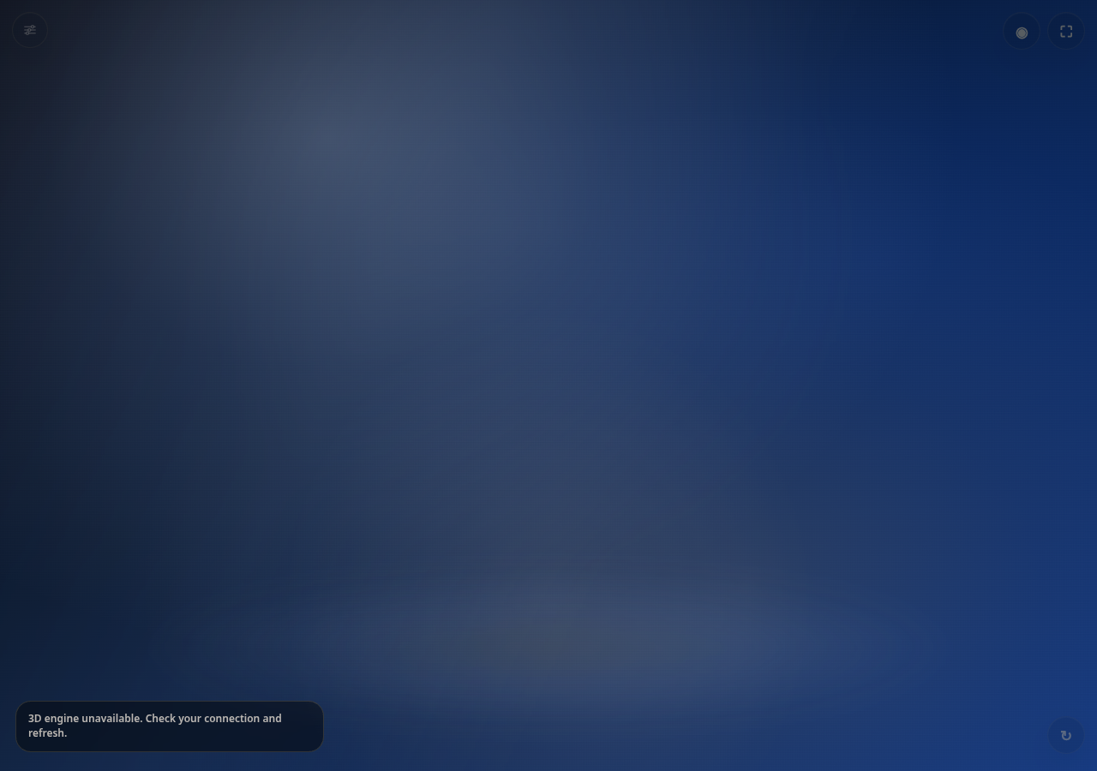
Interactive Diploma — before

Slide 20
Interactive Diploma — polished

