Slide 1
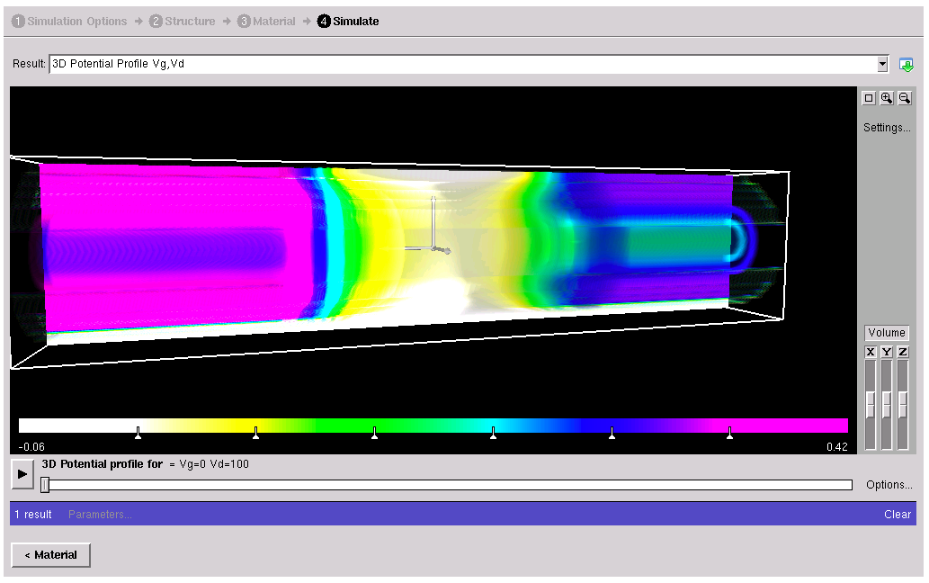
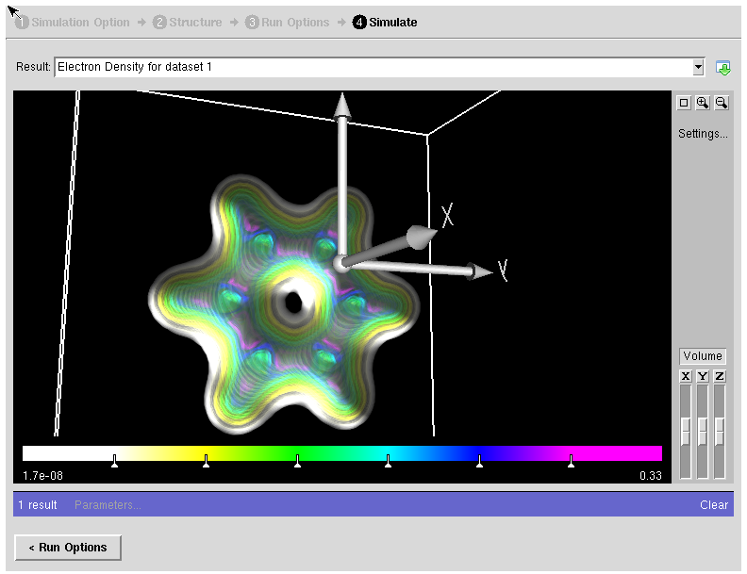
nanoHUB contributions and NCN @ Purdue
Objective:
Develop and support computational tools on the nanoHUB
Promote and support NCN @ Purdue
Approach:
Work with student developers
Develop and support Ruby bindings for the Rappture toolkit
Result:
Published ABINIT on the nanoHUB
Contributed to the NEGF nanowire tool on the nanoHUB
Respond to user questions and provide physics support for all NCN @ Purdue tools
Ruby based tools under development

