Slide 1
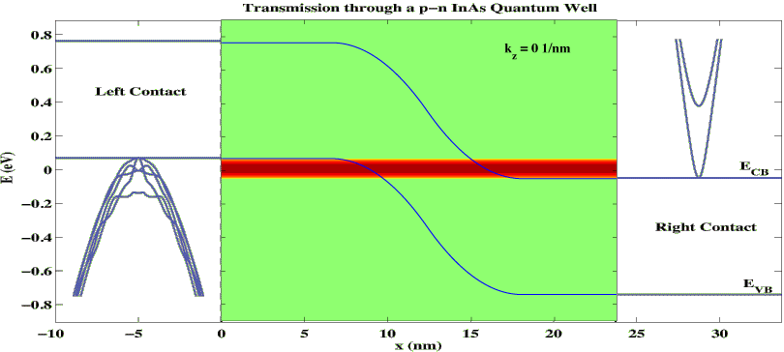
Band-To-Band-Tunneling in InAs Devices
Momentum-Energy-Resolved Transport in Full-Band Simulations
Objective:
Demonstrate BTBT capability
Approach:
UTB - InAs PIN diode
quantization automatically included
Compute energy and momentum transmission coefficient
Result:
Conduction band moves rapidly
=> determines k-cutoff.
Complicated hole dispersion creates Fano-resonance like features in T.
Impact:
Demonstrate explicit E-k-dependence

Slide 2
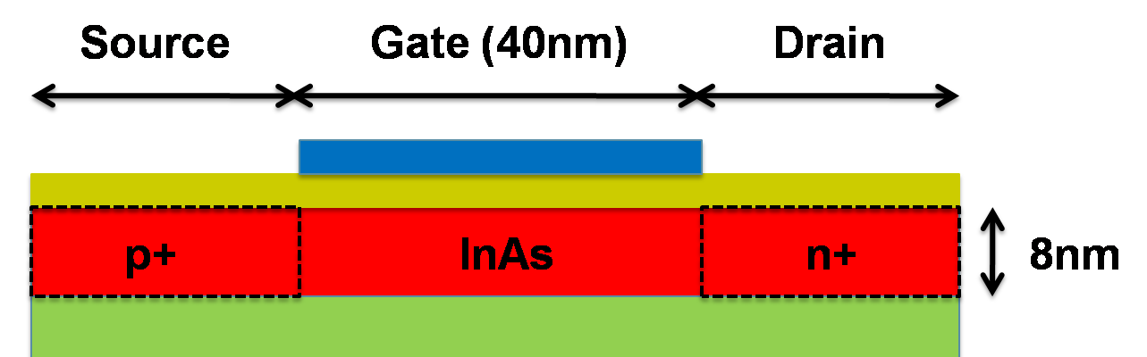
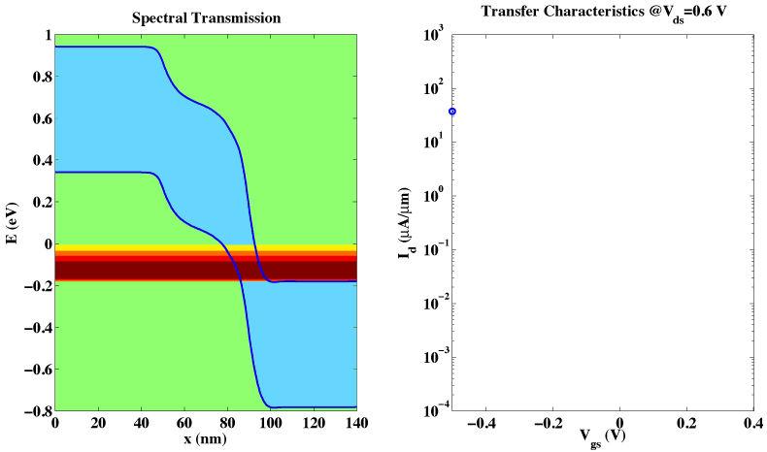
Band-To-Band-Tunneling in InAs Devices
Charge Self-consistent Full-Band Transport in Realistic Structure
Bandgap raised from bulk 0.37=>0.6eV
Doping 1x10¹⁸/cm³
Objective:
Demonstrate BTBT capability
Approach:
Full I-V calculation in OMEN
Impact:
First full band / atomistic charge-self-consistent BTBT simulation
Full ambipolar carrier treatment

Slide 3
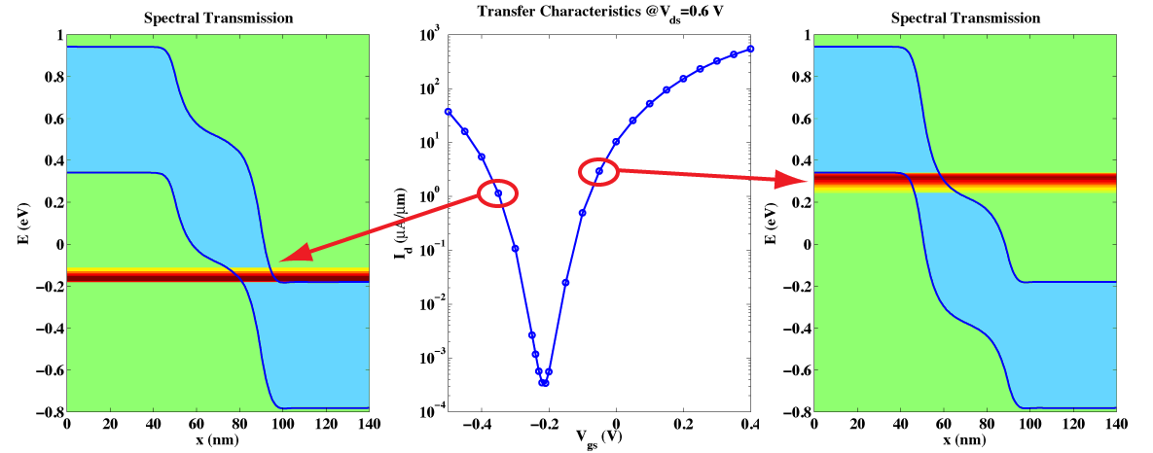
Band-To-Band-Tunneling in InAs Devices
Charge Self-consistent Full-Band Transport in Realistic Structure
Bandgap raised from bulk 0.37=>0.6eV
Doping 1x10¹⁸/cm³
Objective:
Demonstrate BTBT capability
Approach:
Full I-V calculation in OMEN
Impact:
First full band / atomistic charge-self-consistent BTBT simulation
Full ambipolar carrier treatment

Slide 4
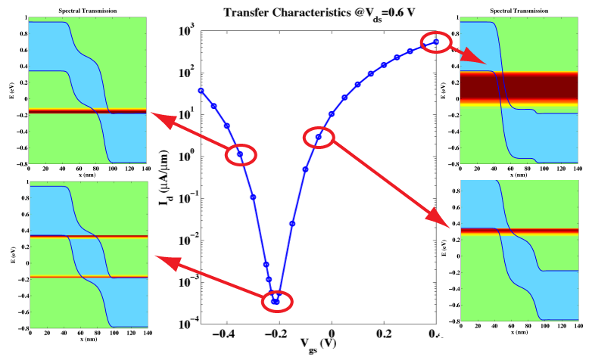
Band-To-Band-Tunneling in InAs Devices
Charge Self-consistent Full-Band Transport in Realistic Structure
Bandgap raised from bulk 0.37=>0.6eV
Doping 1x10¹⁸/cm³
Objective:
Demonstrate BTBT capability
Approach:
Full I-V calculation in OMEN
Impact:
First full band / atomistic charge-self-consistent BTBT simulation
Full ambipolar carrier treatment

Slide 5
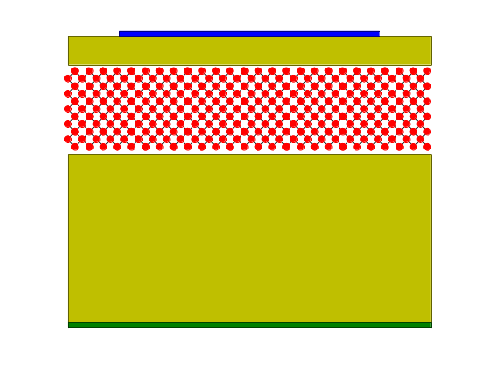
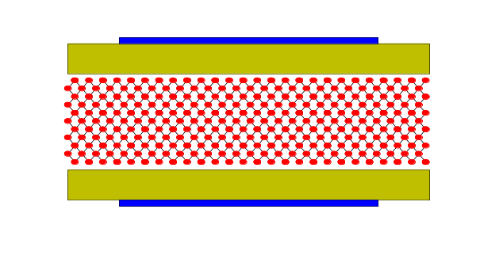
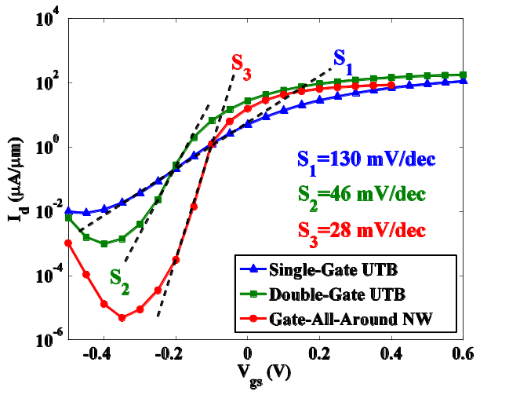
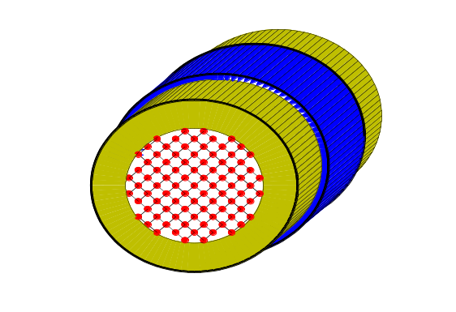
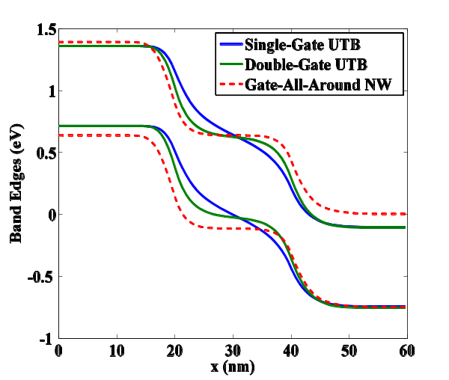
Gate Control and Sub-Threshold Swing in BTBT
Comparison of pin InAs pin Devices – SG-UTB / DG-UTB / NW
Objective:
Low voltage, good turn-on/off switches
Develop low sub-threshold swing FETs with band-to-band-tunneling (BTBT)
Provide guidance to experiments
Approach:
Utilized OMEN – atomistic, full band quantum transport simulator
3 diff. geom., InAs, 20nm gates. 6nm body/diameter, 1nm Oxide, 5e19/cm³
Result – 3 different devices have:
dramatically different sub-thresholds
Slightly different gate controls
Impact:
BTBTdevices much more sensitive to smooth band bending than expected
gate all-around NW fairs best.
Authors:
M. Luisier, Gerhard Klimeck

Slide 6
20nm gates. 6nm body/diameter,
1nm Oxide, 5e19/cm³

