Slide 1
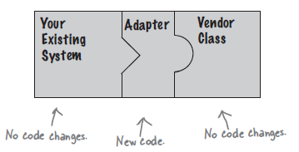
Adapter Pattern
Hanoi, October 2017

Slide 2
Content
Introduction
Example: Object Adapter
Example: Class Adapter
INFO3.5L Adaptive Classes

Slide 3
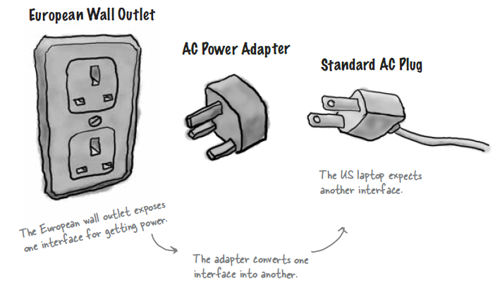
Introduction
OO Adapter: they take an interface and adapt it to one that a client is expecting
Notes:
Decorator: wrapped objects to give them new responsibilities
Adapter: make their interfaces look like something they are not
+ adapt a design expecting one interface to a class that implements a different interface

Slide 4
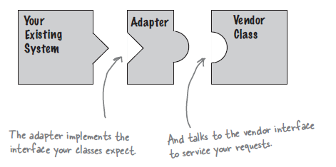
Introduction
Adapter lets classes work together that couldn’t otherwise because of incompatible interfaces
You don’t want to change your existing code
You can’t change the vendor’s code
You can write an adapter class that acts as a middleman
Notes:
Adapter acts as a middleman by receiving requests from the client and converting them into requests that make sense on the vendor class

Slide 5
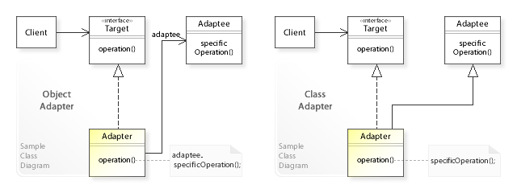
Introduction
How? 2 types
Object Adapter
Class Adapter
Need multiple inheritance to implement it, which isn’t possible in Java

Slide 6
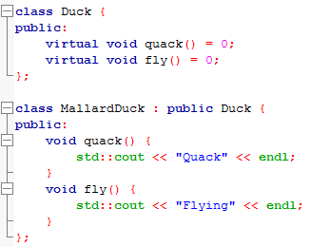
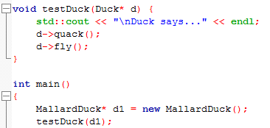

Example – Object Adapter
We are breeding Ducks
Duck has an interface which consists of 2 methods
Function testDuck(Duck*) working with Duck object

Slide 7
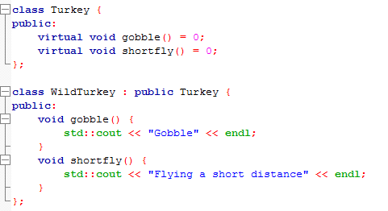


Example – Object Adapter
In order to expand our farm, we try to adopt Turkey
Turkey also has its own interface includes 2 different methods

Slide 8
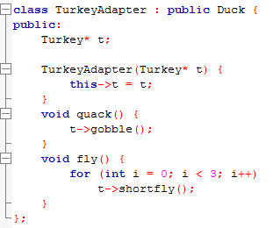
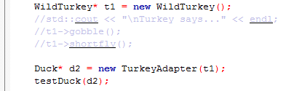

Example – Object Adapter
Obviously, function testDuck(Duck*) cannot work with Turkey object
Let’s write an TurkeyAdapter

Slide 9
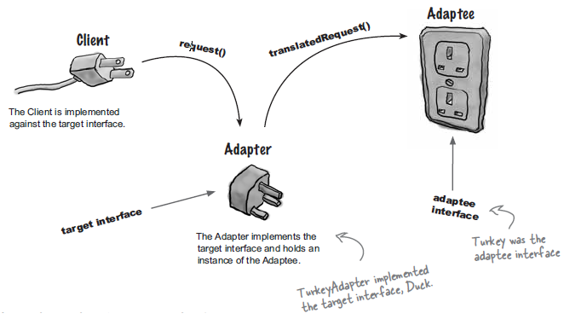
Example – Object Adapter
Explain
Duck::quack()
Turkey::gobble()
TurkeyAdapter::quack()
Notes:
The client makes a request to the adapter by calling a method on it using the target interface
The adapter translates that request into one or more calls on the adaptee using the adaptee interface
The client receives the results of the call and never knows there is an adapter doing the translation

Slide 10
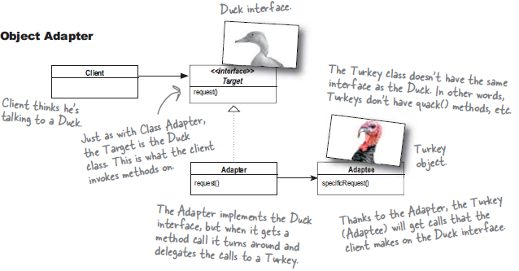
Example – Object Adapter
Let’s take a look at the UML Diagram

Slide 11
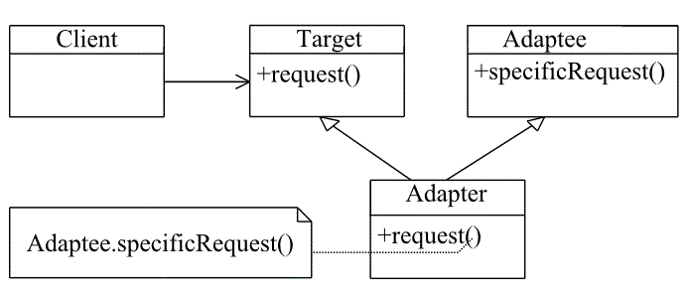
Example – Class Adapter
Class Adapter UML diagram
The only difference is that with class adapter we subclass the Target and the Adaptee, while with Object adapter we use composition to pass requests to an Adaptee

Slide 12
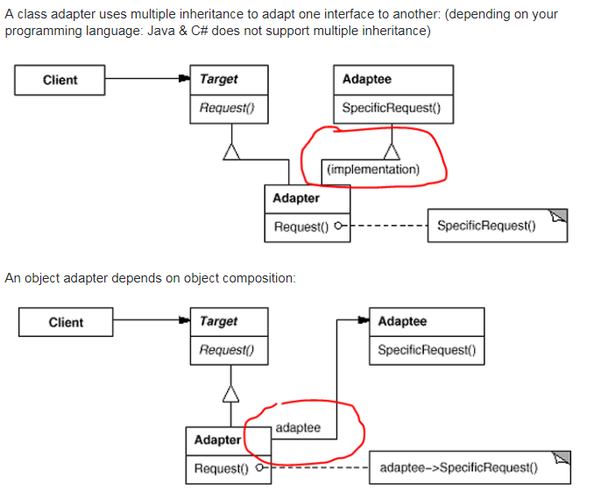
Example – Class Adapter
Difference

Slide 13
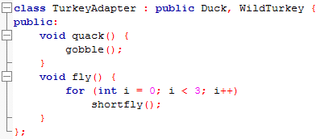


Example – Class Adapter
Modify class TurkeyAdapter

Slide 14
Class Adapter vs. Object Adapter
Pros
Don’t have re-implement the entire adaptee
Can override the behavior of adaptee
Cons
Depending on programming language
Favor composition over inheritance
Has-A is better than Is-A
Need to specify all parameters (the part for our adapter and the part for class adaptee because of the inheritance) when we instantiate adapter.
Notes:
With inheritance, we're locked into compile time decisions…about behavior-like, say, when a duck subclass has…to use the fly implementation and the dark superclass.

Slide 15
Adapter vs. Decorator
Adapter
Converts one interface to another
Decorator
Doesn’t alter the interface, but adds responsibilities
Façade
Make an interface simpler

Slide 16
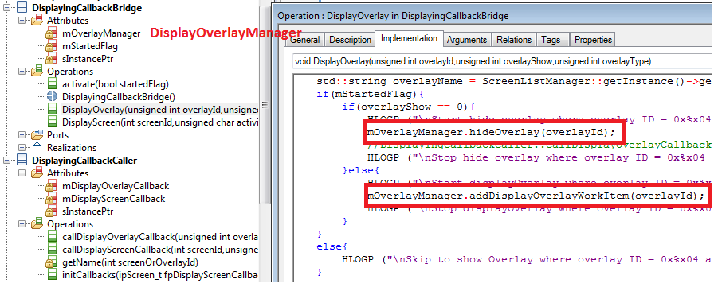
INFO3.5 - Class DisplayingCallbackBridge
Provides method DisplayOverlay(), DisplayScreen()
Client: Components
Adaptee: DisplayOverlayManager

Slide 17
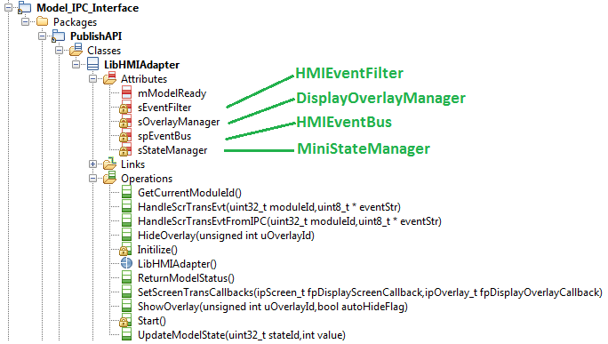
INFO3.5 - Class LibHMIAdapter
A Middleman between Qt/IPC and Model classes
Works like a normal middle class
Does not convert interface at all
Look like Façade Pattern

Slide 18


