Slide 1

Façade Pattern
Hanoi, October 2017

Slide 2
Content
Introduction
Façade example
Usage

Slide 3
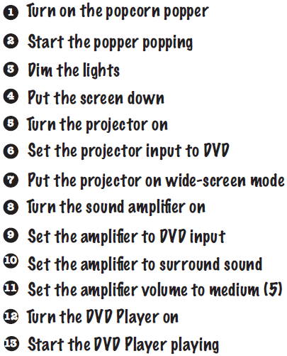
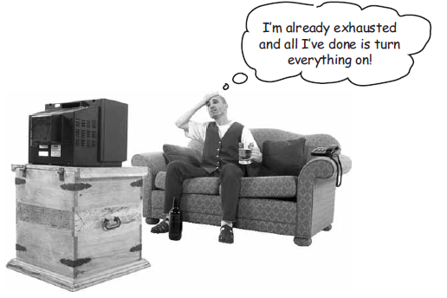
Introduction
Let’s imagine, you return home and want to watch a movie

Slide 4
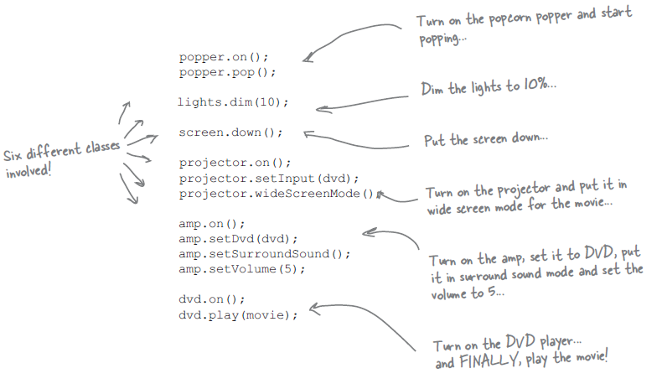
Introduction
Talk in the code world
The complexity of using your home theater is becoming apparent!
Notes:
What if there are client2, client3, …?

Slide 5
Introduction
The Façade Pattern: provides an unified interface to a set of interface in a subsystem
Defines a higher-level interface that makes subsystem easier to use
The word “façade” comes from the French language, literally meaning “frontage” or “face”

Slide 6
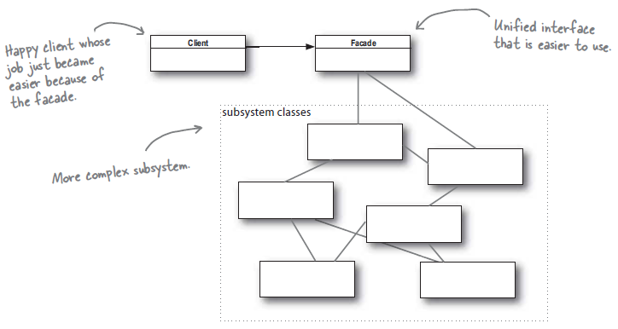
Introduction
Façade
Knows which subsystem classes are responsible for a request
Delegates client requests to appropriate subsystem objects

Slide 7
Introduction
Subsystem classes
Implements subsystem functionality
Handle work assigned by Façade object
Have no knowledge of the Façade

Slide 8
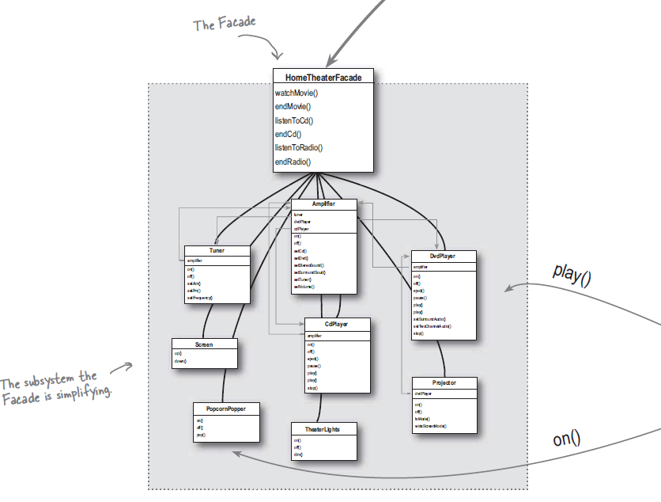
Introduction
Time to create a Façade for your home theater system

Slide 9
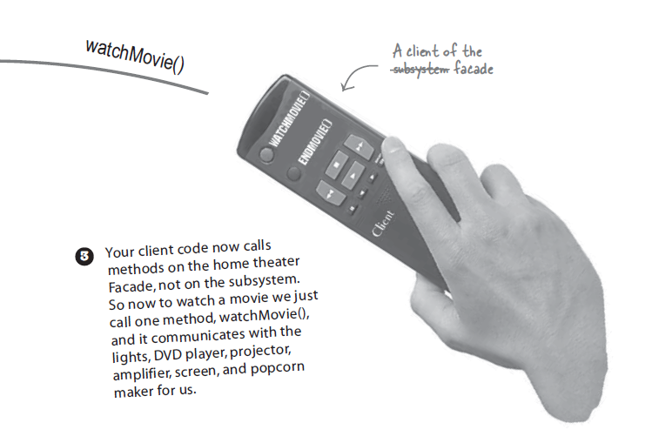
Introduction
Enjoy your movies…
Notes:
+ The Façade still leaves the subsystem accessible to be used directly.
If you need the advanced functionality of the subsystem classes, they are available for your use

Slide 10
Façade vs. Adapter
The difference between the two is in their intent
Adapter
To alter an interface so that it matches one a client is expecting
Façade
To provide a simplified interface to a subsystem

Slide 11
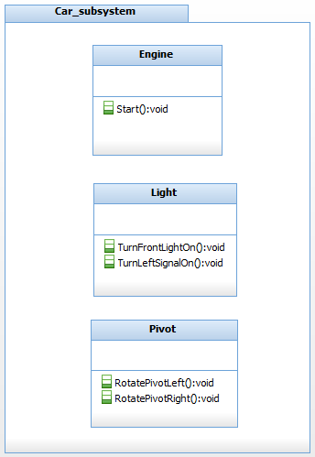
Façade Example
Let’s look at your car
Turn ignition key on
Engine start
Head lights on
Rotate steering wheel left
Turn left signal on
Rotate pivot left

Slide 12
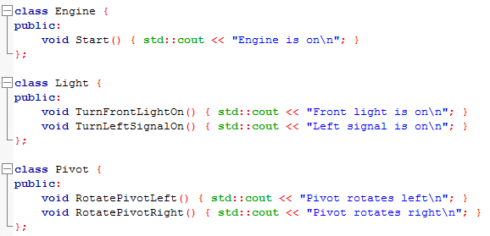
Façade Example
Car subsystem

Slide 13
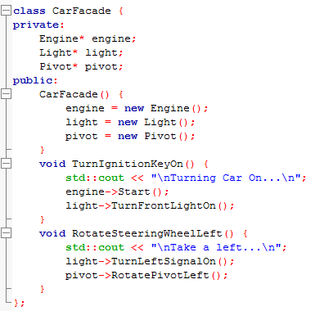
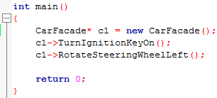
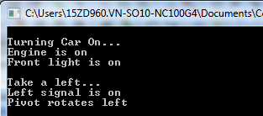
Façade Example
Car Façade

Slide 14
Usage
Use case
Provide simple interface to complex subsystems
When there are many dependencies between clients and implementation class
You want to neatly layer your subsystem

Slide 15
Q&A
References
Head First Design Patterns
https://stackoverflow.com/questions/249581/explain-facade-pattern-with-c-example
https://www.codeproject.com/Articles/822857/Fa-ade-Design-Pattern

Slide 16


Slide 17
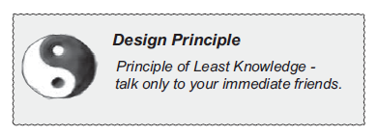


Appendix – The principle of Least Knowledge
Only invoke methods that belongs to
The object itself
Objects passed in a parameter to the method
Any object the method creates or instantiates
Any components of the object

Slide 18
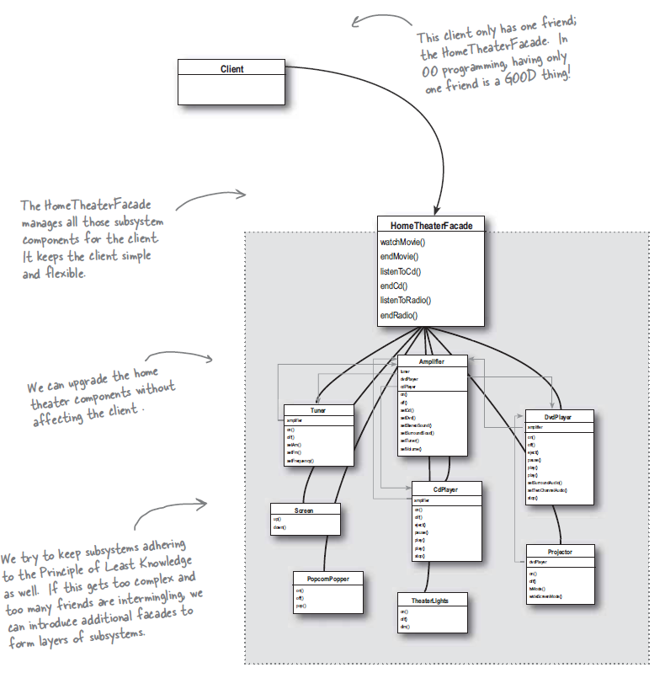
Appendix – The Façade and The Principle
OO

