Slide 1
How StateChart work ???

Slide 2
Content
Classes for States in Rhapsody
Principle of changing states in Rhapsody
Implementation in Model

Slide 3
Classes for State in Rhapsody
OMState
OMState* parent
OMOrState
OMLeafState
OMState* subState
OMComponentState* component
OMComponentState
OMAndState
OMState* Active
…
Notes:
There are other classes for state (but our statechart doesn’t use)
OMAndState don’t have subState => Cannot using history for and line

Slide 4
Example of a statechart and State classes
A
A1
B1
B2
C1
C2
A2
D1

Slide 5
RootState (OMComponentState)
A (OMAndState)
A1 (OMComponentState)
A2 (OMComponentState)
B1 (OMOrState)
B2 (OMLeafState)
D1 (OMLeafState)
C1 (OMLeafState)
C2 (OMLeafState)
Notes:
OMComponentState: always for RootState and for subRootState in case of using And line.
OMAndState: States have and-line
OMOrState: States have sub states
OMLeafState: States have no sub states (lowest level of statechart)

Slide 6
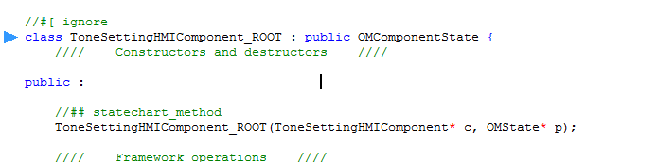
In Rhapsody
There is always a state call rootState (Rhapsody doesn’t allow us to access to this state :3)
Parent of this State is NULL

Slide 7
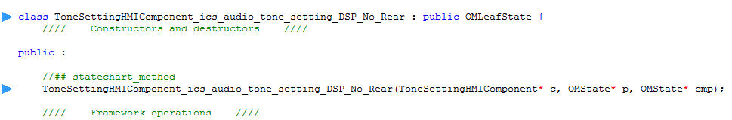
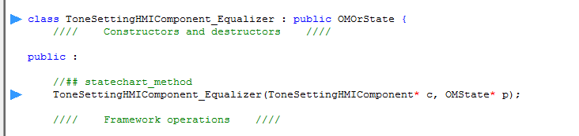
In Rhapsody
+ It create for each state a class that inherit from Basic state Classes in previous slide.

Slide 8
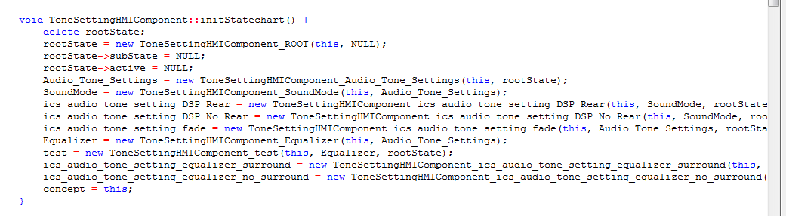
Each state is an object.

Slide 9
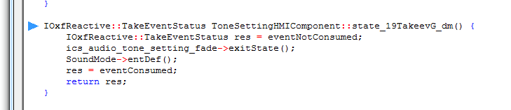
In Rhapsody
For each event, Rhapsody auto generate an method

Slide 10
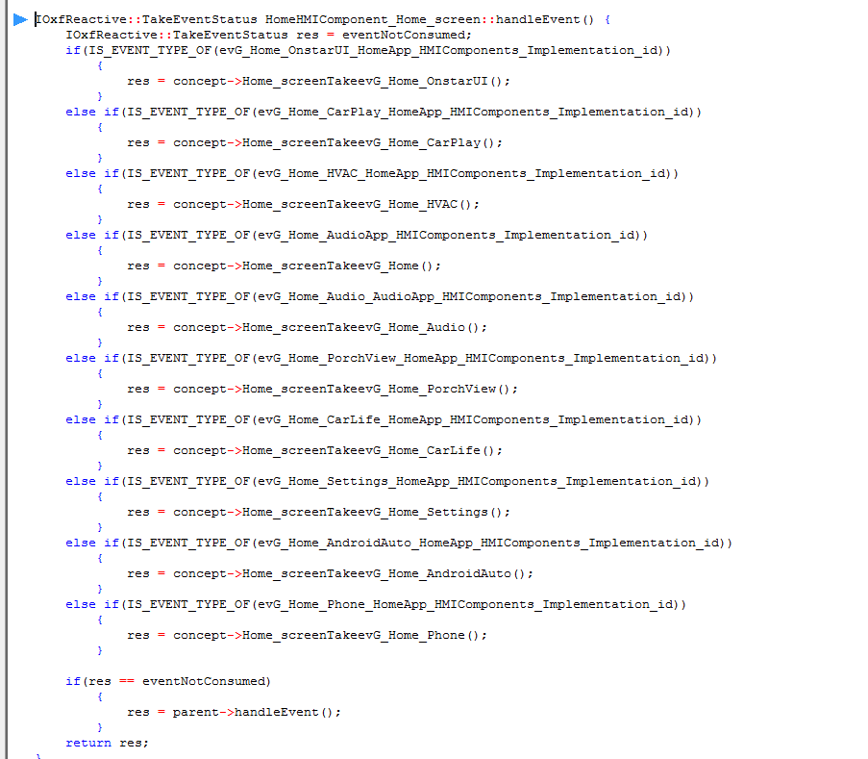
handleEvent()
Notes:
Just a if else function to call suitable method to handle event, each method is a set of ExitState(), EnterState() and Endef(),…..

Slide 11
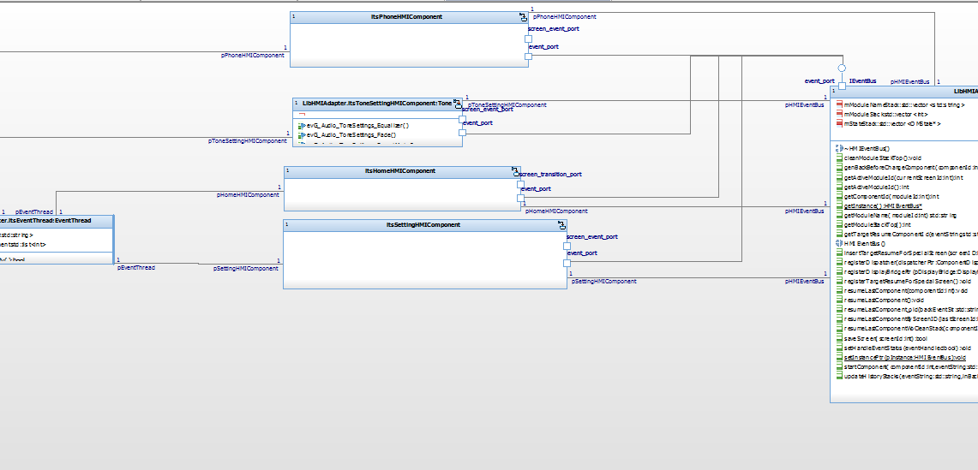
How to associate between Component objects and Core part ???
Notes:
Using Object Diagram with associations

Slide 12
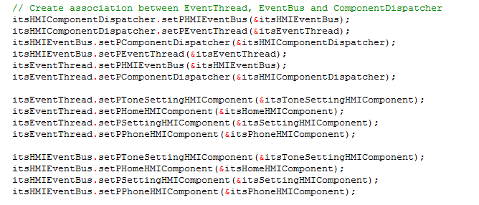
Initiate for associations

Slide 13
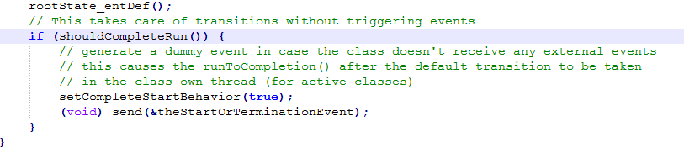
How Rhapsody deal with NULL transition
In HandleEvent method, there is a function call runToCompletion method to take Null transition right after normal transition.
What if there is a NULL transition right after Default transition -> a dummy event will be sent to eventQueue (maybe to trigger the NULL transition) -> need to avoid because relating queue won’t be updated

Slide 14
Normal flow of change State
The root of handling event is based on following methods and attributes:
Attributes:
OMState* Parent
OMState* subState
OMState* Active
Methods
EnterState()
ExitState()
EntDef()
Notes:
- Parent is fix for each state of statechart (We can change, but don’t do it). We only get but not set.
- Each OMOrState or OMComponentState has SubState attribute to store pointer (OMState) of current active substate in that state. These SubState determine current only and only active configuration of an object.
- OMState* Active of OMLeafState is the current active (lowest level) State of OMComponentState
- EntDef: is also a function that need to concern about, but it just only use to call enterState or use to go to Default state.

Slide 15
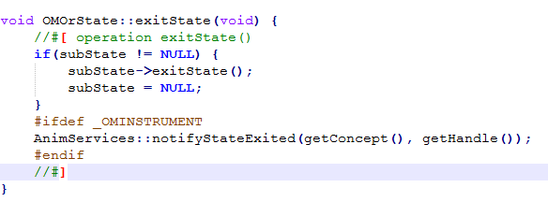
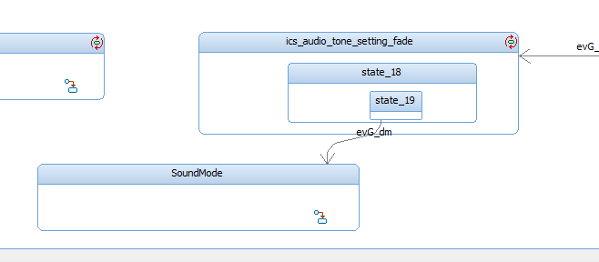
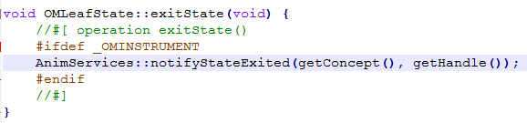
Exit a State (From inside)
Notes:
Actually, this action is only for the purpose of erase subState of State (and call action on exit)

Slide 16
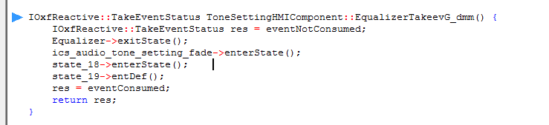
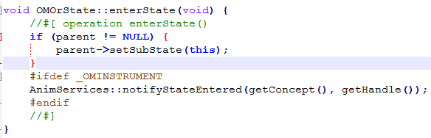
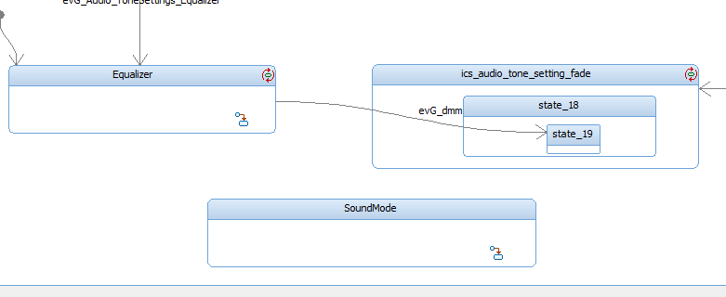
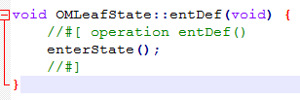
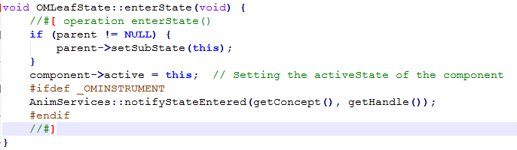
Enter a State (From outside)
Notes:
Main command in this method is to set subState of parent state (from outside to inside) to make the active configuration of statechart

Slide 17
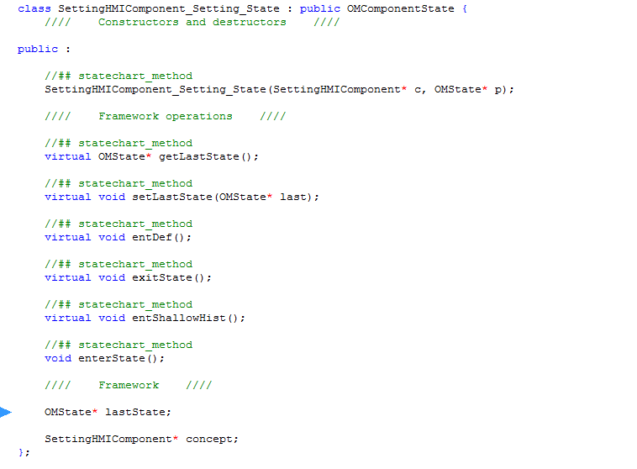
History connector
Rhapsody just only creates another attribute to each state to store subState and the active configuration of the state chart call: OMState* lastState
lastState will be update in exitState()
Using history connector, we enter (of course sequentially from outside to inside) to state stored in lastState.

Slide 18
Can we go directly to a state without go through parent states???
YES
(But by this way we break the flow of Rhapsody and make a side effect)

Slide 19
Go from A3 to B3
C
A1
B1
A2
B2
A3
B3

Slide 20
Compare flows
Rhapsody Flow
Broken Flow
Exit A3 -> setSubState of A2 = NULL
Exit A2 -> setSubState of A1 = NULL
Exit A1 -> setSubState of C = NULL
Enter B1 -> setSubState of C = B1
Enter B2 -> setSubState of B1 = B2
Enter B3 -> setSubState of B2 = B3
Exit A3 -> setSubState of A2 = NULL
Exit A2 -> setSubState of A1 = NULL
Exit A1 -> setSubState of C = NULL
Enter B3 -> setSubState of B2 = B3

Slide 21
Result after state transition
Rhapsody Flow
Broken Flow
Active configuration
Before: C-A1-A2-A3
After: C-B1-B2-B3
Active configuration
Before: C-A1-A2-A3
After: C-NULL … B2-B3
Side effects:
SubState of C is NULL instead of B1
Disorder active configuration

Slide 22
Go from A3 to B3 (by broken flow)
C
A1
B1
A2
B2
A3
B3

Slide 23
How to fix it
Reset Substate of Parent State by ourself….

Slide 24
Review issue:
Component A(screen1-State1)->Component B->Component A(screen2-State2)
Back 1st time: ok
Back 2nd time: screen1-State2 => Incorrect State

Slide 25
Idea
Breaking flow for state transition of Rhapsody
Change state without event transition
Store the last state of statechart each time change component
Example:
ModuleStack:
StateStack:
Home | Settings(State1) | Phone | Settings(State2) | Audio
H_state1 | S_State1 | P_State1 | S_State2

Slide 26
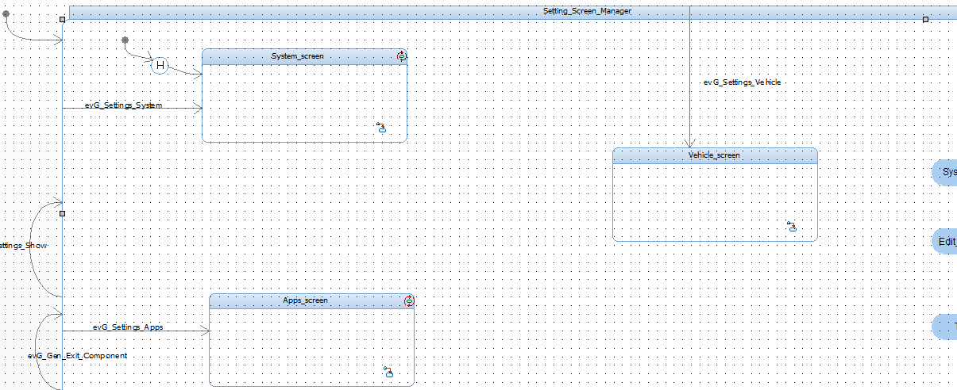
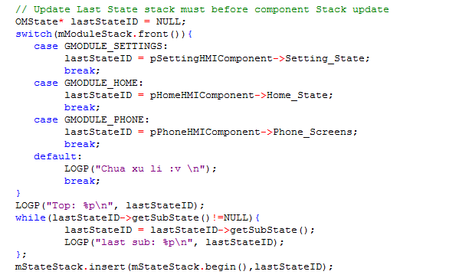
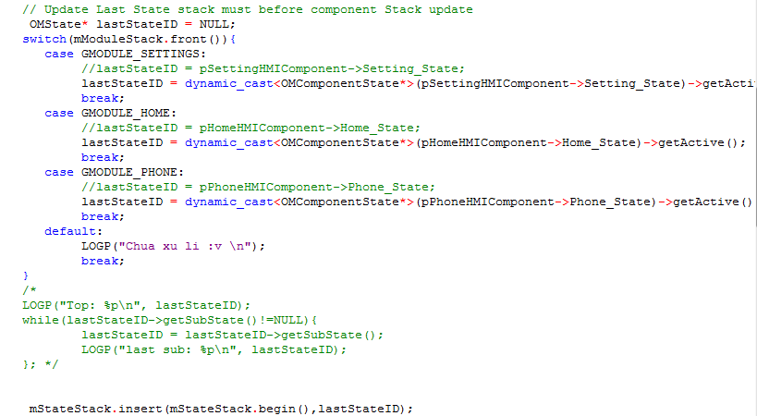
Store
We start with Setting_State because cannot access to root state as well as OMAndState doesn’t have subState.
OMComponentState
Method 1: Use subState
Method 2: Use Active (state)
Notes:
Note: We use a map instead of switch case: mComponentState

Slide 27
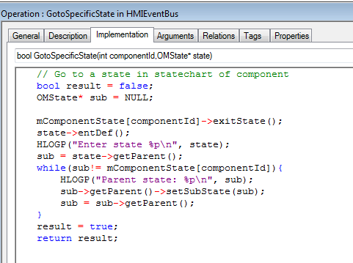
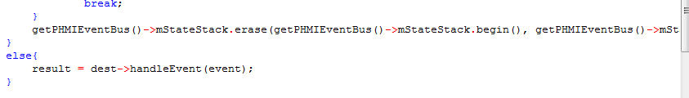
Back to last state
Back (go) to last (a specifice) state
Clear Stack
Notes:
When we back to laste State, we also need to reset current subState of parent State.
When event Home-> clear all stack same as Module Stack

Slide 28
Limitation
Because OMAndState doesn’t have subState => need to move all and line to the outermost (Topview) State of Statechart.
State with startcomponent MUST be remove (using internal transition as proposed by Mr.Viet)

Slide 29
References
Cpp and header file in C:\ProgramData\IBM\Rational\Rhapsody\8.1.5\Share\LangCpp\oxf
https://www.ibm.com/support/knowledgecenter/SSB2MU_7.6.1/com.ibm.rhp.frameworks.doc/topics/rhp_r_fw_oxf_classes_methods.html

Slide 30


