Slide 1
VERSION CONTROL
Why
How
GIT/SVN
Tools
Hanoi, June 2016

Slide 2
1. WHY?
Version Control
Version control = revision control = source control
Manage changes of files (revision/commit)
Allow show log, branching, compared revisions, reversed, merged, resolved conflict…

Slide 3
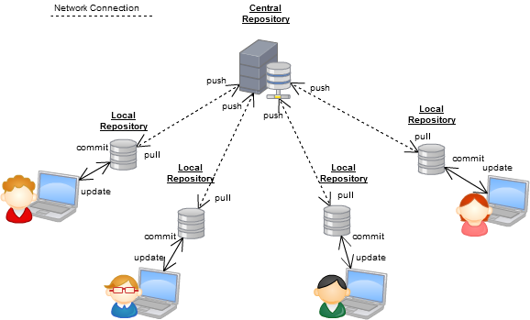
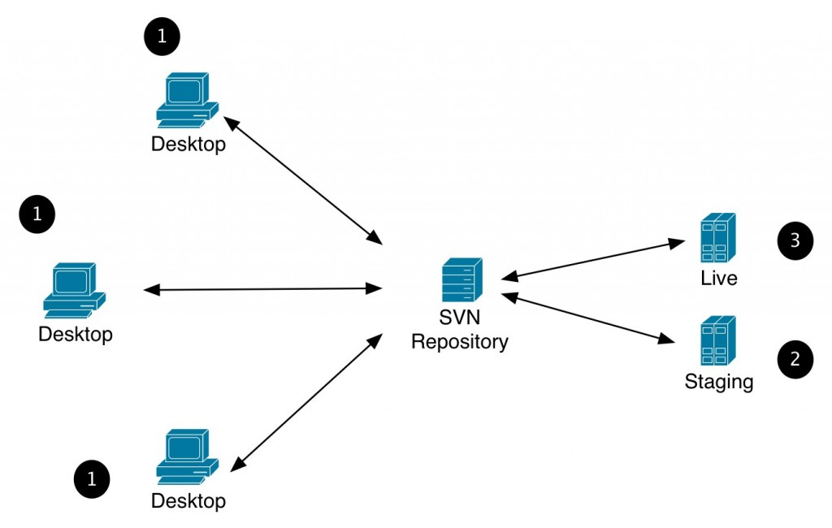
2. HOW?
Version Control

Slide 4
3. GIT/SVN
Version Control
GIT
SVN
Others (Hg Mercurial, CVS, Bazaar, LibreSource, Monotone, Cogito…)

Slide 5

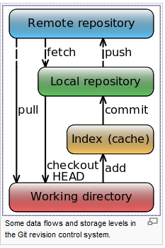
3.1 GIT
Version Control

Slide 6

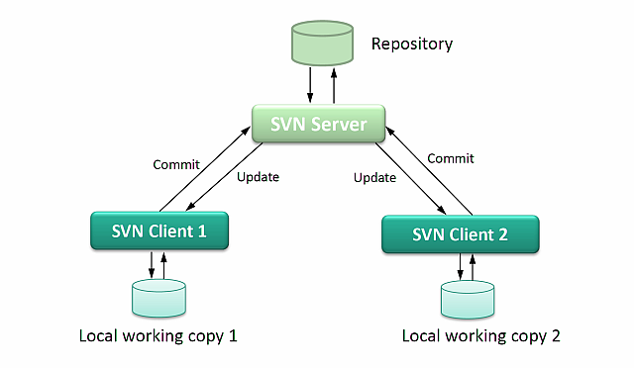
3.2 SVN
Version Control

Slide 7
3.3 GIT/SVN – General
Version Control
 | SVN | GIT
Speed | Slower | Faster
P2P | No | Yes
Plug-ins for IDEs | Wide variety | Wide variety
Commands line | Insufficient | Sufficient
Server side | Windows | Linux
Client side | Many OS | Many OS
Repository | Single Repos (on Server) | Multi Repos, Local Repos
Branching | Yes | Yes
Revert | Yes | Yes
Resolve Conflict | Yes | Yes
Show log | Yes | Yes
Configuration folder | .svn | .git

Slide 8
3.3 GIT/SVN - Commands
Version Control
Commands | SVN | GIT
Get source code from server to local (1st time) | checkout | clone
Get latest (HEAD) source code from server to local | update | full, fetch
Save changes to server | commit | push
Show author and revision information in-line | blame | blame
Discard changes and revert to specific revision | revert | reset, checkout
Create branch | copy | branch
Switch branch | switch | checkout
Remove “conflicted” state on local | resolved | resolved
Merging | merge | merge
Show history of changes | log | log
Display the differences between revisions | diff | diff
Apply the differences between two sources to local | merge | merge
Make a snapshot | copy | tag
Stash the changes in a dirty working directory |  | stash
Save changes to local repository |  | commit

Slide 9
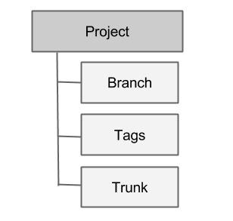
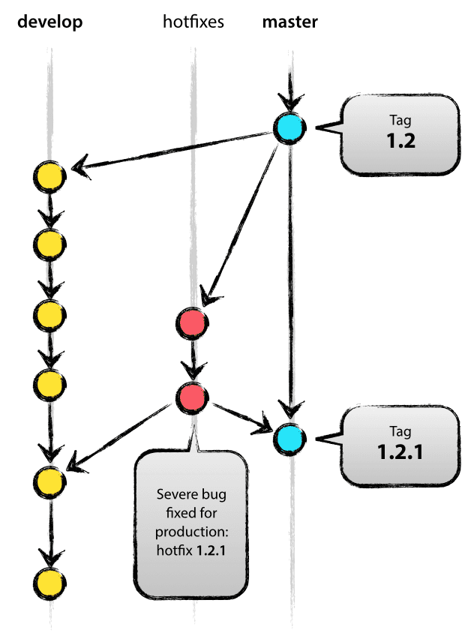
3.4 GIT/SVN – Methodology
Version Control
Mark versions based on
physical folders
Mark versions based on
branch concept

Slide 10
3.5 GIT - Best practice
Version Control
Do read about git
Do commit early and often
Don't panic
Do backups
Don't change published history
Do choose a workflow
Do divide work into repositories
Do make useful commit messages
On Sausage Making
Do keep up to date
Do periodic maintenance
Do enforce Standards
Do use useful tools
Do integrate with external tools
Miscellaneous "Do"s
Miscellaneous "Don't"s
Refer to: http://sethrobertson.github.io/GitBestPractices/

Slide 11
3.6 SVN - Best practice
Version Control
Use a sane repository layout
Commit logical changesets
Use the issue-tracker wisely
Understand mixed-revision working copies
Be patient with large files
Know when to create branches
The Never-Branch system
The Always-Branch system
The Branch-When-Needed system
Refer to: https://svn.apache.org/repos/asf/subversion/trunk/doc/user/svn-best-practices.html

Slide 12
3.7 GIT – Common problems
Version Control
Discard local file modifications
Undo local commits
Remove a file from git without removing it from your file system
Edit a commit message
Clean up local commits before pushing
Reverting pushed commits
Avoid repeated merge conflicts
Find the commit that broke something after a merge
Avoid common mistakes with git hooks
When all else fails
Refer to: https://www.codementor.io/git/tutorial/10-common-git-problems-fix

Slide 13
3.8 SVN – Common problems
Version Control
Locking Files
I can't commit and I can't update
Refer to:
https://prod-web.oit.uwplatt.edu/files/csse/tools/subversion/subversion-help.html#problems
https://subversion.apache.org/faq.html

Slide 14
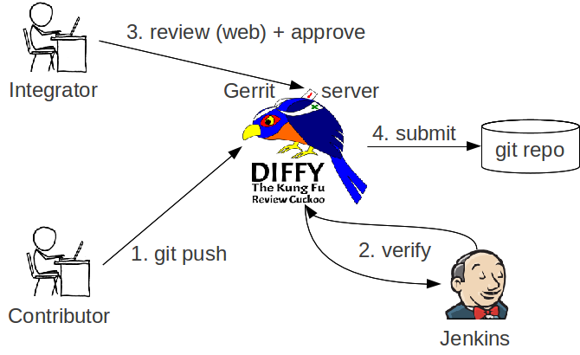
3.9 Gerrit – Review code
Version Control

Slide 15
4. TOOLS
Version Control
Some popular tools:
GitHub
BitBucket
GitLab
TortoiseGIT
TortoiseSVN
Gerrit

Slide 16



Q&A
UML/SYSML

