Slide 1

Decorator Pattern
Hanoi, September 2017

Slide 2
Content
Introduction
Study real life implementation
Make a summary

Slide 3
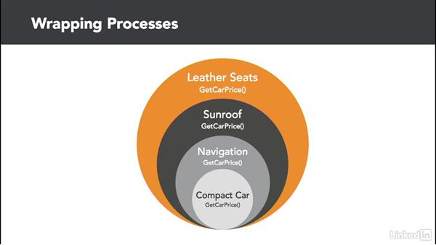
Introduction
Decorator Design Pattern
Also known as Wrapper
Allows behavior to be added to an individual object at runtime, without affecting the behavior of other objects from the same class
Notes:
It is easy to add functionality to an entire class of objects by sub-classing an object, but it is impossible to extend a single object this way.
With the Decorator Pattern, you can add functionality to a single object and leave others like it unmodified.

Slide 4
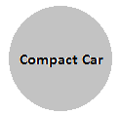

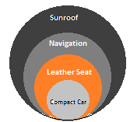
Introduction
Keywords
Adding behaviors to an object at runtime
in any order
Without changing the original object or class
Notes:
It is easy to add functionality to an entire class of objects by sub-classing an object, but it is impossible to extend a single object this way.
With the Decorator Pattern, you can add functionality to a single object and leave others like it unmodified.

Slide 5
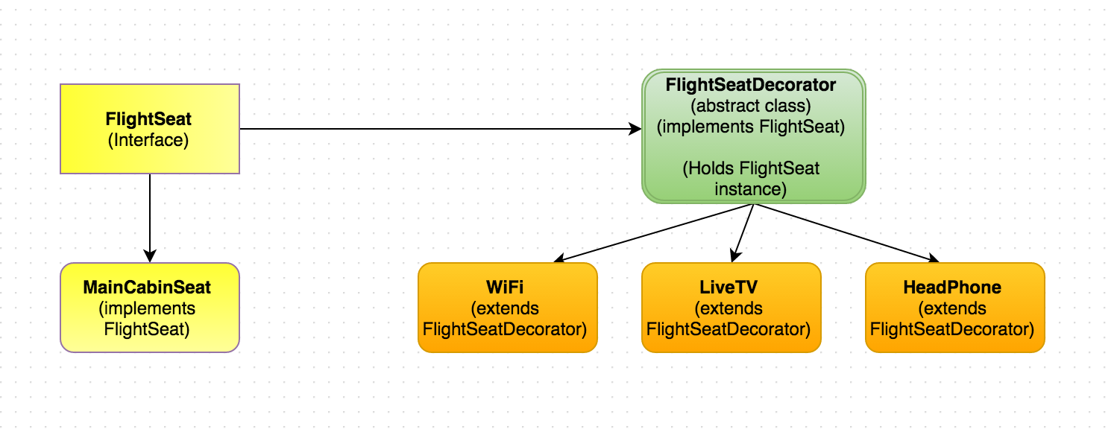
Introduction
A Real Life Example
You have a main cabin seat in a flight
You are allowed to choose multiple amenities. Each amenity has its own cost associated with it.
Main cabin seat ($500) + WiFi ($10) = $510
Main cabin seat ($500) + LiveTV ($8) = $508
This is Not an UML diagram
Notes:
Now if a user chooses wi-fi and Head Phone, he/she will be charged for seat + wi-fi + head phone.

Slide 6
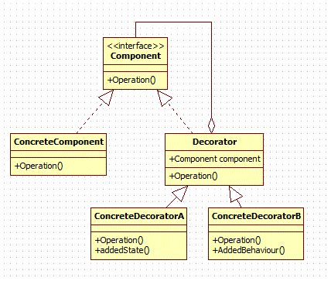
UML Diagrams
Class diagram
Component: defines interface for objects
ConcreteComponent: defines object on which additional responsibilities can be added
Decorator: maintains a reference to component object
ConcreteDecorator: add responsibilities to the object

Slide 7
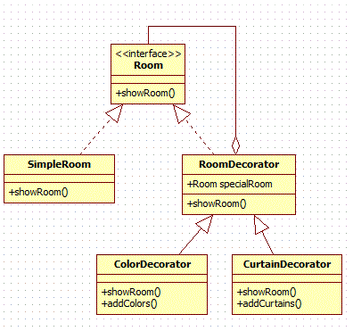
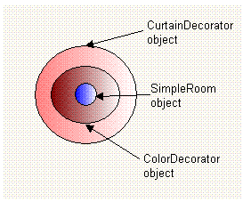
UML Diagrams
Example: Decorate simple room with color and curtains
We first create SimpleRoom object
Then decorate it with ColorDecorator
Then decorate resultant object with CurtainDecorator
Notes:
Room(Component)
It is an interface which creates a blue print for the class which will have decorators
SimpleRoom(ConcreteComponent)
Object of SimpleRoom class will be decorated. Additional responsibilities will be attached to it dynamically.
RoomDecorator(Decorator)
It contains reference to Room class which will be decorated.
ColorDecorator(ConcreteDecorator)
ColorDecorator will add additional responsibility i.e., add color to room.
CurtainDecorator(ConcreteDecorator)
CurtainDecorator will add additional responsibility i.e., add curtains to room.

Slide 8
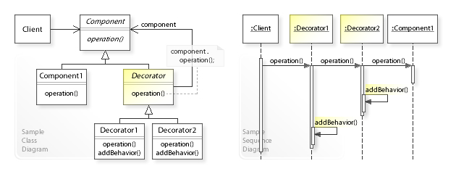
UML Diagrams
Sequence diagrams
The Client object works through Decorator1 and Decorator2 objects to extend the functionality of a Component1 object
Notes:
The Client calls operation() on Decorator1, which forwards the request to Decorator2.
Decorator2 performs addBehavior() after forwarding the request to Component1 and returns to Decorator1, which performs addBehavior() and returns to the Client.

Slide 9
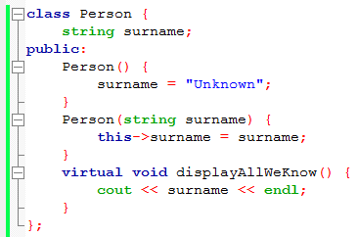
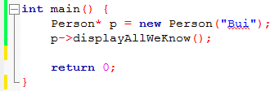

Study real life implementation (I)
We got a Person class, simply holds a surname
My surname is …

Slide 10
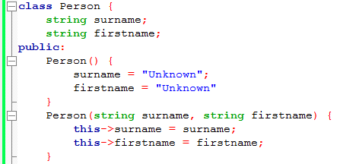
Study real life implementation (I)
Now we have a change request: We would like to add the person’s first name to our records
Our first instinct is to go straight
Breaks Open Closed Principle!
Notes:
Software should be open to extension, but closed to modification. Well, we've modified Person in a big way. We've changed a class. We've changed a constructor. We will have to change all the Unit Tests to reflect that. If any other teams are using Person in their code, somebody better tell 'em quick. And hope they are not on an urgent release deadline ...

Slide 11
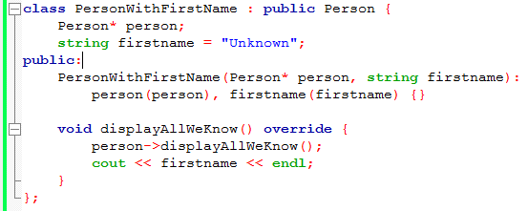
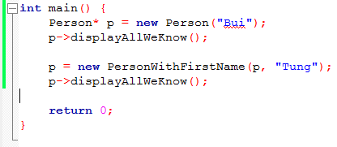
Study real life implementation (I)
The Decorator pattern comes to rescue
and my first name is …
My surname is …

Slide 12
Study real life implementation (I)
The result is:
Our original Person class is completely unchanged
Method .displayAllWeKnow() is unchanged because the inheritance Person makes the polymorphism.

Slide 13
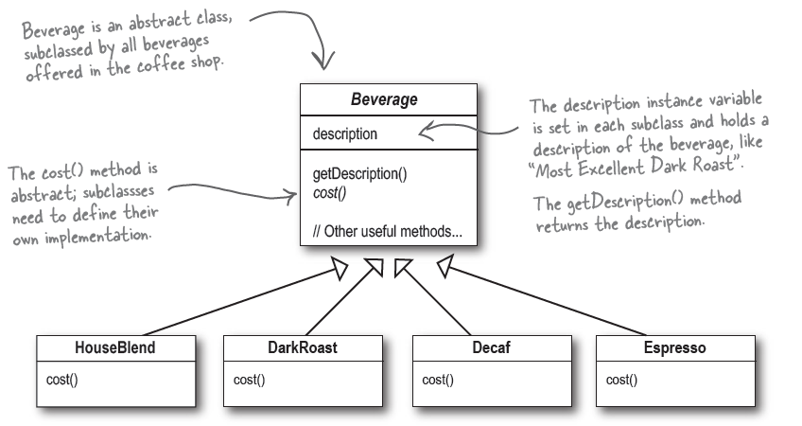
Study real life implementation (II)
Starbuzz Coffee: 4 main coffee types
Customer can ask for several condiments like milk, soy, and mocha. Each of these has its own cost.
Starbuzz need to change their order system to calculate cost?

Slide 14
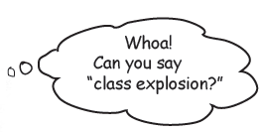
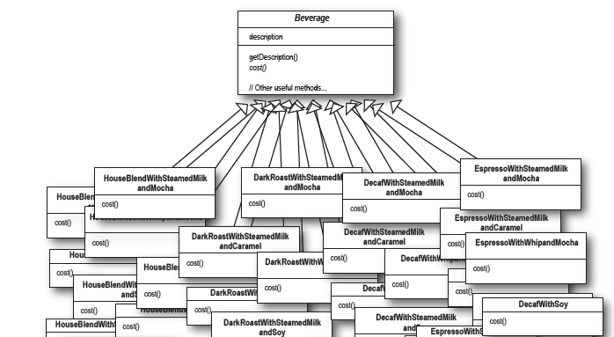
Study real life implementation (II)
Method 1. Using sub-class
Espresso + Milk + Mocha = 1 class
Espresso + Milk + Caramel = 1 class
Notes:
Lets say you have 6 factors that can change the characteristics of your object, in that case you will have factorial of 6 which is, 6! = 720, so there can be 720 objects with different characteristics.

Slide 15
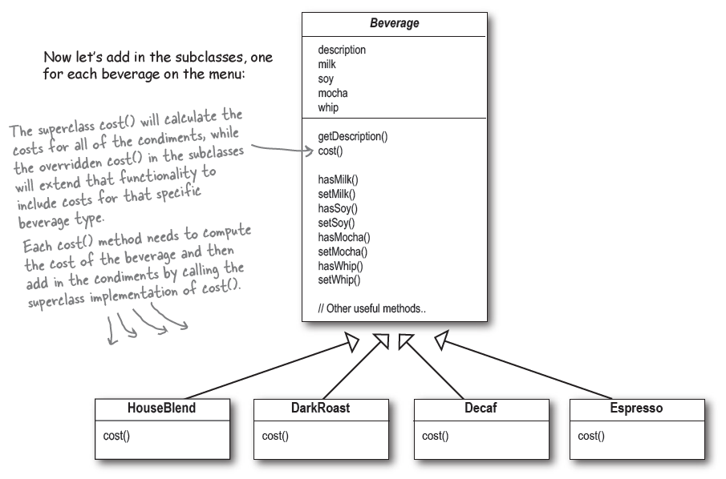
Study real life implementation (II)
Method 2. Adding new boolean values for each condiment
How we calculated the cost?
Notes:
Price changes for condiments will force us to alter existing code.
New condiments will force us to add new methods and alter the cost method in the superclass.
We may have new beverages. For some of these beverages (iced tea?), the condiments may not be appropriate, yet the Tea subclass will still inherit methods like hasWhip().
What if a customer wants a double mocha?

Slide 16
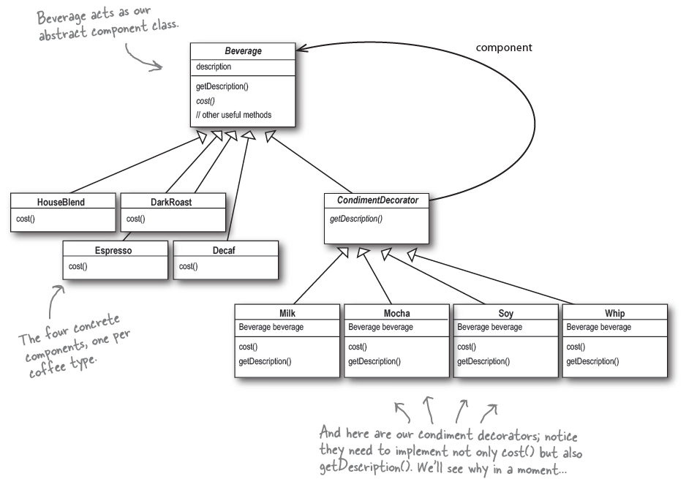
Study real life implementation (II)
Method 3. Decorator design pattern

Slide 17
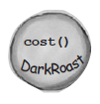

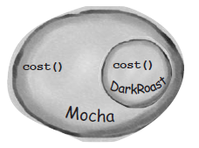

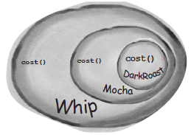
Study real life implementation (II)
Method 3. Decorate an object

Slide 18
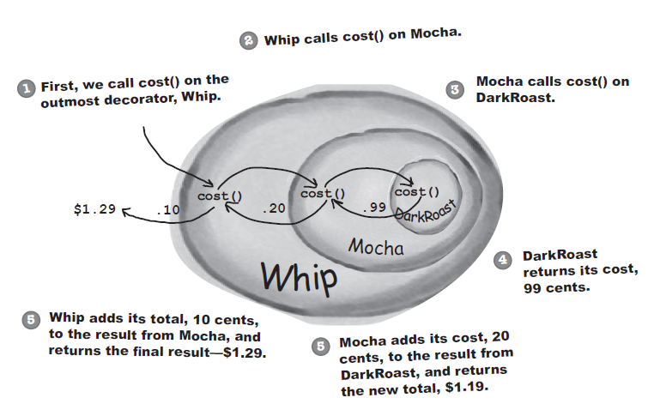
Study real life implementation (II)
Method 3.
Customer ordered DarkRoast, with some Mocha and Whip

Slide 19
Study real life implementation (II)
Method 3.
What if customer want double or triple Whip?

Slide 20
Code
Demo on CodeBlocks (Appendix I)
Notes:
In Java, a classical example of the decorator pattern is the Java I/O Streams implementation.
FileReader frdr = new FileReader(filename);
LineNumberReader lrdr = new LineNumberReader(frdr);
The preceding code creates a reader -- lrdr -- that reads from a file and tracks line numbers. Line 1 creates a file reader (frdr), and line 2 adds line-number tracking.

Slide 21
Make a summary
Decorator design pattern versus Sub-classing
Inheritance requires creating a new class for each additional responsibility
E.g., EspressoWithMilkMocha, EspressoWithMilkCaramel
This gives rise to many classes
Decorators make it easy to add a property twice or more.
E.g., to give an Espresso a double Milk and triple Mocha.
Inheriting from a class twice is error-prone at best.

Slide 22
Make a summary
Advantages
Modify the characteristics of an object at runtime
Provide different flavors to an object
Give flexibility to choose what ingredients we want to use
Extend functionality of object without affecting any other object
Notes:
This pattern helps to modify the characteristics of an object at runtime.
It provides different flavours to an object and gives flexibility to choose what ingredients we want to use in that flavour.

Slide 23
Make a summary
Disadvantages
Code maintainability because this pattern creates lots of similar decorators which are sometimes hard to maintain and distinguish
Another danger is that the Single Responsibility Principle gets violated.
Behaviour is sliced across many objects
Many tiny objects, none of which really do anything on their own

Slide 24
Use case
What problems can the Decorator design pattern solve?
Add additional functionalities / responsibilities dynamically
Remove functionalities / responsibilities dynamically
Provide a flexible alternative to sub-classing for extending functionality.
When using sub-classing, different sub-classes extend a class in different ways. But extension is bound to the class at compile time and can’t be changed at run time.

Slide 25


Slide 26
Q&A
Source
https://en.wikipedia.org/wiki/Decorator_pattern
https://www.codeproject.com/Tips/468951/Decorator-Design-Pattern-in-Java
http://www.singhajit.com/decorator-design-pattern/
https://www.quora.com/Can-you-give-a-real-world-example-of-the-usefulness-of-Decorator-pattern

Slide 27
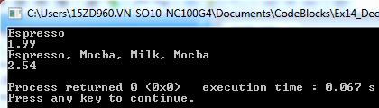
Appendix I
Source code
// Decorator Pattern
#include <iostream>
#include <string>
using namespace std;
class Beverage {
public:
string name = "Unknown Beverage";
virtual string getName() {
return name;
}
virtual double cost() = 0;
};
class Espresso: public Beverage {
public:
Espresso() {
name = "Espresso";
}
double cost() {
return 1.99;
}
};
class CondimentDecorator: public Beverage {
public:
//virtual string getName() = 0;
};
class Mocha: public CondimentDecorator {
public:
Beverage* beverage;
Mocha(Beverage* b) {
beverage = b;
}
string getName() {
return beverage->getName() + ", Mocha";
}
double cost() {
return .20 + beverage->cost();
}
};
class Milk: public CondimentDecorator {
public:
Beverage* beverage;
Milk(Beverage* b) {
beverage = b;
}
string getName() {
return beverage->getName() + ", Milk";
}
double cost() {
return .15 + beverage->cost();
}
};
int main() {
Beverage* nb = new Espresso();
cout << nb->getName() << endl;
cout << nb->cost() << endl;
// Add some flavours
nb = new Mocha(nb);
nb = new Milk(nb);
nb = new Mocha(nb);
cout << nb->getName() << endl;
cout << nb->cost() << endl;
return 0;
}

