Slide 1

Factory Pattern
Hanoi, October 2017

Slide 2
Content
Introduction
Example I
Example II
INFO3.5L - HMIEventFactory
Summary

Slide 3
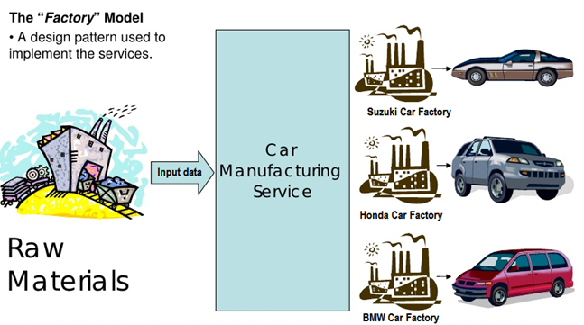
Introduction
Factory Pattern: defines an interface for creating an object, but lets subclasses decide which class to instantiate.
Notes:
They say “decides” not because the pattern allows subclasses themselves to decide at runtime, but because the creator class is written without the knowledge of the actual products that will be created, which is decided purely by the choice of the subclass that is used.

Slide 4
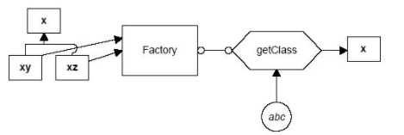
Introduction
How does it work?
The Factory returns an instance of one of several possible classes depending on the data provided to it
+ x is a base class and classes xy, xz are derived from it
+ The Factory is a class that decides which of these subclasses to return depending on the arguments you give it (e.g. “xy” for xy)
+ The getClass() method passes in some value abc, and return some instances of the class x. Which one it returns doesn’t matter to the programmer since they all have the same methods, but different implementations.

Slide 5
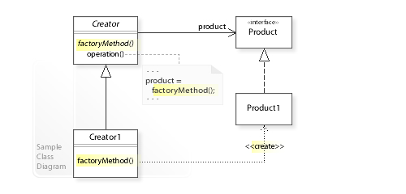
Introduction
UML diagram
The Creator1 is the only class that has the knowledge of how to create products
Notes:
+ The Creator class that requires a Product object doesn’t instantiate the Product1 class directly.
+ The Creator refers to a separate factoryMethod() to create a product object, which makes the Creator independent of which concrete class is instantiated.
+ All products must implement the same interface so that the classes which use the products can refer to the interface, not the concrete class.

Slide 6
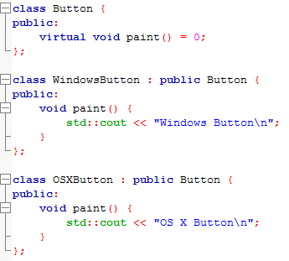
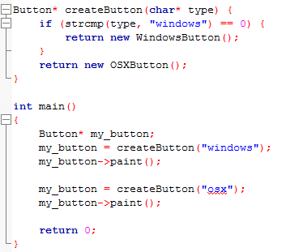

Example I
We produce buttons for OS
2 types of button: Windows and OS X
Think about the disadvantages of below code
Notes:
Problem = Not close for modification
What if we add more button types?
What if we have 2 factories, which procedure different kind of the same button type? E.g. input argument (“factory1”, “windows“), (“factory2”, “windows”),…

Slide 7
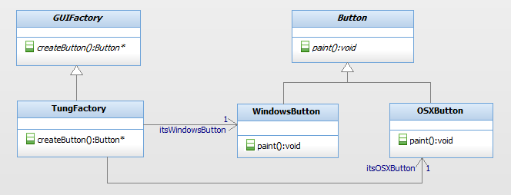
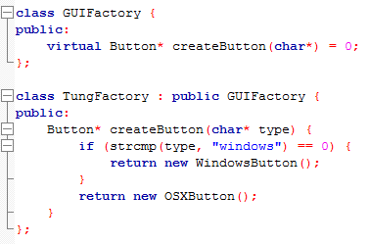
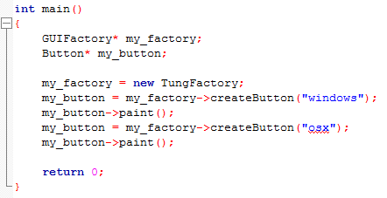
Example I
Implement Factory Pattern
Notes:
Factory provides interface for creating an object, but it doesn’t know what concrete product will be created.
Client decides which product will be created, and it will not be modified if we add new type of product.

Slide 8
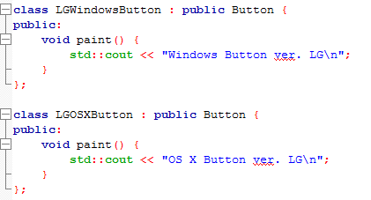
Example II
LG Factory built to compete with TungFactory
It also provides 2 LG types of button
Windows: LGWindowsButton
OS X: LGOSXButton
How to create Button with the same call “windows”, “osx”?
createButton(char* factory_name, char* type)
=> not good

Slide 9
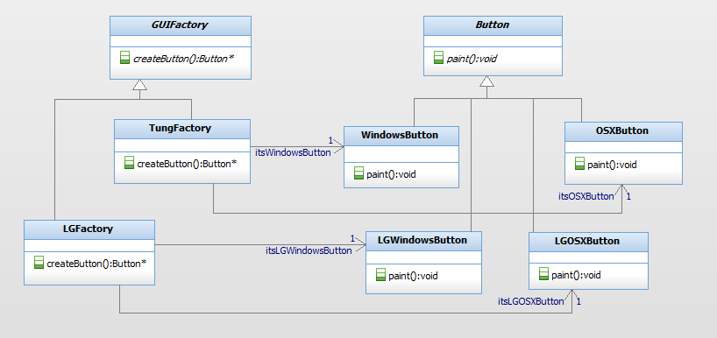
Example II
Add LGFactory into our program

Slide 10
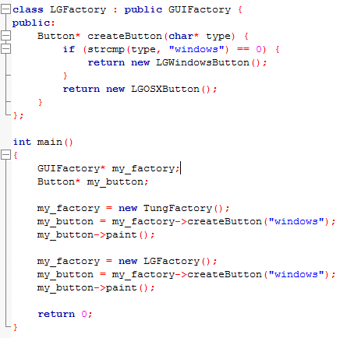

Example II
Code LGFactory

Slide 11
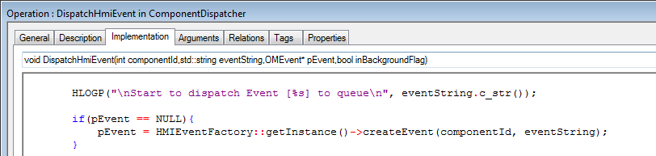
Info3.5L - HMIEventFactory
HMIEventFactory: provides function to create OMEvent, but let other class decides which concrete OMEvent is created
Receive 2 input arguments
componentID
eventString: event name in string type
Client
Factory
ComponentDispatcher
GMODULE_HOME
HMIEventFactory
evG_Home: OMEvent*
“evG_Home”: string

Slide 12
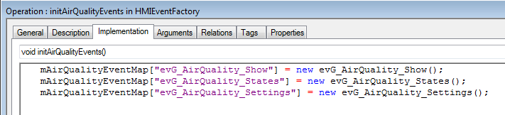
Info3.5L - HMIEventFactory
HMIEventFactory – initialization
Map of <std:string eventString, OMEvent*> for each components

Slide 13
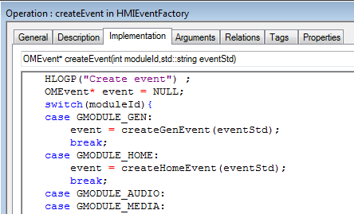
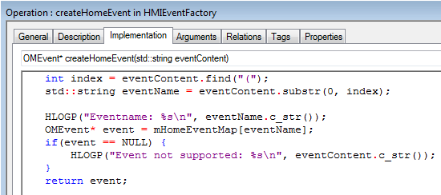
Info3.5L - HMIEventFactory
HMIEventFactory – createEvent(moduleId, eventString)
Invoke the corresponding operation of moduleid
Then, return the mapping OMEvent of eventString

Slide 14
Summary
The Factory Method design pattern solves problems like:
How can an object be created so that subclasses can redefine which class to instantiate?
How can a class defer instantiation to subclasses?
The Factory Method describes how to solve such problems:
Define a separate operation (factory method) for creating an object
Create an object by calling a factory method

Slide 15


