Slide 1

DATA ANALYTICS FOUNDATION
Mindx

Slide 2
Discussion
What did you learn in the previous BI course?
What is the difference between Business Intelligence and Data Analytics?

Slide 3
2. Discussion
What is the difference between Business Intelligence and Data Analytics ?
Business Intelligence :
Use data to present and present information that can bring knowledge to serve decision-making.
Deal with what happened in the past and how it happened without digging too much about why or predicting the future.
Work: building dashboards, metrics to monitor metrics, information, ..
Data Analytics :
Answer questions from the data, analyze why, and make future predictions based on past data.
Job: Write reports, analyze to answer questions, make findings and comments based on data

Slide 4
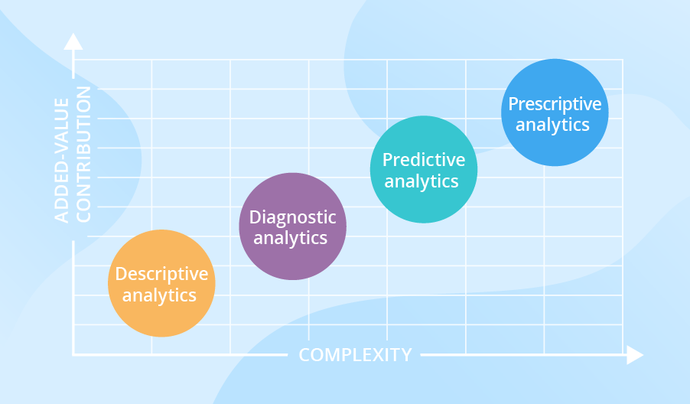
Data Analytics level

Slide 5
Descriptive analytics
What happened ?
Convert historical data into insights ( monthly revenue / total sales / Total Orders / total customers ... )
File excel, thống kê cơ bản,...
Diagnostic analytics
Compare nhiều nguồn data lại với nhau để trả lời câu hỏi về một vấn đề
Diagnostic analytics gives in-depth insights into a particular problem
Ví dụ :
Descriptive analytics : Doanh thu tháng rồi giảm 30%
Diagnostic analytics : Doanh thu tháng rồi giảm 30% vì tỉ lệ người dùng hủy hợp đồng tăng trong khi doanh số bán ra lại giảm.
=> Bắt đầu có sự phân tích dữ liệu

Slide 6


Predictive analytics
Predictive analytics tells what is likely to happen based on current data
It uses the findings of descriptive and diagnostic analytics to detect clusters and exceptions, and to predict future trends, which makes it a valuable tool for forecasting.
Advanced data analytics starts here, with the application of Machine Learning and Deep Learning to reveals things that the data are hiding.

Slide 7

Prescriptive analytics
Prescriptive analytics find the best solution given a variety of choices & allow companies to make decisions based on optimizing the result of future events or risks
Using statistical models and Machine Learning algorithms to find patterns in big data that human analysts may miss

Slide 8
As a result, Machine Learning is compulsory in Predictive analytics & Prescriptive analytics
Machine Learning is also the key factor in this course ! ( Because you all learn Descriptive Analytics & Diagnostic analytics in the 2nd course )

Slide 9

Introduction to Machine Learning
Machine learning is actually a very old field in computer science
“Machine learning is the field of study that gives the ability to learn without being explicitly programmed.” - Arthur Samuel (1959)
(Arthur Samuel ( from IBM ) is the first to wrote a program to play checkers using Machine Learning

Slide 10
Traditionally
Input :
Square Area
Number of
Distance from city
Number of rooms
...
Explicit Programs
( if distance > 200 m^2 and
Number of rooms and number of floors < 5 then price = $1,000,000 elseif .... )
Output :
=>
=>
Price

Slide 11
With machine Learning
Input :
Square Area
Number of
Distance from city
Number of rooms
...
Output :
=>
=> ML Algorithms
=>
Price

Slide 12
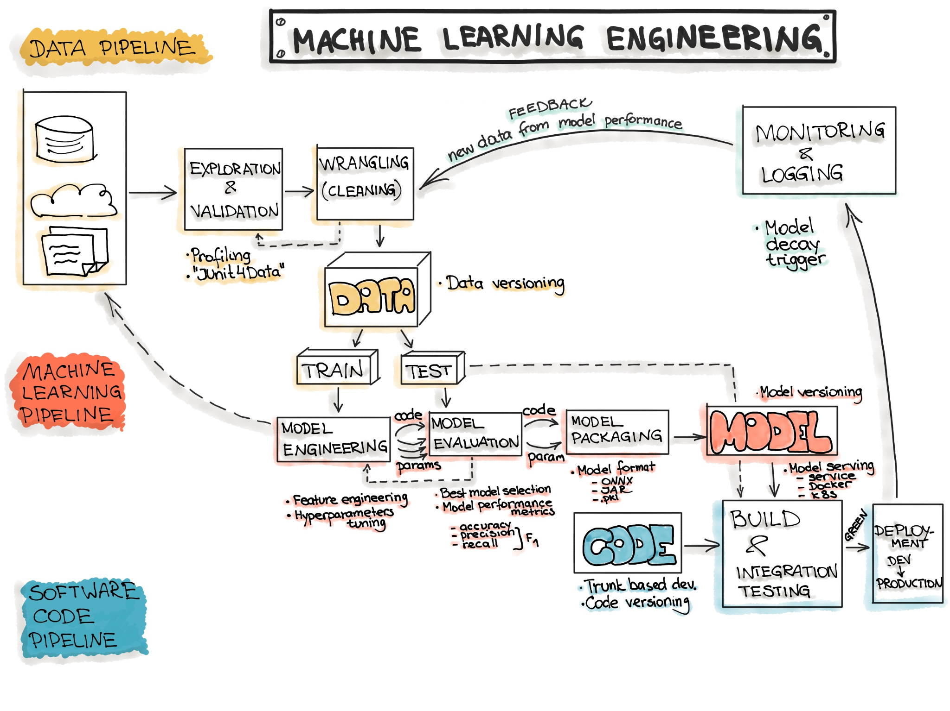
Machine learning Workflow

Slide 13
Machine Learning Types
Unsupervised Learning :
+ Dimensionality Reduction :
Text mining
Face recognigtion
Big Data Visualization
Image recognition
+ Clustering
Supervised Learning
+ Classification :
Fraud Detection
Email spam detection
Diagnostics
Image classification
+ Regression :
Risk assessments
Price prediction
Reinforced Learning

Slide 14
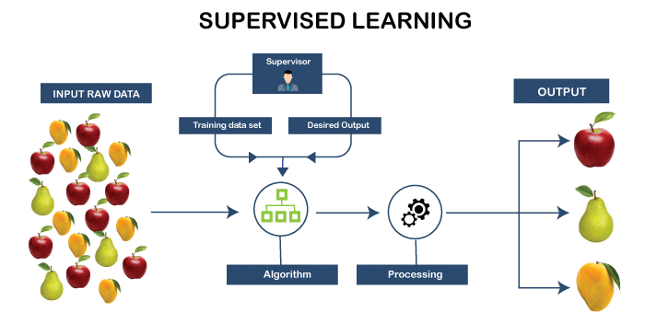
Supervised Learning
In supervised learning , the output is known . It means that you know what you want to see
𝑦 = 𝑓(𝐱)
estimating the target function (f) to predict the output variable (Y) given input variables (X).
we know Y , we have X , know we need to find f so that we can map Y from given X.

Slide 15
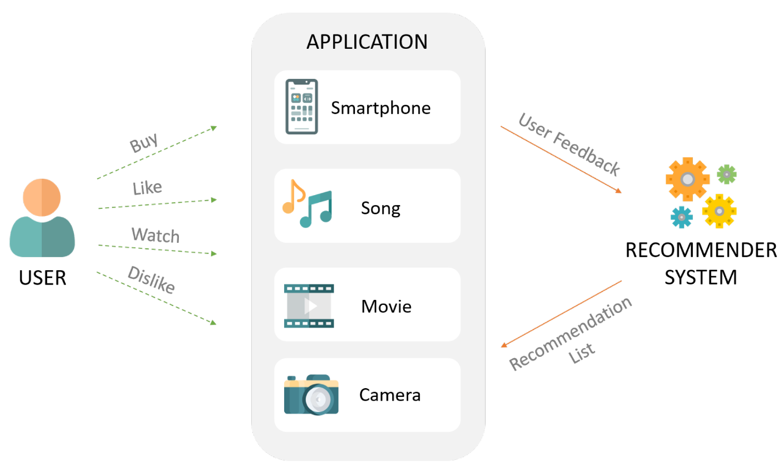
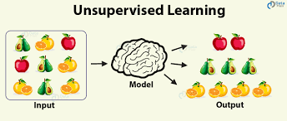
Unsupervised learning
In supervised learning , the output is known . It means that you don’t know the output.
? = 𝑓(𝐱)
estimating the target function (f) to predict the output variable (Y) given input variables (X).
we don’t know Y , we have X , know we need to find f so that we can map Y from given X.

Slide 16
Study Case
Grub is a transportation company. Every vehicle of Grub has GPS in it and every drivers has their application installed in their phones. When there is a request, the nearest driver will receive the job. The company has database for historical customer requests, and their locations as well as driver information.
How can you apply Data Analytics to enhance not only customer experience but also driver experience, and machine learning if possible? What kind of machine learning can be used?
You should try to think outside of the box for further issues: for example:
Driver lives in place A but receive a ride to place B , which is very far from his home and he is unfamiliar with it.
There are Customers choose 5 seat cars but prefer Toyota Vios instead of Kia Morning.

Slide 17
Mathematics in Machine Learning
Lets review some maths
Lets draw the equation Y = ax + b
Assume b = 0 . Plot the function at A(0,0) and B(1,1)

Slide 18
Mathematics in Machine Learning
Lets review some maths, let’s started with Linear Algebra.
Lets draw the equation Y = ax + b (+ e)
Assume b = 0 . Plot the function at A(0,0) and B(1,1)
We have y = x => y = x is the simplest form of linear regression.
It is called linear regression because the result is a linear equation.
Where Y is an observed score on the dependent variable, a is the intercept, b is the slope, X is the observed score on the independent variable, and e is an error or residual.

Slide 19
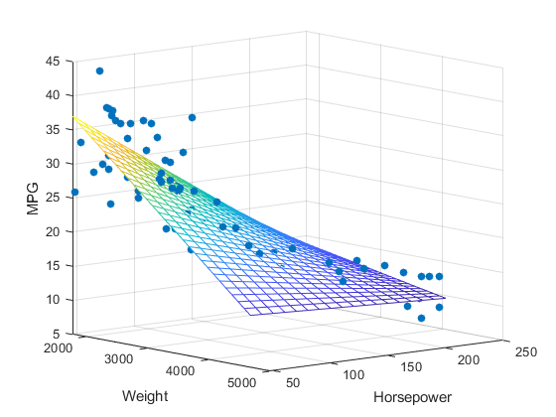
Multivariate Regression
Also, in real life , things are not just affected by one factor, which means that there are many X, from x1 to x2 to … xn.
Therefore, we have Multi-variate regression
Y = a1x1 + a2x2 + a3x3 + anxn + b

Slide 20
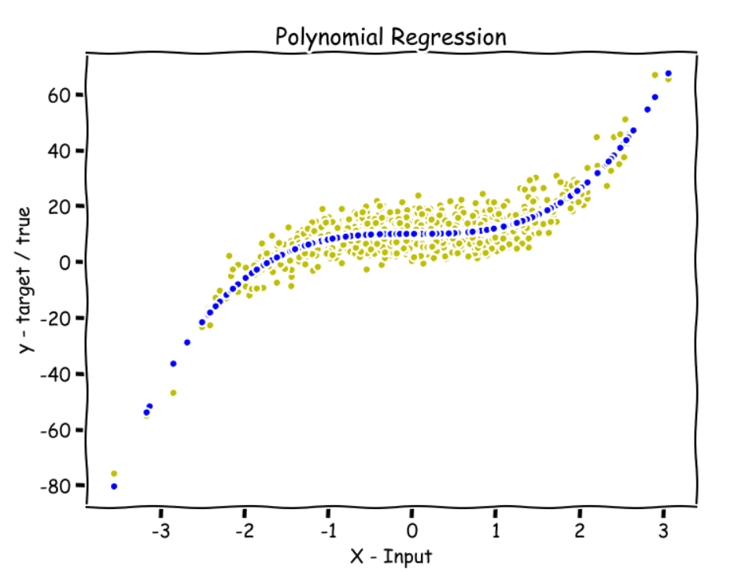
Polynominal Regression
sometimes, when linear regression is too simple and can not represent the data , we have to use non-linear regression, which are Polynomial regression.
The straight line in Linear Regression cannot handle
Things start to be non - linear
Y = ax^2 + b

Slide 21
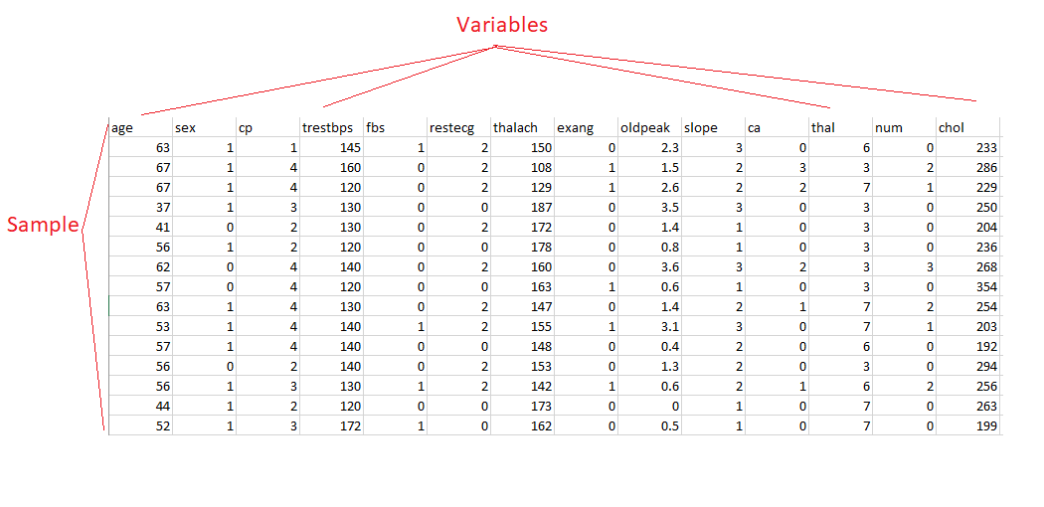
Some Statistics Definitions
Variables and Samples
Data Types
Mean , Mode , Median , Distributions, ....

Slide 22
Tools
Coding Platforms : Google Colabs / Jupyter Notebook / Spyder / ....
Library :
Scikit Learn ( for most machine learning models)
Statsmodels ( for most statistics models
Scipy ( advanced computing library )
Keras , Tensorflow , Pytorch ,...
Warm up : Regression with Python using colab
LINK

