Slide 1
Improving Multi-core Processor Design for Autonomous Vehicles
Julian Bui
STS 402
Computer Science
STS Advisor: Catherine Baritaud
Technical Advisor: Worthy Martin

Slide 2
Agenda
Motivations
Problem
Overview of Concepts
Experiment Walkthrough
Discussion of Results and Recommendations

Slide 3
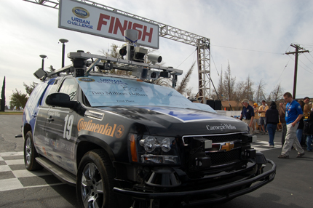
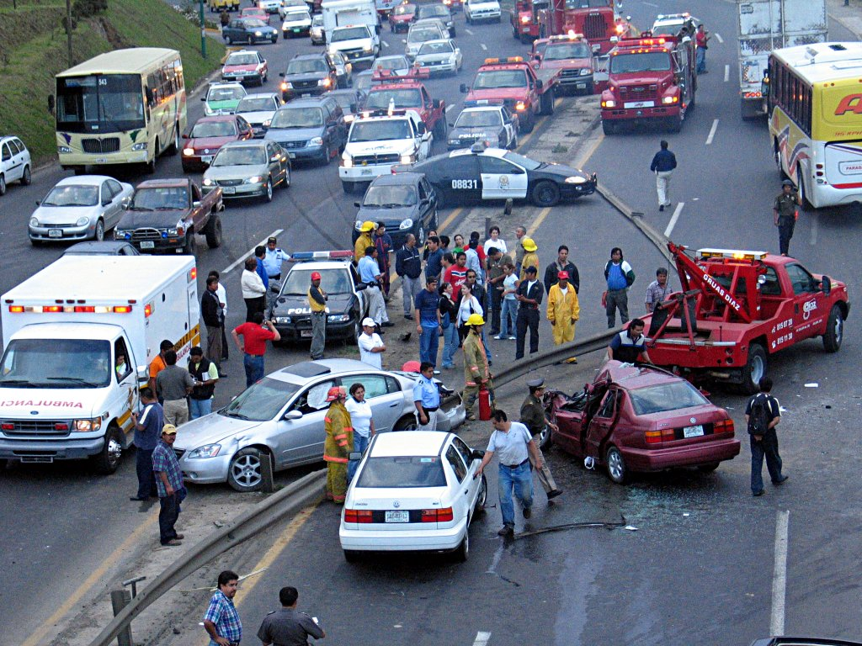
Motivation
DARPA Challenge
Safety
  The elderly, youths,
  the intoxicated
  Unmanned military vehicles
    Social & Ethical Implications

Slide 4
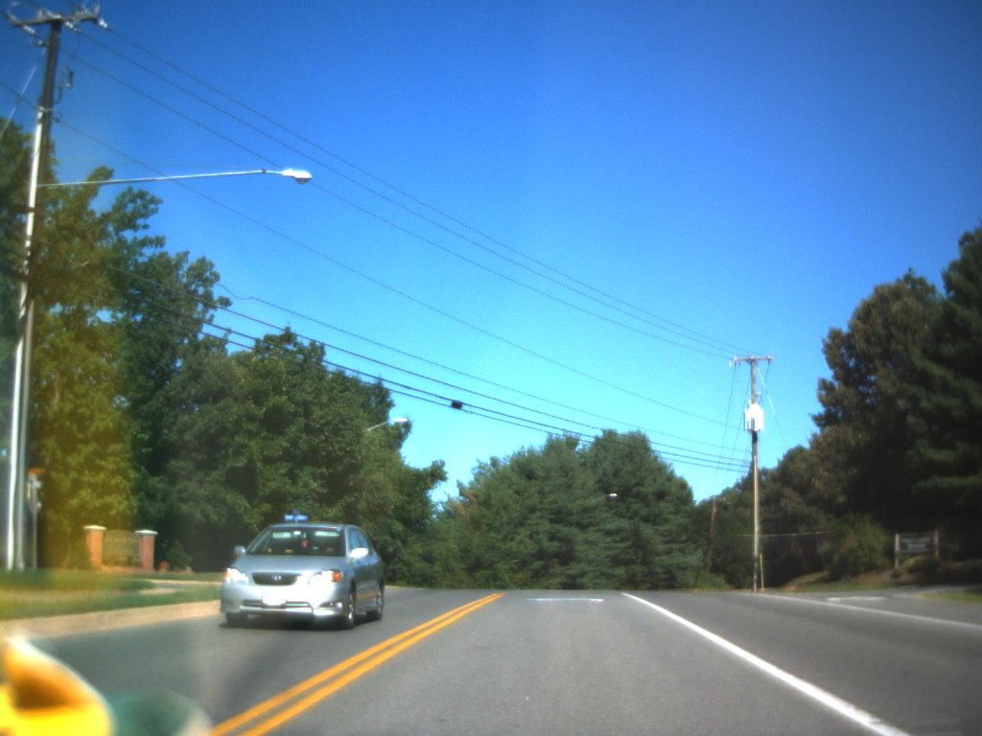
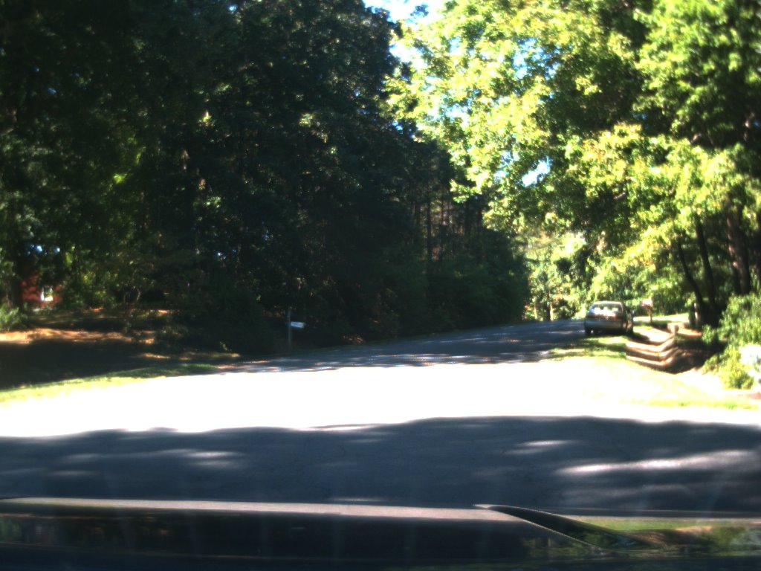
Problem
  Weather, lighting, obstacles, shadows, lack of lane lines, poor contrast
  Computationally expensive!
[Relatively] Easy
Hard

Slide 5
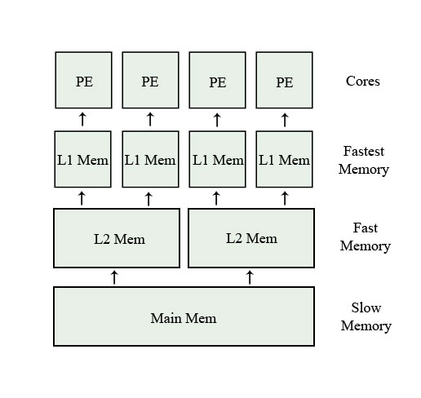

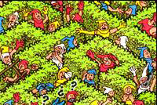


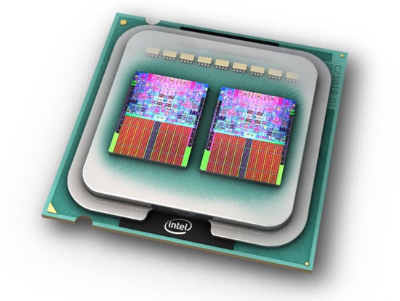
Concepts
1
3
2
4

Slide 6
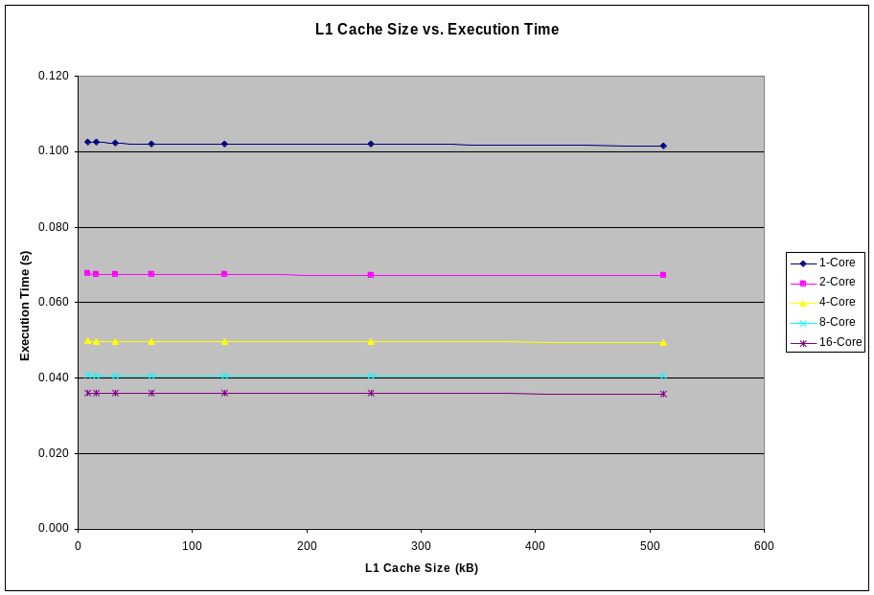
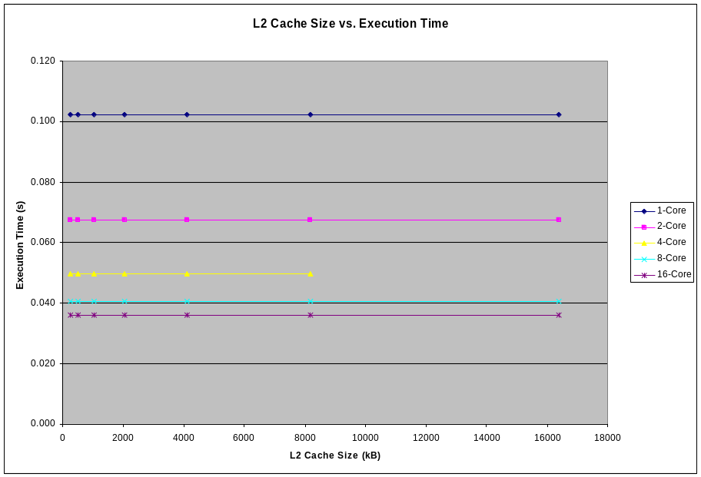
Varying the L1 & L2 Cache Size
Point of Interest: 32kB

Slide 7
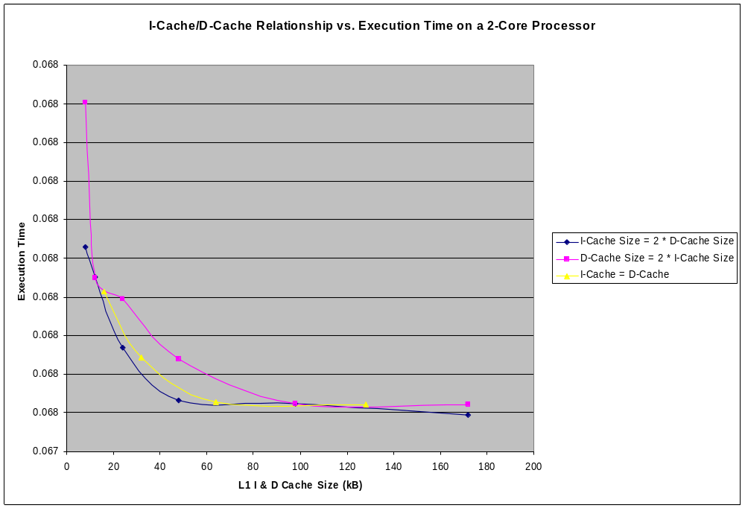
Varying Proportions of L1 Cache

Slide 8
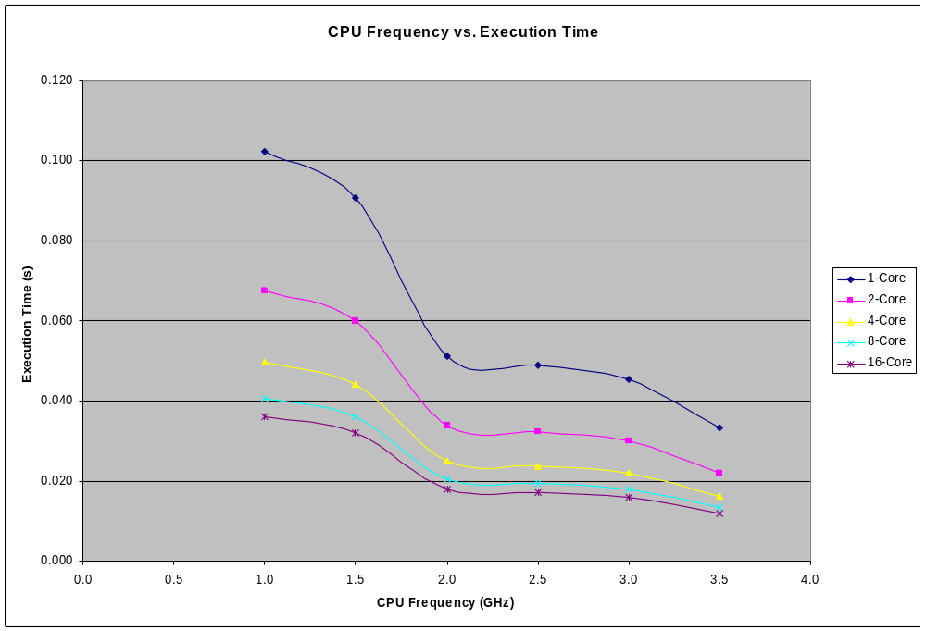
Varying the CPU Clock Speed
Point of Interest: 2.0GHz

Slide 9
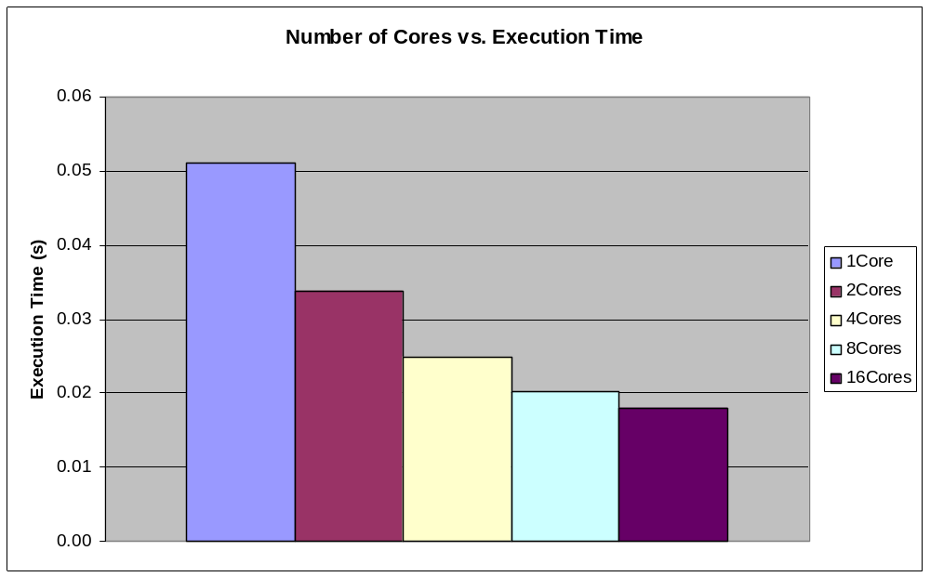
Varying the Number of Processors

Slide 10
Discussion and Recommendations
Single L2 cache banks
Benchmark - higher memory requirements

Slide 11
Conclusion
Efficient configurations
  32kB L1, 256kB L2,
  Instruction-Cache = 2*Data-Cache,
  2.0GHz, 4Cores
Instruction cache > Data Cache
Walls encountered - Frequency, and Number of Processors

