Slide 1
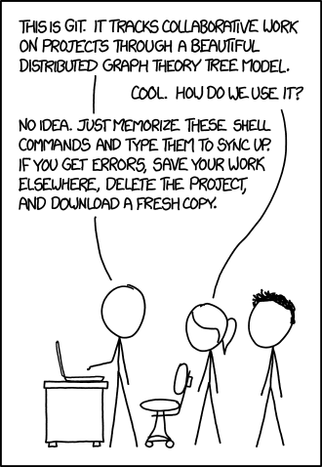

Slide 2
Know your tools: GIT
Beyond the Basics

Slide 3
Why should I learn beyond the basics?
Git is a tool we use daily and for the foreseeable future
We are software engineers, not just coders
In the future you will encounter difficult problems you can’t solve using basic commands
Version control management
Large projects, Branch maintainer
Need to know how to use the tools you work with
Work on remote / server machines without UI

Slide 4
Audience
Everyone who already knows the basics of git (and preferably unix too) and wants to become an intermediate or advanced user.

Slide 5
Agenda: Cover Common Scenarios
I lost my data!
How do I find where a bug was introduced?
Our git history is too messy!
I want to *correctly* push upstream
I just want to apply a single change from another branch!
I want to make things easier!

Slide 6
Goals
Understand how git works:
Content-addressable Filesystem
Git vocabulary
How to specify revisions
Understand the implications of merging, rebasing, and rewriting history

Slide 7
I lost my data!

Slide 8
I lost my data!
Scenario: I lost my data, how do I get it back?
(e.g., delete branch, git reset)
Understand:
Git’s Content-addressable filesystem
Git reflog
Garbage collection

Slide 9
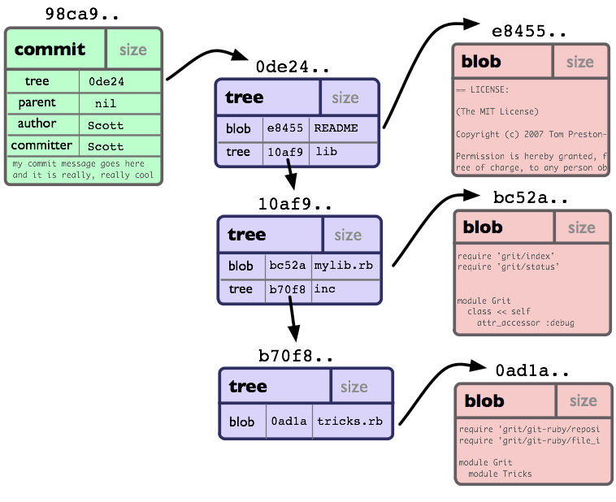
git’s content-addressable filesystem
Key-Value storage
Values addressed by SHA-1
Found in .git/objects
Object Types:
Commits
Trees (Directories)
Blobs (Files)
Tags

Slide 10
git’s content-addressable filesystem
Periodically auto garbage collected (based on # objects).
Manual garbage collection:
git gc --auto
Let’s go explore the filesystem and traverse trees, blobs, and commits
*DEMO*
Notes:
Demo
Explore HEAD
A head can be a branch or an individual commit (vim ./.git/HEAD, replace with ref: refs/heads/master or with an individual commit)
Explore branches
A branch is just a commit! (vim ./.git/ref/heads/<somebranchname>; paste commit)
Create a blob
Echo “helloworld” | Git hash-object --stdin
Vim ./helloworld.txt with “helloworld”
Show hash structure
Remember to show SHA-1 vs. SHA-1 abbr
Show compression
Cat <file>
Git cat-file -p <file>
Explore commit -> tree -> trees & blobs
Navigation
What’s in a commit, what’s in a tree, what’s in a blob?
Git cat-file
Cat <object>
See what happens when file is committed
watch -n 1 tree -a
Be sure to show a propagating SHA-1 change
Show that files that didn’t change keep the same SHA-1
Explore master vs. master^1
Git cat-file -p HEAD^{tree}
Git cat-file -p HEAD~^{tree}
Just need to show how quickly it can determine what’s changed

Slide 11
OK, just tell me how to recover my lost data

Slide 12
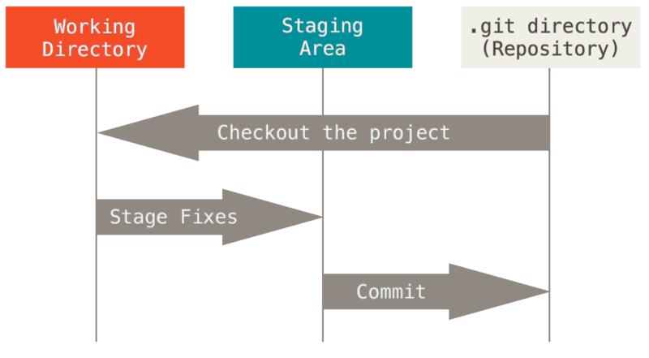
Scenario: Deleted/Lost a commit.
Find the orphan
Find dangling references:
2. Adopt the orphan (point your branch to it)
*DEMO*
Notes:
Commit a new file
Git reset --hard <old commit>
Git reflog expire --expire-unreachable=now --all
Git fsck --full // finds dangling
-------
Create a branch:
git checkout -b recreated b5e14
Try a cherry-pick too
Git cherry-pick b5e14

Slide 13
Scenario: Deleted/Lost a commit.
Find the orphan
Find dangling commit:
git fsck --full
2. Adopt the orphan (point your branch to it)

Slide 14
Scenario: Lost an added change.
Find the orphan
Find dangling references:
2. Adopt the orphan (point your branch to it)
*DEMO*
Notes:
Git add ./newfile
Git reset --hard
Git fsck --lost-found

Slide 15
Scenario: Lost an added change.
Find the orphan
Find dangling references:
git fsck --lost-found
2. Adopt the orphan (point your branch to it)

Slide 16
Scenario: Deleted/Lost a commit - Alternative method
Use the history of the
history
Adopt the orphan (point
your branch to it)
*DEMO*
Notes:
Commit a new file
Git reset --hard <old commit>
Git fsck --full // finds dangling
-------
Git add ./newfile
Git reset --hard
Git fsck --lost-found

Slide 17
Scenario: Deleted/Lost a commit - Alternative method
Use the history of the
history
git reflog
Adopt the orphan (point
your branch to it)

Slide 18
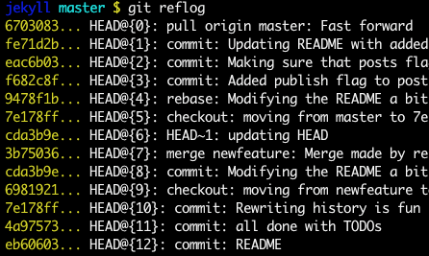
Git reflog
History of your branch’s HEAD (reference to the currently checked out commit)
Note: <refname>@{<n>} is called ORDINAL notation. It is the nth prior entry in the reflog.

Slide 19
Revision Specification
Scenario:
I want to compare my current branch vs. what I was looking at last week.

Slide 20
Revision Specification
Scenario:
I want to compare my current branch vs. what I was looking at last week.
git diff HEAD HEAD@{one.week.ago}
git diff HEAD HEAD@{‘one week ago’}
<refname>@{<date>} specifies what the ref pointed to at that date
Notes:
Weird syntax is due to the shell not taking spaces well during tokenization

Slide 21
How do I find where a bug was introduced?

Slide 22
How do I find where a bug was introduced?
git bisect
Binary search for a commit
Optionally specify the search window (last good, earliest bad)
Requires user input to find the commit at every iteration
*DEMO*

Slide 23
How do I find where a bug was introduced?
git bisect
start
while !found
good / bad
reset

Slide 24
How do I find where a bug was introduced?
git bisect
start
give oldest good/old, give most recent bad/new
while !found
good / bad ← or new/old
reset

Slide 25
Our git history is too messy!

Slide 26






Cleaning up a history
Scenario: many small commits that should be part a main commit, out of order, typos
Why is it bad?
Non-atomic
Reverting is harder
Cherry-picking is harder
Can’t work with consecutive commits
Harder to search for a commit
Non-descriptive

Slide 27
Vocabulary
Squash: Combines multiple commits
Amend: To add, make minor changes to...

Slide 28
Cleaning up a history
Solutions:
git reset --soft
git commit --amend
git merge --squash
Squashing
Moving commits
Deleting commits
Reorder commits

Slide 29
Cleaning up a history
Solutions:
git reset --soft
git commit --amend
git merge --squash
Squashing
Moving commits
Deleting commits
Reorder commits
}
Rebase! DEMO

Slide 30
Cleaning up a history
git rebase
“Forward-port local commits to the updated upstream head” => Apply your commits on top of another branch
Situation: Want to to merge topic’s commits to master
git rebase master topic
OR
git rebase master

Slide 31
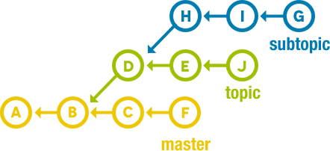
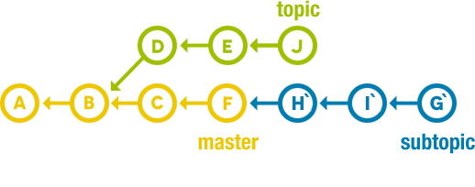
Cleaning up a history
git rebase [--onto <newbase>] [<upstream [<branch>]]
Situation: Let’s rebase subtopic onto master without any of topic’s changes

Slide 32
Cleaning up a history
Rewritten: git rebase [--onto <graft-point>] <exclude-from> <include-from>
Situation: Let’s rebase subtopic onto master without any of topic’s changes

Slide 33
Cleaning up a history
Rewritten: git rebase [--onto <graft-point>] <exclude-from> <include-from>
Command: git rebase --onto master topic subtopic

Slide 34
Cleaning up a history
Don’t revise public history!
Commits are replayed and recommitted from the graft-point.
Commit Date changes => SHA-1 change => Other users’ old objects are invalid

Slide 35
Rebase vs. Merge
I can put my changes onto the upstream branches using git merge, so what’s the difference?

Slide 36
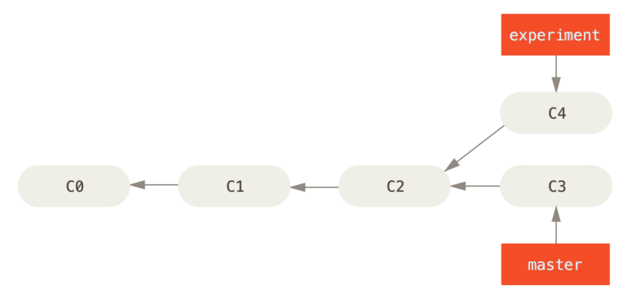
Rebase vs. Merge
Scenario: Experiment branched at C2 and commit C4 was added. C3 was then added to master. How will the changes in Experiment be merged into Master?

Slide 37
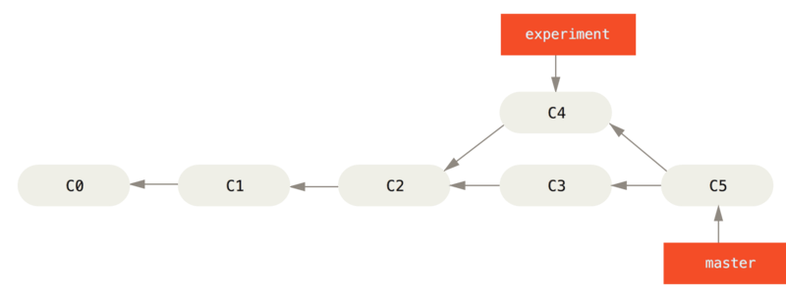
Rebase vs. Merge
Merge: Adds a brand new commit with all the commits from Experiment merged into Master.

Slide 38
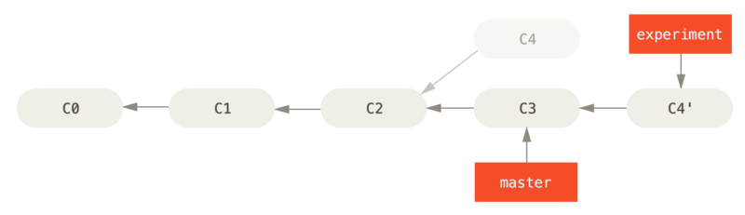
Rebase vs. Merge
Rebase: Apply commits from Experiment to the current tip of the Master branch. In other words, apply commits from Experiment as if they happened today in the Master branch.

Slide 39
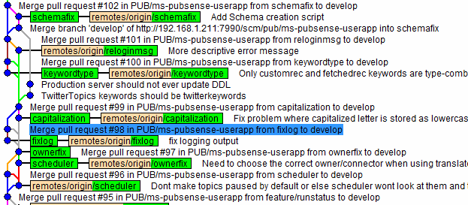
Rebase vs. Merge

Slide 40
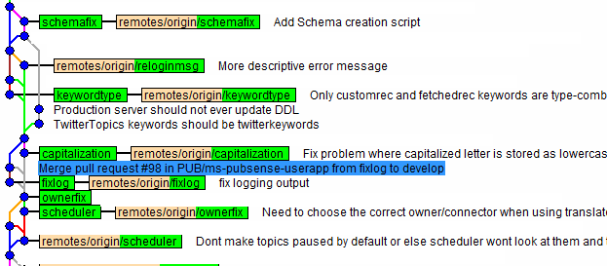
Rebase vs. Merge
FYI: At the command line you can use
git log --no-merges ...

Slide 41
Rebase vs. Merge
Rebase is destructive - it modifies history. Only use it on local or non-public changes.
Cons
Doesn't tell you when upstream features were merged, which could affect your feature
Upstream branch doesn’t know which branch the changes came from
The rebased commits lose their actual commit dates
Rebase modifies the history, so you can lose information. Never rebase public history.

Slide 42
Rebase vs. Merge
Pros
cleaner, linear history that can be traced to project inception
no merge commits polluting the history
other tools can make better use of the linear history
e.g., git bisect

Slide 43
I want to apply a single change from another branch

Slide 44
Applying commits from somewhere else
git cherry-pick <commit>...
Applies commits.
The new commit SHA-1 sums are not the same. Why?

Slide 45
Make Commands a Bit More User Friendly

Slide 46
User Friendly
Interactive Modes
Patch Modes
Notes:
Checkout has -p
Add has -p and -i
Reset has -p

Slide 47
Revision Specifications

Slide 48
Why is Revision Specification Important?
Allow you to express your commands
Allow you to do more with your commands
Allow you to understand the git documentation which uses a lot of different revision specifications
Allow you to do things most GUI tools don’t

Slide 49
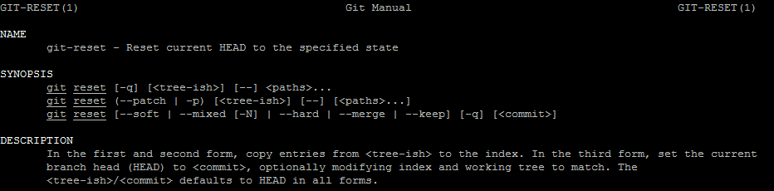
Understand the Documentation
Need to understand the vocabulary to understand the documentation

Slide 50
Understand the Documentation
Tree-ish: Something that will RESOLVE to a tree or blob (a blob is part of the tree)
Commit-ish: Something that resolves to a commit. Commits also resolve to trees, so commit-ish is also tree-ish.

Slide 51
Revision Specification
Scenario:
I want to compare my HEAD against the branch 5 revisions ago. There are too many changes and binary differences. I just want to see the changes of a particular directory.

Slide 52
Revision Specification
Scenario:
I want to compare my HEAD against the branch 5 revisions ago. There are too many changes and binary differences. I just want to see the changes of a particular directory.
git diff HEAD:./scripts/ HEAD~5:./scripts/
Tilde (~) specifies nth generation ancestor

Slide 53
Revision Specification
Scenario: I want to add something to the commit I just made (AMEND).

Slide 54
Revision Specification
Scenario: I want to add something to the commit I just made (AMEND).
git reset --soft HEAD~
git reset --soft HEAD~1 //equivalent
Default: --mixed : puts changes in working tree
--soft : puts changes in the index (staging area)

Slide 55
Revision Specification
Scenario:
I want to compare the resulting merge with the branch it came from.

Slide 56
Revision Specification
Scenario:
I want to compare the resulting merge with the branch it came from.
git diff HEAD HEAD^2
Caret (^) specifies nth parent

Slide 57
Revision Specification
git rev-parse <revision specification>
Resolves your revision specification to a SHA-1 sum (commit, tree, blob, tag)

Slide 58
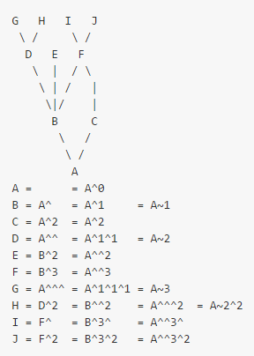
Revision Specification
Tilde (~) and Caret (^)

Slide 59
Revision Specification
Scenario:
I want to compare my current branch vs. what I was looking at last week.

Slide 60
Revision Specification
Scenario:
I want to compare my current branch vs. what I was looking at last week.
git diff HEAD HEAD@{one.week.ago}
git diff HEAD HEAD@{‘one week ago’}
<refname>@{<date>} specifies what the ref pointed to at that date
Notes:
Shell requires us to deal with spacing in the datetime specifier

Slide 61
Revision Specification
Scenario:
I want to see the most recent commit with “featurex” in the commit description

Slide 62
Revision Specification
Scenario:
I want to see the most recent commit with “featurex” in the commit description
git show HEAD^{/featurex}
git show :/featurex
<rev>^{/<regex>} and :/<regex> - these two specifiers use match a regular expression

Slide 63

Revision Specification
Double dot (..)
Resolve a range of commits that are reachable from one commit but aren't reachable from another.
git log master..experiment => C, D
git log experiment..master => E, F
By the way - how do I find the common ancestor (B) ? git merge-base

Slide 64
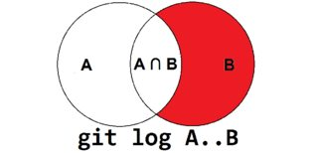
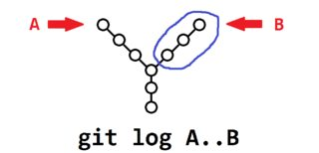
Revision Specification
Double dot (..)

Slide 65
Revision Specification
Triple dot (...)
Specifies all the commits that are reachable by either of two references but not by both of them
git log master...experiment = E, F, C, D

Slide 66
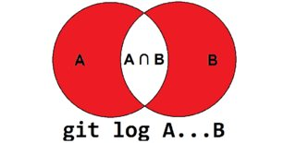
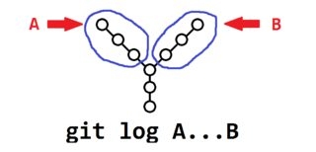
Revision Specification
Triple dot (...)

Slide 67
Questions?
Thanks for listening. If you enjoyed this talk and would like me to continue covering git topics please let me know.
I am still interested in:
git grep’s features
Branch maintenance, workflows
Plumbing commands
Merge strategies
Rerere
Octopus?
All the diff formats

