Slide 1
University of science and technology of Hanoi
DEPARTMENT OF INFORMATION COMMUNICATION AND TECHNOLOGY
Natural Language Processing
Customer Review Understanding for E-commerce Platforms
using Sentiment and Issue Extraction
Team 17

Slide 2
Team Members
Le Duc An – 22BA13002
Bui The Anh – 22BA13007
Do Gia Bao – 22BA13042
Tran Hien Chuong – 22BA13056
Nguyen Nhu Tien Tuan – 22BA13314
Pham Quang Tung – 22BA13320

Slide 3
Table content
Introduction
Project Scope and Main Contributions
Data and Label Strategy
NLP Pipeline
Experiment Protocol and Complexity
Evaluation and Discussion
Stage 1 Sentiment Results
Stage 2 Issue Extraction Results
Practical Deployment Notes
Threats to Validity
Conclusion

Slide 4
I. Introduction
Problem: Understand Amazon Gift Card reviews with NLP
- Goal: negative-first sentiment triage and issue tagging.
- Business risk: missing negative reviews harms support quality.
- Two main tasks: sentiment classification + multi-label issues.

Slide 5
II. Project Scope and Main Contribution
1. Context-aware classic NLP pipeline (TF-IDF + Chi-square + Logistic Regression).
2. Uncertainty control for safer triage decisions.
3. Multi-label issue extraction with 9 labels.
4. Optional transformer extension for deep contextual analysis.

Slide 6
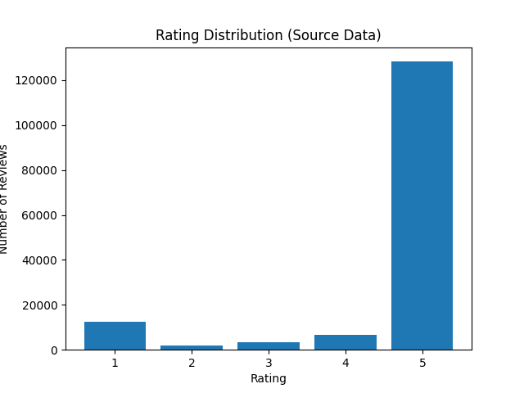
III. Data and Label Strategy
1. Dataset Overview
152,410 reviews
- Strong imbalance (Positive about 9.5x Negative).
- Token stats: mean=15.88, median=8, P90=37.
- Low ratings are much longer than 5-star reviews.
2. Stage 1 – Data Split
Strong labels only (1,2,4,5):
- 70% Train / 10% Validation / 20% Test.
- Stratified split, Seed = 42.
3. Stage 2 – Label Design
19,000 labeled reviews
- 9 issue labels (multi-label).
- Average 1.069 labels/review; other about 84.0%.

Slide 7
IV. System Pipeline
- Stage 1: Clean text -> TF-IDF variants -> Chi-square -> Logistic Regression.
- Select by Recall_0 -> F2_0 -> Precision_0, then tune uncertainty thresholds.
- Stage 2: OVR multi-label models + per-label thresholds.
- Optional transformer module for semantic hard-case analysis.

Slide 8
V. Experiments Protocol and Complexity
- Protocol: fixed seed 42, train/val/test split, train-only fit for TF-IDF + Chi-square.
- Metrics: Recall_0, F2_0, selective coverage, micro-F1, macro-F1.
- Complexity: sparse TF-IDF and Chi-square are near-linear in non-zero terms.
- Running time: fast classic models, suitable for iterative classroom experiments.

Slide 9
VI. Evaluation and Discussion
- Stage 1 best model V6: Precision_0=0.677, Recall_0=0.932, F2_0=0.867.
- Stage 2 (word LR) test: micro-F1=0.765, macro-F1=0.381.
- Stage 2 (word+char LR) test: micro-F1=0.763, macro-F1=0.408.
- Rare labels remain the main challenge in practical routing.

Slide 10
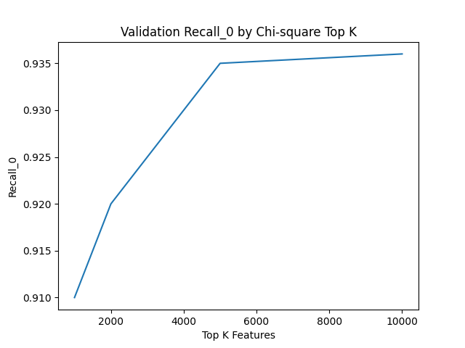
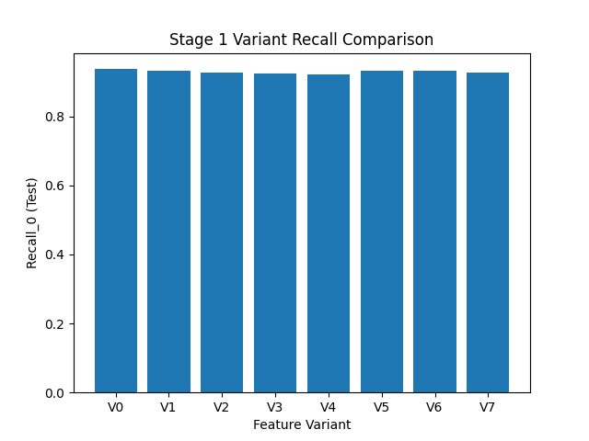
VII. Stage 1 Detailed Results
1. Baseline Chi-square Sweep
Baseline V0 with K values of 1,000, 2,000, 5,000, and 10,000.
Clear gains from larger K and context-aware variants.
Supports negative-first sentiment triage.
2. Stage 1 – Final Model (V6)
- Word 1-2 + Char 3-5 + Negation
K = 10,000 features
Class weight = w10
Test Recall_0 = 0.932
Test F2_0 = 0.867

Slide 11
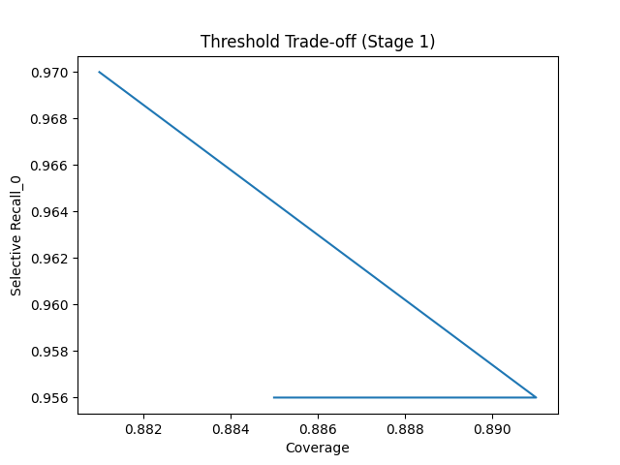
VII. Stage 1 Detailed Results
3. Why Not Random Forest?
Tree models show lower negative recall.
- Random Forest Recall_0 around 0.45.
- Logistic Regression remains safer for triage.
4. Uncertainty Control
Probability thresholds (tl, th)
- Deployed default: 0.55 / 0.70.
- Selective Recall_0 can reach about 0.97.
- Fallback for short/sparse text.

Slide 12
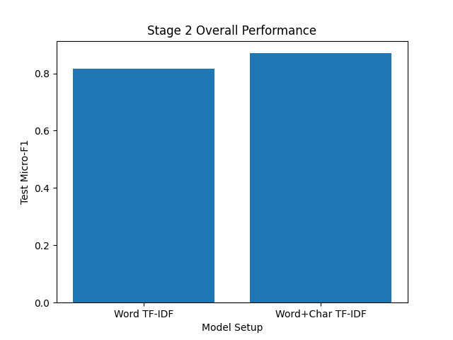
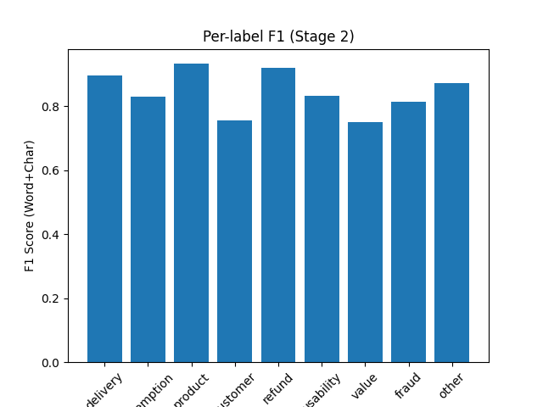
VIII. Stage 2 Detailed Results
1. Overall Performance (19,000 labels)
- Word LR + Chi-square K=10,000.
- Validation micro/macro F1 = 0.759 / 0.387.
- Test micro/macro F1 = 0.765 / 0.381.
- Word+char test micro/macro F1 = 0.763 / 0.408.
2. Per-label Discussion
- Strong labels: other F1~0.911, delivery_shipping F1~0.475.
- Char features help refund_return (0.145 -> 0.333).
- Char features help fraud_scam (0.265 -> 0.388).
- Some labels remain unstable due to low support and overlap.

Slide 13
IX. Practical Use and Deployment Notes
Saved artifacts: vectorizer, selector, model, thresholds.
- Stage 1 runs first for sentiment triage.
- Stage 2 runs on negative/attention reviews.
- Optional transformer extension for deep semantic checks.
- Graceful fallback is supported.

Slide 14
X. Threats to Validity
- Strong class imbalance in sentiment and issue labels.
- Label imbalance remains high (other about 84%).
- Annotation overlap exists (498 rows with other + another label).
- Single-domain data may limit cross-domain generalization.

Slide 15
XI. Conclusion
Two-stage practical NLP system
- Negative-first sentiment aligns with support objectives.
- Multi-label issue extraction adds actionable routing signals.
- Reproducible artifacts and clear thresholds support deployment.

Slide 16
Thank you
Natural Language Processing Project

