Slide 1
University of science and technology of Hanoi
DEPARTMENT OF INFORMATION COMMUNICATION AND TECHNOLOGY
Natural Language Processing
Sentiment Analysis and Multi-label Issue Extraction for E-commerce Reviews
Team SkyDom+

Slide 2
Group Member
Le Duc An – 22BA13002
Bui The Anh – 22BA13007
Do Gia Bao – 22BA13042
Tran Hien Chuong – 22BA13056
Nguyen Nhu Tien Tuan – 22BA13314
Pham Quang Tung – 22BA13320
Khuong Bao Duc – 22BA13077

Slide 3
Table of Contents
Introduction and NLP Problem Definition
Data and Label Strategy
Text Processing and Feature Engineering
Modeling and Baselines (Classic + Transformer)
Experimental Protocol
Results: Sentiment
Results: Issue Extraction
Error Analysis and Thresholding
Course Alignment and Rubric Fit
Demo and Deployment
Conclusion

Slide 4
I. Introduction
Problem: Understand Amazon Gift Card reviews for support triage
- Task A: Sentiment classification (Negative/Positive/Uncertain).
- Task B: Issue extraction (9-label multi-label).
- Policy: negative-first (missing negative is high-cost).
- NLP focus: noisy short text, negation, contrast, abbreviation.

Slide 5
II. Project Scope and Main Contribution
1. Reproducible NLP pipeline: cleaning + negation + TF-IDF + Chi-square.
2. Strong classic baseline (V6) with uncertainty control.
3. Multi-label issue models (OVR LR/SVM/Blend + dummy sanity baselines).
4. Transformer sentiment extension + fair-split issue comparison.
5. Syllabus-aligned baseline suite (NB, Perceptron, SVM, FFNN, RNN, Transformer, MLM).

Slide 6
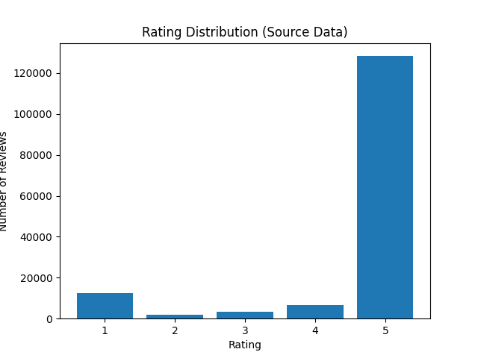
III. Data and Label Strategy
1. Dataset Overview
152,410 reviews
- Strong-label sentiment rows: 149,139
- Positive: 134,940 | Negative: 14,199 (approx 9.5:1)
- Short/noisy text: abbreviations, negation, mixed polarity
2. Stage 1 - Sentiment Split
Strong labels only (1,2,4,5):
- 70% Train / 10% Validation / 20% Test
- 3-star held for uncertainty analysis
- Stratified split, seed = 42
3. Stage 2 - Issue Labels
19,000 annotated reviews
- 9 issue labels (multi-label)
- Split: 13,300 / 1,900 / 3,800
- Label cardinality approx 1.07; other dominates (~84%)

Slide 7
IV. System Pipeline
- Stage 1 (Sentiment): clean text -> TF-IDF variants -> Chi-square -> Logistic Regression
- Variant search V0..V7 (word/char/negation/clause features)
- Selection policy: Recall_0 -> F2_0 -> Precision_0
- Uncertainty band for abstention (coverage vs risk)
- Stage 2 (Issue): OVR LR/SVM/Blend + per-label thresholds

Slide 8
V. Experimental Protocol and Complexity
- Fixed seed 42; train-only fit for vectorizer/selector; held-out val/test
- Metrics: Accuracy, Precision_0, Recall_0, F2_0, micro/macro-F1, hamming loss
- Fair comparison added for issue: classic vs hybrid vs transformer
- Quality gate: pytest 17 passed, 1 skipped
- Runtime note: full transformer fine-tune ~55 minutes on CPU

Slide 9
VI. Evaluation and Discussion
- Best classic sentiment (V6): Precision_0=0.678, Recall_0=0.932, F2_0=0.867
- Transformer sentiment (latest test): Accuracy=0.966, Precision_0=0.799, Recall_0=0.853, F2_0=0.842
- Issue (test 3,800): LR micro/macro=0.780/0.387; SVM=0.771/0.405
- Dummy issue baseline: micro 0.809 but macro 0.101 (fails minority labels)

Slide 10
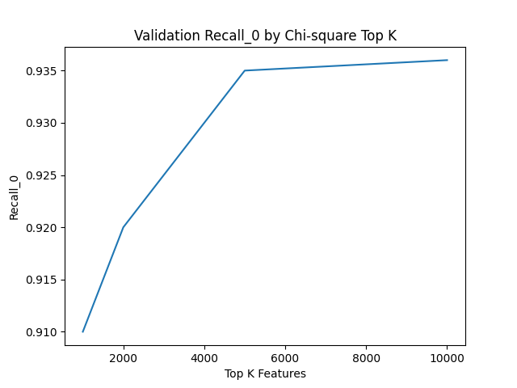
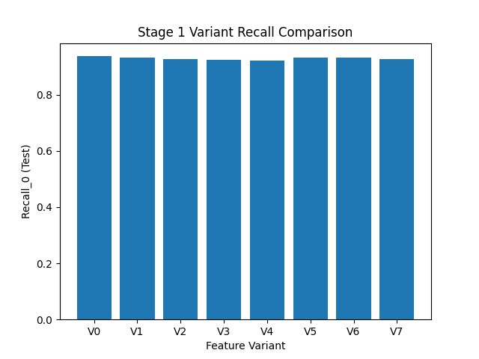
VII. Stage 1 Detailed Results
2. Chi-square and Variant Search
K=10,000 gives strongest negative-first trade-off.
Top variants by F2_0:
- V6: 0.867
- V5: 0.860
- V7: 0.859
1. Final Classic NLP Model (V6)
- Word 1-2 + Char 3-5 + Negation
- K = 10,000 features
- Class weight = w10
- Test Recall_0 = 0.932
- Test F2_0 = 0.867

Slide 11
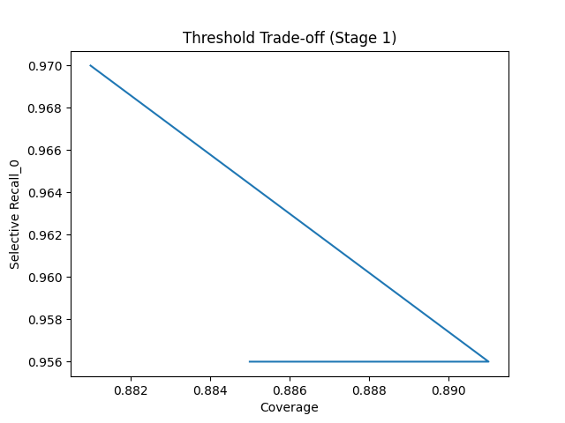
VII. Stage 1 Detailed Results
4. Why Not Tree Ensembles?
Random Forest baseline:
- Precision_0 is high (~0.903)
- Recall_0 is low (~0.486)
=> misses many negative reviews; risky for triage
3. Uncertainty Control
Threshold band (0.40 / 0.60):
- Coverage = 0.886
- Selective Recall_0 = 0.954
- Selective F2_0 = 0.899
- Fallback for too-short / sparse text

Slide 12
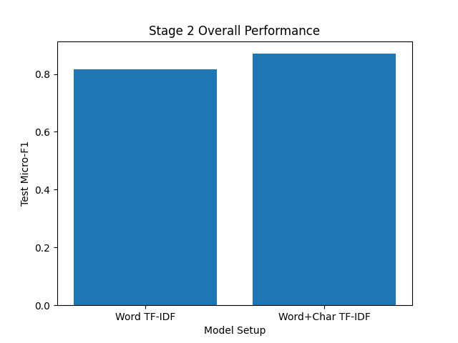
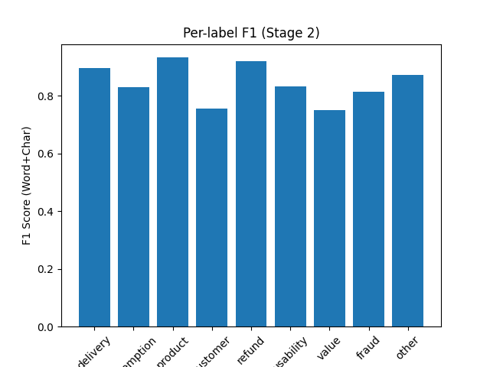
VIII. Stage 2 Detailed Results
1. Overall Performance (Issue Extraction)
- OVR Logistic: micro=0.780, macro=0.387, subset=0.634
- OVR LinearSVM: micro=0.771, macro=0.405
- OVR Blend LR+SVM: micro=0.768, macro=0.391
- Main gap: minority labels remain weak (macro < 0.41)
2. Fair-Split Comparison
- classic_issue_model: micro=0.792, macro=0.528
- hybrid_route: micro=0.730, macro=0.338
- transformer_multilabel: micro=0.646, macro=0.188
=> classic remains strongest on current data

Slide 13
IX. Practical Use and Deployment Notes
Saved artifacts: vectorizer, selector, models, thresholds, run metadata
- CLI + UI demos ready; deterministic commands in README
- Auto-generated scoreboard and rubric/syllabus assessment
- Current rubric estimate: 18.04/20 (90.2%), syllabus fit: 94.3%

Slide 14
X. Threats to Validity
- Strong class imbalance in sentiment
- Severe label imbalance in issue (other ~84%)
- Label overlap exists (498 rows with other + another label)
- Single product domain limits generalization
- Transformer issue model underperforms on current split

Slide 15
XI. Conclusion
NLP pipeline is reproducible and deployment-ready
- Classic model is best for negative-first sentiment triage
- Transformer adds context strength but is not full replacement yet
- Priority next step: improve issue macro-F1 via minority-label quality

Slide 16
Thank you

