Slide 1

Exercise #1: Heart Disease Prediction
Problem: Predict heart disease base on health care dataset from a study of heart disease of UCI Machine Learning Center.
Solution: Apply Machine Learning to predict

Slide 2
Team Introduction
1. Manoj Moond: Data understanding
2.Gurpreet Singh Virdi: Preprocessing
3. Roshan Kuriakose Angelo: Feature Engineering
4. Chiranjeev Singh: Data Modeling
5. The Cuong, Bui: Model Performance

Slide 3
Outlines
Introduction: Heart Diseases, Machine Learning, Language and Tools
Process of Building Machine Learning Model to predict Heart Diseases
  Understanding and Process Heart Diseases Data
  Feature Engineering
  Data Modeling
  Model Performance and Improvement

Slide 4
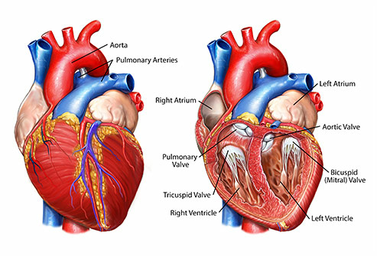
Introduction
Heart diseases cause the serious causes of high death
Big Data and Data Science plays pivotal roles in different edges of the world include Health Care.
Apply Machine Learning to detect Health Care is promisingly helping doctors and hospital to save life of a lots of patients

Slide 5
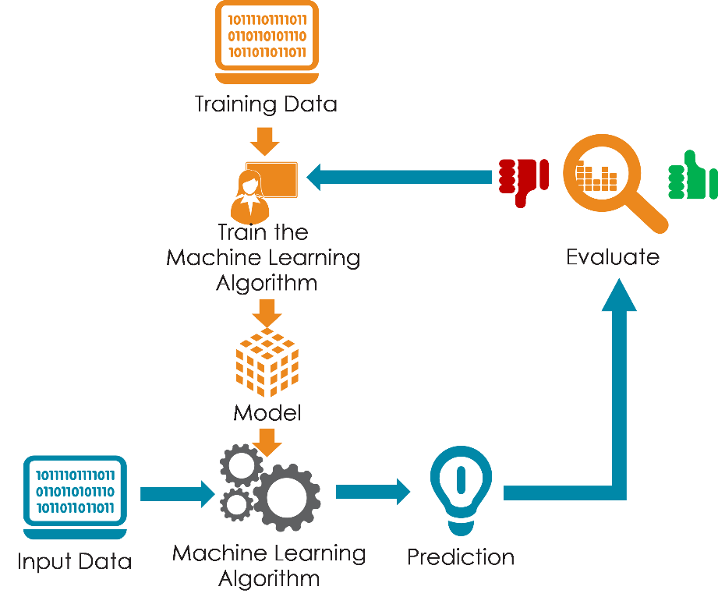
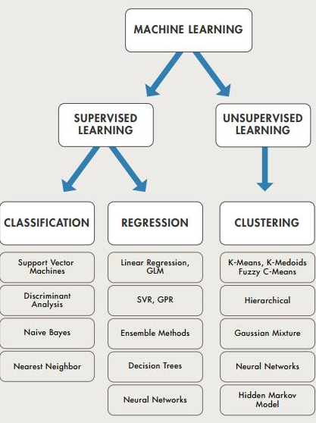
Machine Learning
Arthurl Samuel (1959) : Machine learning is the field of study that gives computers the ability to learn without being explicitly programmed.

Slide 6



Programming Language and Tools
Programming Language:
Among Python, R and other programming languages, group decided to use Python for our exercise as it can help us learn practical language for our future work.
Jupiter: A popular interface for Machine Learning. Using notebook format with input cells contains code and output cells contains the results of code.
Advantage:
It can iterative code quickly, instantly visualizing the result of modification.
Pandas: Is the reference module to efficiently manipulate millions rows of data in Python
Scikit learn: Is one of the reference modules for Machine Learning in Python
These are more convenient modules for data computerization and data visualization
Numpy and SciPy and Matplotlib:.

Slide 7
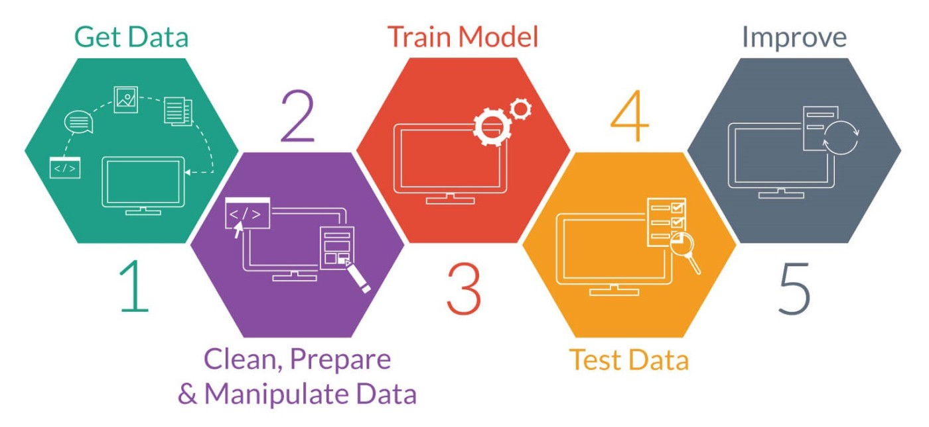
Process of Building Machine Learning Model to predict Heart Diseases

Slide 8
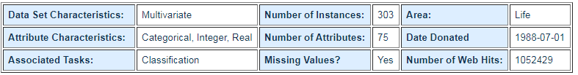
Heart Disease Data Preparation
Processed Cleveland Data (UCI)

Slide 9
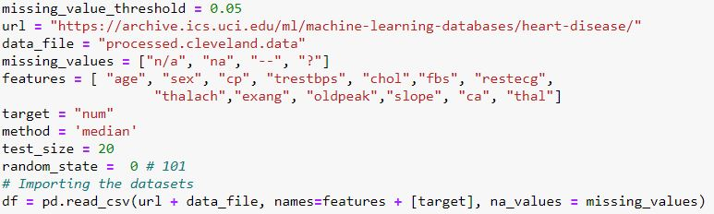
Stage 1
Data Preparation
It is an act of handling pre-processed data into a form of readily and accurately analysed.
A) Query your data:
This is the first phase of data preparation out of three. It includes the import of processed file which is “processed.Cleveland.data”.

Slide 10
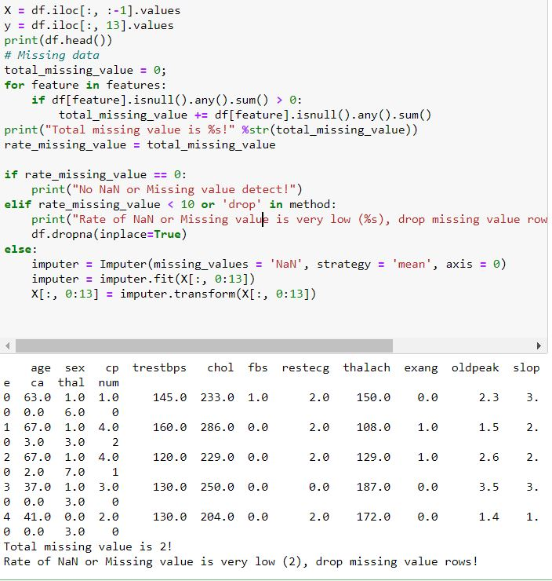
B) Clean Data:
Some of the columns has missing values, however there are methods to deal with the missing values. For this assignment we have used the method called mean. After running the code the 2 of the rows values <10 and were dropped. The values with NaN is replaced with the mean value.

Slide 11
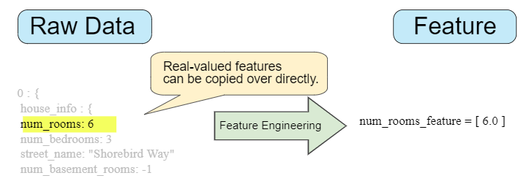
FEATURE ENGINEERING
1.How do you turn the raw data into meaningful data?
2. How is the data relevant in our machine learning algorithm?
3. How can you distinguish between useful and useless data from the given dataset?
A measurable trait or characteristic of a dataset is called as feature
It includes the process of creating features from raw data.

Slide 12
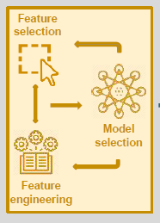


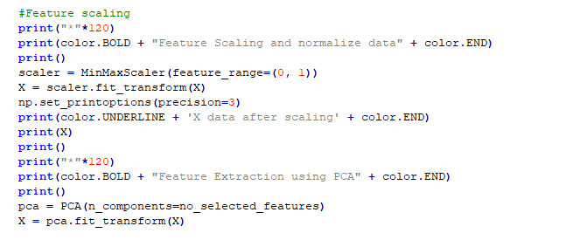
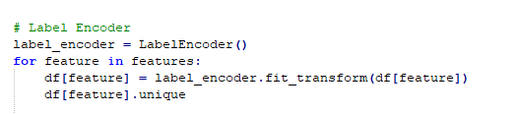
Feature Engineering Techniques
Feature construction
Feature Transformation: Scaling
Dimension Reduction : feature selection, feature extraction, feature transformation

Slide 13

Machine Learning Algorithm & Model
  The type of supervised learning that we have focussed on is the Linear Regression, which defines the dependency of the output variable ‘ y’ on the independent variables ‘ x’ in the form:
  y = a.x1 + b.x2 + c.x3 + .. + z

Slide 14
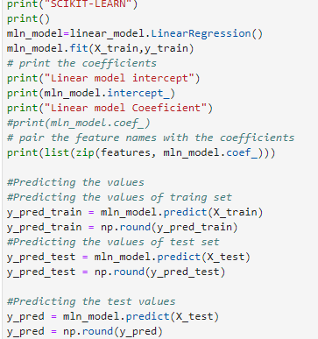
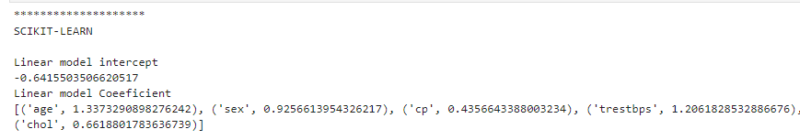
Explanation
Linear Equation
Formation

Slide 15
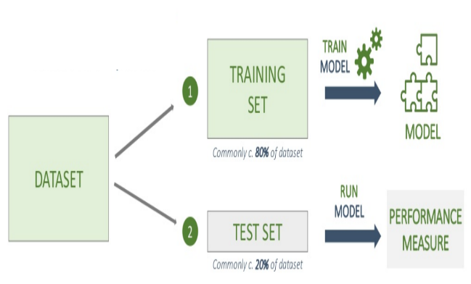
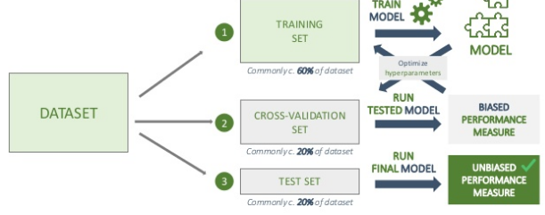
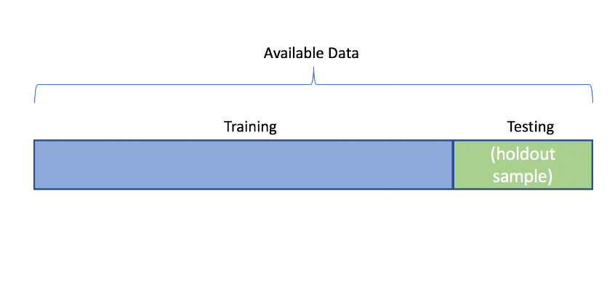
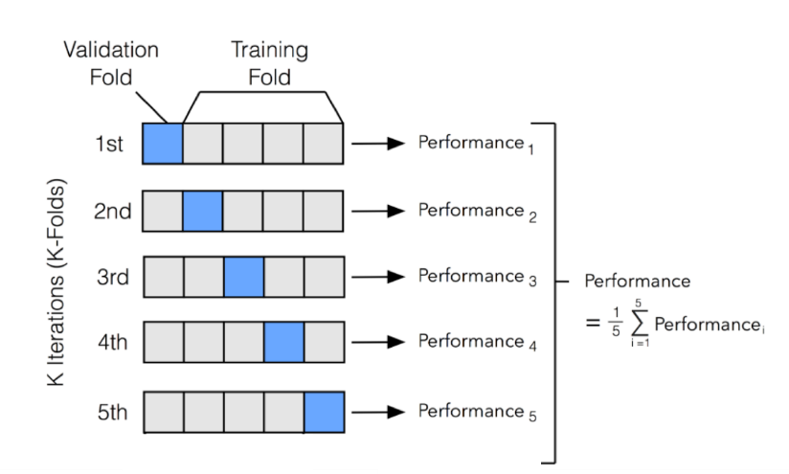
Model Performance and Improvement
Predict the heart disease label from the training model to predict the label (heart disease) from test and sometimes training input include methods such split train and test, Cross-validation
Train model and test model

Slide 16
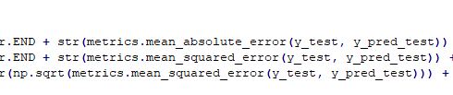
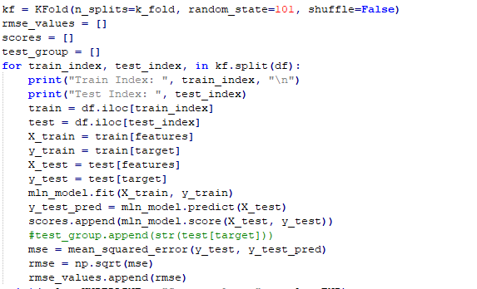


Performance Metrics
Score
Accuracy
Mean Absolute Error
Root Mean squared Error (RMSE)

Slide 17
Conclusion
Linear Regression predict with pretty good performance and good RMSE
For Linear Regression RMSE is used better than accuracy

Slide 18


Slide 19
Reference
https://www.slideshare.net/CharlesVestur/building-a-performing-machine-learning-model-from-a-to-z
https://www.ritchieng.com/machine-learning-evaluate-linear-regression-model/
https://towardsdatascience.com/
http://machinelearningmastery.com

