Slide 1
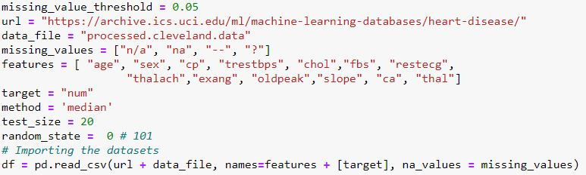
Stage 1 Data Preparation It is an act of handling pre-processed data into a form of readily and accurately analysed.
A) Query your data:
This is the first phase of data preparation out of three. It includes the import of processed file which is “processed.Cleveland.data”.

Slide 2
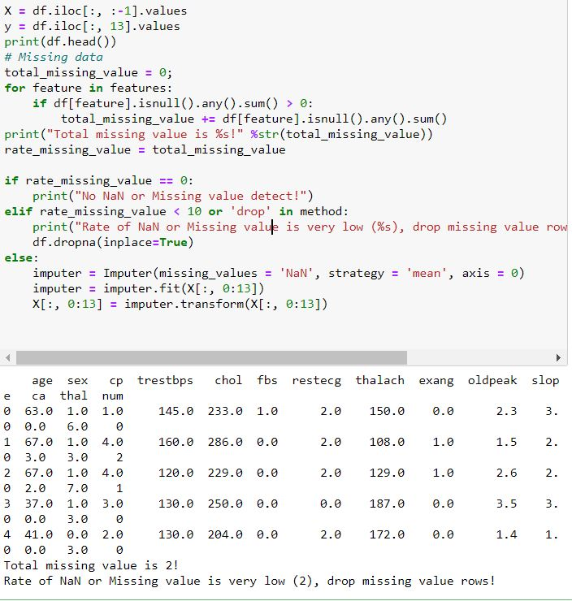
B) Clean Data: Some of the columns has missing values, however there are methods to deal with the missing values. For this assignment we have used the method called mean. After running the code the 2 of the rows values <10 and were dropped. The values with NaN is replaced with the mean value.

Slide 3
Machine Learning Model
A Machine Learning Model can be defined as a Mathematical Equation/Representation that can predict the output dependent variable ‘y’ when made to learn by providing training data having ‘x’ as independent variables.
We have used two machine learning algorithms in our project in order to completely understand and implement the required logic and working of an Machine Learning Model
Note: The model that predicts the result accurately will be considered optimum otherwise we can always make changes to the model to make it the best. Making the process of machine learning iterative in nature.

Slide 4
Learning Approach
We are using the Supervised Learning Approach as we already know the Output values(ie values of the num column contain 0,1,2,3,4) but having these values in different frequencies made us choose the regression approach.
The values are predicted over a continuous range and then are categorised under the nearest value for the required output.

Slide 5
Algorithm Used
The type of supervised learning that we have focussed on is the Linear Regression, which defines the dependency of the output variable ‘ y’ on the independent variables ‘ x’ in the form:
y = a.x1 + b.x2 + c.x3 + .. + z
where (a,b,c) represent the coefficients of the particular variables present in the dataset and (z) represents the intercept or the random error (noise) present in the data.
SCIKIT-LEARN algorithm is used to automate the implementation of the machine learning algorithm.
In this approach the algorithm based on our prior parameters carry out the prediction process and provides us with the required output.

Slide 6
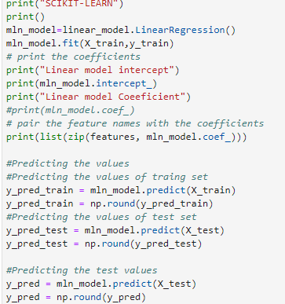
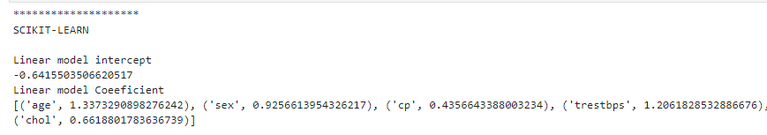
Explanation
Linear Equation
Formation

