Slide 1
CS-695 final project Dual-Robot Path Planning with geometries through narrow passages with Max Entropy IRL
Hoang-Dung Bui
Notes:
<number>

Slide 2
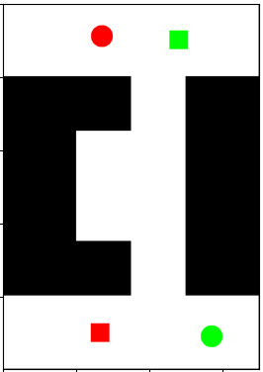
We aim to develop a path planner to plan collision-free paths for dual agents going through a narrow passage.
Challenges:
Obstacles with narrow passages
Two agents cannot go through at the same time
A practical path planner must be able to coordinate two agents, and one must be sacrified its own short-term reward to achieve the long term returns for both agents.
Hoang-Dung Bui - GMU
<number>
Notes:
We aim to develop a motion planner to plan collision-free dynamically feasible trajectories in partially-mapped environment. This is made challenging by the presence of obstacles and vehicle dynamics which requires that the robot plan trajectories that can be executed in physical robot and avoid collision. The challenge compound when the map is not known in advance. Therefore a practical motion planner must be able to plan and replan quickly based on the new information gathered by robot's sensor.
<number>

Slide 3
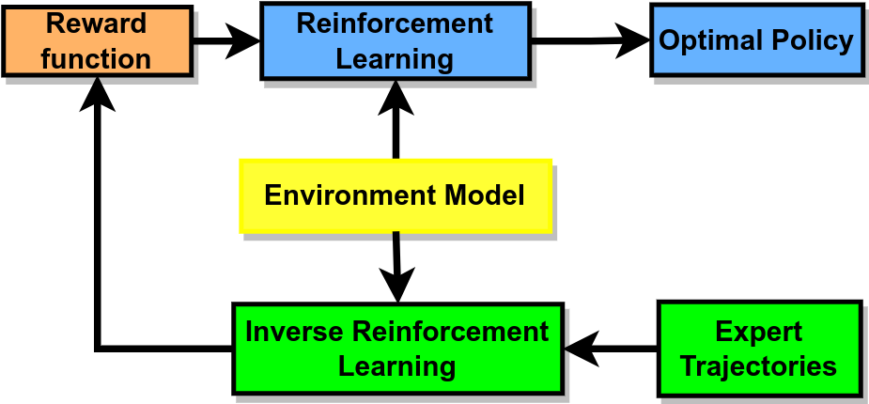
We would like to develop a RL and IRL framework to solve the problem
IRL = Maximum Entropy Deep IRL
RL = PPO algorithm
Expert Paths from a RRT-based planner
Reward function can handle a quadratic term
Hoang-Dung Bui - GMU
<number>
Notes:
Prior work for motion planning focused on fully-known environments. And to account for the robot's dynamics, sampling-based MP has often been used due to it's computational efficiency. However, these algorithms when deployed in unknown environments, has slow re-planning process and show problematic oscillatory behavior.
<number>

Slide 4
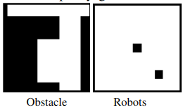
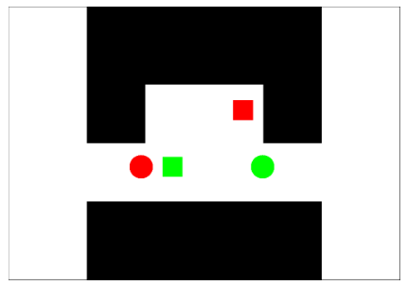
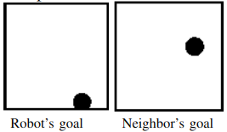
A continuous environment for two agents return four image channels and agent’s orientation to its goal.
Hoang-Dung Bui - GMU
<number>
Notes:
Now, the objective is to compute controls to generate dynamically feasible trajectory to reach the goal while avoiding collisions in unknown environments. For that, we develop a framework that receives as input the robot model R, a sensor model SENSE, an initial state sinit and a goal G. The initial state and the goal are within the world boundaries, which are known to the framework. The obstacles contained in World(W), however, are not known to the framework. So it's with these inputs we compute controls for a dynamically feasible trajectory.
<number>

Slide 5
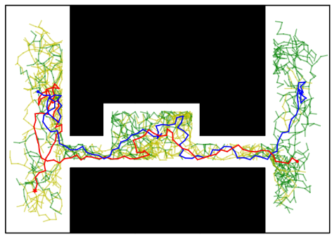
A RRT-based path planner is built for two agents to generate non-collision paths as expert demonstration
To generate the expert paths we feed the paths from the RRT-based planner to environments to get the states along the paths
Hoang-Dung Bui - GMU
<number>
Notes:
Our framework has an execution module (EM) and a planning module (PM).
The execution module carries out the planned trajectory incrementally, while the planning module is responsible for generating collision-free and dynamically-feasible trajectories through the partial map.
The planning module is invoked by the execution module as necessary when new obstacles are detected.
The figures show snapshots of our framework in action. The free areas in World are shown in green, the occupied areas in black, and the unknown space in gray. The robot in dark blue color and head as red is shown at its current state. The planned trajectory from the current state to the goal is shown in magenta. The subdivision of grid, essential for planning module is shown in yellow. More on that later.
<number>

Slide 6
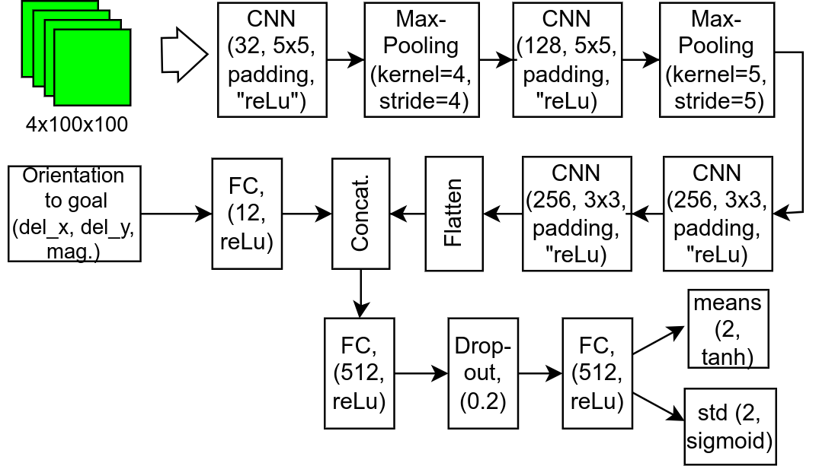
An PPO algorithm to train the policy network
Hoang-Dung Bui - GMU
<number>
Notes:
The inputs to the framework robot model, sensor model, world model & for the world model only the boundaries are known to the framework, obstacles are discovered through sensing
The output of the framework is the executed trajectory - built by invoking the planning module along the way to the goal.
The module starts by marking all the space in the occupancy grid as unknown.
During each iteration, the robot uses its sensor to detect the free and occupied space. The detected space is used to update the world. If there are new occupied cells, the execution module invokes the planning module to plan a new collision-free and dynamically-feasible trajectory from the current state to the goal.
To enhance the planning efficiency, the planning module is provided with the remaining states as input, which it can use to guide the motion-tree expansion to generate a new trajectory towards the goal efficiently.
When the planner completely fails, meaning it cannot generate a trajectory that extends beyond the current state, Planning Module is invoked again.
When the planner succeeds, the execution module progresses to the subsequent state in the planned trajectory.
This process of following the planned trajectory and re-planning when new obstacles are detected is repeated until the robot reaches its goal or exceeds the runtime limit.
Now, my teammate - Bui will continue:
<number>

Slide 7
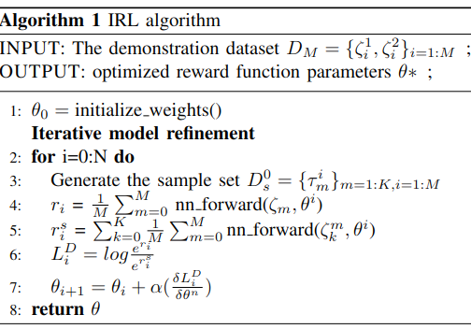
Max. Entropy IRL algorithm with continuous state space: how to calculate the state visited frequencies for all states?
Hoang-Dung Bui - GMU
<number>
Notes:
We propose guided sampling-based motion planner for unknown environments. Our planning framework leverages discrete search over an adaptive grid subdivision and prior solutions to guide the motion-tree exploration, allowing for both
(i) reduced replanning time, and
(ii) greater solution coherence to significantly reduce oscillatory behavior.
In addition, our approach (iii) increases clearance from obstacles to improve robustness, and thereby improves the success rate in reaching the goal despite having only a partial map of the environment.
<number>

Slide 8
Problems hinder the progress ...
- To deploy max entropy IRL, we need state visited frequencies for all the states in state space - partition function – Z(θ). However, the problem becomes intractable in continuous state space.
- Z(θ) can be approximated by generating sample trajectories Ds, then calculate maximum entropy by comparing D and Ds. For our problem, we need to the robot reach its goal. However, the policy is still learning from the reward function, and it cannot assure that the agent can reach its goal.
Hoang-Dung Bui - GMU
<number>
Notes:
To deploy max entropy IRL, we need state visited frequencies for all the states in state space - partition function – Z(θ). For discrete state space, we can develop a policy from the value iteration function, and perform a number of roll-outs, and use that to determine the partition function. However, the problem becomes intractable in continuous state space.
Z(θ) can be approximated by generating sample trajectories and calculate the reward sum along the trajectories. Then the maximum entropy is calculate based on the expert demonstration D and Ds. However, the approach is suitable to autonomous vehicles with safety requirements within a horizon T and no particular target in the movement. For our problem, we need to the robot reach its goal. However, the policy is still learning from the reward function, and it cannot assure that the agent can reach its goal. We need a new approach to solve this problem
<number>

Slide 9
Thank you for Listening!
Q&A
Hoang-Dung Bui - GMU
<number>
Notes:
<number>

