Slide 1
CONFIDENTIAL · SEED INVESTOR OVERVIEW · 2026
Inbound
The KYC-verified commerce layer for every inbound traveler.
60 seconds from passport to full participation in any country's digital economy. Starting with the hardest market.
Seed Round · $2M
Raising with strategic seed investors in deep tech and data infrastructure.
bwang@autobebesys.com

Slide 2
01 · THE PATTERN
Every decade, one company makes cross-border connection trivial.
Inbound is building that company for the 1.5B annual cross-border travelers — currently locked out of the local digital economy they visit.
2011
2015
2026
Zoom
Stripe
Inbound
BEFORE
BEFORE
BEFORE
Conference room hardware, $5k/seat, IT-managed
Merchant account, 90-day approval, legal review
Foreign SIM, VPN, cash, broken wallet setup, 40-minute activation
AFTER
AFTER
AFTER
One URL. One click. Anyone joins.
Seven lines of code. Accept payments globally.
Scan passport. Walk out with a fully-configured device. 60 seconds.
INBOUND
2 / 12

Slide 3
02 · THE PROBLEM
150M foreigners entered China in 2025. Most can't pay for coffee.
The same wall exists in Japan, Thailand, India, Saudi Arabia. China is just the hardest version — the market where software-only solutions have failed most completely. Solve it here, and the template ports.
Why foreigners hit a wall
THE BLOCKED MARKET
No local number
$130B
eSIM doesn't support foreign passports. Every Chinese app requires a local number to register.
Payment apps can't onboard
spent by foreign visitors in China, 2025
WeChat Pay binding fails 60%+ of the time for foreign cards. Alipay Tour Pass caps at $5K/year.
Internet is siloed
$11B
Google, Meta, WhatsApp blocked. VPN is illegal for commercial providers to offer.
via mobile payment — 8.5% capture
No KYC bridge
The other $119B moves through cash, broken card swipes, and skipped purchases.
A foreigner's identity in the US cannot be verified by a Chinese service provider in real-time.
INBOUND
3 / 12

Slide 4
03 · WHY NOT A SOFTWARE-ONLY PLAY
Every pure-software attempt has failed the last mile.
Not for lack of trying. The gaps are structural — identity, SIM issuance, and payment are regulated layers a pure-software product can't traverse.
Approach
What it solves
What it can't solve
Why
International eSIM
Data connectivity
Can't register for any Chinese app; no local number
Regulatory
Alipay Tour Pass
Basic QR payments
$5K/year cap; no WeChat Pay; no local services access
AML / KYC
VPN apps
Home-country internet
Illegal for commercial providers; constantly blocked
Legal
Translation apps
Language friction
Don't solve identity, payment, or access layer
Surface-only
WiFi egg / pocket router
Group data sharing
Doesn't solve any account or payment problem
Wrong layer
Inbound (hardware-anchored)
All of the above + KYC bridge
—
Regulated hardware is the key
The insight: every point solution above stops at a regulated choke-point (SIM, KYC, payment rails, network access). A pre-configured physical device is the smallest possible physical artifact that clears all four choke-points simultaneously. Hardware is the wedge — not the product.
INBOUND
4 / 12

Slide 5
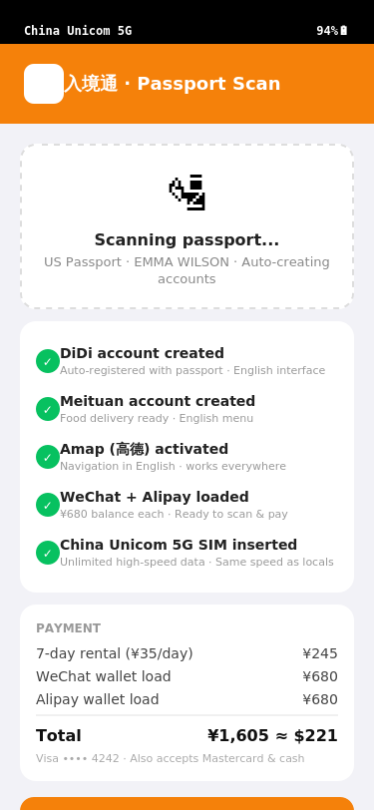
04 · THE PRODUCT
60 seconds from passport to full digital participation.
At baggage claim: scan, tap, go. Every local account pre-authenticated. Wallet pre-funded. Data, maps, translation, international internet — all working before the traveler leaves the airport.
01
Identity & KYC bridge
Passport OCR + liveness check + visa verification, cleared against carrier & payment AML requirements in a single flow
02
Pre-funded payment layer
WeChat Pay & Alipay wallets loaded at kiosk via traveler's existing foreign card — 100% payment success from step one
03
Local super-apps, pre-authenticated
DiDi, Meituan, Amap, Trip all registered to the traveler's passport identity. No 'verification code to China mobile number' dead-ends
04
Compliant international connectivity
Dual-SIM with offshore roaming carrier for international services — no VPN, compliant with PRC telecom law
05
Cryptographic wipe on return
GDPR/PIPL-grade remote factory reset on device return, logged and auditable. Privacy is a product feature, not an afterthought
Onboarding at airport kiosk
INBOUND
5 / 12

Slide 6
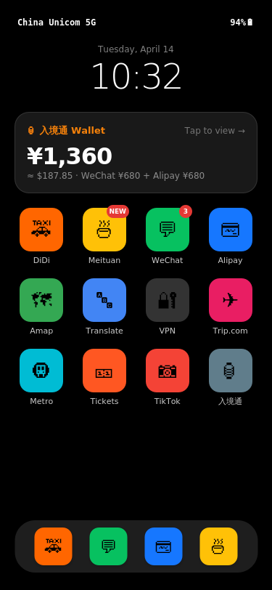
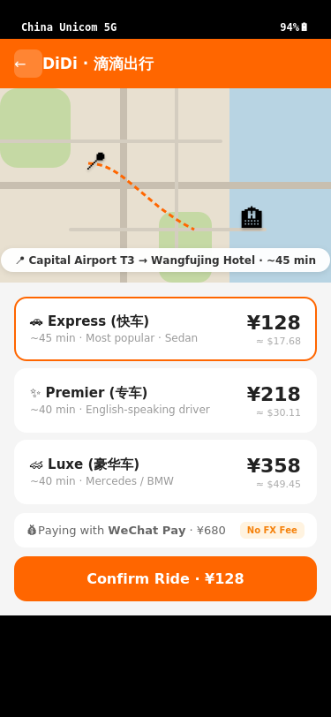
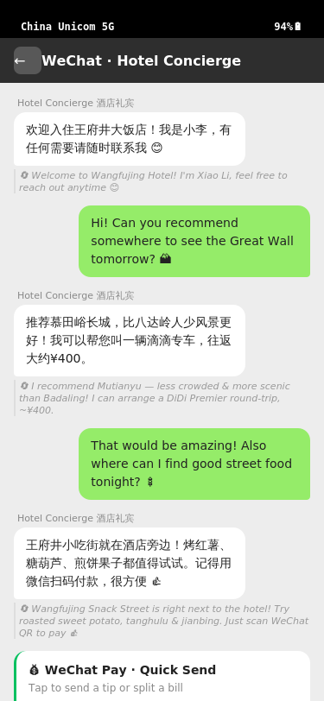
05 · PRODUCT EXPERIENCE
What a traveler actually sees.
Live interactive prototype available on request. Representative screens below trace a 7-day trip.
T+60 sec
T+5 min
T+2 hr
T+7 days
Home screen. 12 local apps pre-signed-in. Wallet ¥1,360 funded.
First DiDi ride. English UI. WeChat Pay auto-debit.
WeChat with hotel concierge. Real-time EN ↔ CN translation.
Kiosk return. Wallet balance refunded. Device remotely wiped.
INBOUND
6 / 12

Slide 7
06 · INSIGHT & MOAT
Hardware rental is the wedge. The data is the company.
Every device generates a stream of KYC-verified, consent-based, cross-border commerce data — a dataset that neither Alibaba nor Tencent can assemble from their existing products.
The proprietary data asset
WHY THIS DATA IS UNIQUE
Identity layer
A foreigner's China trip is the only consumer event on earth that generates identity, payment, and cross-cultural preference data in a single session.
Nationality, age, travel purpose, visa type
Spend layer
Categorized transactions across 10+ Chinese rails
Tencent sees spend, no identity.
Alibaba sees spend, no cross-country signal.
Booking/Trip sees travel intent, no real spend.
Inbound sees all three, by construction.
Movement layer
City flow, dwell time, return frequency
Preference layer
App usage, merchant selection, language switches
INBOUND
7 / 12

Slide 8
07 · TECHNICAL STACK
What 'hardware-anchored' actually means in engineering.
The product looks like a rental. The engineering is a KYC-bridging orchestration platform. Five proprietary systems, none of which off-the-shelf vendors solve together.
A
Passport-to-Account Orchestrator
B
Cross-border KYC Verifier
Single 60-second flow chains 8+ external services (carrier, WeChat, Alipay, DiDi, Meituan, Trip, etc.) with retry/fallback logic. Proprietary.
Passport OCR + NFC read + liveness + visa check, against both payment AML rules and PRC telecom real-name rules, in one pass.
C
Payment Routing Engine
D
Device Posture & Remote Wipe
Foreign card → licensed FX provider → RMB wallet top-up. Handles Visa/MC/Mir/UnionPay/cash with graceful degradation. Per-transaction routing.
MDM layer with geofence, jailbreak detection, 10-min heartbeats, cryptographically verifiable wipe-on-return with audit log.
E
Event Stream → Data Warehouse
INBOUND
All traveler activity (with consent) flows to a structured warehouse. Feeds Slide 06 moat from day one.
8 / 12

Slide 9
08 · MARKET · WHY NOW
China first. Then every inbound-tourism market on earth.
China is our beachhead because it's the hardest version of the problem. The infrastructure we build in China compounds across 15+ high-volume inbound markets.
150M
1.5B
$1.9T
<10%
China inbound, 2025
global inbound trips
global travel spending
digitally captured
Our beachhead market
UNWTO 2024 · cross-border arrivals
Our expanded TAM
The opportunity, globally
Why this is buildable in 2026 — and replicable after
BEACHHEAD
TEMPLATE
TIMING
China regulatory opening
Same problem, every market
Global travel back to +5% YoY
PBOC raised foreigner wallet caps 5x in 2024. 79 visa-free countries (up from 15). PIPL cert path live Jan 2026 — a compliance wall for anyone coming later, a moat for the first compliant player.
Japan, Thailand, India, Saudi Arabia, Indonesia all run their own closed-loop domestic payment/identity stacks. The same KYC-bridge + hardware-anchor architecture ports with localization, not rebuild.
UNWTO 2024: international arrivals fully recovered to pre-pandemic levels. 1.5B annual trips growing. No incumbent has solved the payment/identity handshake at the border — the window is still open.
INBOUND
9 / 12

Slide 10
09 · BUSINESS MODEL
Rentals get us to cash flow. Commerce gets us to venture scale.
Year 1: validate unit economics on rentals. Year 3: take a cut of every dollar a foreigner spends through the Inbound rail.
Three revenue horizons
UNIT MATH PER TRAVELER
H1 · Year 1–2
$20/day × 7 days × 70% util
65%
Rental revenue (7 days)
$140
Device rental
Device + SIM + ops cost
-$50
H1 gross profit
$90
H2 · Year 2–3
2–5% on ~$2,000 spend per traveler
80%
Platform take rate
H2 · Est. GMV through Inbound
$2,000
H3 · Year 3+
H2 · Take-rate @ 3%
$60
B2B licensing to OTAs, duty-free, luxury retail, telcos
90%+
Data & API
Blended per-trip gross
$150
INBOUND
10 / 12

Slide 11
10 · MOAT & MILESTONES
Three moats that compound. 12-month path to Series A.
Regulatory licensing, airport placement, and proprietary data — all accumulated advantages that strengthen over time rather than erode.
Regulatory
Physical placement
Data compounding
Telecom real-name partnership, licensed FX processor, PIPL data processor certification. 12–18 months to replicate — minimum.
Exclusive airport kiosk deals at flagship gateways. Real estate, not just software — not subject to download / update cycle.
Every traveler strengthens the recommendation and fraud models. Data licensing revenue starts in Year 2, accelerates forever.
12-month plan with this seed round
1
Q1–Q2 '26
2
Q3 '26
3
Q4 '26
4
H1 '27
China pilot — 1 gateway
Payment & KYC infra live
2nd airport · Series A prep
Series A → 2nd market
150 devices · 1,000 travelers · unit econ validated
Orchestrator + routing in production
5,000+ travelers · data warehouse emitting
Thailand or Japan · replay the China playbook
INBOUND
11 / 12

Slide 12
11 · THE ASK
Raising $2M seed to build the rails.
Co-lead-friendly. Open to seed funds with conviction in infrastructure-layer bets.
USE OF FUNDS
TEAM
40%
Engineering build-out
Orchestrator, KYC, payment routing, MDM, data pipeline
Technical founding team,
25%
Pilot fleet & kiosk
currently expanding.
300 devices + 2 airport kiosks + field ops
Led by an experienced technical founder with prior company-building experience. Deep engineering background, bilingual operating capacity across North America and Asia. Key compliance, airport-BD, and growth roles actively being filled with this round.
20%
Regulatory & compliance
Carrier partnership, FX license, PIPL processor cert
15%
Key hires
Technical co-founder, compliance lead, airport BD
linkedin.com/in/bujinwang
bwang@autobebesys.com
Product demo, full data room, and traction updates available on request.

