Slide 1
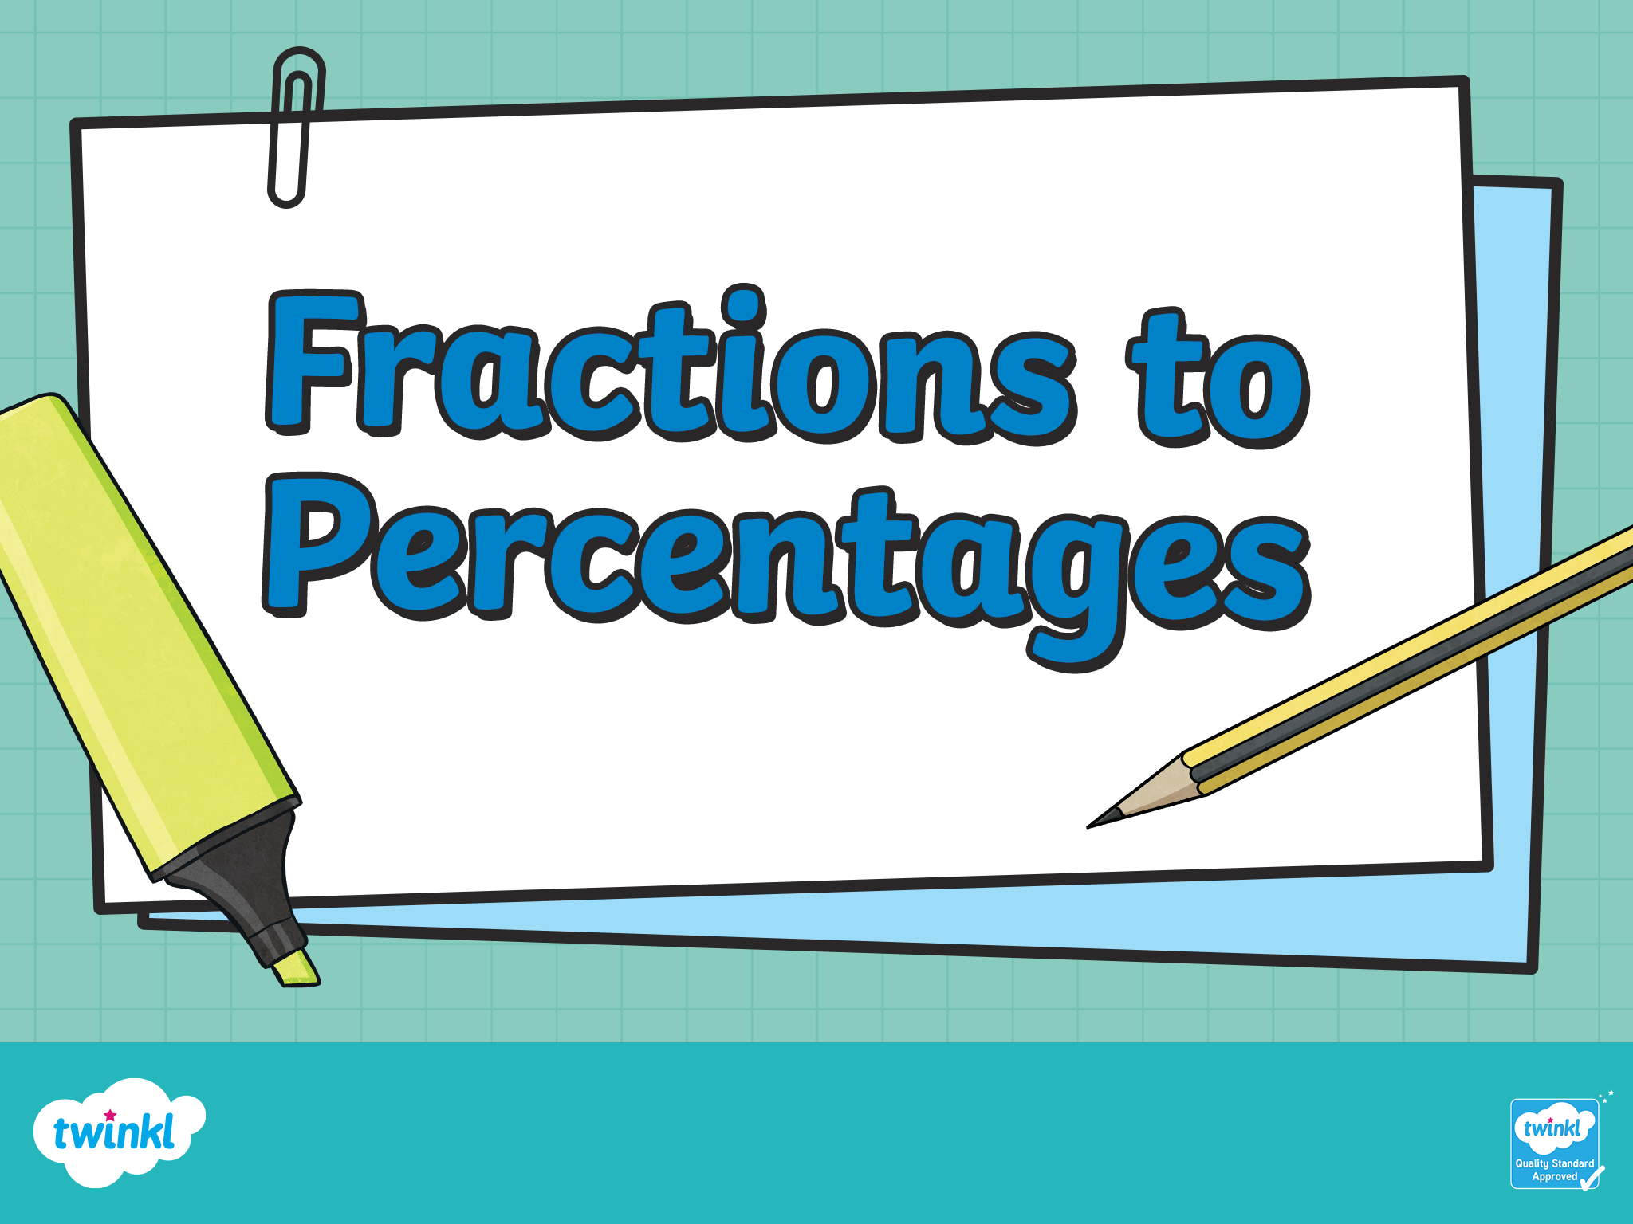

Slide 2

What is a percentage?
The whole is divided into 100 equal parts.
1 part is shaded.
of the whole is shaded.
A percentage is a part out of 100.
1% of the whole is shaded.
1 100

Slide 3
What is a percentage
What fraction of this shape is shaded?
23 100
What percentage of this shape is shaded?
23%
What fraction of this shape is unshaded?
77 100
What percentage of this shape is unshaded?
77%

Slide 4
What is a percentage
What fraction of this shape is shaded?
50 100
1 2
or
What percentage of this shape is shaded?
50%
What fraction of this shape is unshaded?
50 100
What percentage of this shape is unshaded?
50%

Slide 5
What is a percentage
What fraction of this shape is shaded?
25 100
1 4
or
What percentage of this shape is shaded?
25%
What fraction of this shape is unshaded?
75 100
3 4
or
What percentage of this shape is unshaded?
75%

Slide 6
What is a percentage
What fraction of this shape is shaded?
10 100
1 10
or
What percentage of this shape is shaded?
10%
What fraction of this shape is unshaded?
90 100
9 10
or
What percentage of this shape is unshaded?
90%

Slide 7
What is a percentage
What fraction of this shape is shaded?
20 100
1 5
or
What percentage of this shape is shaded?
20%
What fraction of this shape is unshaded?
80 100
4 5
or
What percentage of this shape is unshaded?
80%

Slide 8
What is a percentage
Complete the table by converting each fraction to a percentage.
Fraction | Percentage
52 100
52%
3 10
30%
2 4
50%
2 20
10%

Slide 9
What is a percentage
Complete the table by converting each percentage to a fraction in its simplest form.
Fraction | Percentage
 | 75%
 | 20%
 | 60%
 | 50%
3 4
1 5
3 5
2 2

Slide 10
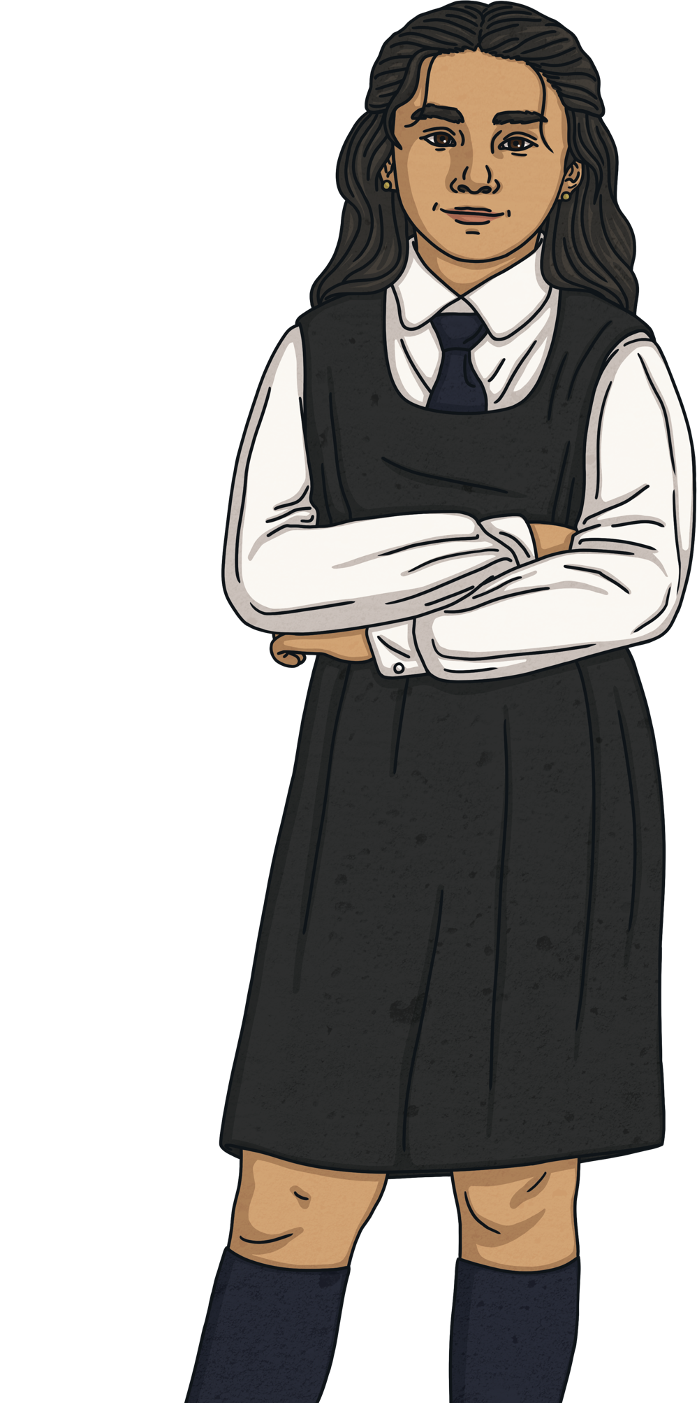
What is a percentage
Luna scored 25 out of 50 on her maths test.
What was her score as a percentage?
Luna’s score as a fraction is .
This is equivalent to or .
or are both equivalent to 50% so Luna’s score as a percentage is 50%.
25 50
50 100
1 2
50 100
1 2

Slide 11
