Slide 1

Cookie Remediation Guideline for Developer/Site Admins 09.Aug.2018

Slide 2
Privacy Requirements - Background
As per the EU GDPR directive and our company¹ Privacy compliance requirements, all our company websites catering to EU, Canada and Mexico visitors/users/customers are required to have the listed features:
High Level Requirement # 1: Discoverable Cookie Panel which should provide the list of cookie(s) used on the site
Categories of Cookies
List of cookie(s) with some applicable attributes (Name, Purpose, Expiry, Path, Description and Company)
Information to manage cookies using browser setting.
High Level Requirement # 2: Ability to OPT-IN and/or OPT-OUT for certain category of cookies
¹ Throughout this communication, our references to “our Company” means Merck & Co., Inc. (Kenilworth, NJ, USA), which conducts business outside of the U.S. and Canada as Merck, Sharp & Dohme (MSD)

Slide 3
Company Cookie Categories and Default Setting
Cookie Categories | How These Cookies Are Used | Your Choices | Default Setting
Necessary (may also be referred to as “Required” or “Strictly Necessary”) | These cookies are essential to enable services that you specifically have asked for, such as to access secure areas of our web sites or to remember products you have placed in a shopping cart on some of our sites. These session cookies are stored only temporarily while you are using our web sites and are deleted from your device once you close your browser. | Since these cookies are strictly necessary for certain of our web sites to operate, our cookie preferences tools do not enable you to control these cookies. If you set your browser not to accept them, you will not be able to use the sections of our web sites that depend on them. | Feature Unavailable
Functionality (may also be referred to as “Site Experience”) | These cookies enable core site functionality, such as enabling our web sites to remember you as a unique visitor and your choices so that we can improve your experience on our web sites, such as remembering your language preference, the country in which you are located and whether you are a health care professional. These cookies are also used on some parts of our web sites to provide services you have requested, such as watching a video, including videos or other content that are delivered by third parties through our web sites. | Like Necessary cookies, our sites depend on Functionality cookies in order to deliver content and features that you request when using our web sites. By using our web sites that use these types of cookies, you are agreeing that we can place them on your device. You can control the use of these cookies either by electing not to designate certain preferences offered on our web sites, or by controlling these cookies through your browser settings as described above. If you set your browser not to accept these cookies, certain functionality on our web sites may not work. | Feature Unavailable
Performance and Analytics (may also be referred to as “Operation”) | These cookies allow us to analyze web site usage or e-mail usage so we can measure trends and improve performance. For example, whether or not you have visited our web sites before, which web pages you and other visitors to our sites prefer, how many unique users visit our web sites, and how many recipients of certain email communications click on the web site links in those emails. Unless you are a registered user of our web sites and are signed in, we cannot use these cookies to identify you. If you are signed in, we can use these cookies to link your use of our web sites to your registration information or other personal information we may have collected about you. | Some of our web sites have cookie preferences tools that enable you to control these cookies. You also can set your browser not to accept these cookies. Some of these cookies are set by us and some are set by third parties. You can use the cookie settings in your browser to choose to block third party cookies without affecting the cookies that are set by us. | OPT-IN
Advertising and Cross-site tracking | These cookies are used by advertising companies to serve ads that are relevant to your interests, such as in the United States to remind you about the content of one of our web sites that you previously visited. They also may be used by third parties to track which web sites you visit. | Some of our web sites have cookie preferences tools that enable you to control these cookies. You also can set your browser not to accept these third party cookies. | OPT-OUT**
Social Media | These cookies may be used by social media sites, such as Facebook, Twitter and YouTube, to track articles that you share and to track social network users when they visit our web sites. | Some of our web sites have cookie preferences tools that enable you to control these cookies. You also can set your browser not to accept these third party cookies. | OPT-OUT**
* :- User visiting the site for the first time or first time after the cookies are cleared/deleted from a machine
** :- If a default setting is not applicable for a market, please reach out to Global Privacy Office
Reference: http://www.msd.com/privacy/cookie-privacy-commitment/

Slide 4
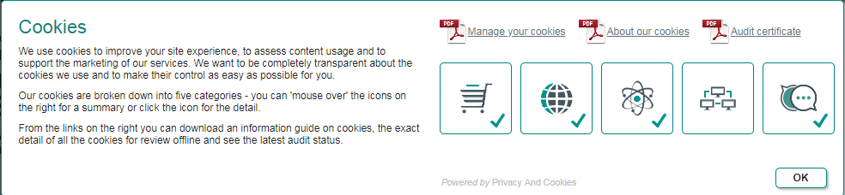
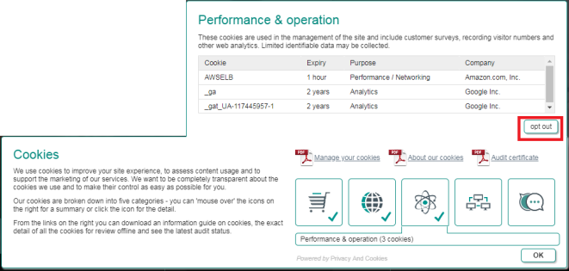
Enterprise Technical Solution
Privacy Requirements | Enterprise Solution – Output | Remediation, Timeline & Status
High Level Requirement # 1 (Discoverable cookie Panel - Consent) |  | Remediation: Inject ‘SiteMorse’ cookie panel code in the site. Timeline: Past Due Status:90% of impacted GHH Sites remediated & 97% of impacted AH Sites.
High Level Requirement # 2 (Ability for users to OPT-IN or OPT-OUT |  | Remediation: No changes required for Sites that does not use or have any 3rd Party Cookies^{Δ} ( 3rd party cookies typically fall under Category 4 – Advertising & Cross-site tracking and Category 5 - Social Media) Changes required on sites to handle 3rd Party cookies. See below (ASK slide) for details Timeline: Complete by August 2018. Status: To Start
^{Δ} Cookies that does not share domain as the website itself are considered as 3rd Party Cookies. Note: Google Analytics cookies typically share the same site domain hence are not considered as 3rd Party cookies.

Slide 5
Cookie – Remediation Scope
Cookie Category | 1st Party Cookie | Remediation Required? | 3rd Party Cookie | Remediation Required?
Necessary (no Opt-out option) | Yes | Not Required | NA | NA
Site Experience (no Opt-out option) | Yes | Not Required | NA | NA
Performance & Operations (default-OPT-IN) | Yes (include Google Analytics) | Not Required | Yes (exclude Google Analytics) | Required
Advertising & Cross-Site Tracking (Default = OPT-OUT, exception: 3 French site for DMP integration) | Yes | Not Required | Yes | Required
Social Media (Default – OPT-OUT) | Yes | Not Required | Yes | Required

Slide 6
What is the ASK ?
What is a ASK from Site Owner?
Review the use of ‘Category 4 – Advertising & Cross-Site Tracking’ and/or ‘Category 5 – Social media’ in the site. It is recommend to avoid use Category 4 (Advertising or Cross-site tracking cookies) and Category 5 (Social Media) cookies in our sites with appropriate consent/consultation from our company compliance office.
If these cookie(s) are NOT REQUIRED, then remediate the site to drop these cookies
If these cookie(s) are REQUIRED, then REMEDIATE the site to push these cookie(s) based on user’s OPT-IN/OPT-OUT preference. Here are high level guidance
Include the code to obtain/retrieve an user selection for a category
Evaluate the output of the above to make a decision to push/set or not push/not-set a cookie or frame on an user machine.
There should be appropriate communication for an user to change their preference.

Slide 7
Cookie Remediation – Developer Guidelines
Review the use of ‘Category 4 – Advertising & Cross-Site Tracking’ and/or ‘Category 5 – Social media’ in the site. It is recommend to avoid use Category 4 (Advertising or Cross-site tracking cookies) and Category 5 (Social Media) cookies in our sites with appropriate consent/consultation from our company compliance office.
If these cookie(s) are NOT REQUIRED, then remediate the site to drop these cookies
If these cookie(s) are REQUIRED, then REMEDIATE the site to push these cookie(s) based on user’s OPT-IN/OPT-OUT preference. Here are high level guidance
Include the code to obtain/retrieve an user selection for a category
Evaluate the output of the above to make a decision to push/set or not push/not-set a cookie or frame on an user machine.
There should be appropriate communication for an user to change their preference.

Slide 8
Cookie Remediation – High Level Guidance
Include java script on the site
<script type="text/javascript">
function cookieLevelConsent(level) {
var m = document.cookie.match(
"^(.+;)? *wscrCookieConsent=([^;]+&)?" + level + "=(t|f)");
return m ? (m[3] === "t") : null;
}
Before setting any 3rd Party cookie, do the following
Identify the Cookie category
Call the function ‘cookieLevelConsent(<category#>)’ to obtain the user option
Based on the output, make a decision to set or not-to-set the cookie.

Slide 9
Cookie Remediation – Developer Guideline
The basic principle is that whenever a piece of third-party code or content is going to be included in a page, you need to decide whether this should involve the user’s consent. This includes inline content such as <script> and <iframe> elements, but not links to external sites using <a> elements. The cookie panel can of course be used to help identify such content and to see what cookie categories are involved. On the front-end this would generally involve including the small piece of code we provided very early on in-line in the page:
<script type="text/javascript">
function cookieLevelConsent(level) {
var m = document.cookie.match(
"^(.+;)? *wscrCookieConsent=([^;]+&)?" + level + "=(t|f)");
return m ? (m[3] === "t") : null;
}
Using this function as appropriate to make external code conditional upon the appropriate consent. The following condition can be used to only run code if the user has opted in to category 4:
if (cookieLevelConsent(4)) {
…
}
Similar but slightly different test that the user has not opted out of category 4:
If (cookieLevelConsent(4) !== false) {
…
}
For <iframe> elements, these may need to be made conditional in the server-side code that generates the page source. How precisely this is done will depend greatly upon which precise technologies are being used to create the site, but should in general be very straightforward and involve checking for the “wscrCookieConsent” cookie exactly as per the above JavaScript code. For embedded YouTube videos, such as the one on https://www.medelli.fr/j-ai-eu-une-scoliose.-je-voudrais-surveiller-le-dos-de-mes-enfants.-existe-t-il-un-examen-simple-./, it is probably easiest to simply change the code to use the www.youtube-nocookie.com domain, e.g.:
<iframe src="https://www.youtube-nocookie.com/embed/Z2Yi_skqhGQ?rel=0&amp;controls=0&amp;showinfo=0" …

Slide 10
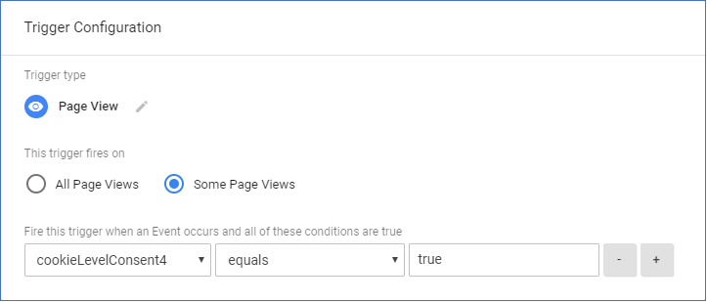
Cookie Remediation – Google Tag Manager
To remediate Google Tag Manager, a very broad-brush approach would be to make the code that loads Google Tag Manager to be conditional using “if cookieLevelConsent(…)”. For a more fine-grained approach, there are a couple of options. Note the “cookieLevelConsent” function is defined in the page before the Google Tag Manager code.
For custom tag code, add the “if cookieLevelConsent(…)” into the relevant tag code in the Google Tag Manager control panel:
<script>if (cookieLevelConsent(4)) { … tag code goes here … }</script>
For any kind of tag, make it conditional upon the cookie level consent using a custom trigger:
Create a custom variable:
Click ‘Variables’ and then ‘New’.
Name the variable, e.g. “cookieLevelConsent4”.
Click to choose the variable type and select ‘Custom JavaScript’.
Set the Custom JavaScript code:
function(){return cookieLevelConsent(4)}
‘Save’ the variable.
Create a custom trigger:
Click ‘Triggers’ and then ‘New’.
Name the trigger, e.g. “cookieLevelConsent4”.
Click to choose the trigger type, e.g. ‘Page View’.
Click to choose ‘This trigger fires on: Some Page Views’.
Select the variable that was defined above, ‘equals’, true:
‘Save’ the trigger
Then simply use this trigger for the tags which should be conditional upon consent.

