Slide 1



Computer Vision
Scenic
Flax
Burak PASTIRMACI
Notes:
Audience: general ML audience. A beginner talk but does require some background knowledge on basic ML terminology such as FFNs, batch normalization, automatic differentiation.

Slide 2
Content
JAX / FLAX
SCENIC
Examples

Slide 3
JAX & FLAX

Slide 4
JAX: Autograd and XLA
Open-source framework
Very much suited for research work including but not limited to ML
Autograd - Automatically differentiates native Python and Numpy code
XLA - Compiles native Python and Numpy code
Numpy on accelerators (CPU/GPU/TPU)
Some example transformations: jit, pmap, grad
Example compositions: jit(grad), vmap(grad)

Slide 5
Flax (Flexibility – JAX) Preview
class MLP(nn.Module): features: Sequence[int] @nn.compact def __call__(self, x):: for feat in self.features[:-1]: x = nn.relu(nn.Dense(feat)(x)) x = nn.Dense(self.features[-1])(x) return x model = MLP([12, 8, 4]) batch = jnp.ones((32, 10)) variables = model.init(jax.random.PRNGKey(0), batch) output = model.apply(variables, batch)
Everything you need for Deep Learning research:
Module abstraction stateful inside, functional outside.
RNG handling
Thin, decoupled, utility functions (checkpointing, replication, …)
Clean, forkable end-to-end examples
Patterns and HOWTO guides

Slide 6
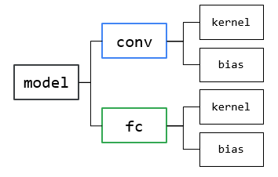
Defining a Module
from flax import linen as nn
class Net(nn.Module):
units: int
def setup(self):
self.conv = nn.Conv(
self.units, [3, 3], [3, 3])
self.fc = nn.Dense(10)
def __call__(self, x):
x = self.conv(x)
x = nn.relu(x)
x = x.reshape([len(x), -1])
x = self.fc(x)
return nn.log_softmax(x)
"Special" Dataclasses.
Predefined modules like nn.Dense()
Auto shape inference.
Automatically creates parameter tree reflecting module hierarchy:

Slide 7
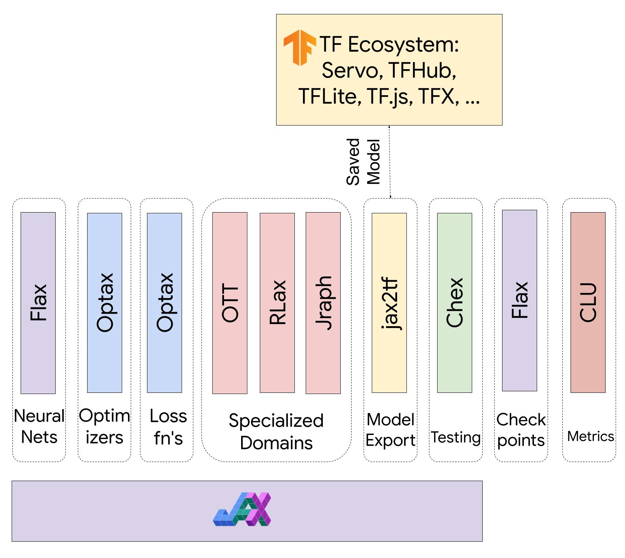
The Flax Ecosystem

Slide 8
Learn more
Documentation
Flax Basics: https://flax.readthedocs.io/en/latest/notebooks/flax_basics.html
Annotated MNIST: https://flax.readthedocs.io/en/latest/notebooks/annotated_mnist.html
HOWTO: https://flax.readthedocs.io/en/latest/howtos/ensembling.html
Design Notes
Design Principles: https://flax.readthedocs.io/en/latest/design_notes/linen_design_principles.html
Lifted Transformations: https://flax.readthedocs.io/en/latest/design_notes/lift.html
Discussion Forums:
https://github.com/google/jax/discussions
https://github.com/google/flax/discussions
flax-dev@google.com, marcvanzee@google.com

Slide 9
SCENIC

Slide 10
SCENIC ( https://github.com/google-research/scenic )
Scenic is a codebase with a focus on research around attention-based models for computer vision.
Scenic has been successfully used to develop classification, segmentation, and detection models for multiple modalities including images, video, audio, and multimodal combinations of them.
Scenic is developed in JAX and uses Flax.

Slide 11
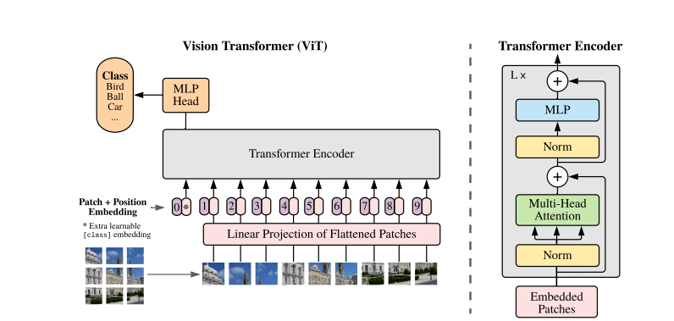
ATTENTION IS ALL YOU NEED
A pure transformer applied directly to sequences of image patches can perform very well on image classification tasks.
When pre-trained on large amounts of data and transferred to multiple mid-sized or small image recognition benchmarks (ImageNet, CIFAR-100, VTAB, etc.), Vision Transformer (ViT) attains excellent results compared to state-of-the-art convolutional networks while requiring substantially fewer computational resources to train.

Slide 12
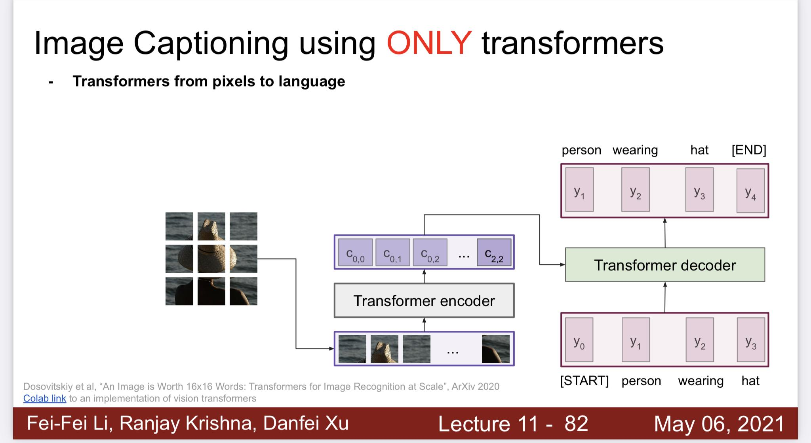

Slide 13
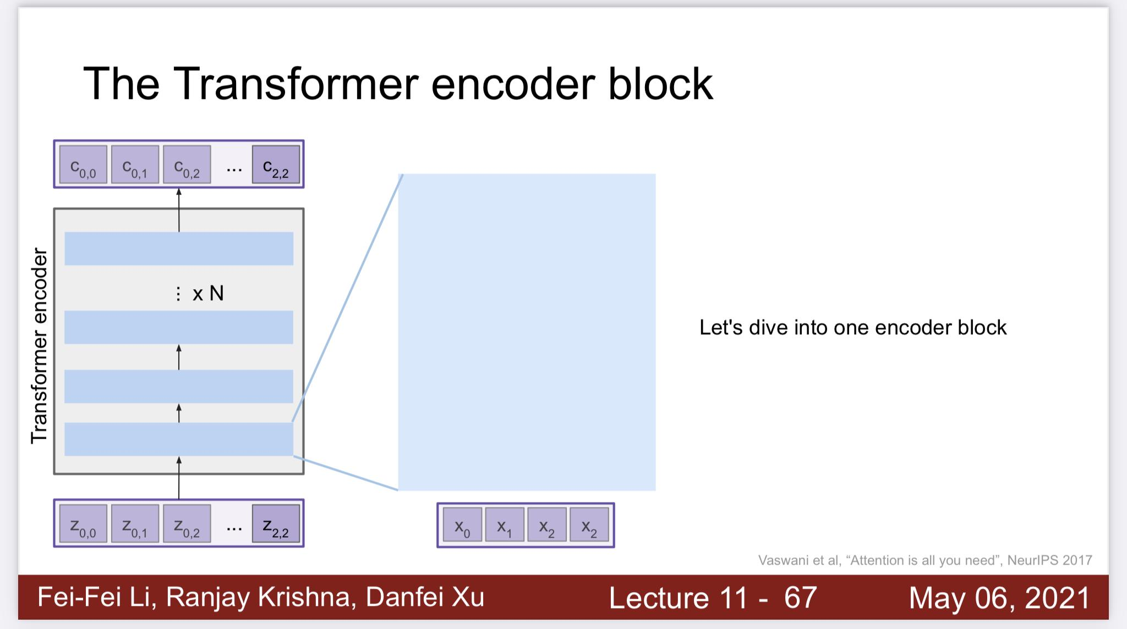

Slide 14
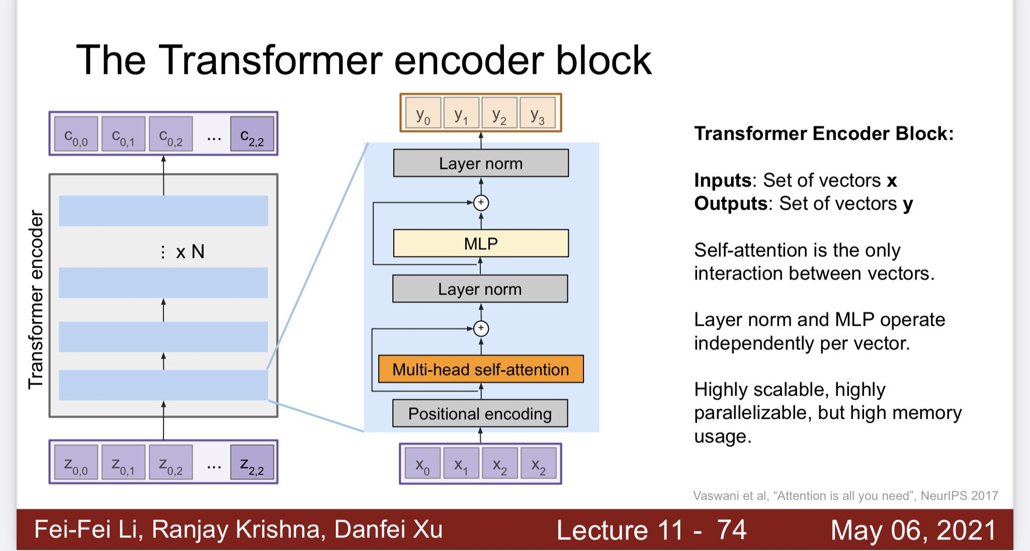

Slide 15
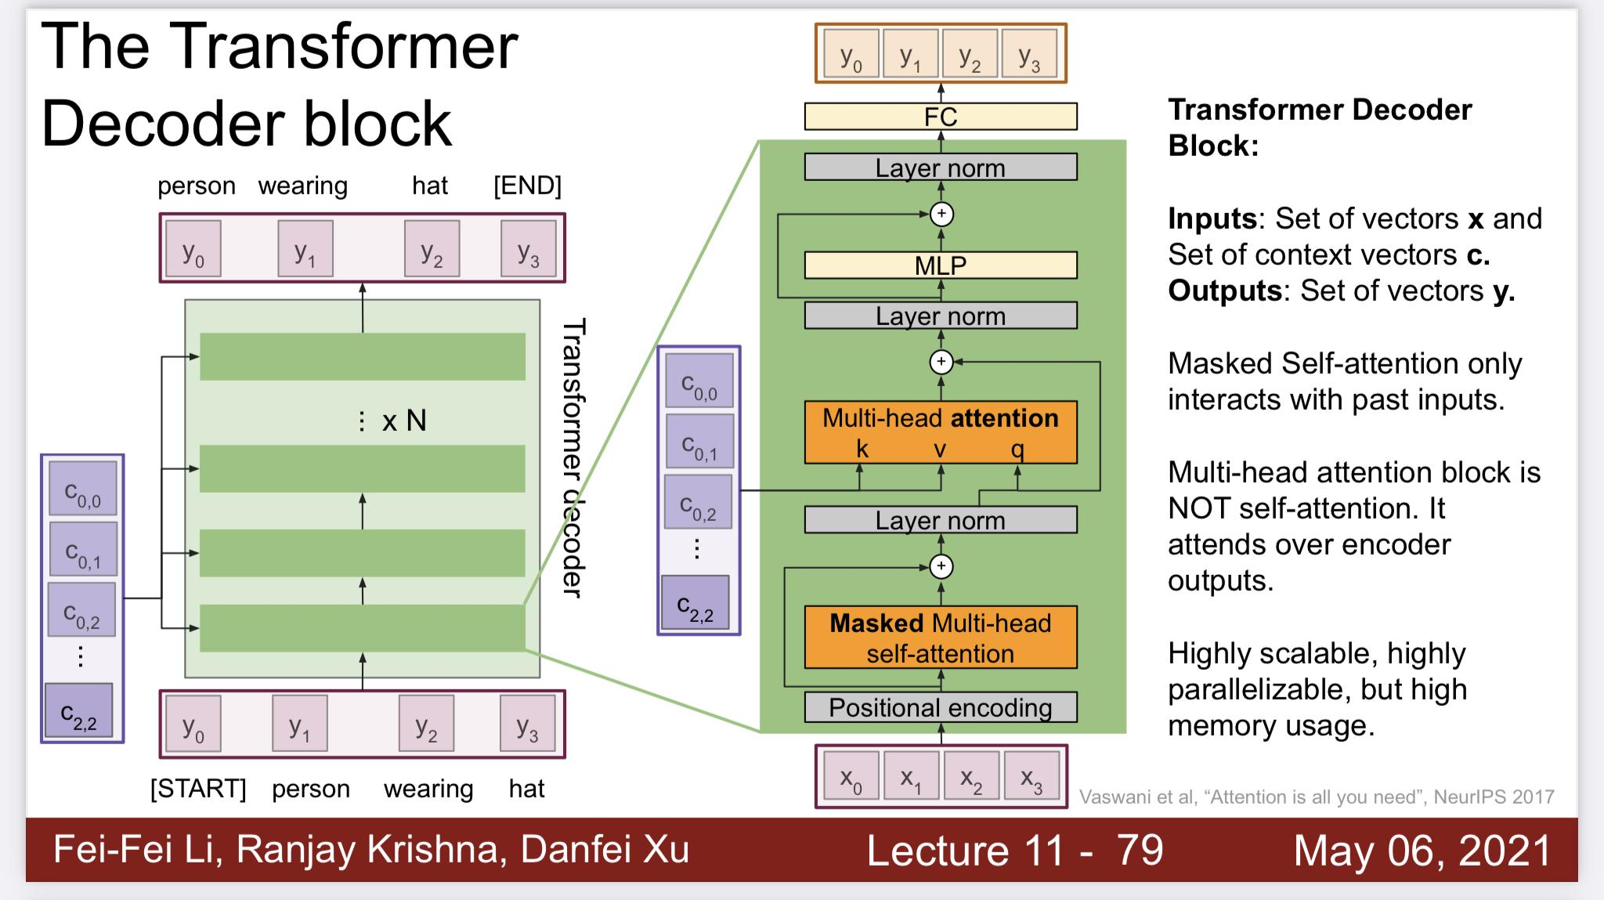

Slide 16
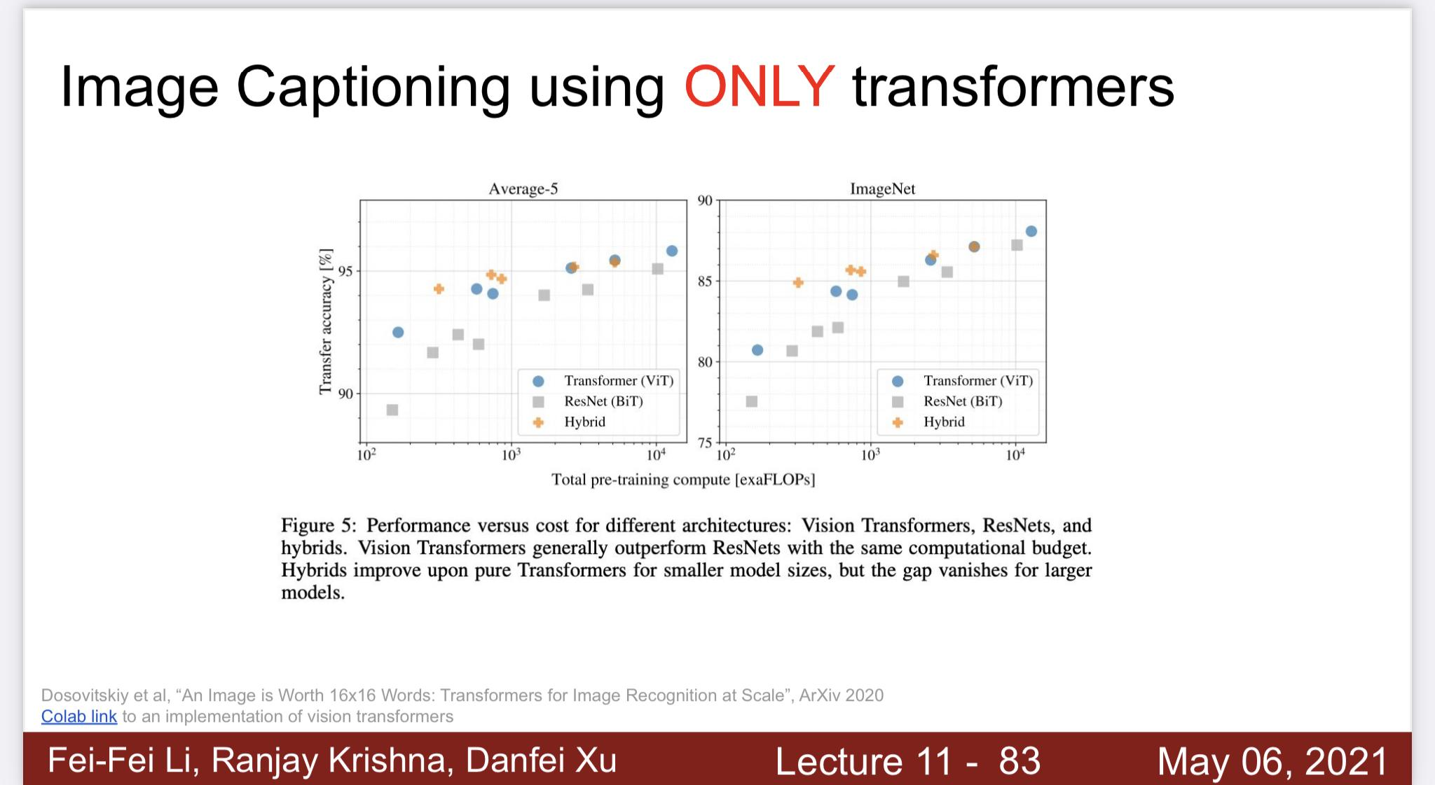

Slide 17
Some projects that were developed in Scenic or used it for their experiments:
Flax Vit
ViViT: A Video Vision Transformer
OmniNet: Omnidirectional Representations from Transformers
Attention Bottlenecks for Multimodal Fusion
TokenLearner: What Can 8 Learned Tokens Do for Images and Videos?
Exploring the Limits of Large Scale Pre-training
The Efficiency Misnomer
Discrete Representations Strengthen Vision Transformer Robustness
Pyramid Adversarial Training Improves ViT Performance

Slide 18
EXAMPLES

Slide 19
VIT GitHub
Hugging Face Image Classification
LIT Models

Slide 20
THANK YOU

