Slide 1
Logging & ELK

Slide 2
Agenda
Asp.net core logging
ELK Introduce (ElasticSearch, Logstash, Kibana)
Kibana Practice

Slide 3
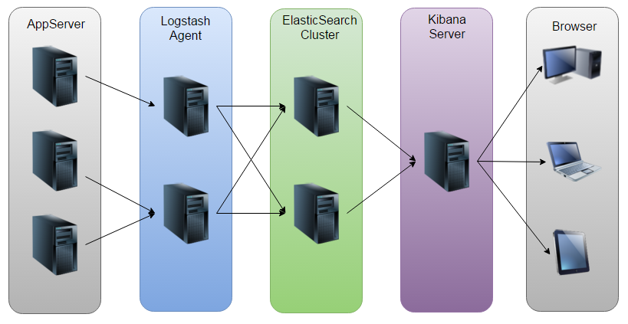
ELK Work Flow

Slide 4
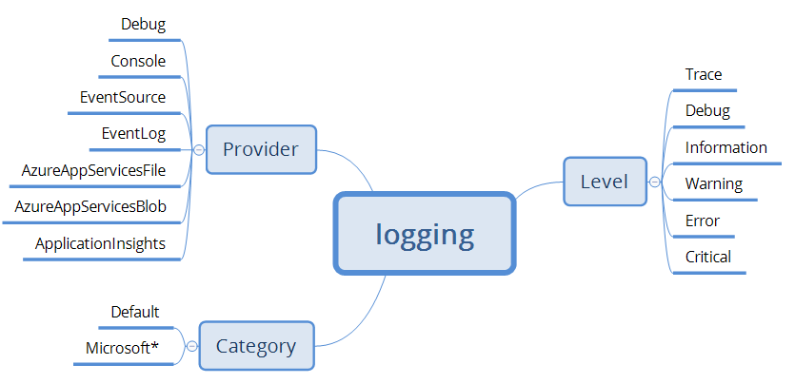
Basic Log Concept

Slide 5
Log Level
LogLevel | Value | Method | Description
Trace | 0 | LogTrace | Contain the most detailed messages. These messages may contain sensitive app data. These messages are disabled by default and should not be enabled in production.
Debug | 1 | LogDebug | For debugging and development. Use with caution in production due to the high volume.
Information | 2 | LogInformation | Tracks the general flow of the app. May have long-term value.
Warning | 3 | LogWarning | For abnormal or unexpected events. Typically includes errors or conditions that don't cause the app to fail.
Error | 4 | LogError | For errors and exceptions that cannot be handled. These messages indicate a failure in the current operation or request, not an app-wide failure.
Critical | 5 | LogCritical | For failures that require immediate attention. Examples: data loss scenarios, out of disk space.
None | 6 |  | Specifies that a logging category should not write any messages.
Notes:
Case1 : user didn’t input email, it cause operation can’t continue
Case2 : Query mongodb timeout
Case3 : Mongodb client throw no permission exception for write

Slide 6
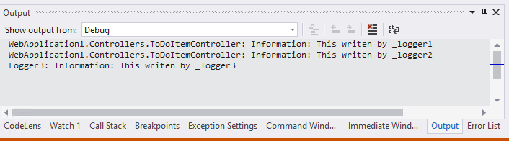
Provider(Debug)
VisualStudio View -> Output -> Debug

Slide 7
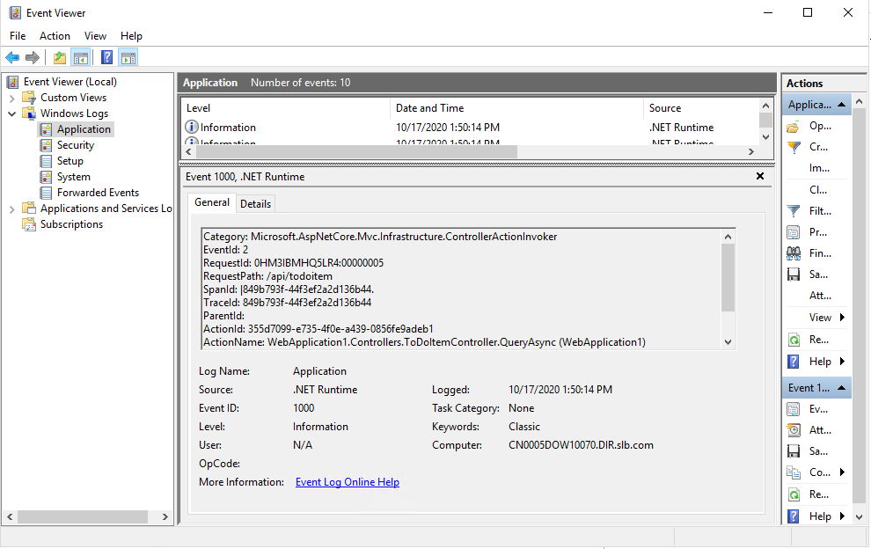
Provider(EventLog)
Event Viewer Windows Logs -> Application

Slide 8
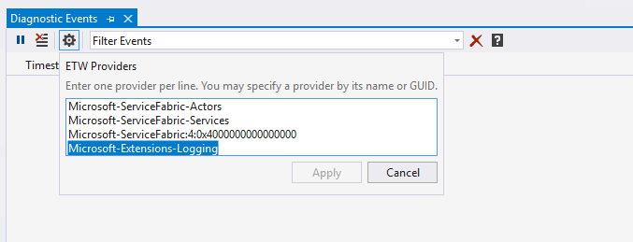
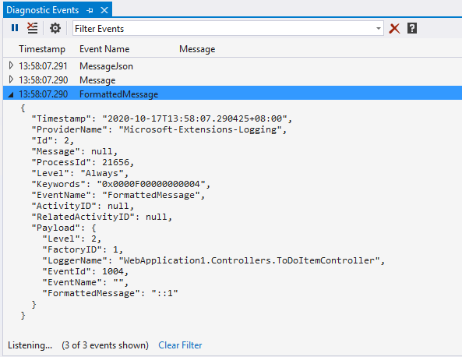
Provider (EventSource)
Visual Studio View -> Other Windows -> Diagnostic Events
Notes:
Microsoft-Extensions-Logging

Slide 9
EventSource(ETW)

Slide 10
Specify Provider In Code
public static void Main(string[] args)
{
var builder = Host.CreateDefaultBuilder(args)
.ConfigureLogging(logBuilder =>
{
logBuilder.ClearProviders();
logBuilder.AddDebug();
logBuilder.AddConsole();
logBuilder.AddEventLog();
logBuilder.AddEventSourceLogger(); //ETW
logBuilder.SetMinimumLevel(LogLevel.Information);
})
.ConfigureWebHostDefaults(webBuilder =>
{
webBuilder.UseStartup<Startup>();
});
builder.Build().Run();
}

Slide 11
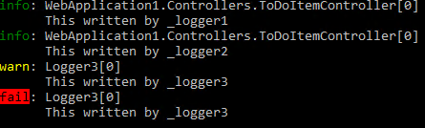
Get Logger With Category
public class ToDoItemController : ControllerBase
{
private ILogger<ToDoItemController> _logger1;
private ILogger _logger2;
private ILogger _logger3;
public ToDoItemController(
ILogger<ToDoItemController> logger,
ILoggerFactory loggerFactory)
{
_logger1 = logger;
_logger2 = loggerFactory.CreateLogger("WebApplication1.Controllers.ToDoItemController");
_logger3 = loggerFactory.CreateLogger("Logger3");
_logger1.LogInformation("This written by _logger1");
_logger2.LogInformation("This written by _logger2");
_logger3.LogWarning("This written by _logger3");
_logger3.LogError("This written by _logger3");
}
}

Slide 12
Logger Configuration
//appsettings.json
{
"Logging": {
"Console": {
"LogLevel": {
"WebApplication1.Controllers": "Information",
"Logger3": "Critical",
"Microsoft": "Warning"
}
}
}
}
public ToDoItemController(
ILogger<ToDoItemController> logger,
ILoggerFactory loggerFactory)
{
_logger1 = logger;
_logger2 = loggerFactory.CreateLogger(
"WebApplication1.Controllers.ToDoItemController");
_logger3 = loggerFactory.CreateLogger("Logger3");
_logger1.LogInformation("This written by _logger1");
_logger2.LogInformation("This written by _logger2");
_logger3.LogWarning("This written by _logger3");
_logger3.LogError("This written by _logger3");
}

Slide 13
Logger Configuration
{
"Logging": {
"LogLevel": {
"WebApplication1.Controllers": "Warning"
},
"Console": {
"LogLevel": {
"Logger3": "Error",
"Microsoft": "Warning"
}
},
"Debug": {
"LogLevel": {
"Logger3": "Error",
"Microsoft": "Warning"
}
}
}
}
public ToDoItemController(
ILogger<ToDoItemController> logger,
ILoggerFactory loggerFactory)
{
_logger1 = logger;
_logger2 = loggerFactory.CreateLogger(
"WebApplication1.Controllers.ToDoItemController");
_logger3 = loggerFactory.CreateLogger("Logger3");
_logger1.LogInformation("This written by _logger1");
_logger2.LogInformation("This written by _logger2");
_logger3.LogWarning("This written by _logger3");
_logger3.LogError("This written by _logger3");
}

Slide 14
Demo Log for Each Request
services.AddControllers(option=>option.Filters.Add<LogFilterAttribute>());
Add [LogFilter] on controller
[TypeFilter(typeof(LogFilterAttribute))]

Slide 15
Kibana
How to Query
Create Visualization
Create Dashboard
DevTool
Link
elastic
*2017*****

