Slide 1
LastBuy
Know what a discontinued part costs you before the window shuts.
AMD Developer Hackathon: ACT III · Intelligent Industry · Hamza Mukhtar Bukhari
Gemma-4-31B-IT on AMD Instinct · Evolus workspace lychee · lychee-seven.vercel.app

Slide 2
THE PROBLEM
A letter arrives. Your part is dead in 34 days.
Days
to work one notice out by hand
Someone now has to work out which products use it, which customers are under contract, which certificates re-open, and how many to buy before the door shuts.
3
Miss the date and the part is gone for good. You redesign the product, or you stop building it.
people usually pulled in
0
chances to buy it again afterwards
MODEL
Gemma-4-31B-IT
ON
AMD Instinct
VIA
Evolus / lychee
ENGINE
no model

Slide 3
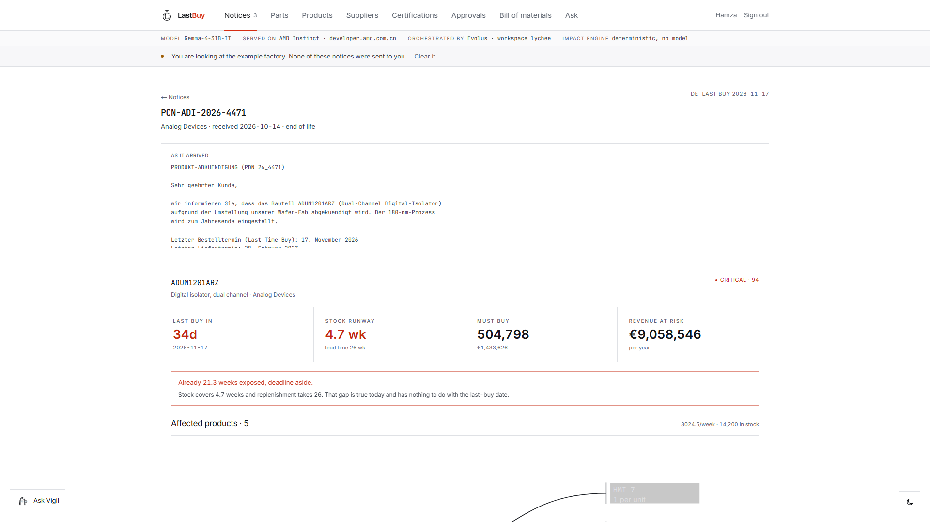
WHAT IT DOES
Drop the letter in. Get the damage.
Reads any notice
27s
A PDF, a scan, a photo. Any language.
Traces the part
5 products
Through your bill of materials, up to every product.
One notice, opened. Everything under it is computed.
Prices the decision
EUR 1.4M
What to buy, what it costs, what it protects.
Shows its working
0 guessed
Every figure is arithmetic you can replay.
MODEL
Gemma-4-31B-IT
ON
AMD Instinct
VIA
Evolus / lychee
ENGINE
no model

Slide 4
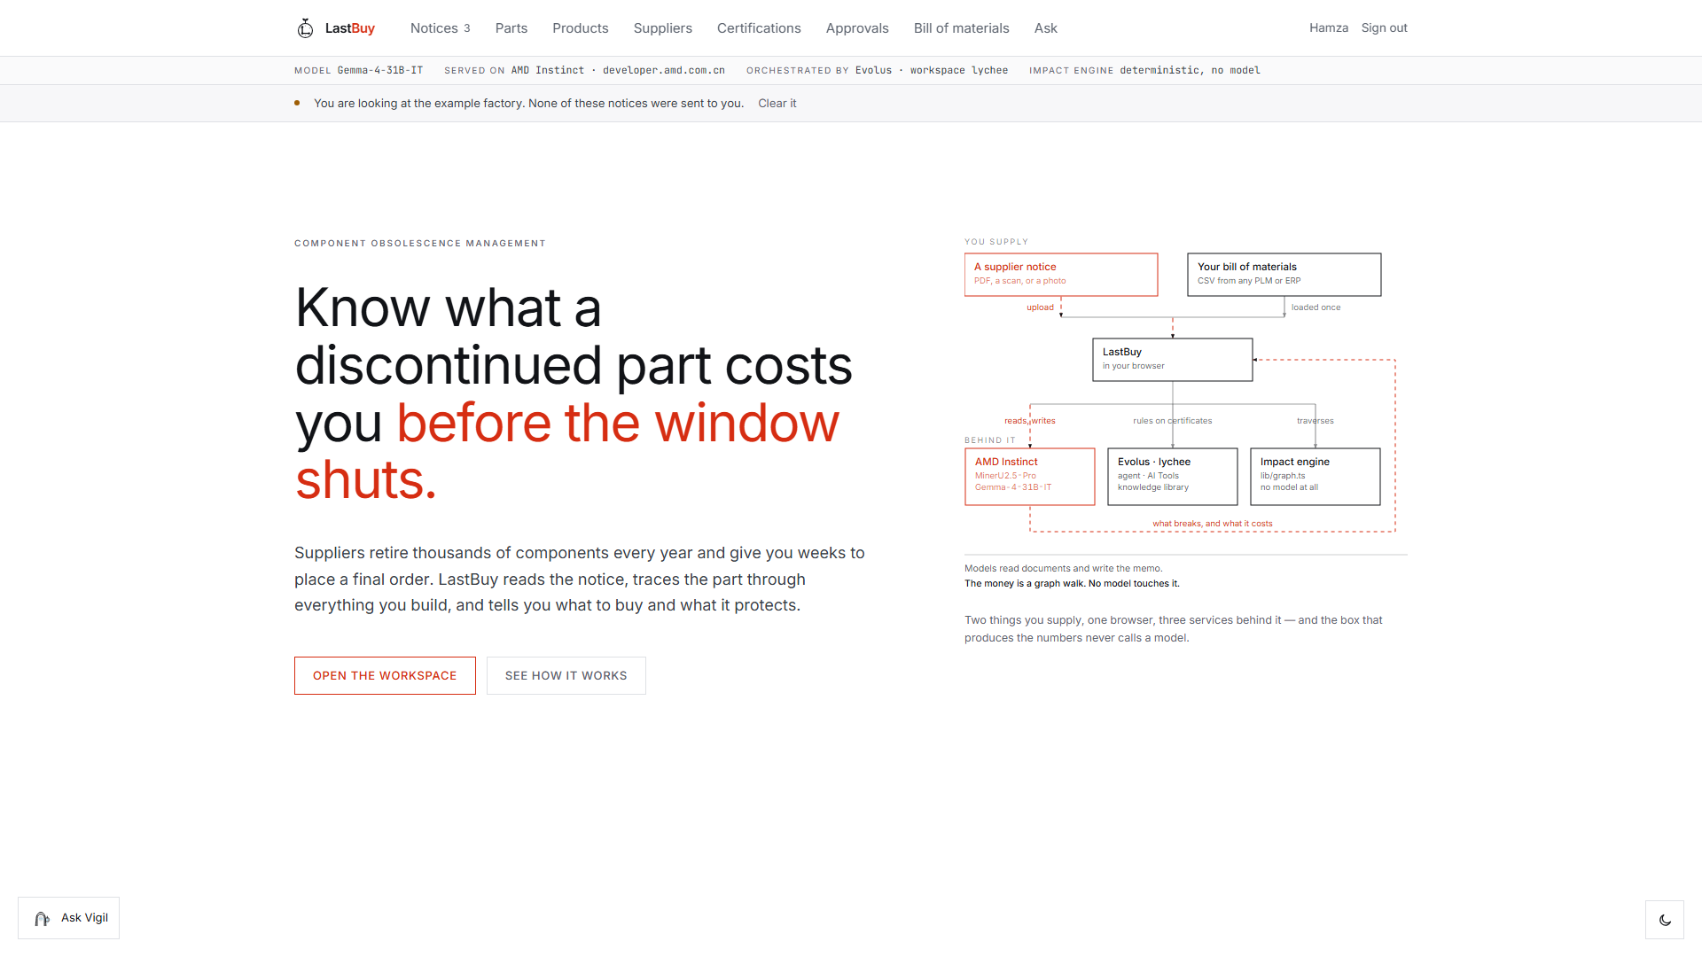
HOW THE NUMBERS ARE MADE
The money is a graph walk. No model touches it.
One isolator sits under five finished products. We walk the bill of materials from the part up to each of them, multiplying quantities on the way. Ask again and you get the same answer, because it is arithmetic.
Models read documents and write the memo.
They never make a number you act on.
The same part, traced on screen.
5
EUR 9.05M
products it reaches
revenue behind them, a year
MODEL
Gemma-4-31B-IT
ON
AMD Instinct
VIA
Evolus / lychee
ENGINE
no model

Slide 5
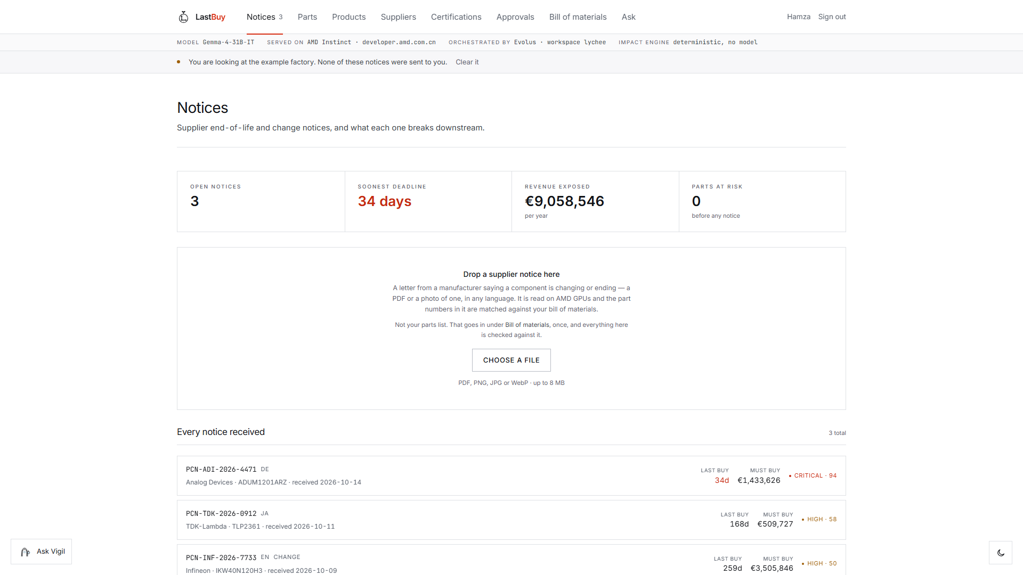
ON A REAL DOCUMENT
We tested it on a letter nobody wrote for us.
Hittite Microwave PCN140002 - a real 2014 notice, 488 KB, scanned. It is a form, so we read the form first and only ask a model for what the page does not say.
model always
form first
OCR on AMD
42s
27s
Evolus extraction
17s
skipped
Model normalisation
103s
skipped
Five parts matched. Last-time buy 2014-02-01, read off its own label.
Total
161s
27s
Cost
10.4 credits
nothing
Vercel kills a request at 60 seconds. The left column does not just cost more - it fails.
MODEL
Gemma-4-31B-IT
ON
AMD Instinct
VIA
Evolus / lychee
ENGINE
no model

Slide 6
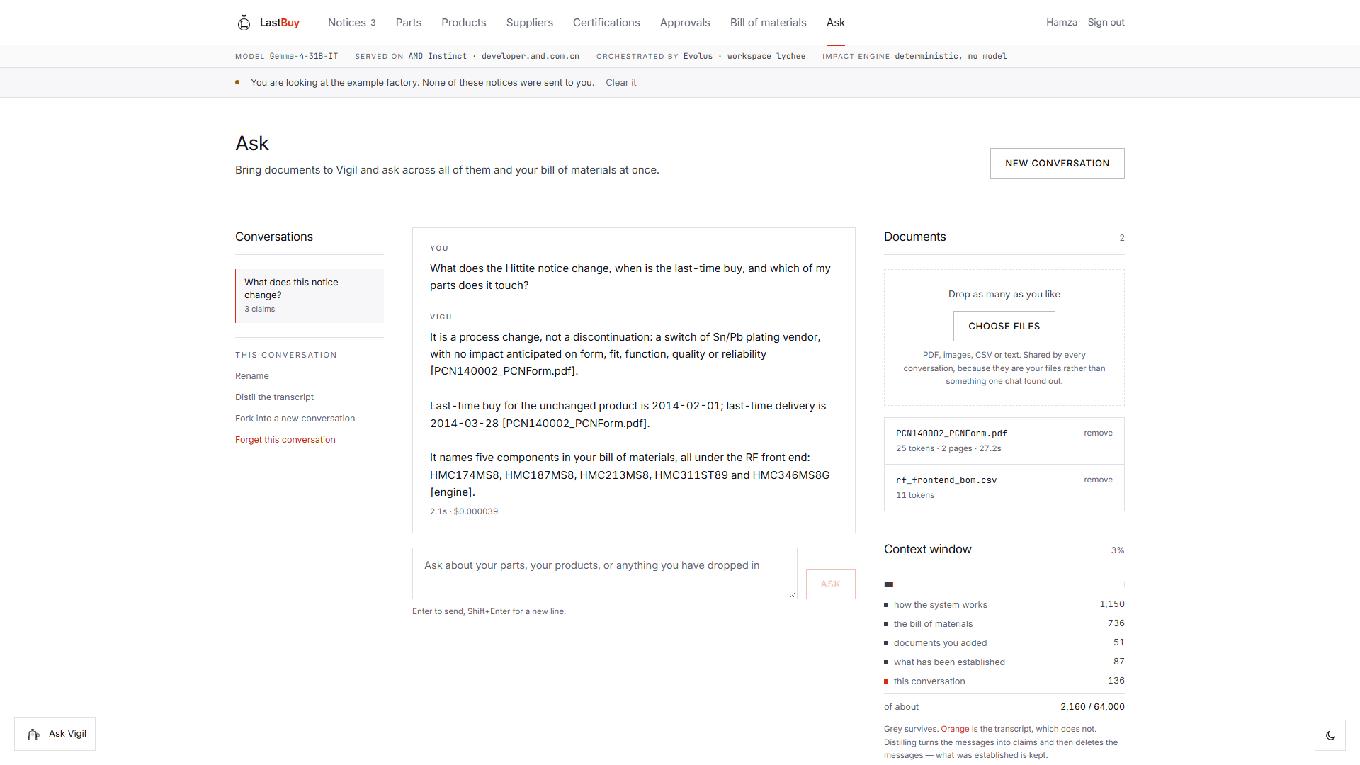
ASK
Bring your own documents. Every answer says where it came from.
Drop in as many files as you like and ask across all of them at once. A claim read from a document ends with the filename. A figure computed from the bill of materials ends with [engine]. The two are never mixed up.
When the window fills, the chat is not summarised. It becomes claims - each with its subject, how it is known, and which document it came from - and the messages are thrown away. A summary cannot be checked. A claim can.
2.1 seconds. $0.000039.
MODEL
Gemma-4-31B-IT
ON
AMD Instinct
VIA
Evolus / lychee
ENGINE
no model

Slide 7
WHAT IT RUNS ON
Three partners, and one file that proves it.
Gemma-4-31B-IT
Google's open model. Reads notices, writes memos, answers in Ask.
2.1s an answer
AMD Instinct
developer.amd.com.cn - MinerU2.5-Pro reads, Gemma does the rest.
every model call
Evolus / lychee
Agent, AI Tools and a knowledge library, driven through the REST API.
cites its clauses
lib/graph.ts
The impact engine. Pure traversal - no model is involved at all.
replayable
lib/amd.ts is the only file in the repository that reaches an inference provider. Grep it for openai, anthropic, groq or fireworks and nothing comes back.
MODEL
Gemma-4-31B-IT
ON
AMD Instinct
VIA
Evolus / lychee
ENGINE
no model

Slide 8
WHAT IT COSTS
Cheap enough to run on everything.
Most teams triage - they only look at the notices that seem important. That is how the expensive ones get missed. At this price you read all of them.
$0.00012
27s
0
60s
a complete assessment
a scanned notice, end to end
credits when the form says it plainly
the request limit we had to fit inside
Every stage reports its own cost on screen, so nobody has to take our word for it.
MODEL
Gemma-4-31B-IT
ON
AMD Instinct
VIA
Evolus / lychee
ENGINE
no model

Slide 9
Contributions
What this is actually for.
Obsolescence management is already an industry.
Every tool in it is a database you search.
This one reads the letter and tells you what breaks.
Keeps products alive
A missed last-time buy ends a product line. Nobody meant to miss it - they just could not work it out in time.
Not only for big firms
A hundredth of a cent a notice, and your own spreadsheet is the input. No enterprise licence, no data migration.
Numbers you can check
Every figure is arithmetic over your bill of materials. Nobody should sign a 1.4 million euro order on a model's word.
LIVE
lychee-seven.vercel.app
CODE
github.com/bukhari-hamzamukhtar
Less thrown away
Buy the quantity the maths gives you, not the panic order that gets scrapped three years later.
EVOLUS WORKSPACE
lychee
Gemma-4-31B-IT on AMD Instinct · Evolus · impact by graph traversal, not generation

