Slide 1
ERTAC EGU Projection Tool Installation
February 24, 2022

Slide 2
Requirement/Recommendation
Hardware
  4 GB of RAM and 1TB HDD for CONUS runs
Software
  Python Version 3.x
  https://www.python.org/downloads/
  * You might already have Python installed if you have ArcGIS or other applications using it.
  ERTAC EGU Projection Code Version 3.0
  https://marama.sharefile.com/home/shared/fod18584-341c-434a-9bc9-c63d65843a7e
  ERTAC EGU Projection Tool Tutorial Data
  https://marama.sharefile.com/home/shared/fof3387f-26e7-4f9c-b528-670f20e9378f
  Request access from MARAMA

Slide 3

Show of Hands
Who has already installed
  Python?
  ERTAC EGU Source Code?

Slide 4
ERTAC EGU Projection Code and Tutorial Data
Steps
Copy source codes and tutorial dataset
  Copy ERTAC EGU code v2.1.1 into the following directory:
    C:\ertac_egu\3.0
  Copy the tutorial dataset into the following:
    C:\ertac_egu\REG2019_Test_Case
Test if the installation is done correctly:
  Open the command window
    “Start” => type cmd
    Type cd C:\ertac_egu\REG2019_Test_Case
    Type C:\ertac_egu\3.0\ertac_preprocess.py –h
    This should return the “help” menu of the code.

Slide 5
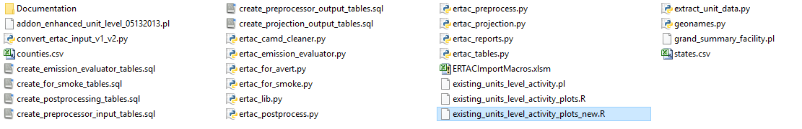
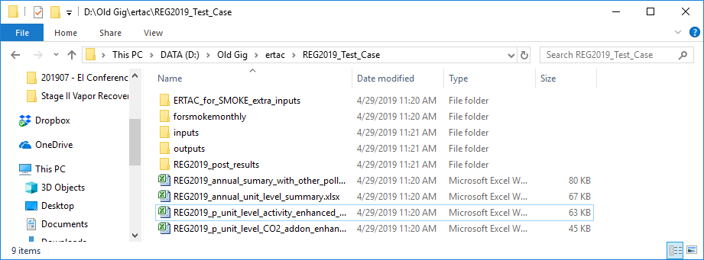
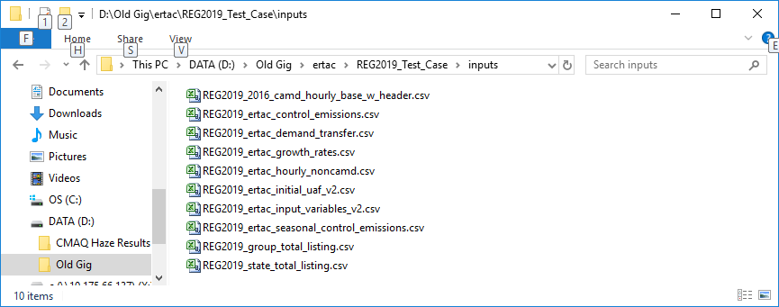
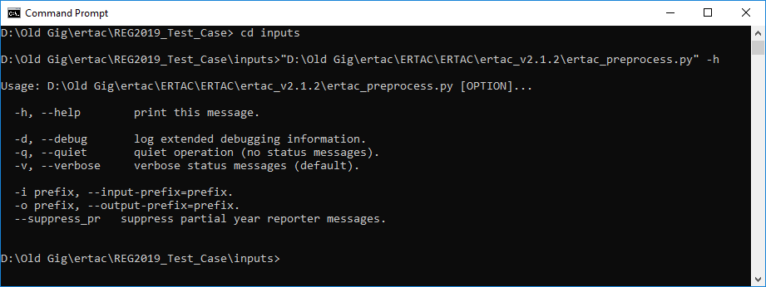
Successful Installation

Slide 6
Before We Run For Real
This isn’t the best practice, but is the simplest way to run the code. Tomorrow you’ll learn better ways to run it.
In windows
  Rename REG2019_2016_camd_hourly_base_w_header.csv to REG2019_camd_hourly_base.csv
  Rename every file so that you remove REG2019_ from the file name

Slide 7
Convert ERTAC Inputs
If you are upgrading from ERTAC v1.x you need to convert the inputs to be v2.x compatible
In the command line window, type
  C:\ertac_egu\2.1.1\convert_ertac_input_v1_v2.py
Wait until you see the command line prompt again
  This will finish in a flash
  You will have new versions of ertac_inital_uaf and ertac_input_variables

Slide 8
Tutorial Case - Preprocessing
Steps
In the command line window, type
  C:\ertac_egu\3.0\ertac_preprocess.py
Wait until you see the command line prompt again
  May take about 2-3 minutes to finish
  You should be able to see calc* files
Review the log file before running the projection code

Slide 9
Tutorial Case - Projection
Steps
In the command line window, type
  C:\ertac_egu\3.0\ertac_projection.py
Wait until you see the command line prompt again.
  May take about 2-3 minutes to finish
  You should be able to see “calc*” files
Review the log file before running the post-processing code

Slide 10
Tutorial Case - Postprocessing
Steps
In the command line window, type
  C:\ertac_egu\3.0\ertac_postprocess.py
Wait until you see the command line prompt again
  May take about 2-3 minutes to finish
  You should be able to see calc* files
Review the log file carefully
Notes:
  Additional command line inputs are available for power users
  Additional post processor available to create SMOKE-ready files with stack info and additional pollutants

Slide 11
Options for Advanced Users
Setting Up a Batch Run
  If you want to do streamline run, you can create a batch file that contains the following lines:
    C:\ertac_egu\3.0\ertac_preprocess.py
    C:\ertac_egu\3.0\ertac_projection.py
    C:\ertac_egu\3.0\ertac_postprocess.py
Command Line Options (except postprocessor)
  -i for prefix of input files
  -o for prefix of output files
  Note: post processor has additional command line options that are available by running --help

Slide 12
Got Problems?
Join our technical support Google Group: ertac-egu-user and ask your question:
  https://groups.google.com/forum/#!forum/ertac-egu-user

