Slide 1
EGU Forecasting Tool Setup
Joseph Jakuta
Environmental Associate
OTC

Slide 2
Background
Hardware Requirements
A 64-bit computer running at least 4 GB of RAM
Recommend a hard drive that is at least 1 TB
Software Requirements
Windows with Python libraries version 2.6 or 2.7 series installed, which should include SQLite 3.6 or 3.7 series
Note: the code is known not to work if Python and SQLite are not up to the suggest versions

Slide 3
Background
ERTAC Model Files These are the executable files
ertac_preprocess.py
ertac_projection.py
ertac_postprocess.py
ERTAC Library Files
ertac_reports.py, ertac_lib.py, ertac_tables.py,
counties.csv, states.csv,
create_preprocessor_input_tables.sql, create_preprocessor_output_tables.sql, create_projection_output_tables.sql,
create_postprocessing_tables.sql

Slide 4
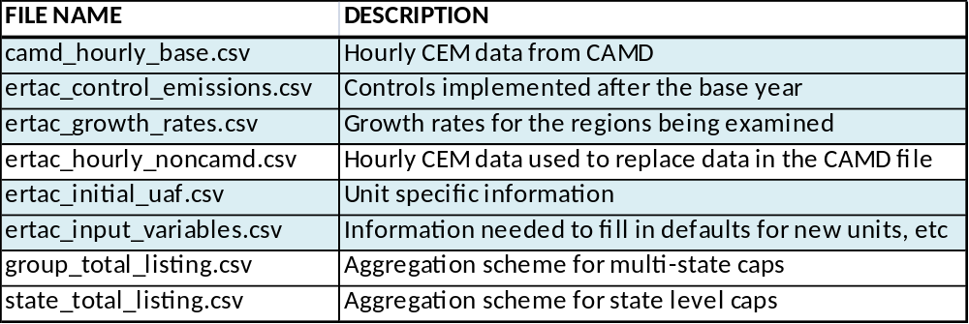
Inputs
File names are important and must contain certain information for the model to read them correctly
Shaded files are required.

Slide 5
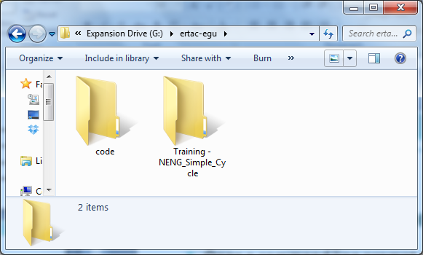
Tool Setup
Create a directory for your executables (tool) as well as county, state, and SQL files
Download copies of the latest version of the input files, i.e. CONUS1.7 (2007 base) or CONUS2.0 (2011 base)
Create a second
directory for your
input files as well as
an output directory
if desired

Slide 6
Tool Setup
The preprocesser is to be used to screen the input files for potential issues
Log file from the preprocess can be lengthy and some warnings may be ignored
The projection portion of the model is the second step and will yield results that should be reviewed extensively
Run times will depend on your system (6 hours for the preprocessor and 16 hours for the projection module for a CONUS run)
  These run times are on a Intel Quad Core Q9400 @ 2.6 6GHz with 8 GB installed RAM and 64-bit operating system using Windows 7 Professional and a 1 TB hard drive
Typical CONUS run creates about 5 or 6 GB in output files after the projection portion

Slide 7
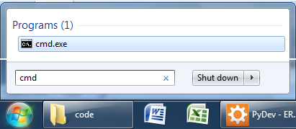
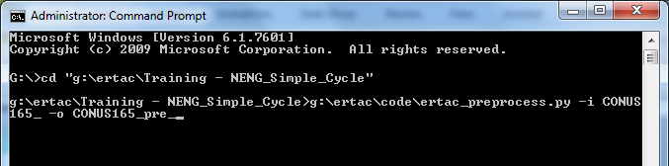
Tool Execution: Preprocess
Open a command line prompt
(go to the start button and type “cmd” in the search window
Navigate to the directory that contains the input files
Example command:
  c:\ertac\code\ertac_preprocess.py –i CONUS165_ -o CONUS165pre_

Slide 8
Tool Execution: After Preprocess
Review the log file for possible issues and refer to the user’s guide and documentation e-mails for information
If the input files require editing open them in Excel and make changes and save as CSV files (beware of leading zeros in unit ID fields)

Slide 9
Tool Execution
Run the projection module
  Reads files created by the preprocessor
Example command:
  c:\egu-code\ertac_projection.py –i CONUS165pre_ -o CONUS165proj_
Review log and output files

Slide 10
Tool Execution: Post Processing
Four files are created to allow for easier viewing of unit level results.
  Annual Summary
  Hourly diagnostic file including base and future year data
  Hourly file by region
  Hourly file by state
The Annual Summary in particular can easily be imported into excel and used with pivot tables
Notes: There is an additional, experimental version that allows graphics to be produced, but its only in Beta

Slide 11
Tool Execution: Post Processing
Extra input options are available for the script
  --input-prefix-pre=: required, will be the output prefix used in the preprocesor
  --input-prefix-proj=: required, will be the output prefix used in the projection
  --output-prefix=: recommended, prefix for making sure your run is clearly located
  The following can be used in combination with each other:
    --state=: produces results for only a particular state (set of states) (CT,DE,ME)
    --region=: produces results for only a particular ERTAC region (set of regions) (RFCE,RFCW)
    --fuel-bin=: produces results for only a particular ERTAC fuel unit type bin (set of…) (Coal,”Combined Cycle”,”Boiler Gas”)
    --orisid=: produces results for a particular facility (set of facilities) (2076,2077)
    --unitid=: produces results for a particular unit (set of units) (orisid is required) (“BLR 1”, “BLR 2”)
    --time-span=: produces results for: Annual, FirstQtr, SecondQtr, ThirdQtr, FourthQtr, OzoneSeason (Annual,OzoneSeason)
Run time: About as long as projection code
Example command:
  c:\ertac\code\ertac_postprocess.py –input-prefix-pre= CONUS165_ --input-prefix-proj= CONUS165_proj_ --ouput-prefix=CONUS165_post_ --fuel-bin=Coal --time-span= OzoneSeason -- region=RFCE,RFCW
  This will provided results for all Coal units during Ozone Season in RFCE and RFCW

Slide 12
Tool Execution: Smoke Conversion
Note: This code is not provided on the ftp
An additional script exists to convert ERTAC results to SMOKE ready to hourly and annual inputs (in ff10 format)
Also adds hourly emissions for PM, CO, NH3, and VOC based on hourly heat rate
Script requires three additional input csv files
  ertac_additional_variables.csv – contains additional state/fuel unit type defaults to fill in missing information (generic stack parameters, emission rates)
  ertac_base_year_rates_and_additional_controls.csv – contains base year emission rates to be used for PM, CO, NH3, and VOC as well as information about future year controls
  ertac_pusp_info_file – contains information about unit specific stack parameters, scc codes, and ways to allocate pollutants for units with multiple stacks/processes
Can produce results for a particular state (sets of states) or pollutant (set of pollutants)
Future version should process base year emissions as well

Slide 13
Questions
For additional information, please contact Joseph Jakuta at jjakuta@otcair.org (202) 508-3839 or John Welch at jwelch@idem.IN.gov or (317) 233-2637
To read and ask support questions visit the google group - https://groups.google.com/d/forum/ertac-egu-user.
Note: anyone can read previous posts, but you must register to post questions.
To join the group:
  Sign in using your google account
    If you don’t want a full gmail email address you can sign up using your work account
  Click to apply to the group

