Slide 1
The Tetris game
Valeriia Zaichikova
Egor Kravchenko
Dmitry Zlobin
23930

Slide 2
Contents
Introduction
Purpose and area of application
Functional characteristics
Technical characteristics
Conclusion

Slide 3
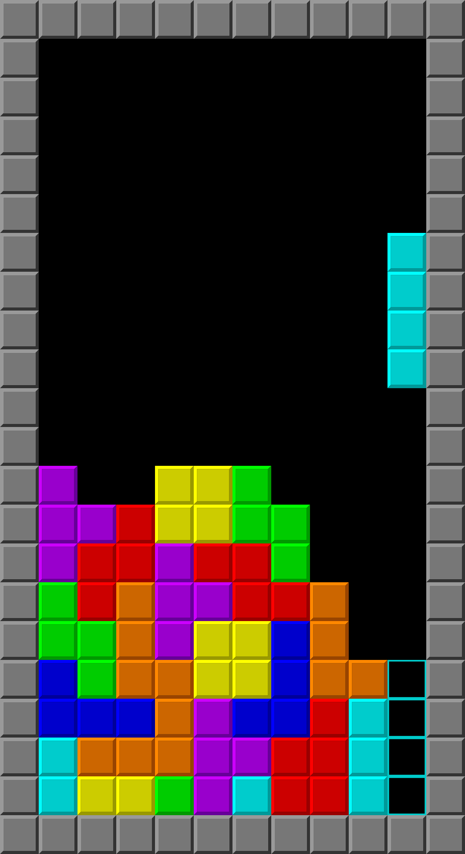
Introduction
Number of full lines | Score for them
1 | 100
2 | 300
3 | 700
4 | 1500
Standard lines-to-score comparison
Classic example of Tetris gameplay

Slide 4
Purpose and area of application
The objective of the program is to implement it on low-level platforms such as assembler and logic circuits
The program is designed for use in gaming and entertainment spheres

Slide 5
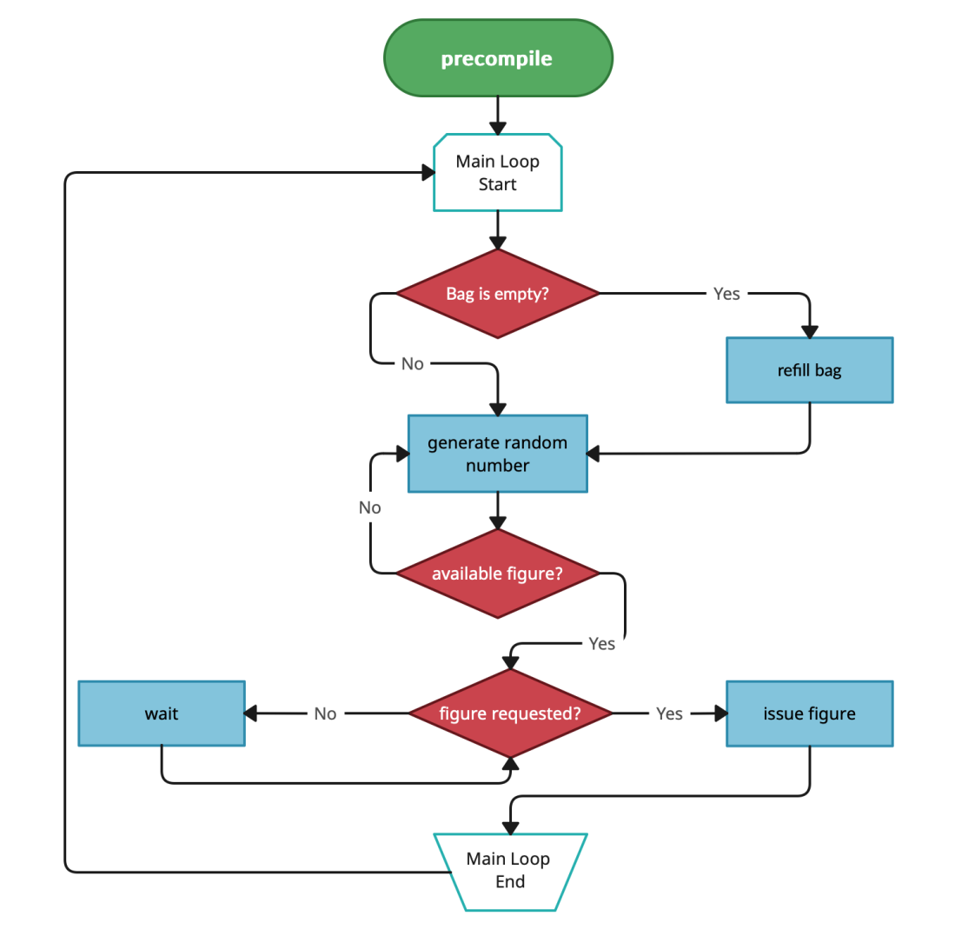
FUNCTIONAL CHARACTERISTICS (SOFTWARE)
The software part (assembly code) for our project is used to generate random figures for the gameplay.
The Random Generator in this project is using the «bag» system. In this system, a list of figures is placed in a «bag», after which they are randomly removed from it one by one until the «bag» is empty.

Slide 6
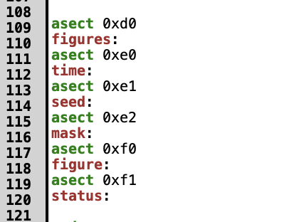
1 Code parts’ description
Code parts description
A section of code for allocating memory for a "bag", components for a random number generator and working with the CdM-8 processor

Slide 7
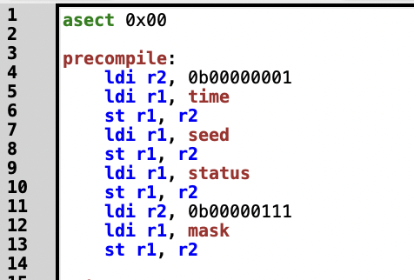
1 Code parts’ description
Code parts description
The precompile section is used for initial data filling

Slide 8
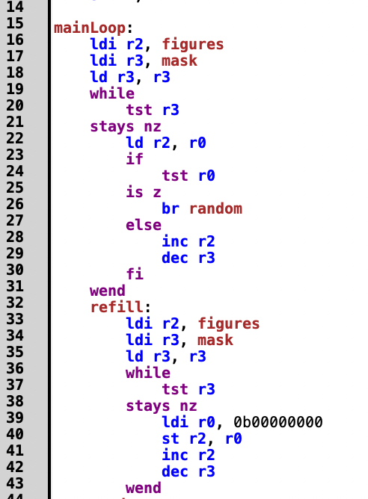
CODE PARTS DESCRIPTION
The main cycle of the program contains all the necessary functions for the correct operation of the randomizer. Firstly, we check if there are any available shapes left and refill the bag if necessary

Slide 9
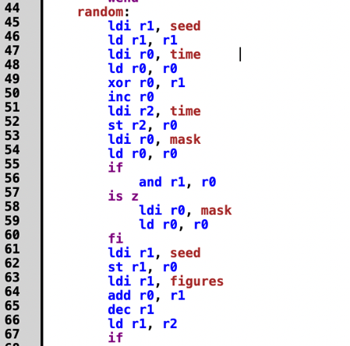
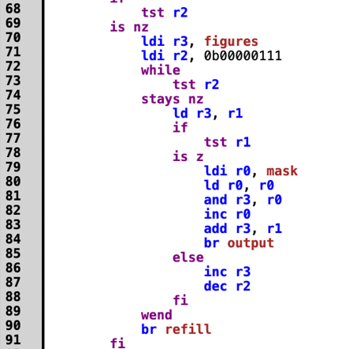
Code parts description
A function for generating a random number by using a timer and seed, as well as a mask that limits the range of numbers from 0 to 7, after which a check is performed if the number is not 0. This is a feature of the program. Finally, the function checks if the resulting figure has not been used yet and replaces it if necessary.

Slide 10
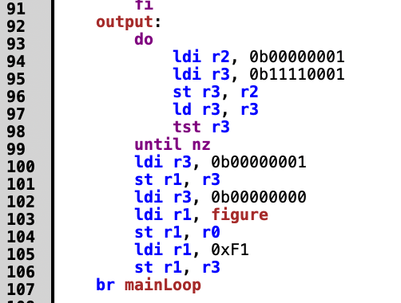
CODE PARTS DESCRIPTION
The next part of the code checks if a new figure has been requested and issues it to the hardware

Slide 11
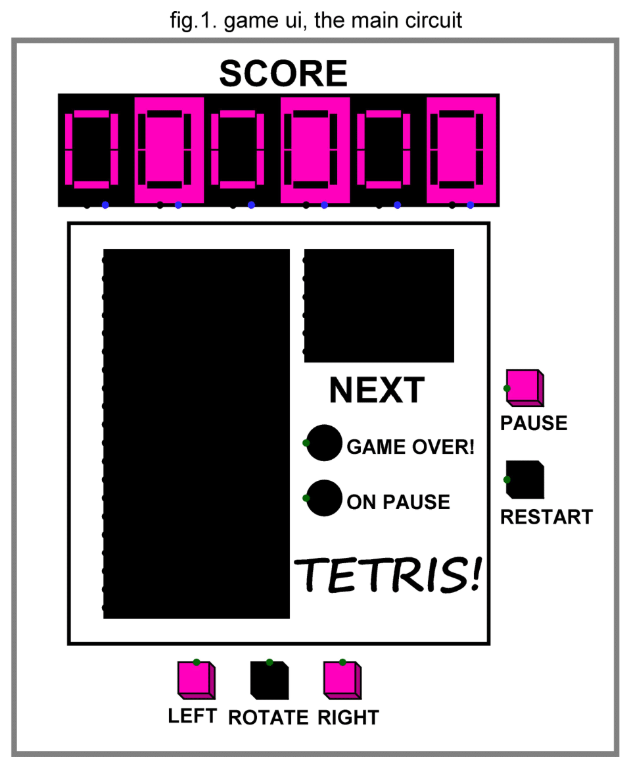
Technical characteristics (HARDWARE)
The Output Display

Slide 12
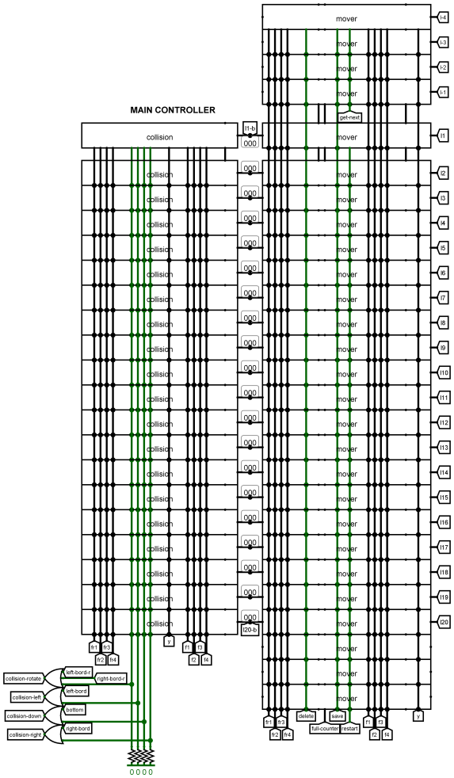
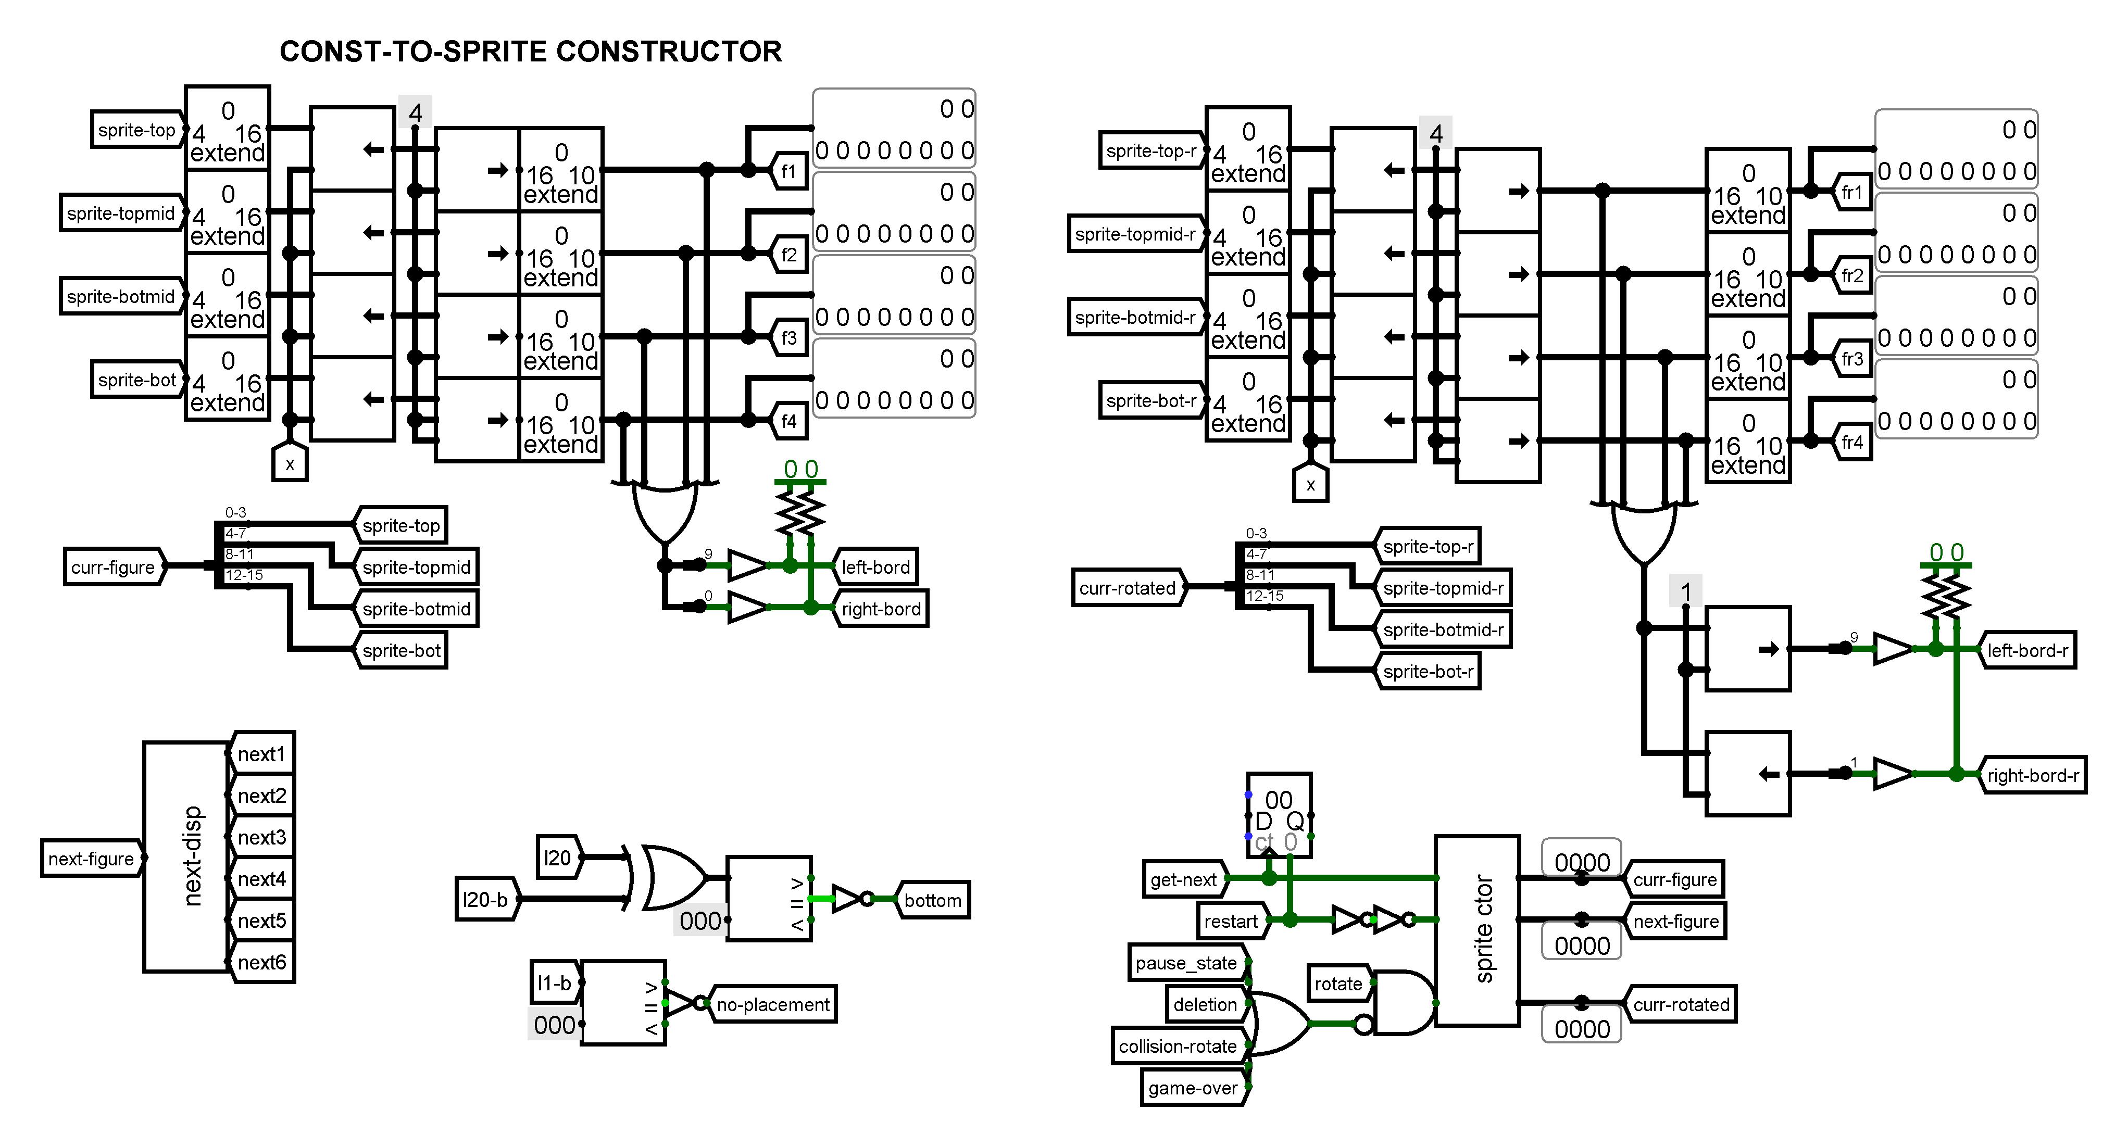
The field subcircuit
Const-to-sprite constructor
Main controller

Slide 13
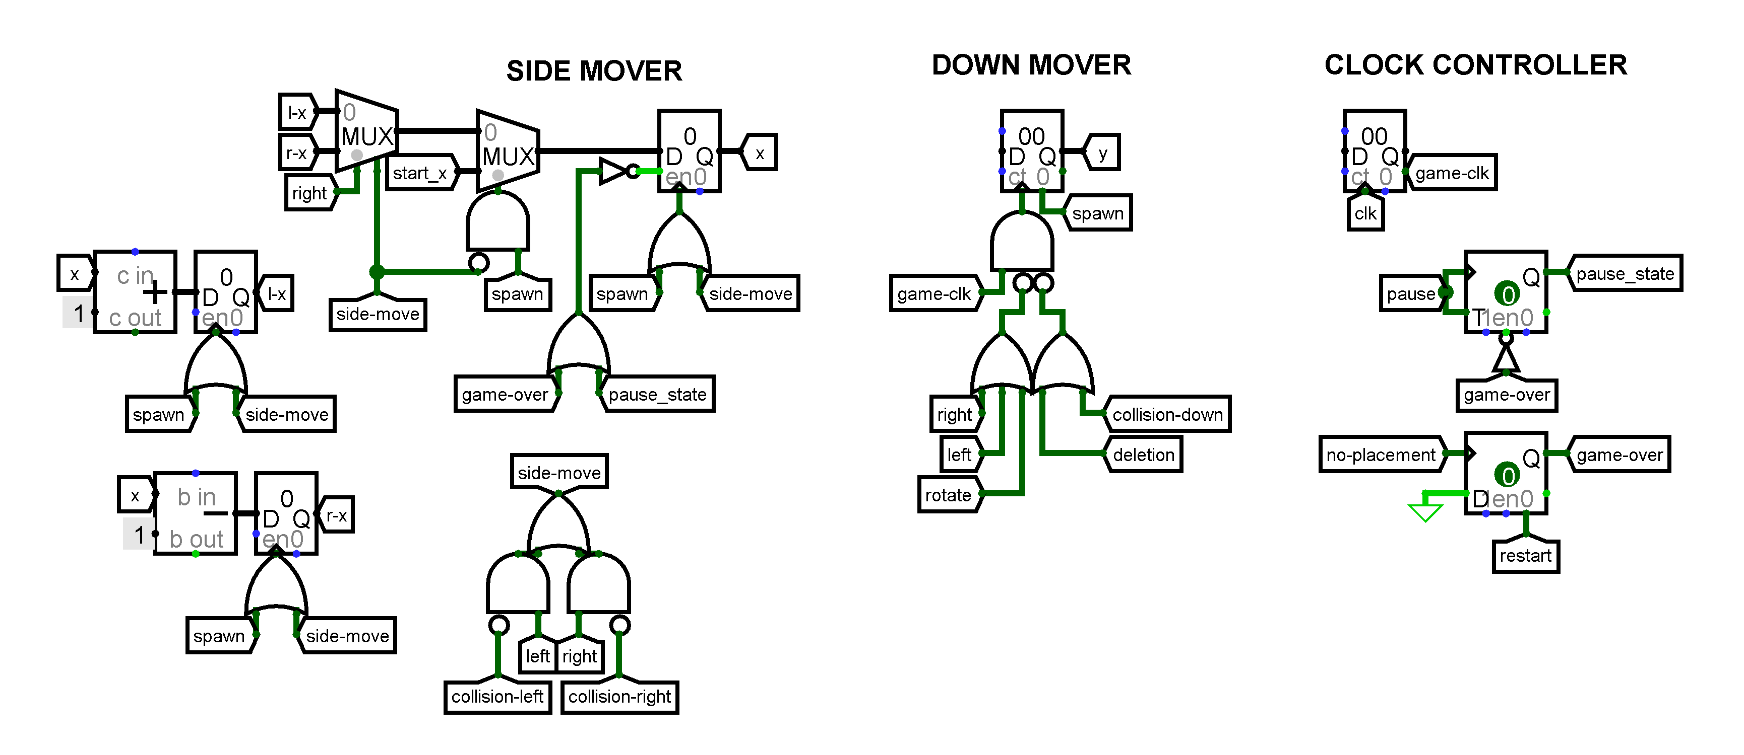
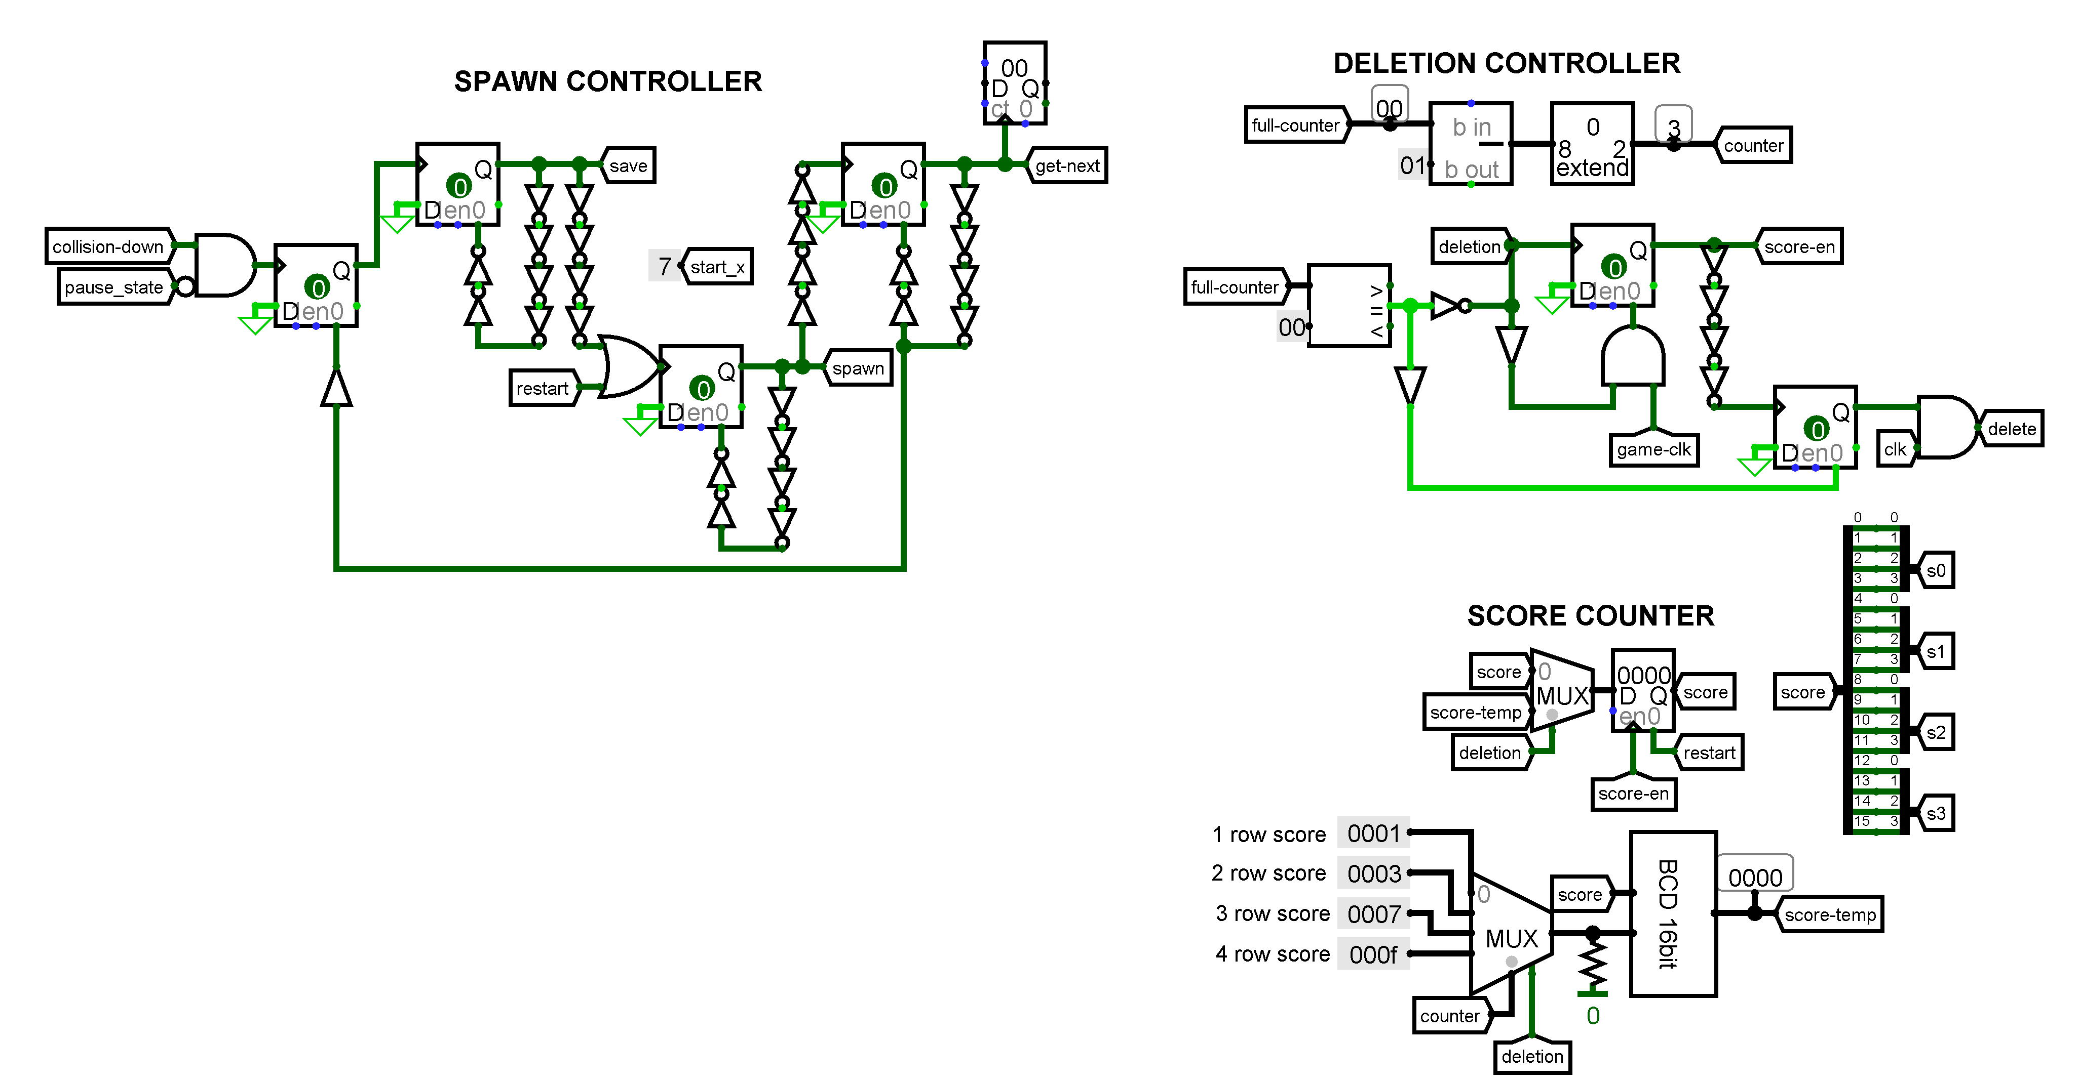
THE FIELD SUBCIRCUIT
Movement controller
Score counter and deletion controller

Slide 14
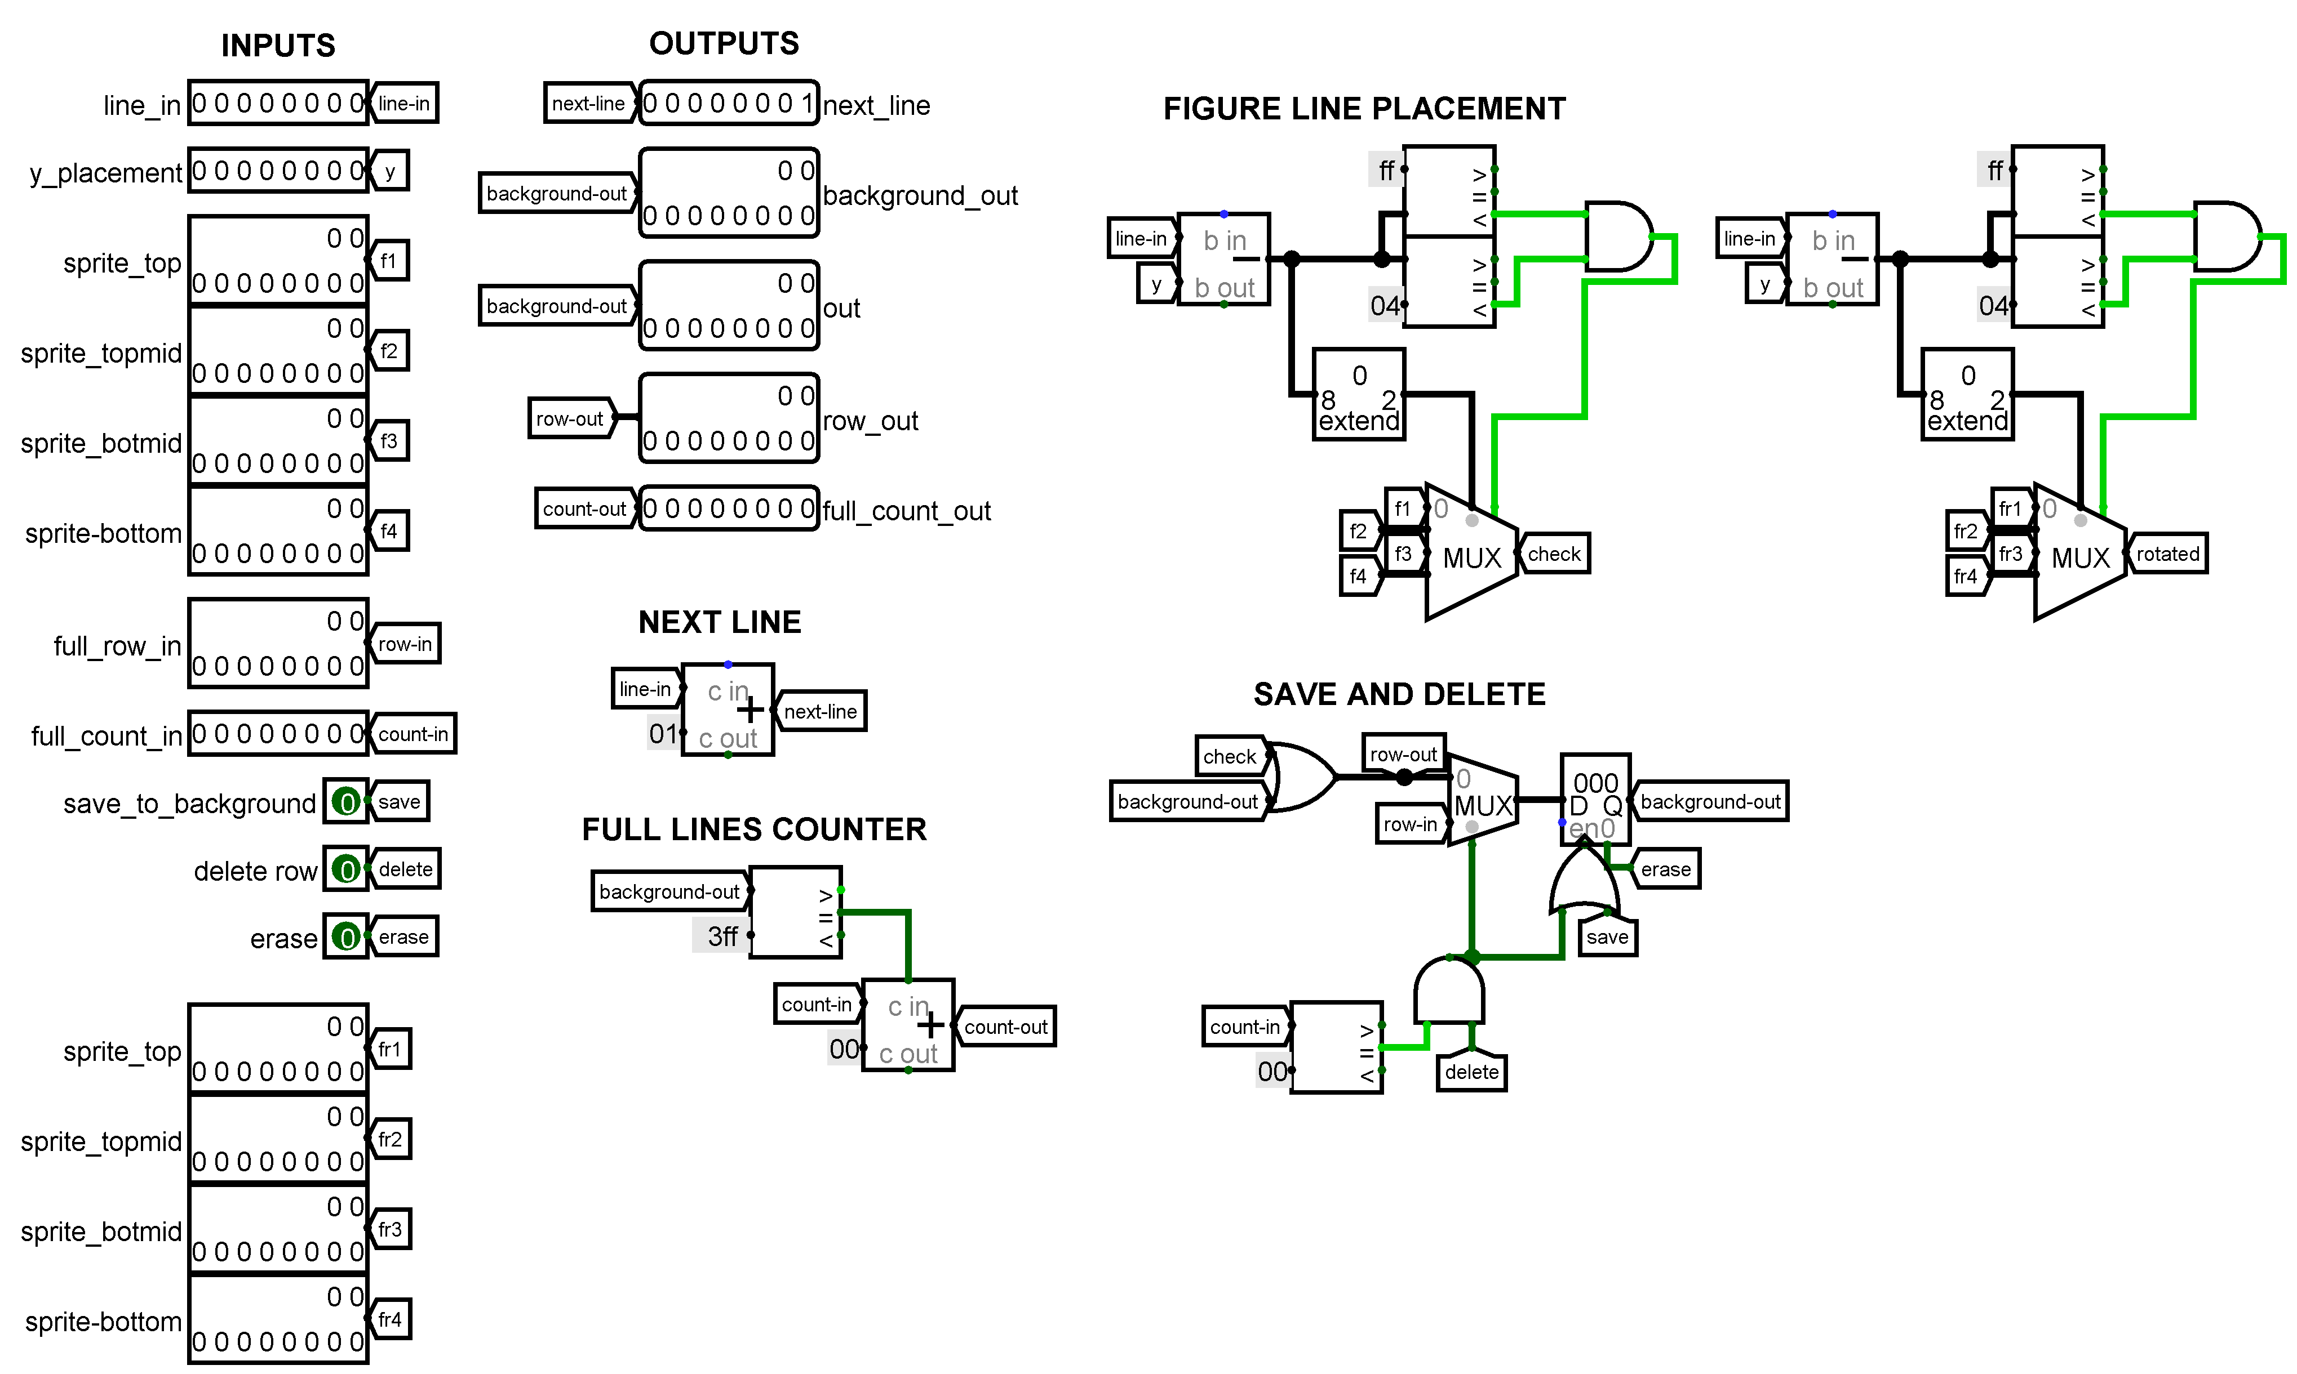
Sprite Control subcircuit

Slide 15
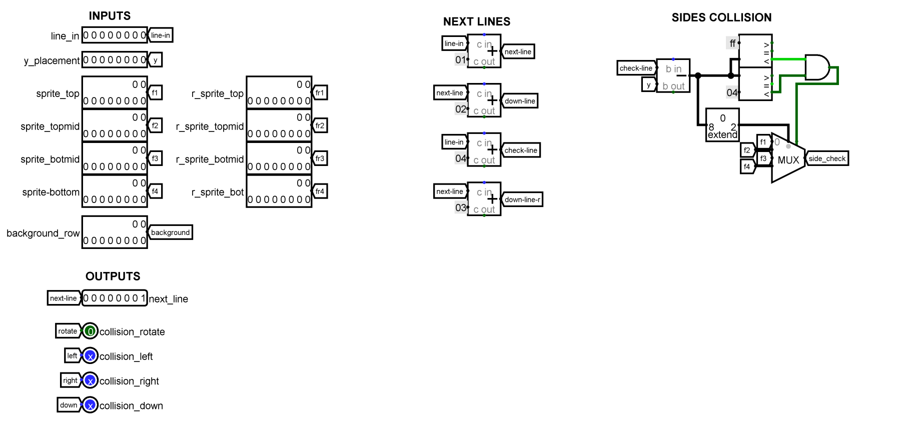
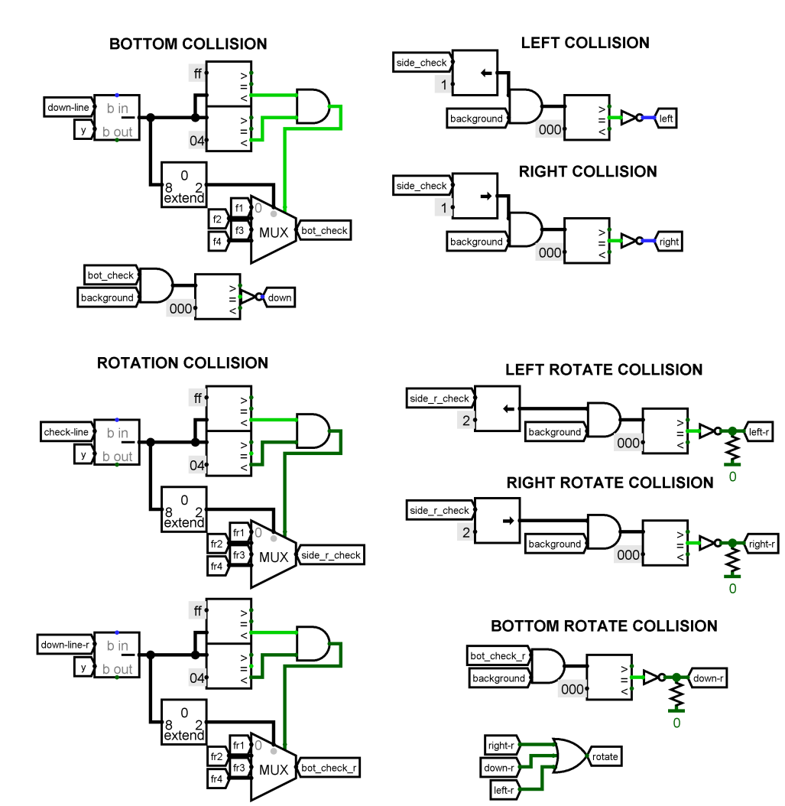
Collision subcircuit

Slide 16
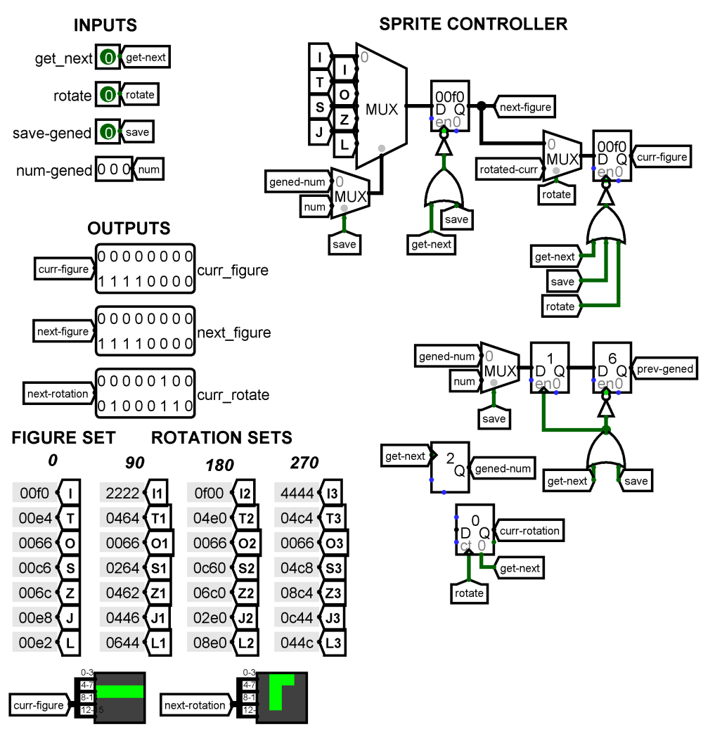
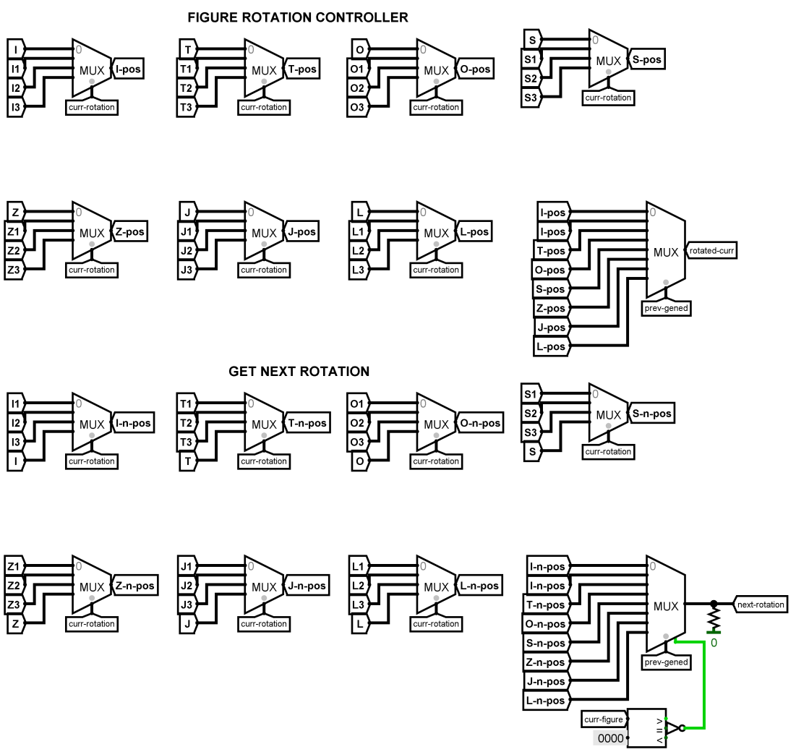
Get Figure subcircuit

Slide 17
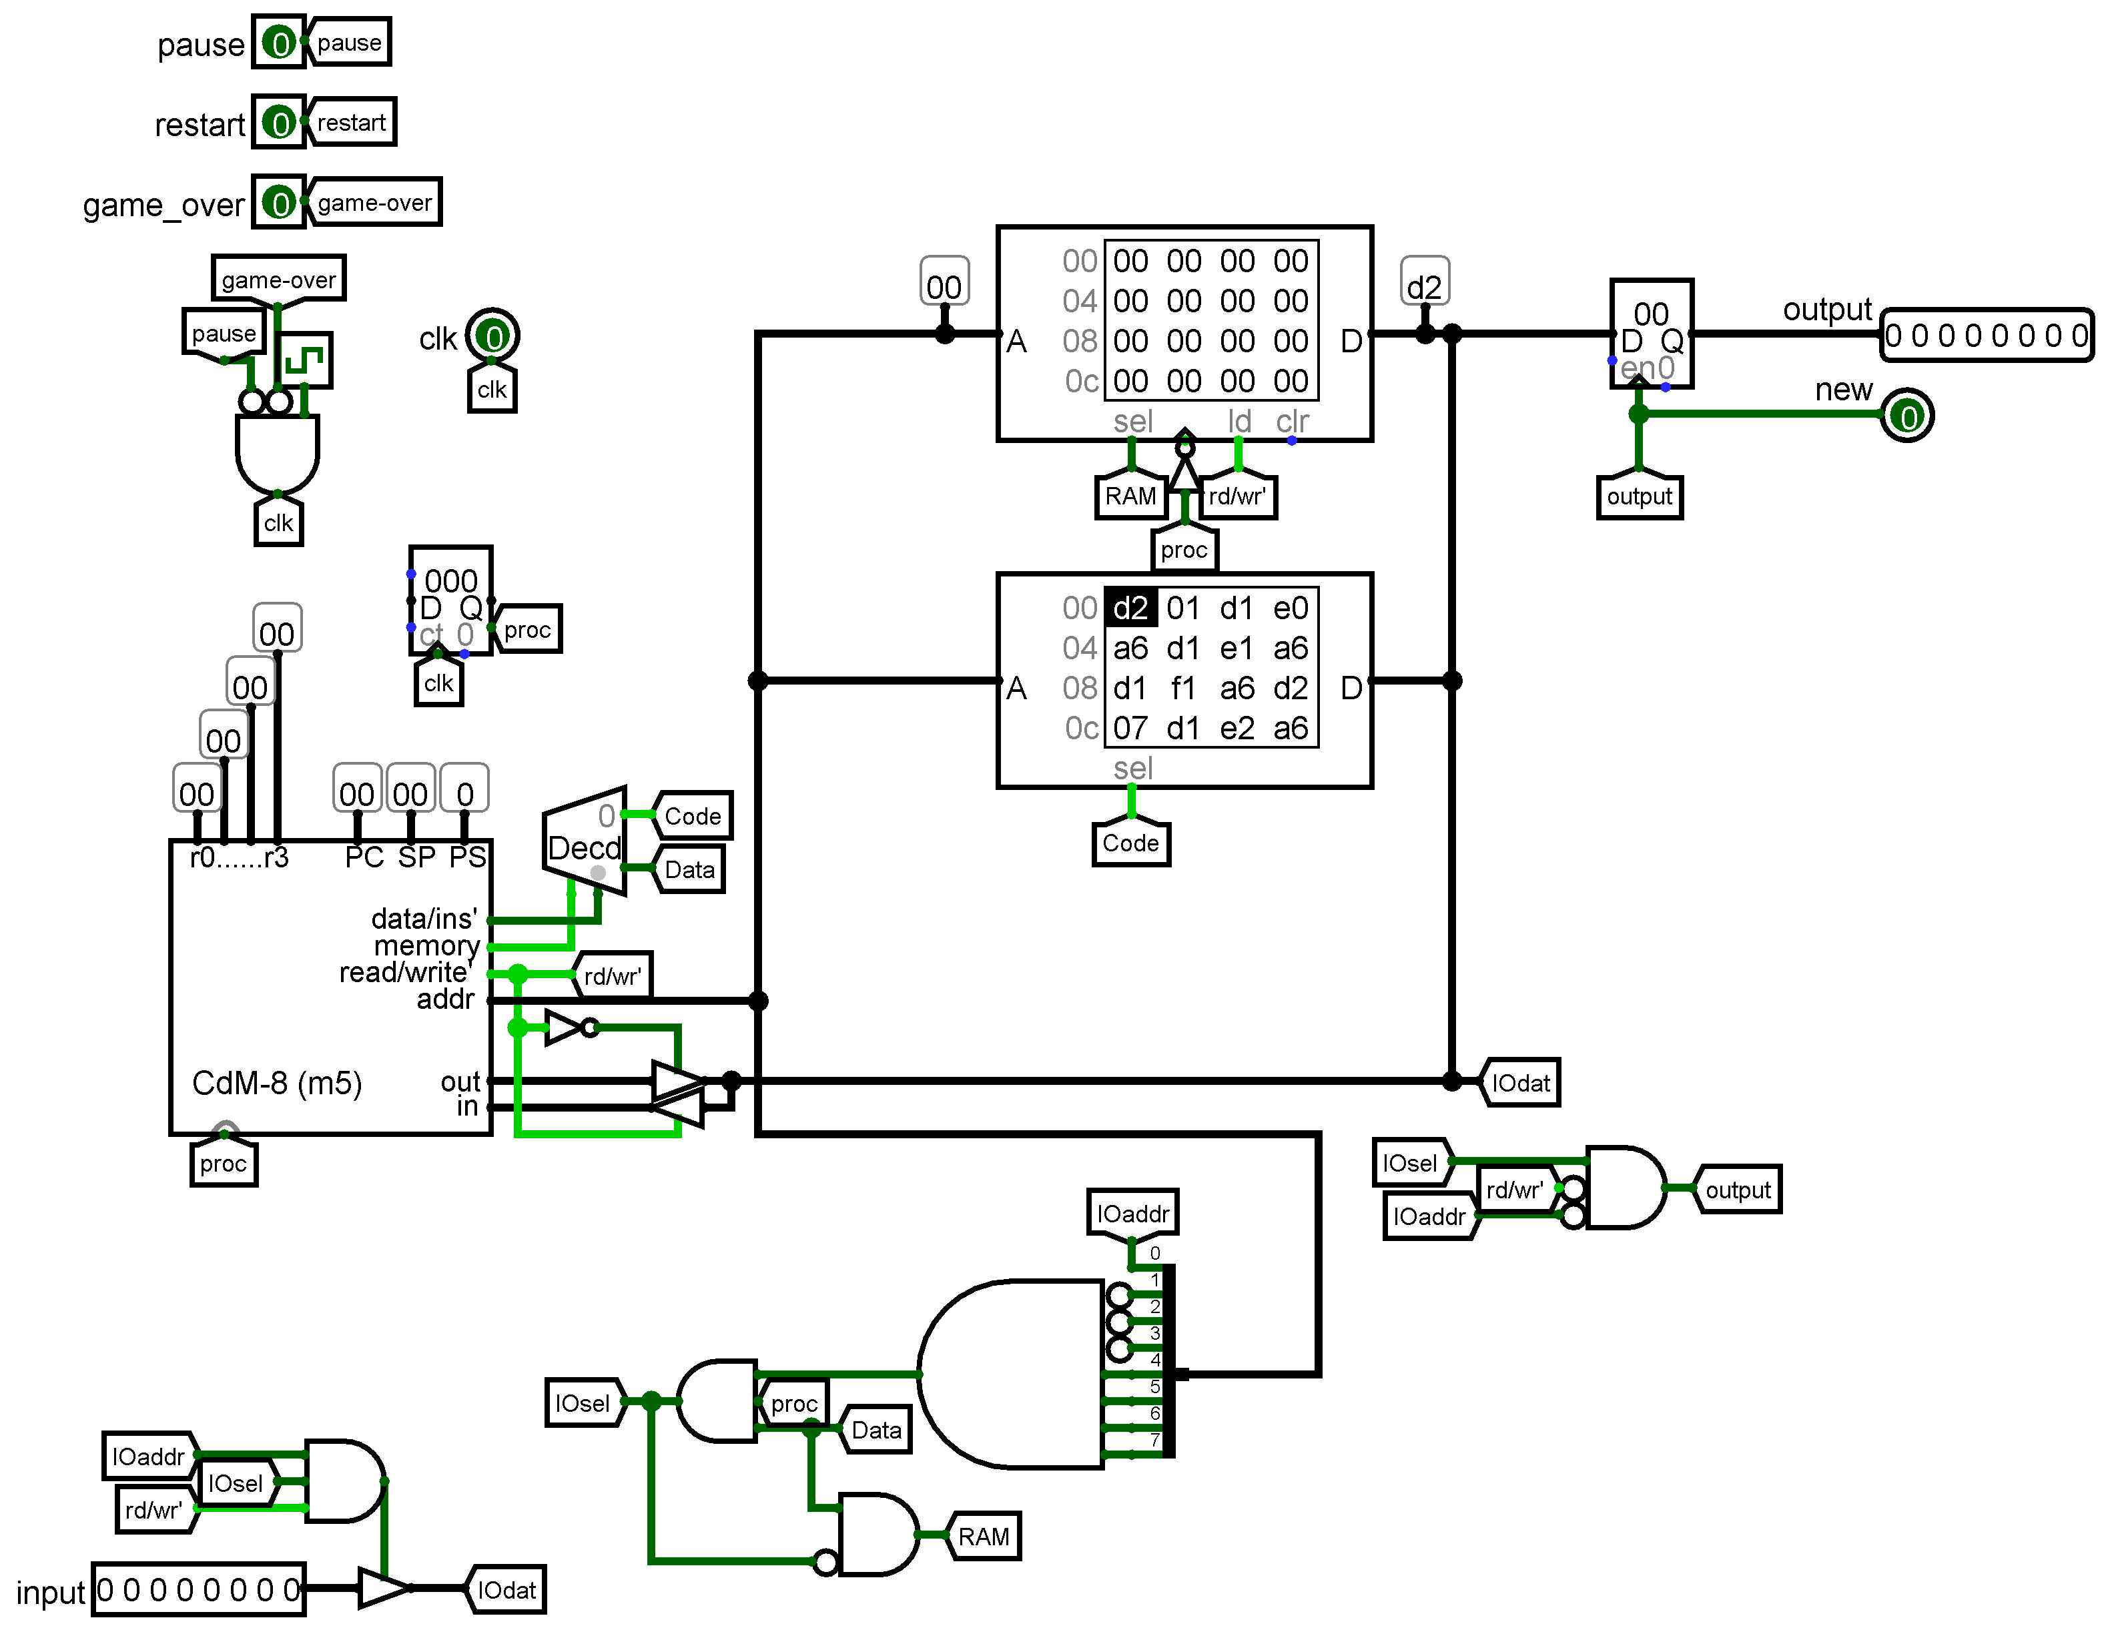
Processor manager subcircuit

Slide 18
GAME DEMONSTRATION

Slide 19

CONCLUSION
The project of implementing the Tetris game on assembler and via logic circuits has been successfully completed.

