Slide 1

WRITING SQL OUTER JOINS
Bukola Olafenwa
Academic Mentor at The LETTA Trust, London​​

Slide 2

Presentation outline
Reminder: What makes a JOIN.
Reminder: Types of JOIN.
Types of OUTER JOIN.
Syntax for writing types identified.
Writing OUTER JOINs
Summary.

Slide 3
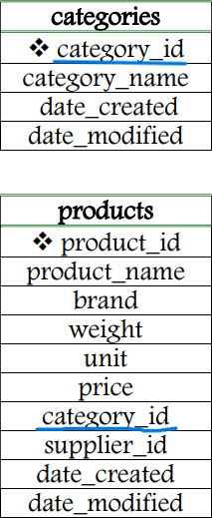
What makes a JOIN
A data analytical operation involving retrieving data from fields of two or more tables in a single query.
Tables are joined based on a common/related field.
Also, aliasing is paramount! Field names are qualified by table names and tables names by their shortened forms to achieve brevity, clarity and successful return of the result set.

Slide 4
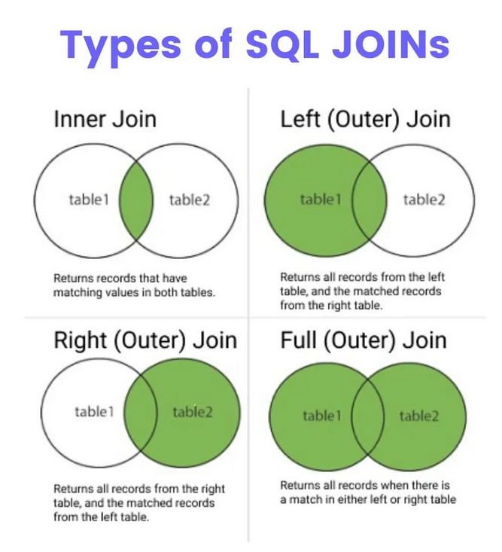
LEFT and RIGHT JOINs return unmatched records as NULL values.

Slide 5

FOCUS
LEFT
and
RIGHT
(OUTER) JOINS!

Slide 6
SYNTAX FOR WRITING A LEFT JOIN
SELECT column list,
FROM table1
LEFT (OUTER) JOIN table2
ON table1.column = table2.column;

Slide 7
SYNTAX FOR WRITING A LEFT JOIN
SELECT column list,
FROM table1
LEFT (OUTER) JOIN table2
USING (column);

Slide 8
SYNTAX FOR WRITING A RIGHT JOIN
SELECT column list,
FROM table1
RIGHT (OUTER) JOIN table2
ON table1.column = table2.column;

Slide 9
SYNTAX FOR WRITING A RIGHT JOIN
SELECT column list,
FROM table1
RIGHT (OUTER) JOIN table2
USING (column);

Slide 10
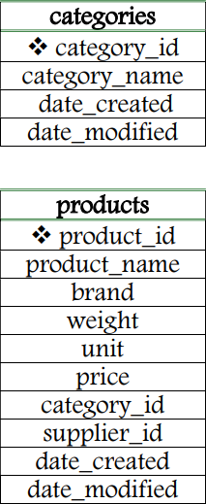
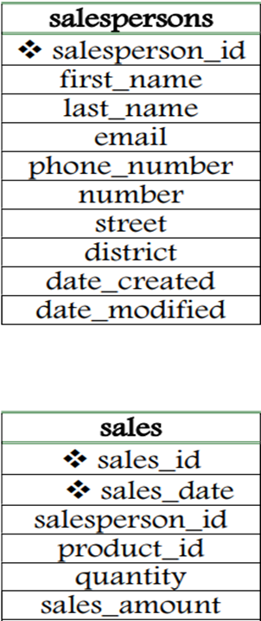
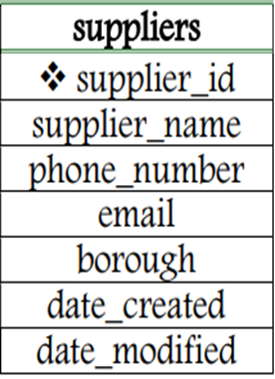
SAMPLE RELATIONAL DATABASE
FIVE TABLES

Slide 11
WHAT NEXT?
LET’S WRITE SOME LEFT and RIGHT (OUTER) JOINS!

Slide 12
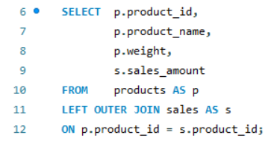
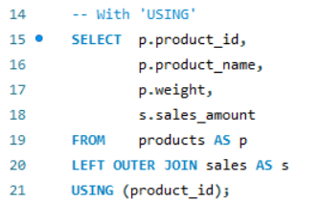
WRITING A LEFT JOIN WITH ‘ON’AND ‘USING’ COMMANDS (OF TWO TABLES)
SAMPLE QUESTION
Retrieve the id, name, weight and sales amount of all products, including products that have not been sold.
USING ‘ON’
USING ‘USING’

Slide 13
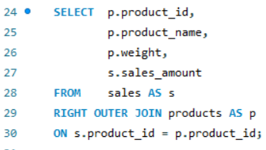
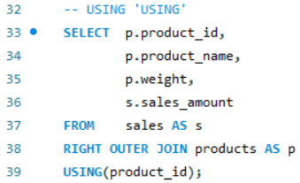
WRITING A RIGHT JOIN REVERSAL OPERATION WITH ‘ON’ AND ‘USING’ COMMAND (OF TWO TABLES)
SAMPLE QUESTION
Retrieve the id, name, weight and sales amount of all products, including products that have not been sold.
USING ‘ON’
USING ‘USING’

Slide 14
MORE QUESTIONS ON WRITING A LEFT JOIN/RIGHT JOIN EQUIVALENT
WITH TWO TABLES:
Write queries to find the following:
Salespersons’ id along with their corresponding total sales, including salespersons who haven’t made any sales.
All categories along with their product count, including categories with no product.
Salespersons’ first names and total quantity of products sold, including salespersons without any sales record.
All suppliers and product count, including suppliers who have not supplied products.
WITH TWO JOIN CONDITIONS
Supplier names of all products with id greater than 20.
WITH THREE TABLES:
All categories and suppliers’ names, including categories without suppliers.

Slide 15
Summary
LEFT and RIGHT OUTER JOINs clearly exceed the limits of inner joins by facilitating more complex data analytical operations that require the return of both matched and unmatched records.
The relations of reversibility between the LEFT JOIN and the RIGHT JOIN offers more than one way of retrieving unmatched records from the database.

Slide 16
References
Bukola, O. bukola-2023/BUKOLA-PROJECTS: Bukola's Project Profile (github.com)
https://twitter.com/Python_Dv/status/1721309165967323608
https://www.tutorialrepublic.com/sql-tutorial/sql-cross-join-operation.php
https://databasefaqs.com/sql-server-self-join/
Udemy. Course: The Ultimate MySQL Bootcamp: Go from SQL Beginner to Expert | Udemy
CFG (2023). Code First Girls (2023). Data ANALYSIS FOR complex structures.

