Slide 1


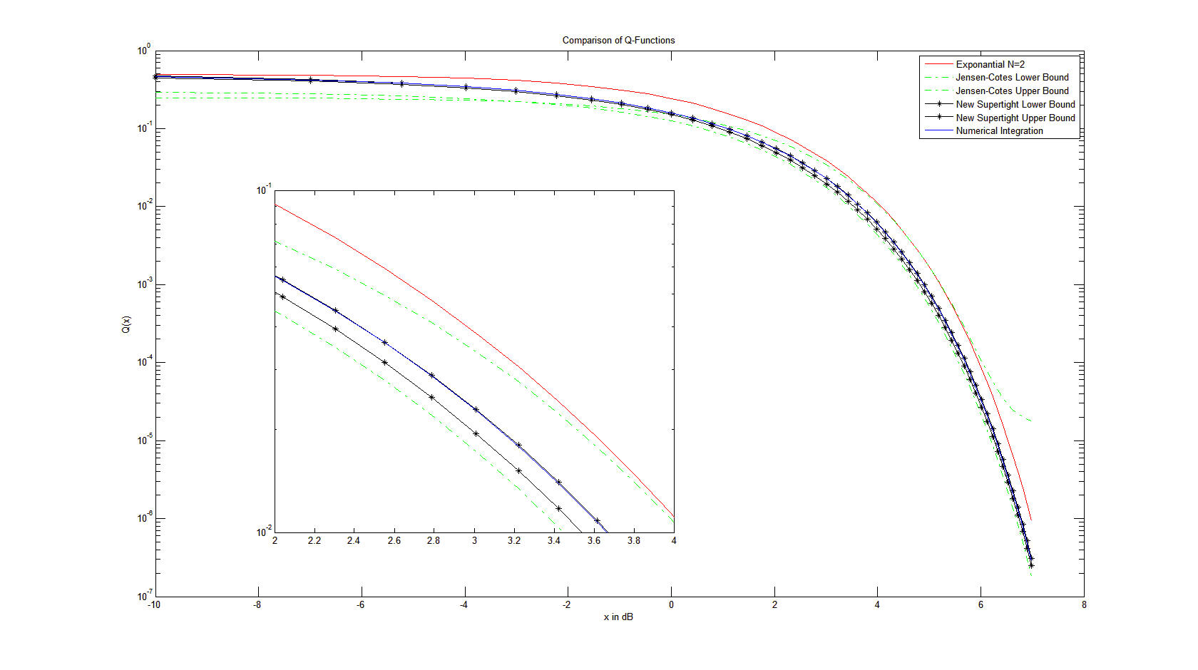
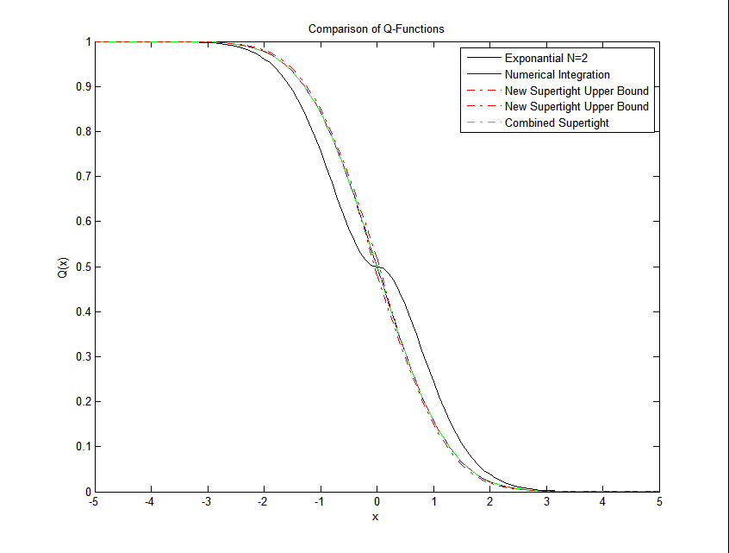
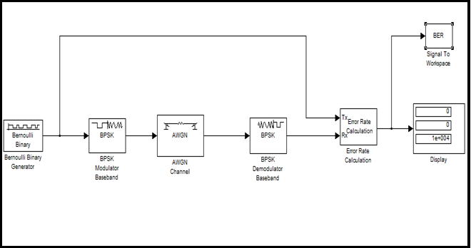
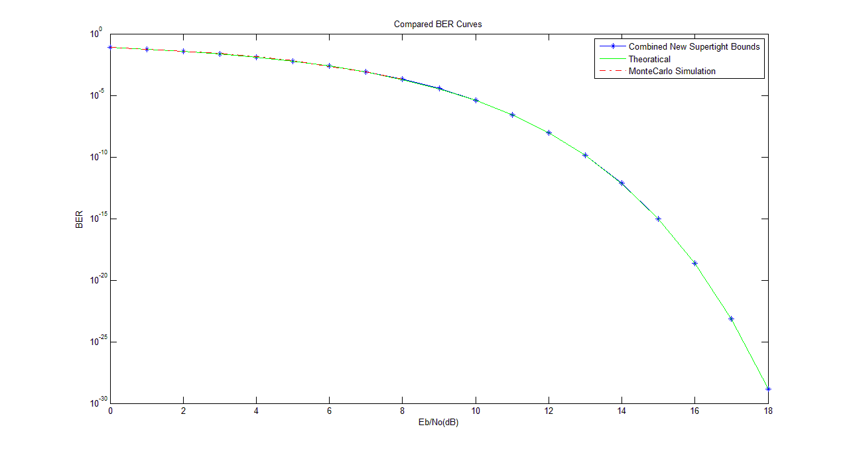
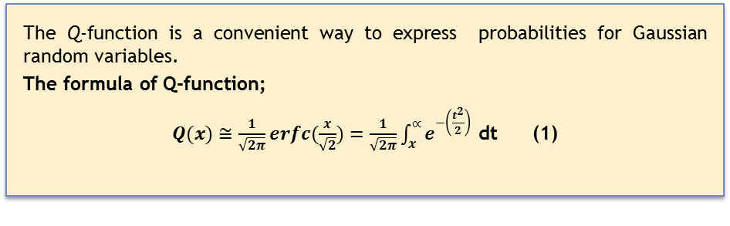
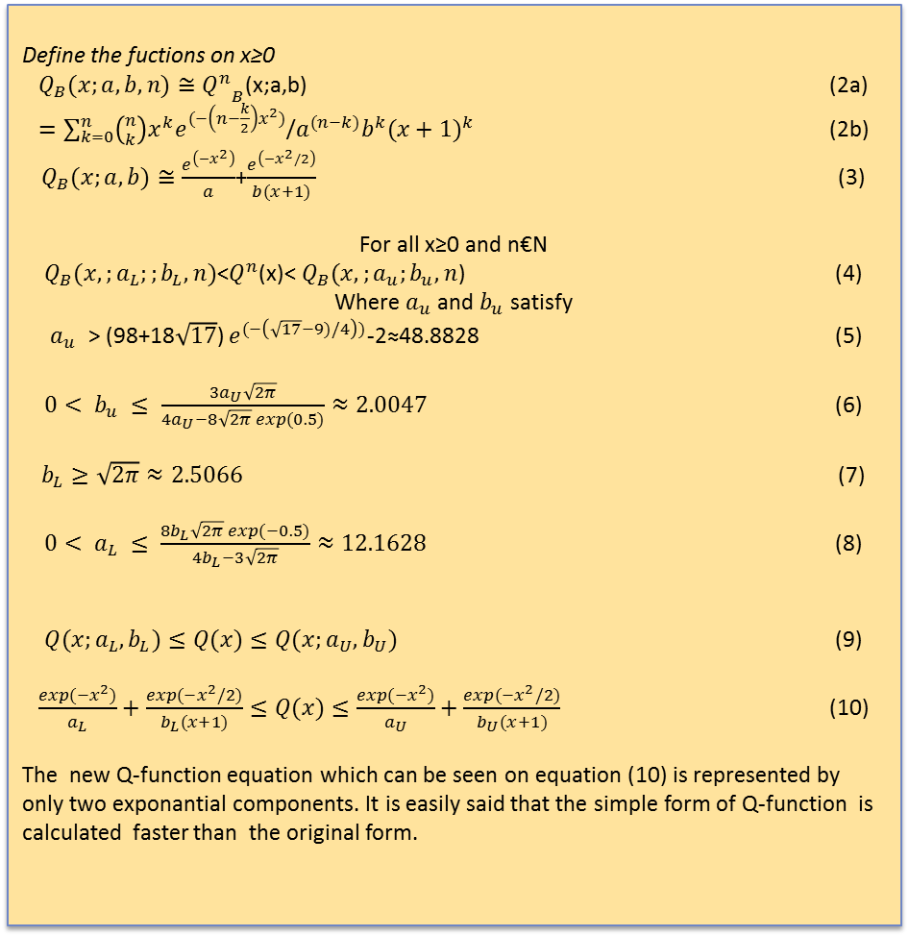
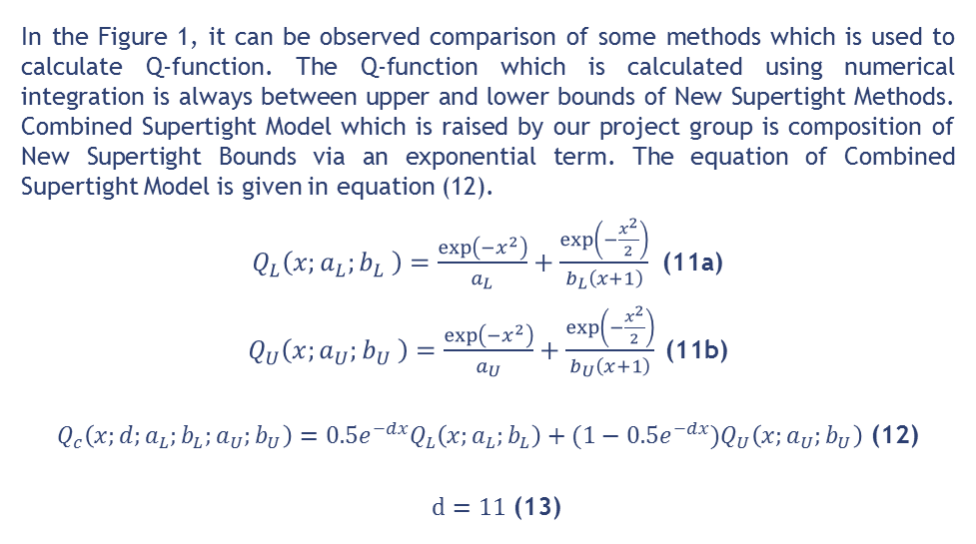
ANALYSIS OF NEW SIMPLE TIGHT BOUNDS ON THE Q-FUNCTION
BURAK COREKCIOGLU(040080498),ILKNUR ATES(040080456),BURAK KURT(040080486)
ADVISOR: GUNES ZEYNEP KARABULUT KURT
ISTANBUL TECHNICAL UNIVERSITY, ELECTRONICS AND COMMUNICATION ENGINEEERING DEPARTMENT
INTRODUCTION
ANALYSIS OF SUPERTIGHT NEW BOUNDS
RESULTS
In the Figure 1, it can be observed comparison of some methods which is used to calculate Q-function. The Q-function which is calculated using numerical integration is always between upper and lower bounds of New Supertight Methods. Combined Supertight Model which is raised by our project group is composition of New Supertight Bounds via an exponential term. The equation of Combined Supertight Model is given in equation (12).
$Q_{L}\left(x;a_{L};b_{L} \right)=\frac{\exp\left(−x^{2}\right)}{a_{L}}+\frac{\exp\left(−\frac{x^{2}}{2}\right)}{b_{L}\left(x+1\right)}$ (11a)
$Q_{U}\left(x;a_{U};b_{U} \right)=\frac{\exp\left(−x^{2}\right)}{a_{U}}+\frac{\exp\left(−\frac{x^{2}}{2}\right)}{b_{U}\left(x+1\right)}$ (11b)
$Q_{c}\left(x;d;a_{L};b_{L};a_{U};b_{U}\right)=0.5e^{−dx}Q_{L}\left(x;a_{L};b_{L}\right)+(1−0.5e^{−dx})Q_{U}\left(x;a_{U};b_{U}\right)$ (12)
$d=11$ (13)
Q-function which is used for error analysis in communication systems over fading channels is an integral function. It is very important for communication systems because of that error probability of communication channels is calculated by the help of this function. It is needed to determine error behavior of channel to achieve better quality in communication. However, it takes a long time to calculate Q-function because of integral form of the function. So that, we focused on how to calculate Q-function having better performance and more speedy.
In this study, new lower and upper bounds on the Gaussian Q-function are obtained on Matlab. As part of the project, new bounds of Q function is calculated with new method which contains only two exponential terms with a constant and a rational coefficient. The curve of obtained Q-function and the other methods such as Jensen Cotes, exponential, numeric integration are plotted to present correctness of new method. At the second step of the study, bit error rate (BER) of QPSK modulation on AWGN channel is calculated by the help of new Gaussian Q-function . Results are compared with the theoretical bit error rate curve and Monte Carlo simulation curve of QPSK modulation.
In this study, new and simple bounds of Q-function are calculated and compared with other methods such as Jensen-Cotes, exponantial form ,numerical integration.
Because of the fact that Q-function has an integral form, calculating Q-function takes a long time and shows worse performance. The New Supertight bounded Q-function has an exponantial form so it represents better performance. Mathematical operations take shorter time than other methods.
The curves of New Supertight Lower Bound and New Supertight Upper Bound are plotted and checked against other methods. The curve of new Supertight Bounds Q-function is similar to others in addition to this, speed performance is much better .
Figure 2: Comparison of Q-Functions (x in dB)
Calculation time performance analysis of four methods is represented in Figure 3. Result has been brought out with running matlab codes of methods 1000 times. Every result block indicates avarage calculation time of each methods in milliseconds.
Although the time of Exponantial Methods is less than Supertight Methods’, approximation of it has worst result for N=2. If N parametre is increased, time performance dicreases. So that Supertight method has best time performance with better approximation result.
THE ORIGINAL FORM OF Q-FUNCTION
The Q-function is a convenient way to express probabilities for Gaussian random variables.
The formula of Q-function;
$Q(x)≅\frac{1}{\sqrt{2π}}erfc(\frac{x}{\sqrt{2}})=\frac{1}{\sqrt{2π}}\int_{x}^{∝}{e^{−\left(\frac{t^{2}}{2}\right) }}$dt (1)
REFERENCES
Figure 1: Comparison of Q-Functions
[1] Giuseppe Abreu, “Very Simple Tight Bounds on the Q-Function”, IEEE Transactions On Communications, vol. 60, no. 9, September 2012.
[2]Giuseppe Thadeu Freitas de Abreu, “Jensen-Cotes Upper and Lower Bounds on the Gaussian Q-Function and Related Functions “IEEE Transactions On Communications, vol.57, no.11, November 2009
[3] Marco Chiani,Davide Dardari, Marvin K. Simon,» New Exponential Bounds and Approximations for the Computation of Error Probability in Fading Channels», IEEE Transactions On Wireless Communications, VOL. 2, NO. 4, JULY 2003
[4] Won Mee Jang, “A Simple Upper Bound of the
Gaussian 𝑄-Function with Closed-Form Error Bound” IEEE Communications Letters, vol. 15, vo. 2, February 2011
[5] Marco Chiani, “Improved Exponential Bounds and Approximation for the Q-function with Application to Average Error Probability Computation”, DEIS, CSITE-CNR, CNIT University of Bologna, V.le Risorgimento 2,40136 Bologna, ITALY
BURAK COREKCIOGLU(040080498),ILKNUR ATES(040080456),BURAK KURT(040080486)
THE NEW BOUNDS ON Q(X)
ADVISOR: GUNES ZEYNEP KARABULUT KURT
Figure 2 shows approaches of Numerical Integration, Exponential [3], Jensen-Cotes [2] and New Supertight Bounds Methods [1]. In the interval of x between two and four, the supertight upper bound is on the numerical integration bound and the supertight lower bound is very close to it. It is easly can be said that the most closest bounds are New Supertight Bounds in this interval.
Define the fuctions on x≥0
$Q_{B}(x;a,b,n)≅{Q_{}^{n}}_{B}^{}$(x;a,b) (2a)
$=\sum_{k=0}^{n}{\left({n \atop k}\right)x^{k}e^{(−\left(n−\frac{k}{2}\right)x^{2})}}$/$a^{(n−k)}b^{k}{(x+1)}^{k}$ (2b)
$Q_{B}(x;a,b)≅\frac{e^{\left(−x^{2}\right)}}{a}$+$\frac{e^{\left(−x^{2}/2\right)}}{b(x+1)}$ (3)
For all x≥0 and n€N
$Q_{B}(x,;a_{L};;b_{L},n)$<$Q_{}^{n}$(x)< $Q_{B}(x,;a_{u};b_{u},n$) (4)
Where${ a}_{u}$ and $b_{u}$ satisfy
${ a}_{u }$ > (98+18$\sqrt{17}$) $e^{(−\left(\sqrt{17}−9)/4\right))}$-2≈48.8828 (5)
$0< b_{u} ≤ \frac{3a_{U}\sqrt{2π}}{4a_{U}−8\sqrt{2π} exp(0.5)}≈2.0047$ (6)
$b_{L}≥\sqrt{2π}≈2.5066$ (7)
$0< a_{L} ≤ \frac{8b_{L}\sqrt{2π} exp(−0.5)}{4b_{L}−3\sqrt{2π}}≈12.1628$ (8)
$Q(x;a_{L},b_{L})≤Q(x)≤Q(x;a_{U},b_{U})$ (9)
$\frac{exp(−x^{2})}{a_{L}}+\frac{exp(−x^{2}/2)}{b_{L}(x+1)}≤Q(x)≤\frac{exp(−x^{2})}{a_{U}}+\frac{exp(−x^{2}/2)}{b_{U}(x+1)}$ (10)
The new Q-function equation which can be seen on equation (10) is represented by only two exponantial components. It is easily said that the simple form of Q-function is calculated faster than the original form.
Figure 3: Average calculation time of methods in milliseconds
IMPLEMENTATION PART OF THE STUDY ON BPSK MODULATION
WITH AWGN CHANNEL
Figure 4: Block Diagram of BPSK modulation on Matlab-Simulink
Figure 5: Comparison of BER curves are obtained with using different methods
Bit error rate of BPSK modulation is calculated with combined New Supertight Bounds Q-function to present reliability of it. BER curves which are plotted with New Super Tight Bounds, Theoratical and Monte Carlo Simulation are compared. It has seen that, the curves are at the same line.

