Slide 1

Introducing ACL Operation
Access Control Lists
© 2007 Cisco Systems, Inc. All rights reserved.
ICND2 v1.0—6-1
The PDF files and any printed representation for this material are the property of Cisco Systems, Inc., for the sole use by Cisco employees for personal study. The files or printed representations may not be used in commercial training, and may not be distributed for purposes other than individual self-study.

Slide 2
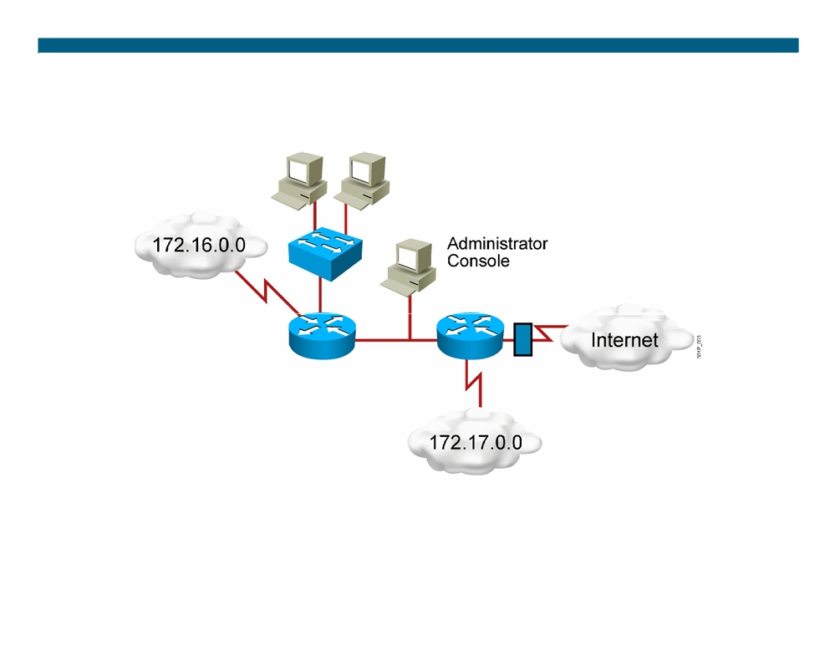
Why Use ACLs?
ƒ Filtering: Manage IP traffic by filtering packets passing through a router ƒ Classification: Identify traffic for special handling
© 2007 Cisco Systems, Inc. All rights reserved.
ICND2 v1.0—6-2
The PDF files and any printed representation for this material are the property of Cisco Systems, Inc., for the sole use by Cisco employees for personal study. The files or printed representations may not be used in commercial training, and may not be distributed for purposes other than individual self-study.

Slide 3
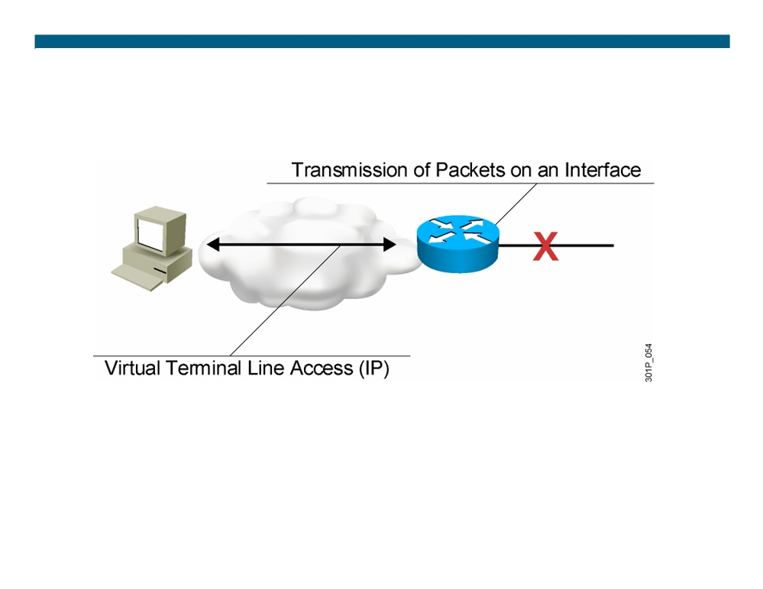
ACL Applications: Filtering
ƒ Permit or deny packets moving through the router. ƒ Permit or deny vty access to or from the router.
ƒ Without ACLs, all packets could be transmitted to all parts of your network.
© 2007 Cisco Systems, Inc. All rights reserved.
ICND2 v1.0—6-3
The PDF files and any printed representation for this material are the property of Cisco Systems, Inc., for the sole use by Cisco employees for personal study. The files or printed representations may not be used in commercial training, and may not be distributed for purposes other than individual self-study.

Slide 4
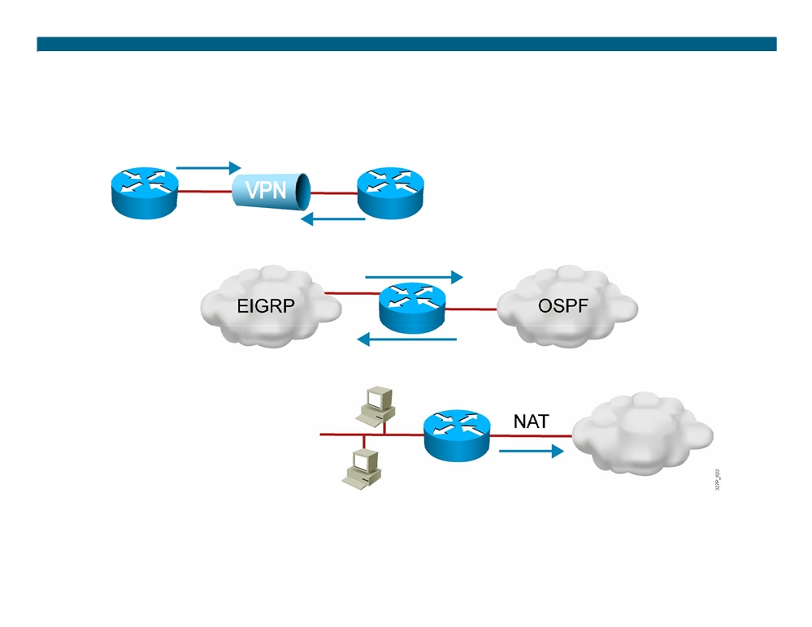
ACL Applications: Classification
Special handling for traffic based on packet tests
© 2007 Cisco Systems, Inc. All rights reserved.
ICND2 v1.0—6-4
The PDF files and any printed representation for this material are the property of Cisco Systems, Inc., for the sole use by Cisco employees for personal study. The files or printed representations may not be used in commercial training, and may not be distributed for purposes other than individual self-study.

Slide 5
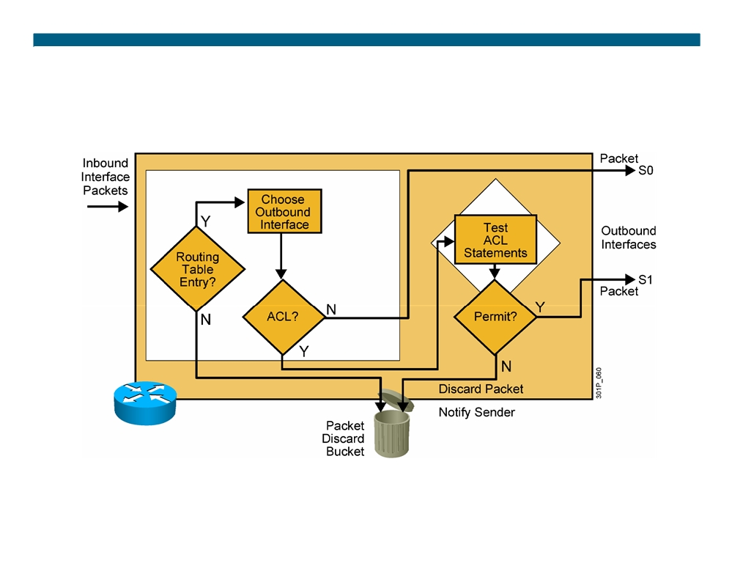
Outbound ACL Operation
If no ACL statement matches, discard the packet.
© 2007 Cisco Systems, Inc. All rights reserved.
ICND2 v1.0—6-5
The PDF files and any printed representation for this material are the property of Cisco Systems, Inc., for the sole use by Cisco employees for personal study. The files or printed representations may not be used in commercial training, and may not be distributed for purposes other than individual self-study.

Slide 6
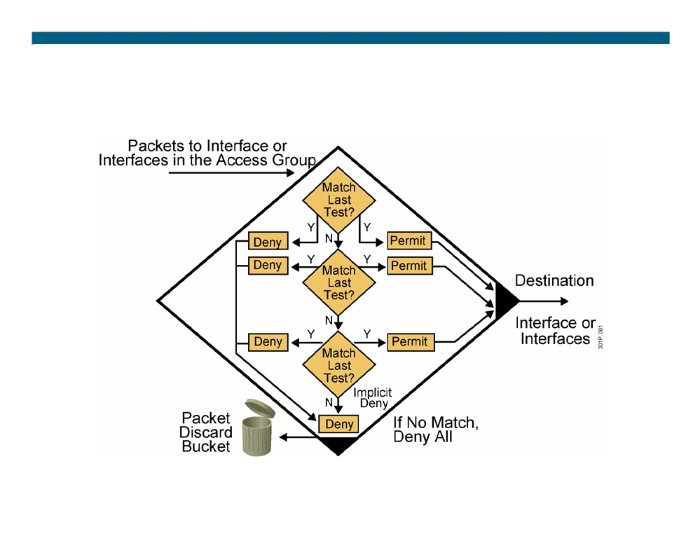
A List of Tests: Deny or Permit
© 2007 Cisco Systems, Inc. All rights reserved.
ICND2 v1.0—6-6
The PDF files and any printed representation for this material are the property of Cisco Systems, Inc., for the sole use by Cisco employees for personal study. The files or printed representations may not be used in commercial training, and may not be distributed for purposes other than individual self-study.

Slide 7

Types of ACLs
ƒ Standard ACL
- Checks source address
- Generally permits or denies entire protocol suite ƒ Extended ACL
- Checks source and destination address
Generally permits or denies specific protocols and applications
ƒ Two methods used to identify standard and extended ACLs:
Numbered ACLs use a number for identification
- Named ACLs use a descriptive name or number for identification
© 2007 Cisco Systems, Inc. All rights reserved.
ICND2 v1.0—6-7
The PDF files and any printed representation for this material are the property of Cisco Systems, Inc., for the sole use by Cisco employees for personal study. The files or printed representations may not be used in commercial training, and may not be distributed for purposes other than individual self-study.

Slide 8
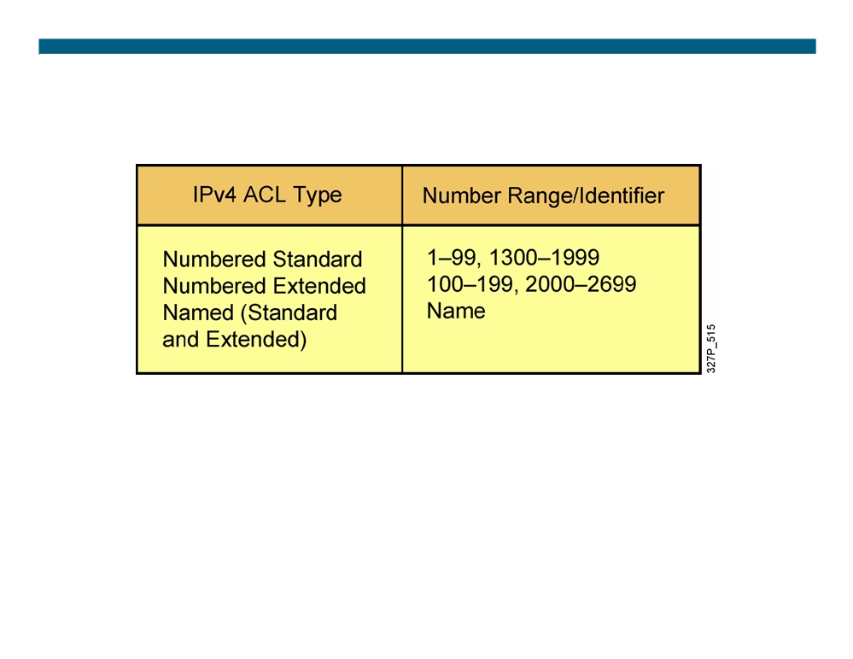
How to Identify ACLs
ƒ Numbered standard IPv4 lists (1-99) test conditions of all IP packets for source addresses. Expanded range (1300-1999). ƒ Numbered extended IPv4 lists (100-199) test conditions of source and destination addresses, specific TCP/IP protocols, and destination ports. Expanded range (2000-2699).
ƒ Named ACLs identify IP standard and extended ACLs with an alphanumeric string (name).
© 2007 Cisco Systems, Inc. All rights reserved.
ICND2 v1.0—6-8
The PDF files and any printed representation for this material are the property of Cisco Systems, Inc., for the sole use by Cisco employees for personal study. The files or printed representations may not be used in commercial training, and may not be distributed for purposes other than individual self-study.

Slide 9
IP Access List Entry Sequence Numbering
ƒ Requires Cisco IOS Release 12.3
ƒ Allows you to edit the order of ACL statements using sequence numbers
- In software earlier than Cisco IOS Release 12.3, a text editor is used to create ACL statements, then the statements are copied into the router in the correct order.
ƒ Allows you to remove a single ACL statement from the list using a sequence number
- With named ACLs in software earlier than Cisco IOS Release 12.3, you must use no {deny | permit} protocol source source- wildcard destination destination-wildcard to remove an individual statement.
- With numbered ACLs in software earlier than Cisco IOS Release 12.3, you must remove the entire ACL to remove a single ACL statement.
© 2007 Cisco Systems, Inc. All rights reserved.
ICND2 v1.0—6-9
The PDF files and any printed representation for this material are the property of Cisco Systems, Inc., for the sole use by Cisco employees for personal study. The files or printed representations may not be used in commercial training, and may not be distributed for purposes other than individual self-study.

Slide 10
ACL Configuration Guidelines
ƒ Standard or extended indicates what can be filtered. ƒ Only one ACL per interface, per protocol, and per direction is allowed.
ƒ The order of ACL statements controls testing, therefore, the most specific statements go at the top of the list.
ƒ The last ACL test is always an implicit deny everything else statement, so every list needs at least one permit statement. ƒ ACLs are created globally and then applied to interfaces for inbound or outbound traffic.
ƒ An ACL can filter traffic going through the router, or traffic to and from the router, depending on how it is applied.
ƒ When placing ACLs in the network: - Place extended ACLs close to the source - Place standard ACLs close to the destination
© 2007 Cisco Systems, Inc. All rights reserved.
ICND2 v1.0—6-10
The PDF files and any printed representation for this material are the property of Cisco Systems, Inc., for the sole use by Cisco employees for personal study. The files or printed representations may not be used in commercial training, and may not be distributed for purposes other than individual self-study.

Slide 11
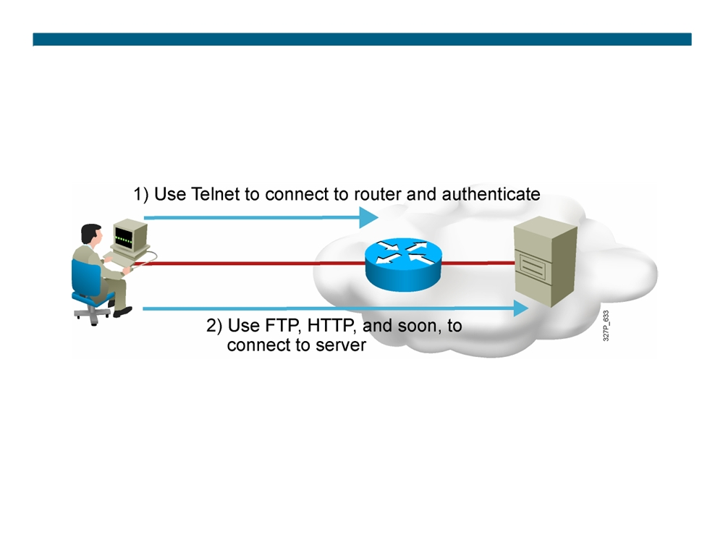
Dynamic ACLs
Dynamic ACLs (lock-and-key): Users that want to traverse the router are blocked until they use Telnet to connect to the router and are authenticated.
© 2007 Cisco Systems, Inc. All rights reserved.
ICND2 v1.0—6-11
The PDF files and any printed representation for this material are the property of Cisco Systems, Inc., for the sole use by Cisco employees for personal study. The files or printed representations may not be used in commercial training, and may not be distributed for purposes other than individual self-study.

Slide 12
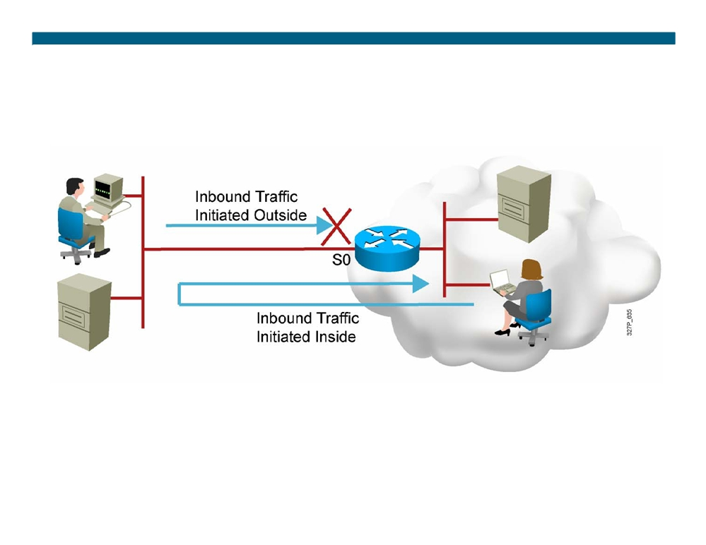
Reflexive ACLs
Reflexive ACLs: Used to allow outbound traffic and limit inbound traffic in response to sessions that originate inside the router
© 2007 Cisco Systems, Inc. All rights reserved.
ICND2 v1.0—6-12
The PDF files and any printed representation for this material are the property of Cisco Systems, Inc., for the sole use by Cisco employees for personal study. The files or printed representations may not be used in commercial training, and may not be distributed for purposes other than individual self-study.

Slide 13
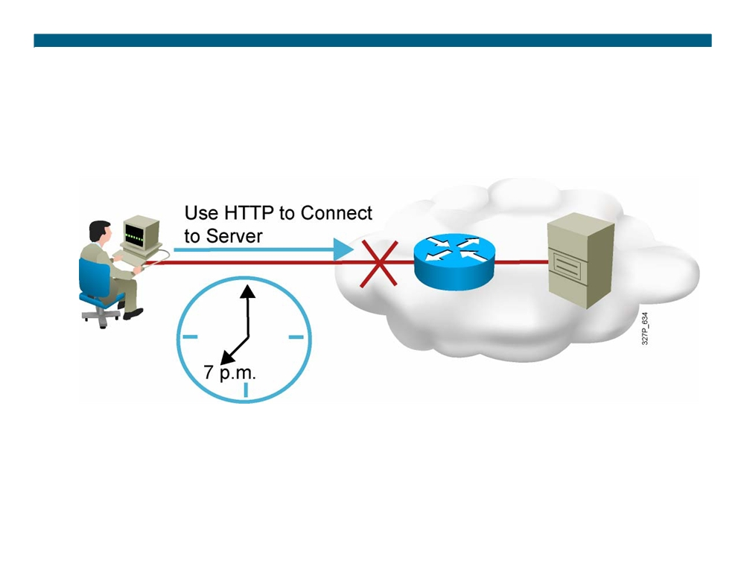
Time-Based ACLs
Time-based ACLs: Allow for access control based on the time of day and week
© 2007 Cisco Systems, Inc. All rights reserved.
ICND2 v1.0—6-13
The PDF files and any printed representation for this material are the property of Cisco Systems, Inc., for the sole use by Cisco employees for personal study. The files or printed representations may not be used in commercial training, and may not be distributed for purposes other than individual self-study.

Slide 14
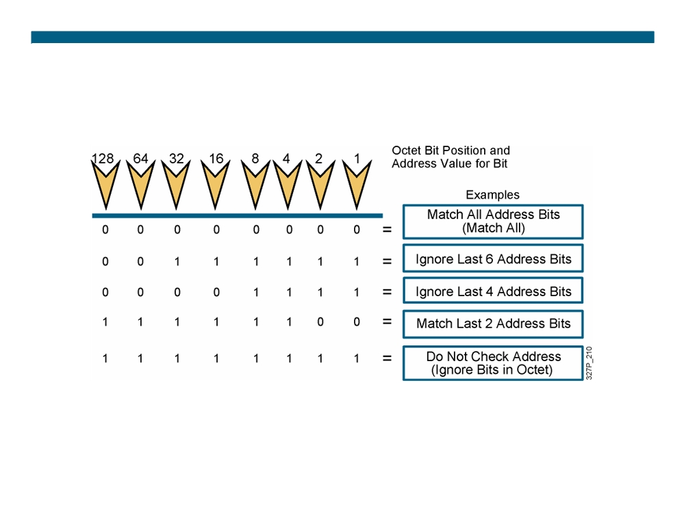
Wildcard Bits: How to Check the Corresponding Address Bits
ƒ 0 means to match the value of the corresponding address bit ƒ 1 means to ignore the value of the corresponding address bit
© 2007 Cisco Systems, Inc. All rights reserved.
ICND2 v1.0—6-14
The PDF files and any printed representation for this material are the property of Cisco Systems, Inc., for the sole use by Cisco employees for personal study. The files or printed representations may not be used in commercial training, and may not be distributed for purposes other than individual self-study.

Slide 15
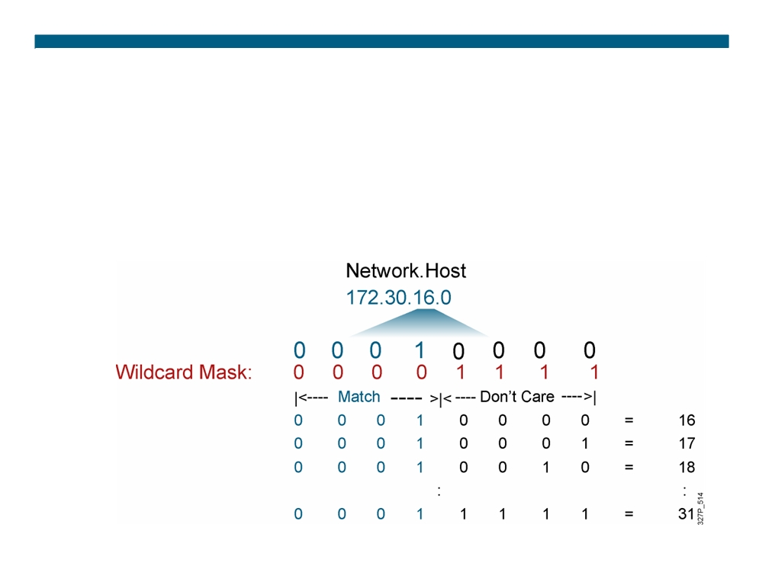
Wildcard Bits to Match IP Subnets
Match for IP subnets 172.30.16.0/24 to 172.30.31.0/24.
Address and wildcard mask:
172.30.16.0 0.0.15.255
© 2007 Cisco Systems, Inc. All rights reserved.
ICND2 v1.0—6-15
The PDF files and any printed representation for this material are the property of Cisco Systems, Inc., for the sole use by Cisco employees for personal study. The files or printed representations may not be used in commercial training, and may not be distributed for purposes other than individual self-study.

Slide 16
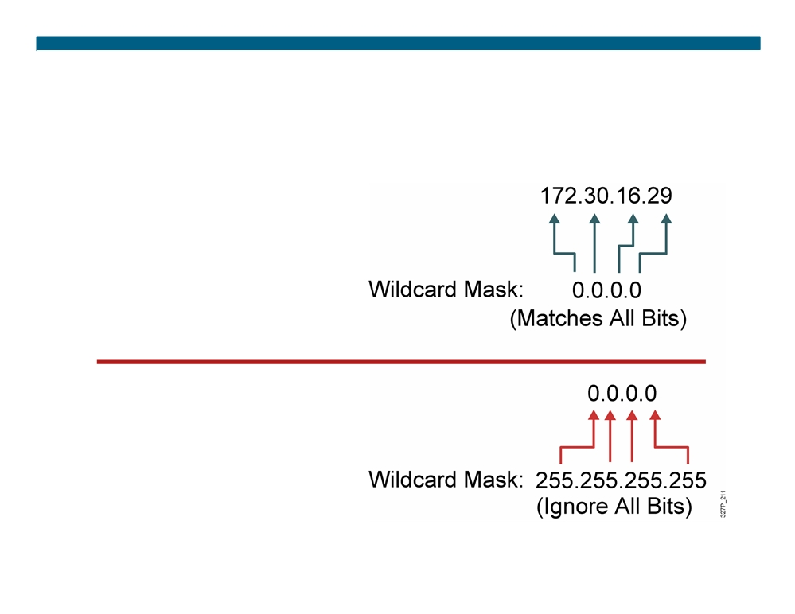
Wildcard Bit Mask Abbreviations
ƒ 172.30.16.29 0.0.0.0 matches
all of the address bits
ƒ Abbreviate this wildcard mask using the IP address preceded by the keyword host
(host 172.30.16.29)
ƒ 0.0.0.0 255.255.255.255 ignores all address bits ƒ Abbreviate expression with the keyword any
© 2007 Cisco Systems, Inc. All rights reserved.
ICND2 v1.0—6-16
The PDF files and any printed representation for this material are the property of Cisco Systems, Inc., for the sole use by Cisco employees for personal study. The files or printed representations may not be used in commercial training, and may not be distributed for purposes other than individual self-study.

Slide 17
Summary
ƒ ACLs can be used for IP packet filtering or to identify traffic to assign it special handling.
ƒ ACLs perform top-down processing and can be configured for incoming or outgoing traffic.
ƒ You can create an ACL using a named or numbered ACL. Named or numbered ACLs can be configured as standard or extended ACLs, which determines what they can filter.
ƒ Reflexive, dynamic, and time-based ACLs add more functionality to standard and extended ACLs.
ƒ In a wildcard bit mask, a 0 bit means to match the corresponding address bit and a 1 bit means to ignore the corresponding address bit.
© 2007 Cisco Systems, Inc. All rights reserved.
ICND2 v1.0—6-17
The PDF files and any printed representation for this material are the property of Cisco Systems, Inc., for the sole use by Cisco employees for personal study. The files or printed representations may not be used in commercial training, and may not be distributed for purposes other than individual self-study.

Slide 18

© 2007 Cisco Systems, Inc. All rights reserved.
ICND2 v1.0—6-18 The PDF files and any printed representation for this material are the property of Cisco Systems, Inc., for the sole use by Cisco employees for personal study. The files or printed representations may not be used in commercial training, and may not be distributed for purposes other than individual self-study.

Slide 19
Configuring and Troubleshooting ACLs
Access Control Lists
© 2007 Cisco Systems, Inc. All rights reserved.
ICND2 v1.0—6-1
The PDF files and any printed representation for this material are the property of Cisco Systems, Inc., for the sole use by Cisco employees for personal study. The files or printed representations may not be used in commercial training, and may not be distributed for purposes other than individual self-study.

Slide 20
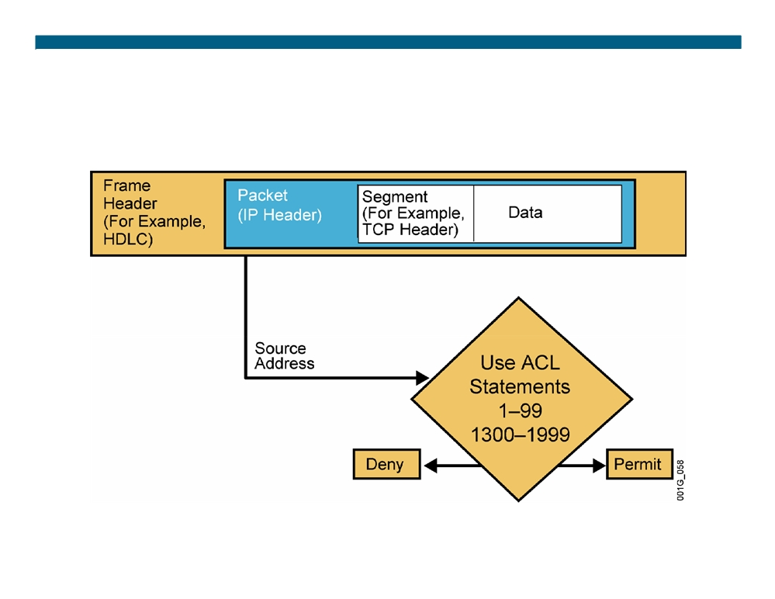
Testing Packets with
Numbered Standard IPv4 ACLs
© 2007 Cisco Systems, Inc. All rights reserved.
ICND2 v1.0—6-2
The PDF files and any printed representation for this material are the property of Cisco Systems, Inc., for the sole use by Cisco employees for personal study. The files or printed representations may not be used in commercial training, and may not be distributed for purposes other than individual self-study.

Slide 21
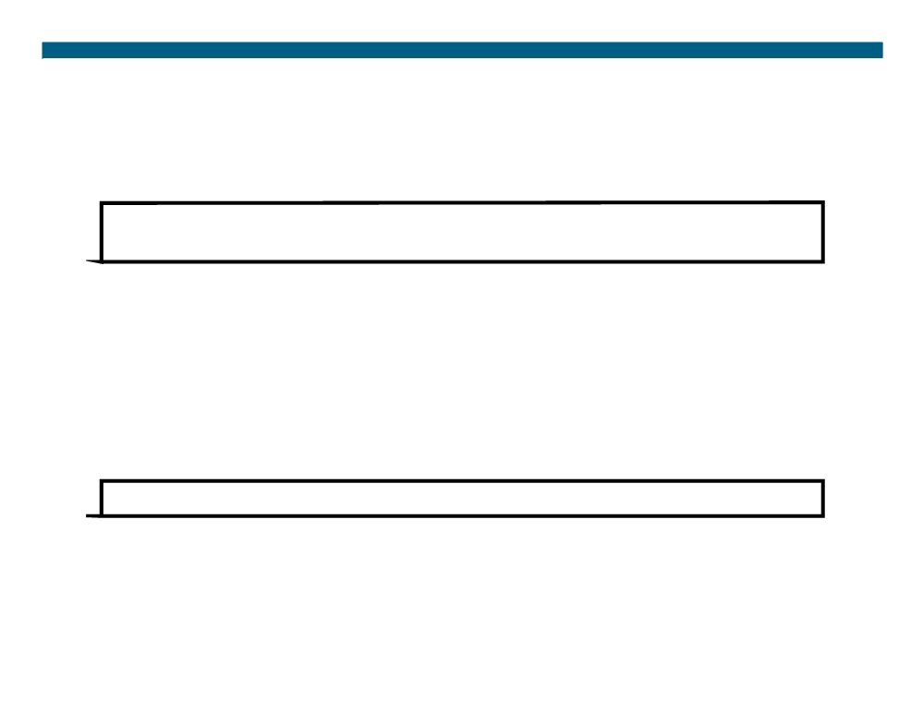
Numbered Standard IPv4 ACL Configuration
RouterX(config)#
access-list access-list-number {permit | deny | remark} source [mask]
ƒ Uses 1 to 99 for the access-list-number.
ƒ The first entry is assigned a sequence number of 10, and successive entries are incremented by 10.
ƒ Default wildcard mask is 0.0.0.0 (only standard ACL). ƒ no access-list access-list-number removes the entire ACL. ƒ remark lets you add a description to the ACL.
RouterX(config-if)#
ip access-group access-list-number{in | out}
ƒ Activates the list on an interface.
ƒ Sets inbound or outbound testing.
ƒ no ip access-group access-list-number {in | out} removes the ACL from the interface.
© 2007 Cisco Systems, Inc. All rights reserved.
ICND2 v1.0—6-3
The PDF files and any printed representation for this material are the property of Cisco Systems, Inc., for the sole use by Cisco employees for personal study. The files or printed representations may not be used in commercial training, and may not be distributed for purposes other than individual self-study.

Slide 22
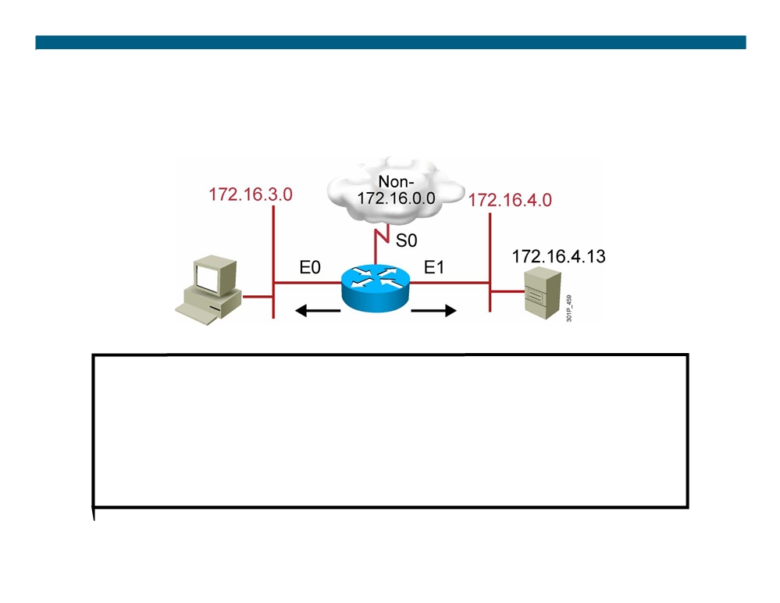
Numbered Standard IPv4 ACL Example 1
RouterX(config)# access-list 1 permit 172.16.0.00.0.255.255
(implicit deny all - not visible in the list) (access-list 1 deny 0.0.0.0255.255.255.255)
RouterX(config)# interface ethernet 0 RouterX(config-if)# ip access-group 1 out RouterX(config)# interface ethernet 1 RouterX(config-if)# ip access-group 1 out
Permit my network only
© 2007 Cisco Systems, Inc. All rights reserved.
ICND2 v1.0—6-4
The PDF files and any printed representation for this material are the property of Cisco Systems, Inc., for the sole use by Cisco employees for personal study. The files or printed representations may not be used in commercial training, and may not be distributed for purposes other than individual self-study.

Slide 23
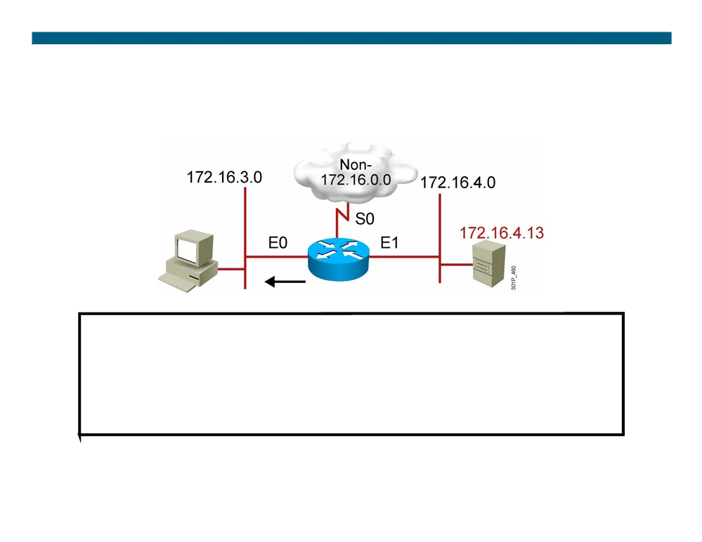
Numbered Standard IPv4 ACL Example 2
RouterX(config)# access-list 1 deny 172.16.4.13 0.0.0.0 RouterX(config)# access-list 1 permit 0.0.0.0 255.255.255.255
(implicit deny all)
(access-list 1 deny 0.0.0.0255.255.255.255)
RouterX(config)# interface ethernet 0 RouterX(config-if)# ip access-group 1 out
Deny a specific host
© 2007 Cisco Systems, Inc. All rights reserved.
ICND2 v1.0—6-5
The PDF files and any printed representation for this material are the property of Cisco Systems, Inc., for the sole use by Cisco employees for personal study. The files or printed representations may not be used in commercial training, and may not be distributed for purposes other than individual self-study.

Slide 24
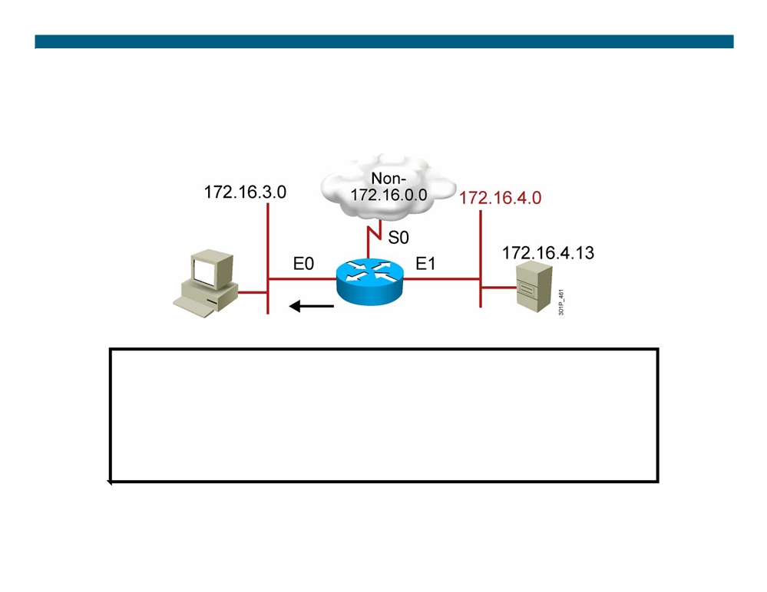
Numbered Standard IPv4 ACL Example 3
RouterX(config)# access-list 1 deny 172.16.4.00.0.0.255 RouterX(config)# access-list 1 permit any
(implicit deny all)
(access-list 1 deny 0.0.0.0255.255.255.255)
RouterX(config)# interface ethernet 0 RouterX(config-if)# ip access-group 1 out
Deny a specific subnet
© 2007 Cisco Systems, Inc. All rights reserved.
ICND2 v1.0—6-6
The PDF files and any printed representation for this material are the property of Cisco Systems, Inc., for the sole use by Cisco employees for personal study. The files or printed representations may not be used in commercial training, and may not be distributed for purposes other than individual self-study.

Slide 25
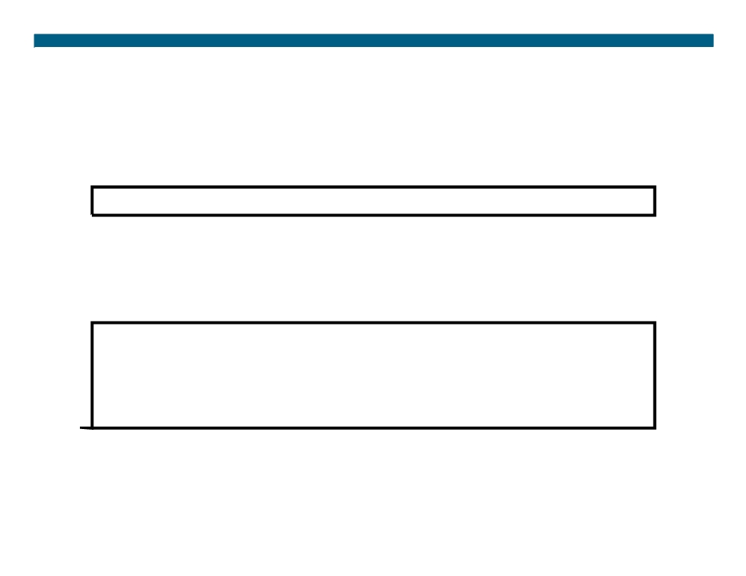
Standard ACLs to Control vty Access
RouterX(config-line)#
access-class access-list-number {in | out} ƒ Restricts incoming or outgoing connections between a particular vty and the addresses in an ACL
Example:
access-list 12 permit 192.168.1.0 0.0.0.255
(implicit deny any)
!
line vty 0 4
access-class 12 in
ƒ Permits only hosts in network 192.168.1.0 0.0.0.255 to connect to the router vty lines
© 2007 Cisco Systems, Inc. All rights reserved.
ICND2 v1.0—6-7
The PDF files and any printed representation for this material are the property of Cisco Systems, Inc., for the sole use by Cisco employees for personal study. The files or printed representations may not be used in commercial training, and may not be distributed for purposes other than individual self-study.

Slide 26
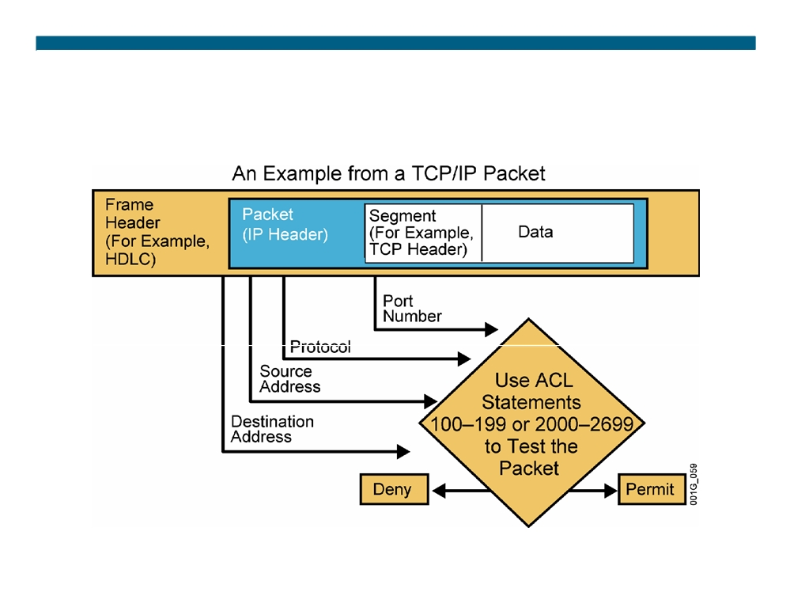
Testing Packets with
Numbered Extended IPv4 ACLs
© 2007 Cisco Systems, Inc. All rights reserved.
ICND2 v1.0—6-8
The PDF files and any printed representation for this material are the property of Cisco Systems, Inc., for the sole use by Cisco employees for personal study. The files or printed representations may not be used in commercial training, and may not be distributed for purposes other than individual self-study.

Slide 27
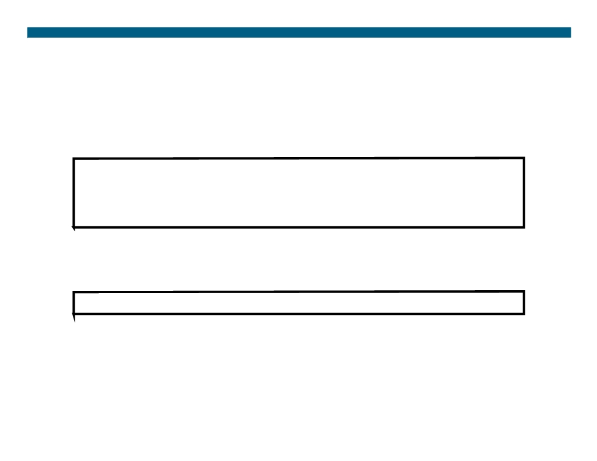
Numbered Extended IPv4 ACL Configuration
RouterX(config)#
access-list access-list-number {permit | deny} protocol source source-wildcard [operator port] destination destination-wildcard [operator port] [established] [log]
ƒ Sets parameters for this list entry
RouterX(config-if)#
ip access-group access-list-number{in | out} ƒ Activates the extended list on an interface
© 2007 Cisco Systems, Inc. All rights reserved.
ICND2 v1.0—6-9
The PDF files and any printed representation for this material are the property of Cisco Systems, Inc., for the sole use by Cisco employees for personal study. The files or printed representations may not be used in commercial training, and may not be distributed for purposes other than individual self-study.

Slide 28
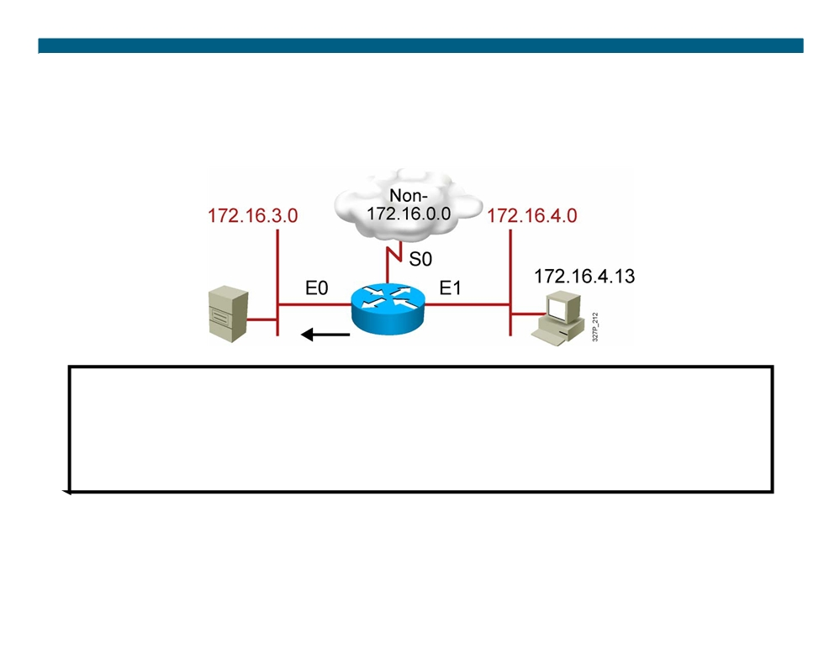
Numbered Extended IPv4 ACL Example 1
RouterX(config)#access-list 101 deny tcp 172.16.4.0 0.0.0.255 172.16.3.0 0.0.0.255 eq 21
RouterX(config)#access-list 101 deny tcp 172.16.4.0 0.0.0.255 172.16.3.0 0.0.0.255 eq 20 RouterX(config)#access-list 101 permit ip any any
(implicit deny all)
(access-list 101 deny ip 0.0.0.0 255.255.255.255 0.0.0.0 255.255.255.255)
RouterX(config)# interface ethernet 0
RouterX(config-if)# ip access-group 101 out
ƒ Deny FTP traffic from subnet 172.16.4.0 to subnet 172.16.3.0 out E0 ƒ Permit all other traffic
© 2007 Cisco Systems, Inc. All rights reserved.
ICND2 v1.0—6-10
The PDF files and any printed representation for this material are the property of Cisco Systems, Inc., for the sole use by Cisco employees for personal study. The files or printed representations may not be used in commercial training, and may not be distributed for purposes other than individual self-study.

Slide 29
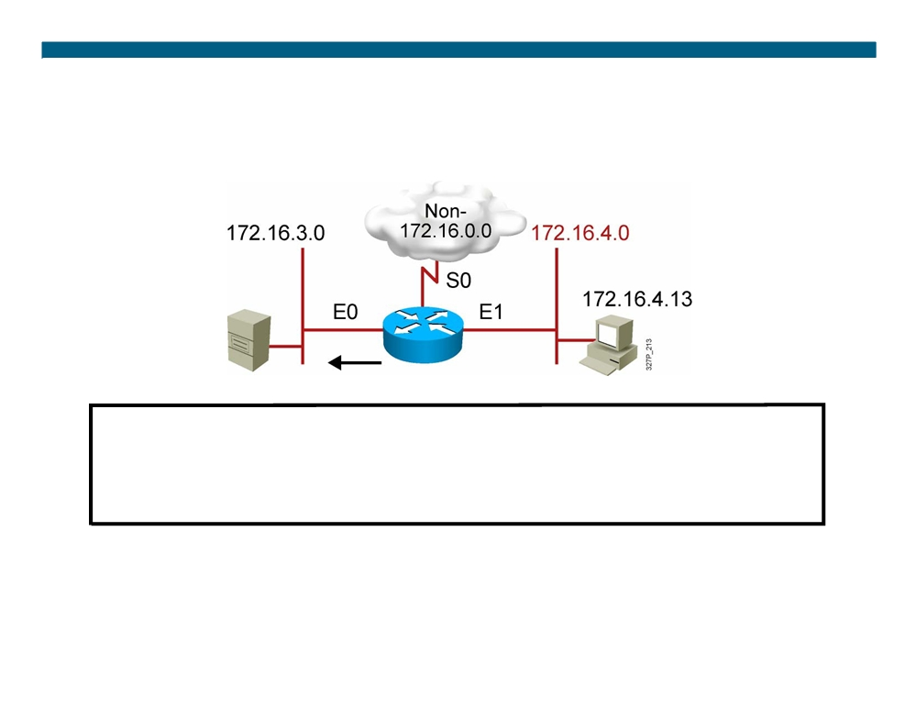
Numbered Extended IPv4 ACL Example 2
RouterX(config)# access-list 101 deny tcp 172.16.4.0 0.0.0.255 any eq 23 RouterX(config)# access-list 101 permit ip any any
(implicit deny all)
RouterX(config)# interface ethernet 0 RouterX(config-if)# ip access-group 101 out
ƒ Deny only Telnet traffic from subnet 172.16.4.0 out E0 ƒ Permit all other traffic
© 2007 Cisco Systems, Inc. All rights reserved.
ICND2 v1.0—6-11
The PDF files and any printed representation for this material are the property of Cisco Systems, Inc., for the sole use by Cisco employees for personal study. The files or printed representations may not be used in commercial training, and may not be distributed for purposes other than individual self-study.

Slide 30
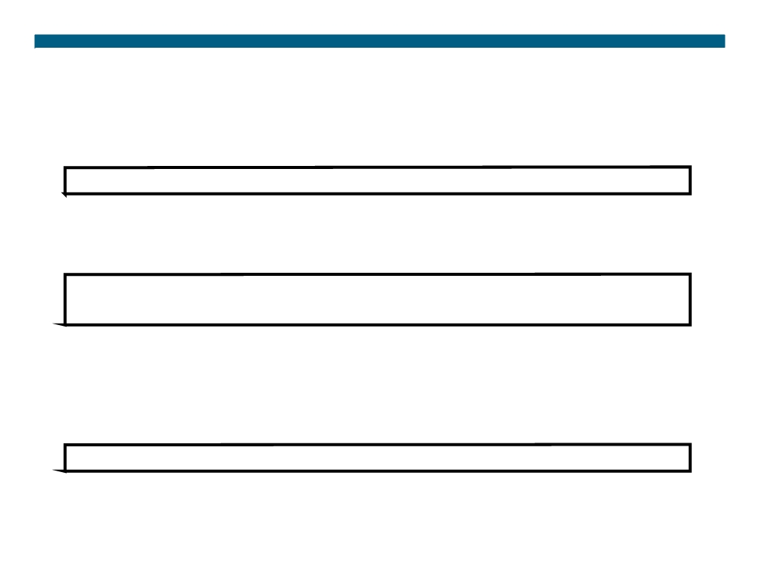
Named IP ACL Configuration
RouterX(config)#
ip access-list {standard | extended} name ƒ Alphanumeric name string must be unique
RouterX(config {std- | ext-}nacl)#
[sequence-number] {permit | deny} {ip access list test conditions} {permit | deny} {ip access list test conditions}
ƒ If not configured, sequence numbers are generated automatically starting at 10 and incrementing by 10
ƒ no sequence number removes the specific test from the named ACL
RouterX(config-if)#
ip access-group name {in | out} ƒ Activates the named IP ACL on an interface
© 2007 Cisco Systems, Inc. All rights reserved.
ICND2 v1.0—6-12
The PDF files and any printed representation for this material are the property of Cisco Systems, Inc., for the sole use by Cisco employees for personal study. The files or printed representations may not be used in commercial training, and may not be distributed for purposes other than individual self-study.

Slide 31
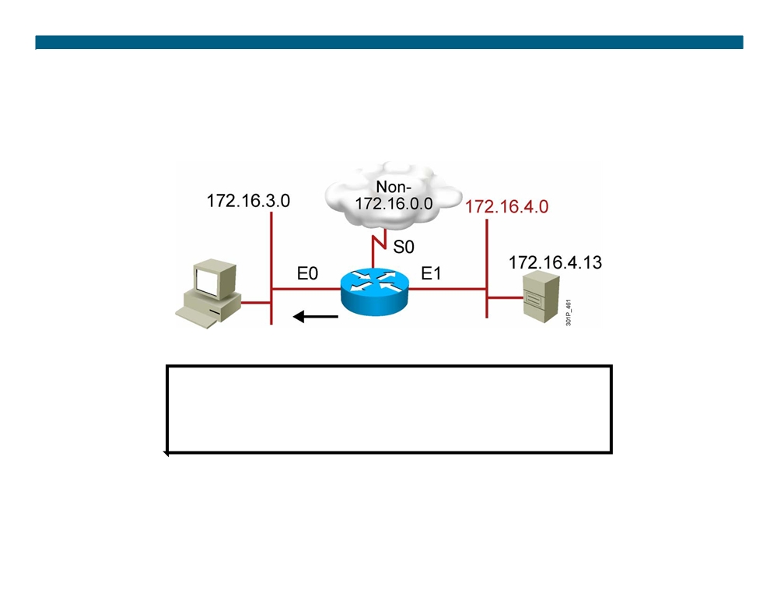
Named Standard IPv4 ACL Example
RouterX(config)#ip access-list standard troublemaker RouterX(config-std-nacl)#deny host 172.16.4.13 RouterX(config-std-nacl)#permit 172.16.4.0 0.0.0.255 RouterX(config)#interface e0
RouterX(config-if)#ip access-group troublemaker out
Deny a specific host
© 2007 Cisco Systems, Inc. All rights reserved.
ICND2 v1.0—6-13
The PDF files and any printed representation for this material are the property of Cisco Systems, Inc., for the sole use by Cisco employees for personal study. The files or printed representations may not be used in commercial training, and may not be distributed for purposes other than individual self-study.

Slide 32
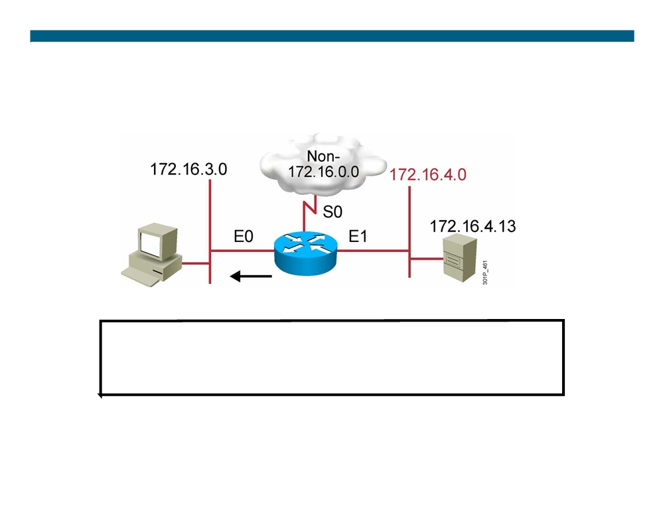
Named Extended IPv4 ACL Example
RouterX(config)#ip access-list extended badgroup
RouterX(config-ext-nacl)#deny tcp 172.16.4.0 0.0.0.255 any eq 23 RouterX(config-ext-nacl)#permit ip any any
RouterX(config-ext-nacl)#interface e0 RouterX(config-if)#ip access-group badgroup out
Deny Telnet from a specific subnet
© 2007 Cisco Systems, Inc. All rights reserved.
ICND2 v1.0—6-14
The PDF files and any printed representation for this material are the property of Cisco Systems, Inc., for the sole use by Cisco employees for personal study. The files or printed representations may not be used in commercial training, and may not be distributed for purposes other than individual self-study.

Slide 33
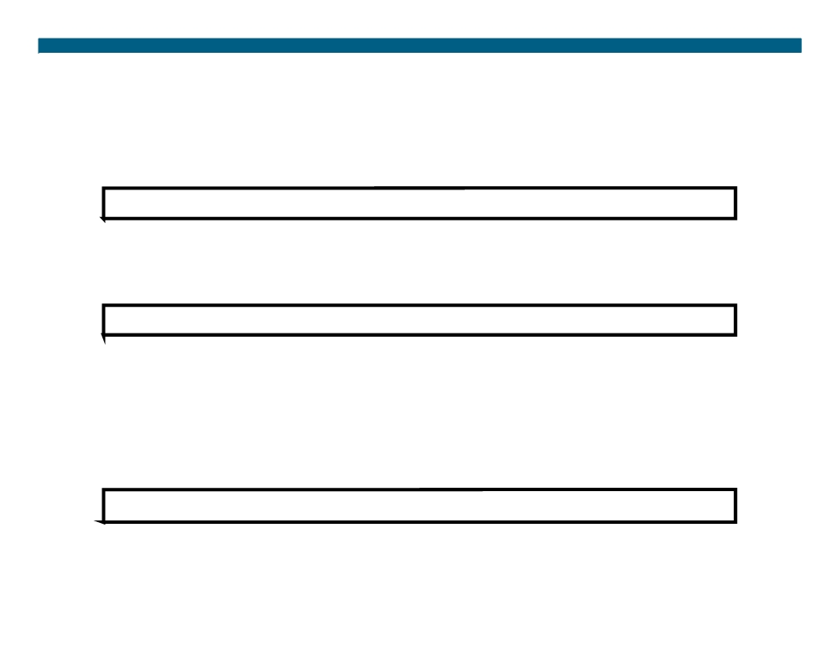
Commenting ACL Statements
RouterX(config)#
ip access-list {standard|extended} name ƒ Creates a named ACL
RouterX(config {std- | ext-}nacl)#
remark remark
ƒ Creates a named ACL comment
Or
RouterX(config)#
access-list access-list-number remark remark ƒ Creates a numbered ACL comment
© 2007 Cisco Systems, Inc. All rights reserved.
ICND2 v1.0—6-15
The PDF files and any printed representation for this material are the property of Cisco Systems, Inc., for the sole use by Cisco employees for personal study. The files or printed representations may not be used in commercial training, and may not be distributed for purposes other than individual self-study.

Slide 34
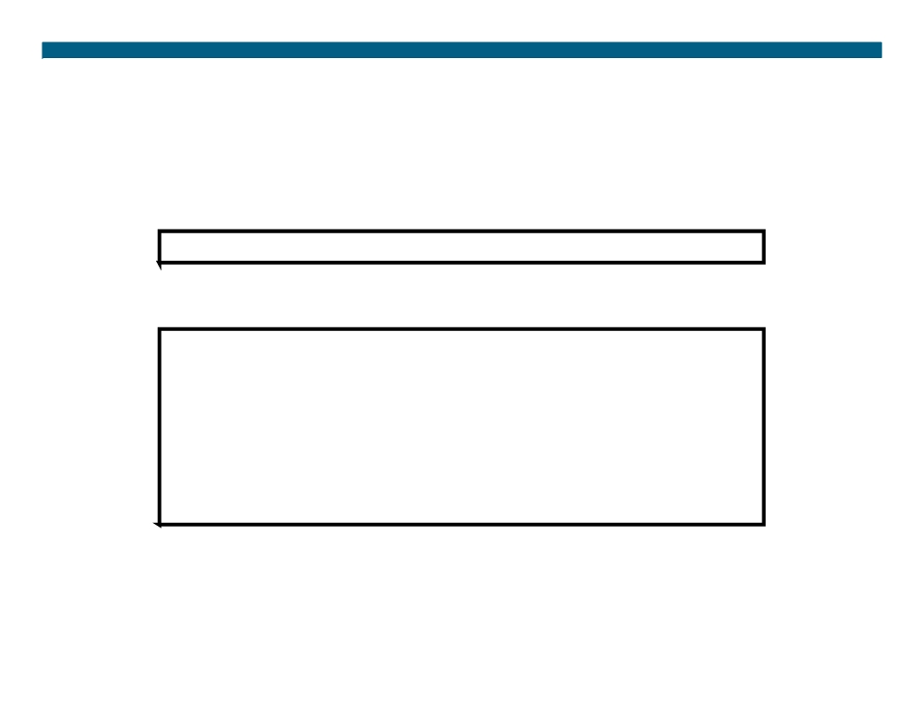
Monitoring ACL Statements
RouterX# show access-lists {access-list number|name}
RouterX# show access-lists
Standard IP access list SALES
10 deny
10.1.1.0, wildcard bits 0.0.0.255
20 permit 10.3.3.1
30 permit 10.4.4.1 40 permit 10.5.5.1
Extended IP access list ENG
10 permit tcp host 10.22.22.1 any eq telnet (25 matches) 20 permit tcp host 10.33.33.1 any eq ftp
30 permit tcp host 10.44.44.1 any eq ftp-data
Displays all access lists
© 2007 Cisco Systems, Inc. All rights reserved.
ICND2 v1.0—6-16
The PDF files and any printed representation for this material are the property of Cisco Systems, Inc., for the sole use by Cisco employees for personal study. The files or printed representations may not be used in commercial training, and may not be distributed for purposes other than individual self-study.

Slide 35
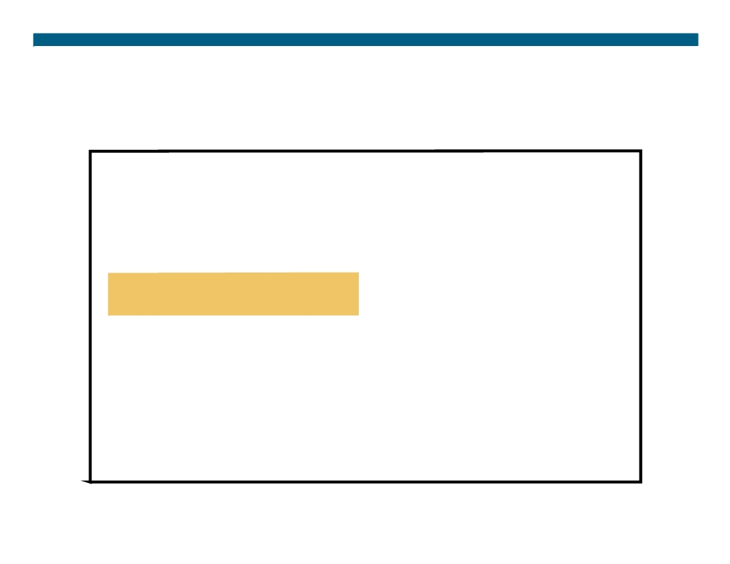
Verifying ACLs
RouterX# show ip interfaces e0 Ethernet0 is up, line protocol is up Internet address is 10.1.1.11/24 Broadcast address is 255.255.255.255 Address determined by setup command MTU is 1500 bytes
Helper address is not set
Directed broadcast forwarding is disabled Outgoing access list is not set Inbound access list is 1 Proxy ARP is enabled Security level is default Split horizon is enabled ICMP redirects are always sent ICMP unreachables are always sent ICMP mask replies are never sent IP fast switching is enabled
IP fast switching on the same interface is disabled IP Feature Fast switching turbo vector
IP multicast fast switching is enabled
IP multicast distributed fast switching is disabled <text ommitted>
© 2007 Cisco Systems, Inc. All rights reserved.
ICND2 v1.0—6-17
The PDF files and any printed representation for this material are the property of Cisco Systems, Inc., for the sole use by Cisco employees for personal study. The files or printed representations may not be used in commercial training, and may not be distributed for purposes other than individual self-study.

Slide 36
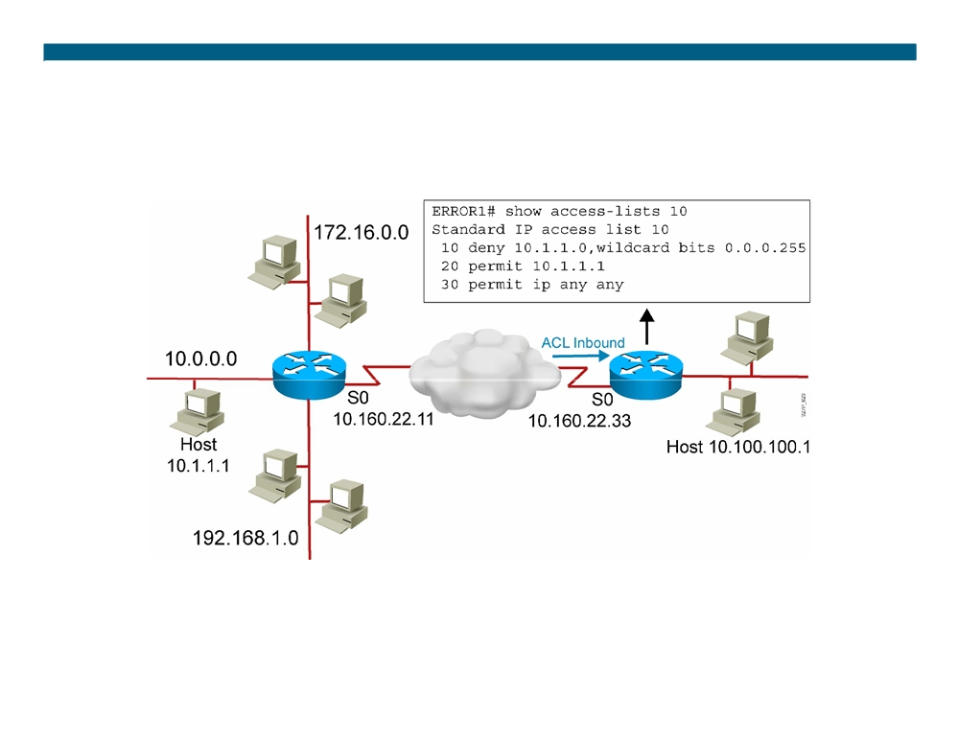
Troubleshooting Common ACL Errors
Error 1: Host 10.1.1.1 has no connectivity with 10.100.100.1.
© 2007 Cisco Systems, Inc. All rights reserved.
ICND2 v1.0—6-18
The PDF files and any printed representation for this material are the property of Cisco Systems, Inc., for the sole use by Cisco employees for personal study. The files or printed representations may not be used in commercial training, and may not be distributed for purposes other than individual self-study.

Slide 37
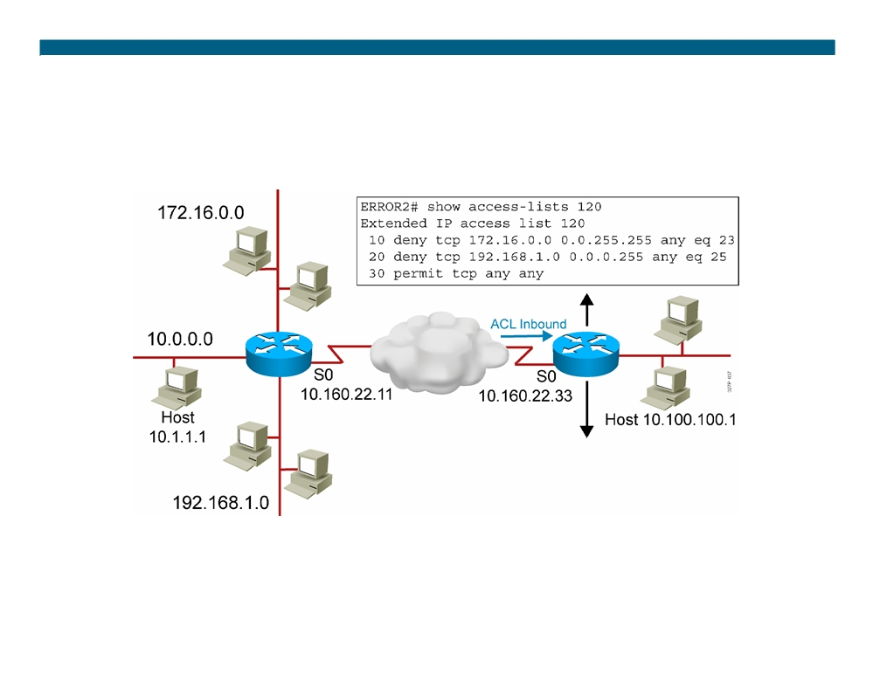
Troubleshooting Common ACL Errors (Cont.)
Error 2: The 192.168.1.0 network cannot use TFTP to connect to 10.100.100.1.
© 2007 Cisco Systems, Inc. All rights reserved.
ICND2 v1.0—6-19
The PDF files and any printed representation for this material are the property of Cisco Systems, Inc., for the sole use by Cisco employees for personal study. The files or printed representations may not be used in commercial training, and may not be distributed for purposes other than individual self-study.

Slide 38
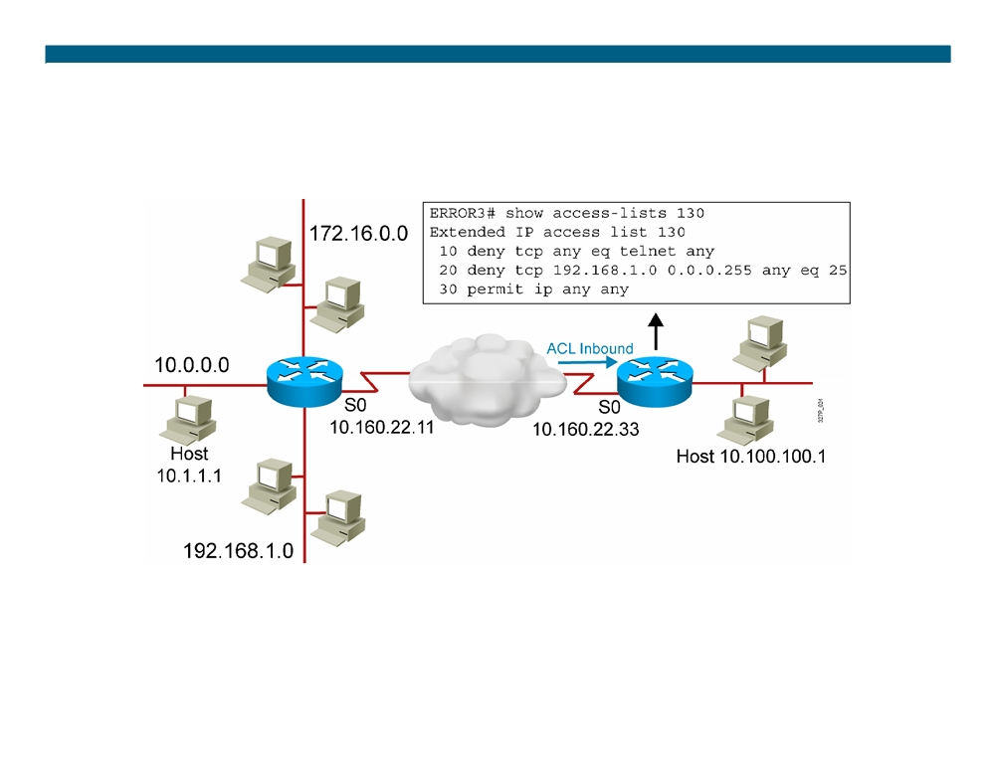
Troubleshooting Common ACL Errors (Cont.)
Error 3: 172.16.0.0 network can use Telnet to connect to 10.100.100.1, but this connection should not be allowed.
© 2007 Cisco Systems, Inc. All rights reserved.
ICND2 v1.0—6-20
The PDF files and any printed representation for this material are the property of Cisco Systems, Inc., for the sole use by Cisco employees for personal study. The files or printed representations may not be used in commercial training, and may not be distributed for purposes other than individual self-study.

Slide 39
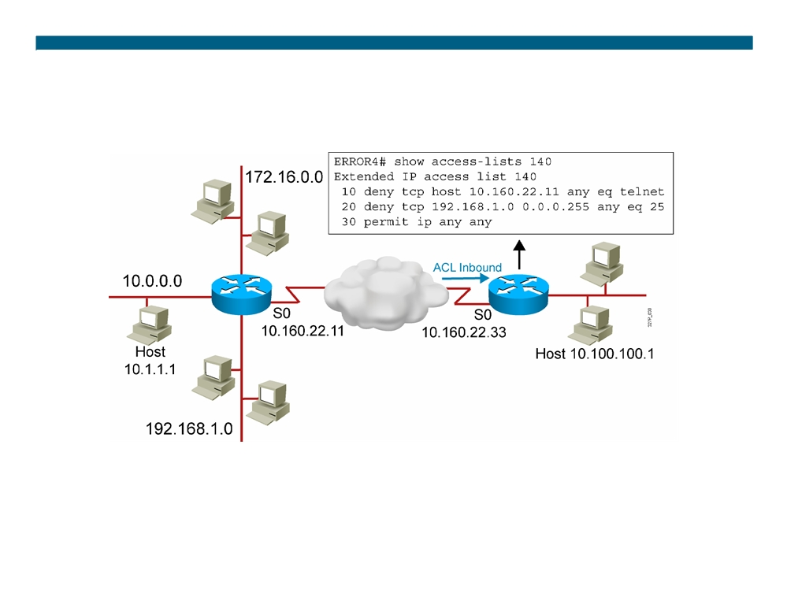
Troubleshooting Common ACL Errors (Cont.)
Error 4: Host 10.1.1.1 can use Telnet to connect to 10.100.100.1, but this connection should not be allowed.
© 2007 Cisco Systems, Inc. All rights reserved.
ICND2 v1.0—6-21
The PDF files and any printed representation for this material are the property of Cisco Systems, Inc., for the sole use by Cisco employees for personal study. The files or printed representations may not be used in commercial training, and may not be distributed for purposes other than individual self-study.

Slide 40
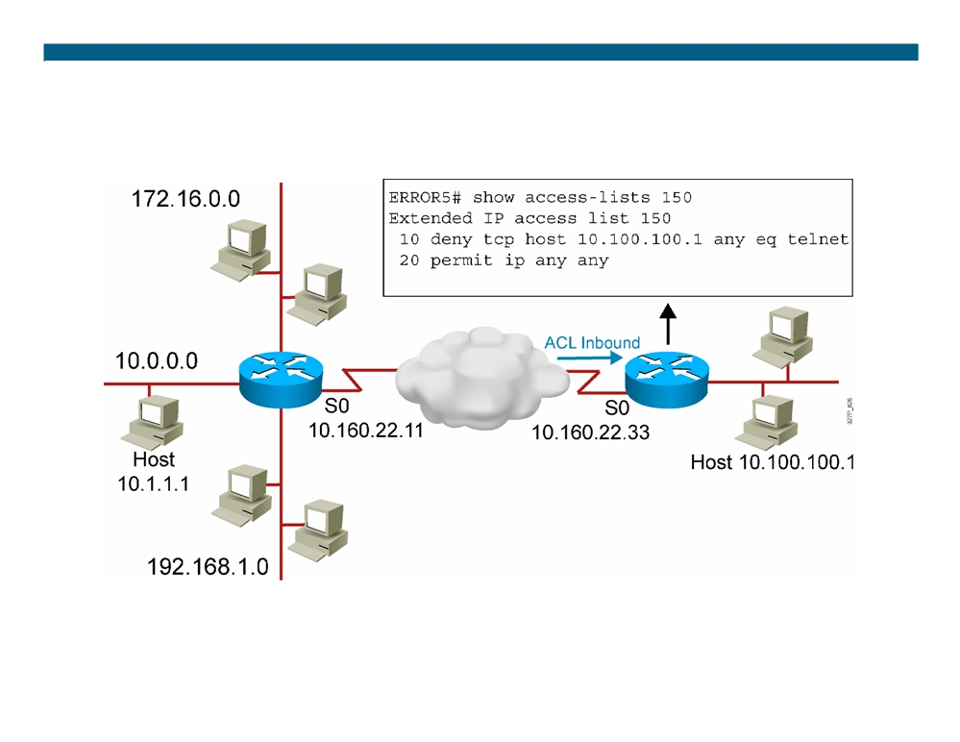
Troubleshooting Common ACL Errors (Cont.)
A
B
Error 5: Host 10.100.100.1 can use Telnet to connect to 10.1.1.1, but this connection should not be allowed.
© 2007 Cisco Systems, Inc. All rights reserved.
ICND2 v1.0—6-22
The PDF files and any printed representation for this material are the property of Cisco Systems, Inc., for the sole use by Cisco employees for personal study. The files or printed representations may not be used in commercial training, and may not be distributed for purposes other than individual self-study.

Slide 41
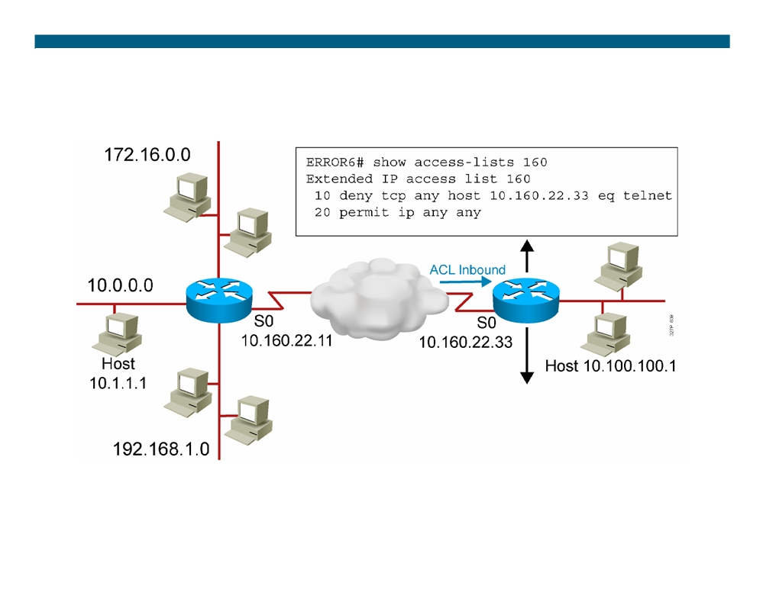
Troubleshooting Common ACL Errors (Cont.)
A
B
Error 6: Host 10.1.1.1 can use Telnet to connect into router B, but this connection should not be allowed.
© 2007 Cisco Systems, Inc. All rights reserved.
ICND2 v1.0—6-23
The PDF files and any printed representation for this material are the property of Cisco Systems, Inc., for the sole use by Cisco employees for personal study. The files or printed representations may not be used in commercial training, and may not be distributed for purposes other than individual self-study.

Slide 42
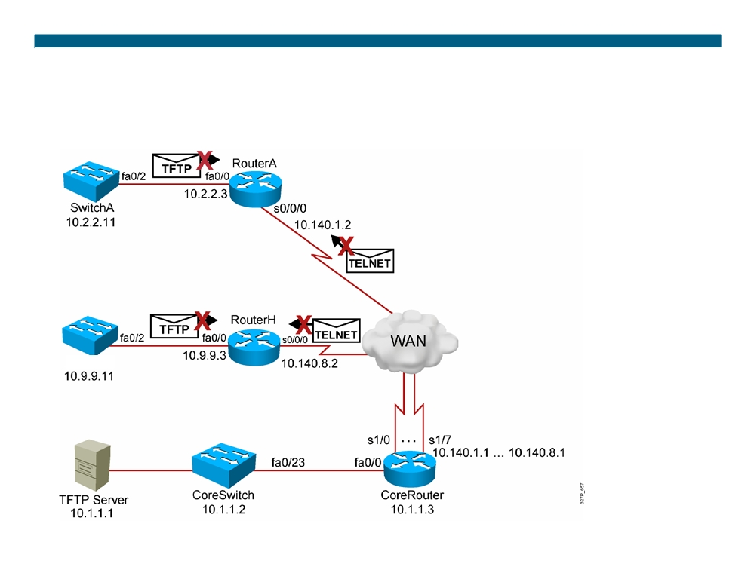
Visual Objective 6-1: Implementing and Troubleshooting ACLs
WG Router s0/0/0 Router fa0/0 Switch
A
10.140.1.2
10.2.2.3
10.2.2.11
B
10.140.2.2
10.3.3.3
10.3.3.11
C
10.140.3.2
10.4.4.3
10.4.4.11
D
10.140.4.2
10.5.5.3
10.5.5.11
E
10.140.5.2
10.6.6.3
10.6.6.11
F
10.140.6.2
10.7.7.3
10.7.7.11
G
10.140.7.2
10.8.8.3
10.8.8.11
H
10.140.8.2
10.9.9.3
10.9.9.11
SwitchH
© 2007 Cisco Systems, Inc. All rights reserved.
ICND2 v1.0—6-24
The PDF files and any printed representation for this material are the property of Cisco Systems, Inc., for the sole use by Cisco employees for personal study. The files or printed representations may not be used in commercial training, and may not be distributed for purposes other than individual self-study.

Slide 43
Summary
ƒ Standard IPv4 ACLs allow you to filter based on source IP address.
ƒ Extended ACLs allow you to filter based on source IP address, destination IP address, protocol, and port number. ƒ Named ACLs allow you to delete individual statements from an ACL.
ƒ You can use the show access-lists and show ip interface commands to troubleshoot common ACL configuration errors.
© 2007 Cisco Systems, Inc. All rights reserved.
ICND2 v1.0—6-25
The PDF files and any printed representation for this material are the property of Cisco Systems, Inc., for the sole use by Cisco employees for personal study. The files or printed representations may not be used in commercial training, and may not be distributed for purposes other than individual self-study.

Slide 44
© 2007 Cisco Systems, Inc. All rights reserved.
ICND2 v1.0—6-26 The PDF files and any printed representation for this material are the property of Cisco Systems, Inc., for the sole use by Cisco employees for personal study. The files or printed representations may not be used in commercial training, and may not be distributed for purposes other than individual self-study.

Slide 45
Module Summary
ƒ ACLs can be used to filter IP packets or identify traffic for special handling.
ƒ ACLs perform top-down processing and can be configured for incoming or outgoing traffic.
ƒ In a wildcard bit mask, 0 means to match the corresponding address bit, and 1 means to ignore the corresponding address bit. ƒ Standard IPv4 ACLs allow filtering based on source address. ƒ Extended IPv4 ACLs allow filtering based on source and destination addresses, as well as protocol and port number.
ƒ IP access list entry sequence numbering allows you to delete individual statements from an ACL to add statements anywhere in the ACL.
ƒ The show access-lists and show ip interface commands are useful for troubleshooting common ACL configuration errors.
© 2007 Cisco Systems, Inc. All rights reserved.
ICND2 v1.0—6-1
The PDF files and any printed representation for this material are the property of Cisco Systems, Inc., for the sole use by Cisco employees for personal study. The files or printed representations may not be used in commercial training, and may not be distributed for purposes other than individual self-study.

Slide 46
© 2007 Cisco Systems, Inc. All rights reserved.
ICND2 v1.0—6-2 The PDF files and any printed representation for this material are the property of Cisco Systems, Inc., for the sole use by Cisco employees for personal study. The files or printed representations may not be used in commercial training, and may not be distributed for purposes other than individual self-study.

