Slide 1

Cloude Computing
Ali MENTEŞ
Platon Bilişim Akademi
1
Notes:
1

Slide 2
Cloude
It is a way of offering IT services.
That is, the consumer or customer of the service must be able to request the service and receive that service without the delay.
Criterias:
On-demand self-service
Broad network access
Resource pooling
Rapid elasticity
Measured service
Private Cloude:
Private cloud creates a service, inside a company, to internal customers, that meets the five criteria(on-premise).
With private cloud, the (internal)vconsumers of IT services—developers, operators, and the like—can click to choose from the cloud services
catalog. And if the request is for a new set of VMs, the
VMs appear and are ready for use in minutes, without
human interaction
Notes:
3

Slide 3
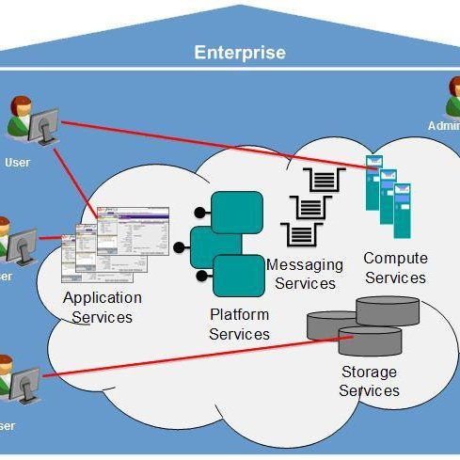
Private Cloude
Even inside one company, using a cloud computing approach can improve the operational speed of deploying IT services.
Notes:
3

Slide 4
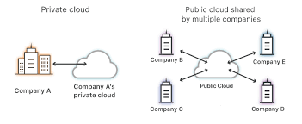
Public Cloude
A public cloud provider offers services, selling those services to consumers in other companies. Public cloud providers sell their services to many enterprises.
A customer user selects a service from Service Catalog and then start virtualization procces at Public Cloude side to provide related service.
Notes:
3

Slide 5
Public Cloude
Known Public Cloude Providers
Amazon Web Services
Google Compute Cloude
Microsoft Azure
RackSpace
HOW TO CONNECT TO CLOUDE ?
Cloud providers support multiple network options. They each connect to the Internet so that apps and users inside the consumer’s network can communicate with the apps that the consumer runs in the cloud provider’s
network. However, one of the five criteria for cloud computing is broad network access, so cloud providers offer different networking options as well, including virtual private network (VPN) and private wide-area network (WAN) connections between consumers and the cloud.
Notes:
3

Slide 6
Cloude Services
The cloud computing world works on a services model. Instead of buying (consuming) hardware, buying or licensing software, installing it yourself, and so on, the consumer receives some service from the provider.
There are three main Cloude services.
Infrastructure as a Service(IaaS)
Provides HW&Operationg System as a service. Necesary applications installed by user(i.e SQL Server,Visual Studio,MS Office etc..)
User specify the amount of hardware performance/capacity to allocate to the VM (number of virtual CPUs, amount of RAM, and so on)
2. Software as a Service(SaaS)
Notes:
3

Slide 7
Cloude
2. Software as a Service (SaaS)
The consumer receives a service with working software. The cloud provider may use VMs, possibly many VMs, to create the service, but those are hidden from the consumer. The cloud provider licenses, installs, and supports whatever software is required. The cloud provider then monitors performance of the application. However, the consumer chooses to use the application, signs up for the service, and starts using the application—no further installation work required.
User only choose what software service he/she wants.
File storage services like Apple iCloud, Google Drive, Dropbox, and Box are all SaaS offerings.
Most online email offerings can be considered SaaS services today
Notes:
3

Slide 8
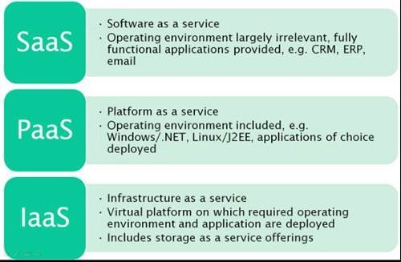
Cloude
3.(Development) Platform as a Service(PaaS)
A PaaS service is like IaaS in some ways. Both supply the consumer with
one or more VMs, with a configurable amount of CPU, RAM, and other
resources. The key difference between PaaS and IaaS is that PaaS includes many more software tools beyond the basic OS.
PaaS VMs often include an integrated development environment (IDE), which is a set of related tools that enables the developer to write and test code easily. Such as Visual Studio,SQL Management Studio,PDF Editors.
Notes:
3

Slide 9
Cloude
Connection To a Public Cloude
Via Internet
It is easy.
Remote workers(sales person) can connect easly
No need for special WAN link,internet is always avaliable
Easy to migrate from one Cloude Provider to another
Internet is not so secure(Man In the Middle)
BW need can be problem
QoS is not possible
No SLA(Service Level Agreement) for Internet
Notes:
3

Slide 10
Connection To a Public Cloude
Private WAN connection or VPN
Enterprise and provider connect via Site to site VPN, MPLS VPN or
Metro Ethernet etc..
Secure ,because it is private
QoS possible
BW as needed provided.
Installing and maintaining WAN connections
High cost WAN links
Difficult migration between Cloud providers. Need new installation
Some InterCloude Exchange companies provide WAN connections to many
Public Cloude providers. Instead of installing private WAN connections to providers,it is preferable to buy WAN link from those companies.
Çok şubeli bir firma mail serveri Cloude tutuyorsa. Cloude her şube
doğrudan mı erişmeli yoksa merkes üzerinden mi?
Nasıl bir çözüm düşünülebilir?
Notes:
3

