Slide 1

Using a Cisco
Router as a DHCP Server
LAN Connections
© 2007 Cisco Systems, Inc. All rights reserved.
ICND1 v1.0—4-1
The PDF files and any printed representation for this material are the property of Cisco Systems, Inc., for the sole use by Cisco employees for personal study. The files or printed representations may not be used in commercial training, and may not be distributed for purposes other than individual self-study.

Slide 2

Understanding DHCP
ƒHCP is built on a client-server model, as follows: - The DHCP server hosts allocate network addresses and deliver configuration parameters.
- The term "client" refers to a host requesting initialization parameters from a DHCP server.
ƒ 
DHCP supports these three mechanisms for IP address allocation:
- Automatic allocation; DHCP assigns a permanent IP address to a
client.
- Dynamic allocation; DHCP assigns an IP address to a client for a limited period of time.
- Manual allocation; A client IP address is assigned by the network administrator, and DHCP is used simply to convey the assigned address to the client.
ƒynamic allocation is the only that allows automatic reuse of an address that is no longer needed by the client to which it was assigned.
© 2007 Cisco Systems, Inc. All rights reserved.
ICND1 v1.0—4-2
The PDF files and any printed representation for this material are the property of Cisco Systems, Inc., for the sole use by Cisco employees for personal study. The files or printed representations may not be used in commercial training, and may not be distributed for purposes other than individual self-study.

Slide 3
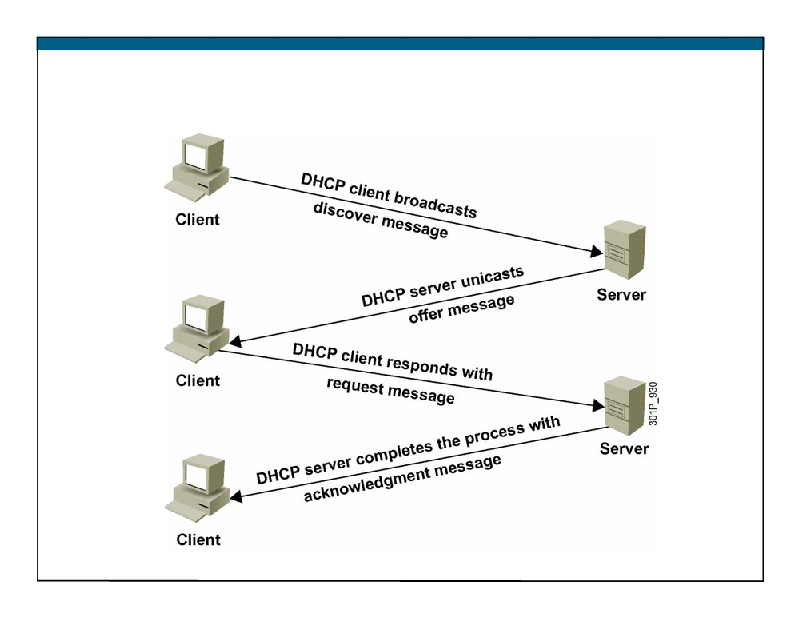
DHCP
© 2007 Cisco Systems, Inc. All rights reserved.
ICND1 v1.0—4-3
The PDF files and any printed representation for this material are the property of Cisco Systems, Inc., for the sole use by Cisco employees for personal study. The files or printed representations may not be used in commercial training, and may not be distributed for purposes other than individual self-study.

Slide 4
Using a Router as a DHCP Server
Cisco IOS Software includes a full DHCP server implementation:
ƒ Assigns IP addresses from specified address pools within the router
ƒ Can be configured to assign the IP address of these components: - Domain Name System (DNS) server
- Default router
© 2007 Cisco Systems, Inc. All rights reserved.
ICND1 v1.0—4-4
The PDF files and any printed representation for this material are the property of Cisco Systems, Inc., for the sole use by Cisco employees for personal study. The files or printed representations may not be used in commercial training, and may not be distributed for purposes other than individual self-study.

Slide 5
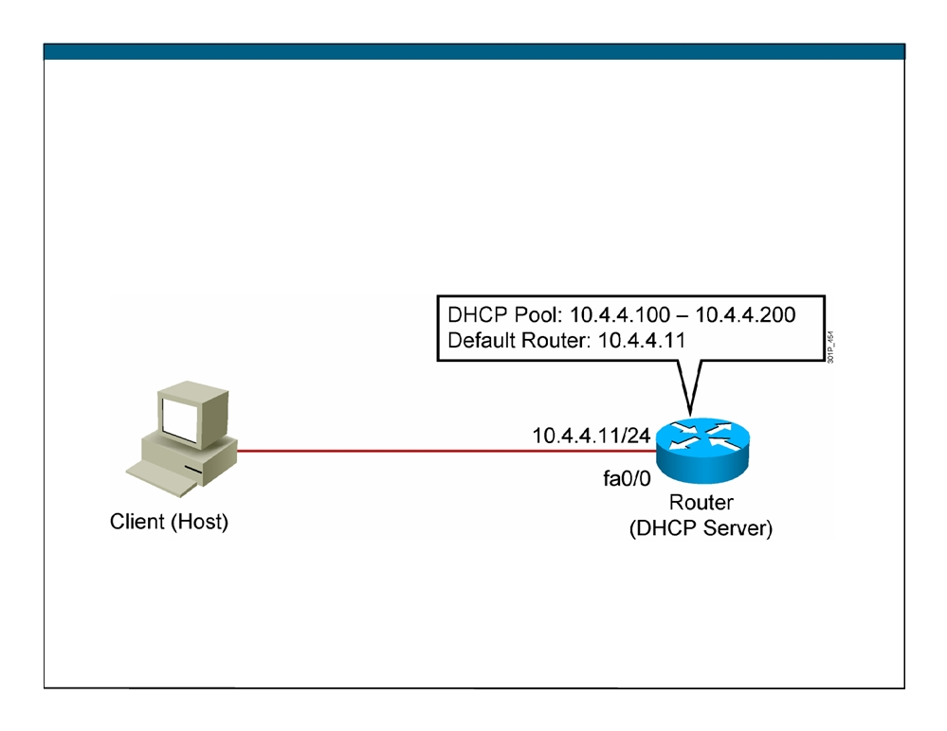
DHCP Server Using a Router
© 2007 Cisco Systems, Inc. All rights reserved.
ICND1 v1.0—4-5
The PDF files and any printed representation for this material are the property of Cisco Systems, Inc., for the sole use by Cisco employees for personal study. The files or printed representations may not be used in commercial training, and may not be distributed for purposes other than individual self-study.

Slide 6
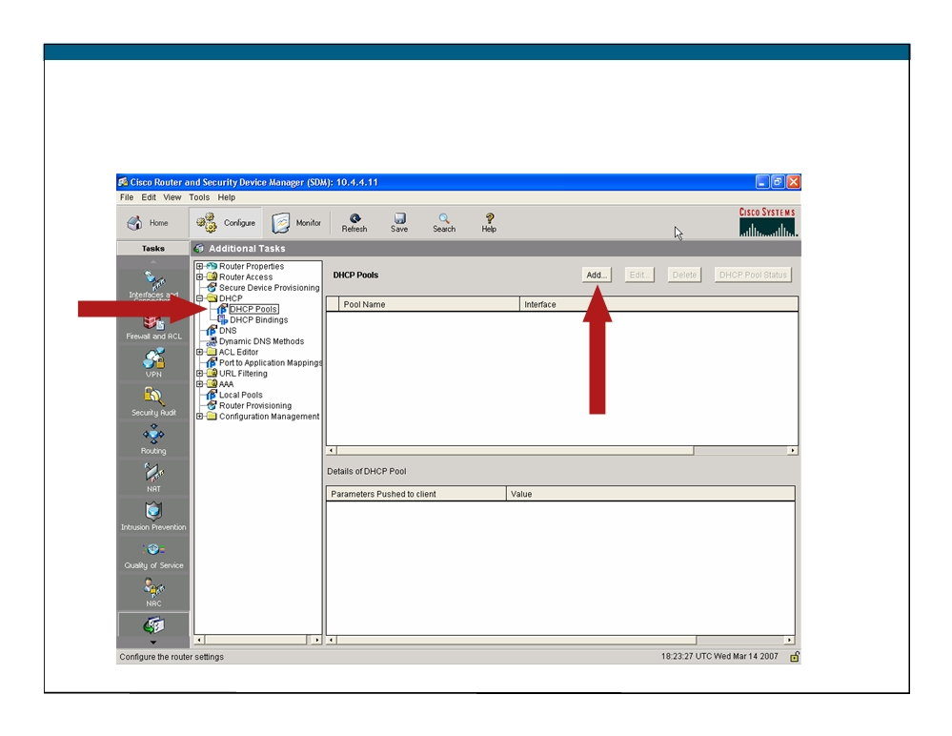
Additional Tasks
© 2007 Cisco Systems, Inc. All rights reserved.
ICND1 v1.0—4-6
The PDF files and any printed representation for this material are the property of Cisco Systems, Inc., for the sole use by Cisco employees for personal study. The files or printed representations may not be used in commercial training, and may not be distributed for purposes other than individual self-study.

Slide 7
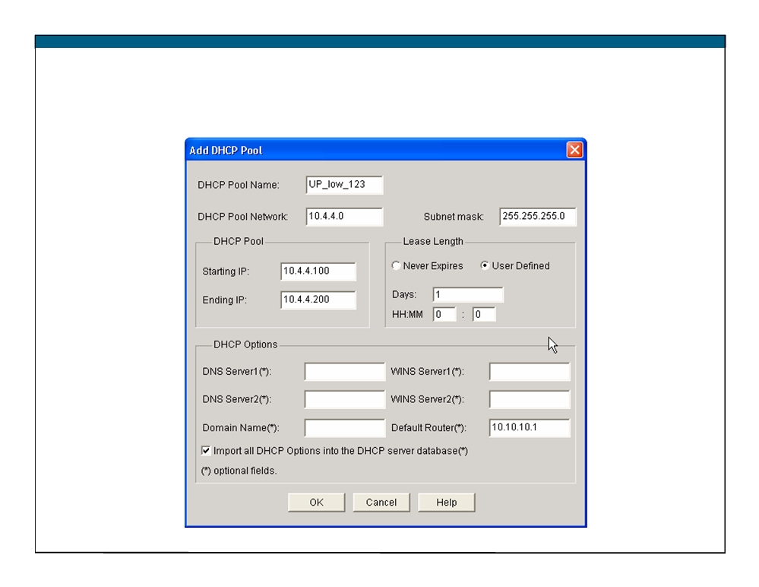
DHCP Pool
© 2007 Cisco Systems, Inc. All rights reserved.
ICND1 v1.0—4-8
The PDF files and any printed representation for this material are the property of Cisco Systems, Inc., for the sole use by Cisco employees for personal study. The files or printed representations may not be used in commercial training, and may not be distributed for purposes other than individual self-study.

Slide 8
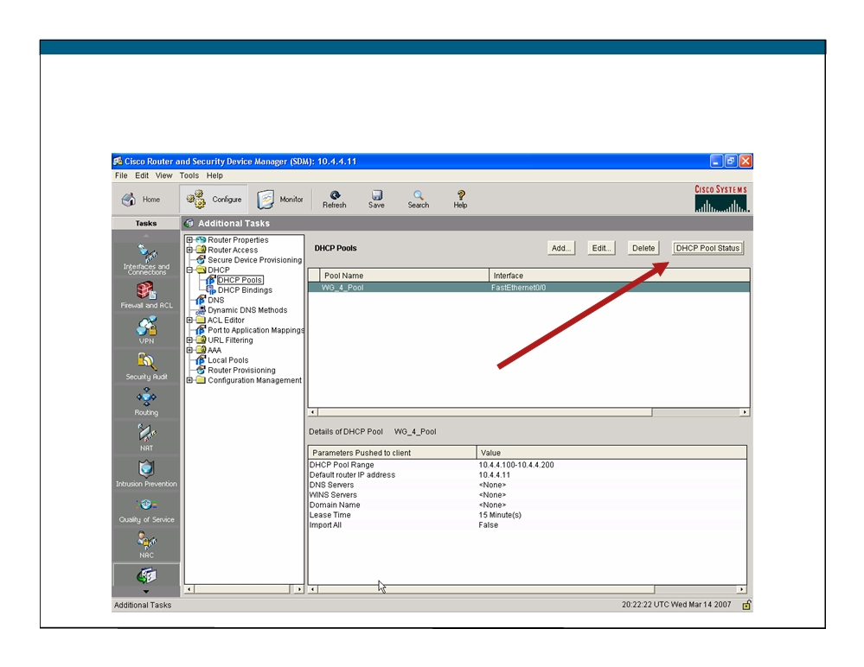
Checking the DHCP Configuration
© 2007 Cisco Systems, Inc. All rights reserved.
ICND1 v1.0—4-10
The PDF files and any printed representation for this material are the property of Cisco Systems, Inc., for the sole use by Cisco employees for personal study. The files or printed representations may not be used in commercial training, and may not be distributed for purposes other than individual self-study.

Slide 9
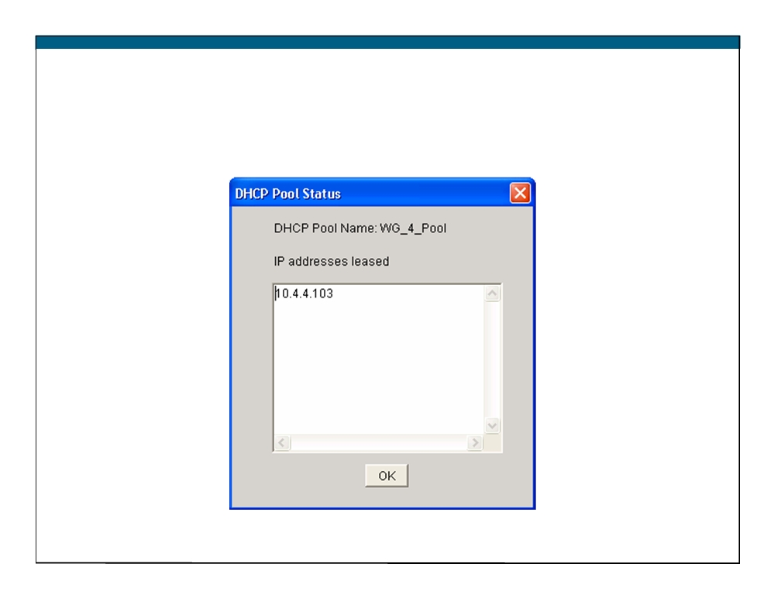
DHCP Pool Status
© 2007 Cisco Systems, Inc. All rights reserved.
ICND1 v1.0—4-12
The PDF files and any printed representation for this material are the property of Cisco Systems, Inc., for the sole use by Cisco employees for personal study. The files or printed representations may not be used in commercial training, and may not be distributed for purposes other than individual self-study.

Slide 10

show ip dhcp conflict
RouterX# show ip dhcp conflict
IP address
Detection Method
Detection time
172.16.1.32
Ping
Feb 16 2007 12:28 PM
172.16.1.64
Gratuitous ARP
Feb 23 2007 08:12 AM
© 2007 Cisco Systems, Inc. All rights reserved.
ICND1 v1.0—4-14
The PDF files and any printed representation for this material are the property of Cisco Systems, Inc., for the sole use by Cisco employees for personal study. The files or printed representations may not be used in commercial training, and may not be distributed for purposes other than individual self-study.

Slide 11
Summary
ƒ DHCP is built on a client-server model.
ƒ DHCP server hosts allocate network addresses and deliver configuration parameters.
ƒ Cisco IOS Software includes a DHCP server.
ƒ Cisco SDM can be used to configure a DHCP server on a router. ƒ The required configuration items are as follows:
- Pool name
- Pool network and subnet - Starting and ending addresses
ƒ Cisco SDM can be used to monitor a DHCP server on the router. ƒ The show ip dhcp conflict command can be used to find conflicts.
© 2007 Cisco Systems, Inc. All rights reserved.
ICND1 v1.0—4-15
The PDF files and any printed representation for this material are the property of Cisco Systems, Inc., for the sole use by Cisco employees for personal study. The files or printed representations may not be used in commercial training, and may not be distributed for purposes other than individual self-study.

Slide 12

ICND1 v1.0—4-16 The PDF files and any printed representation for this material are the property of Cisco Systems, Inc., for the sole use by Cisco employees for personal study. The files or printed representations may not be used in commercial training, and may not be distributed for purposes other than individual self-study.
© 2007 Cisco Systems, Inc. All rights reserved.

