Slide 1

Implementing EIGRP
EIGRP Implementation
© 2007 Cisco Systems, Inc. All rights reserved.
ICND2 v1.0—5-1
The PDF files and any printed representation for this material are the property of Cisco Systems, Inc., for the sole use by Cisco employees for personal study. The files or printed representations may not be used in commercial training, and may not be distributed for purposes other than individual self-study.

Slide 2
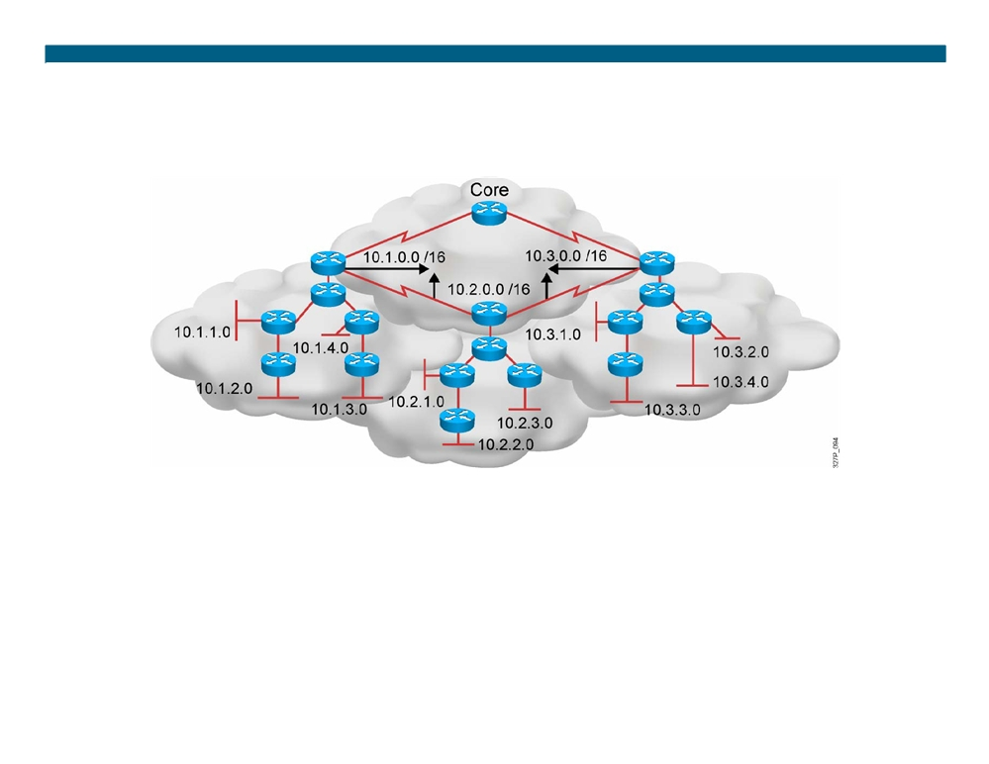
EIGRP Features
ƒ Advanced distance vector
ƒ Flexible network design
ƒ Rapid convergence
ƒ Multicast and unicast instead of broadcast
ƒ 
100% loop-free classless routing
address
ƒ Easy configuration
ƒ Support for VLSM and discontiguous subnets
ƒ Incremental updates
ƒ Manual summarization at any point in the
internetwork
ƒ Load balancing across equal-
ƒ Support for multiple network layer protocols
and unequal-cost pathways
© 2007 Cisco Systems, Inc. All rights reserved.
ICND2 v1.0—5-2
The PDF files and any printed representation for this material are the property of Cisco Systems, Inc., for the sole use by Cisco employees for personal study. The files or printed representations may not be used in commercial training, and may not be distributed for purposes other than individual self-study.

Slide 3
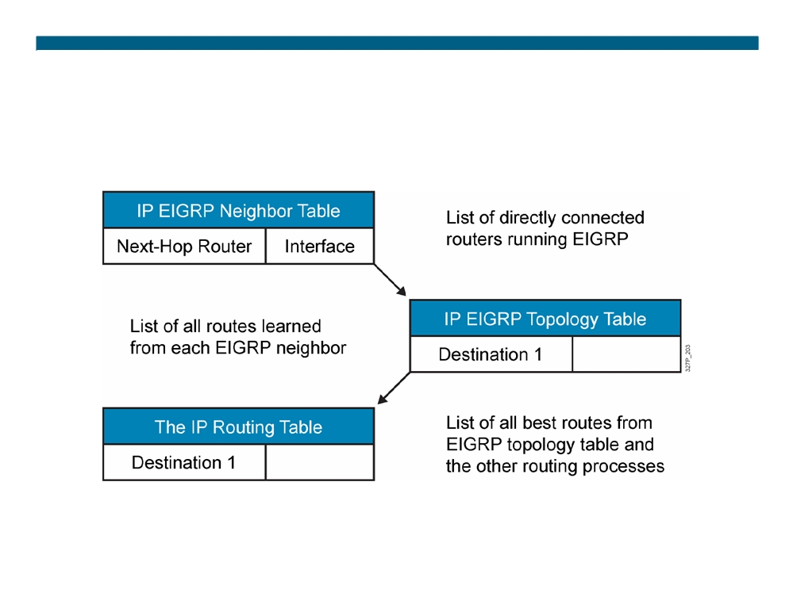
EIGRP Tables
© 2007 Cisco Systems, Inc. All rights reserved.
ICND2 v1.0—5-3
The PDF files and any printed representation for this material are the property of Cisco Systems, Inc., for the sole use by Cisco employees for personal study. The files or printed representations may not be used in commercial training, and may not be distributed for purposes other than individual self-study.

Slide 4
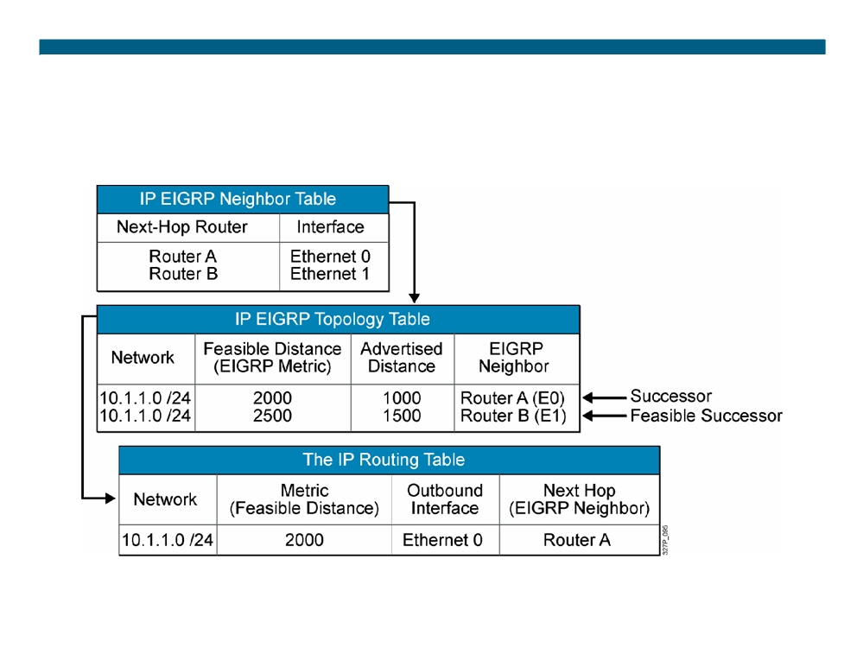
EIGRP Path Calculation (Router C)
© 2007 Cisco Systems, Inc. All rights reserved.
ICND2 v1.0—5-4
The PDF files and any printed representation for this material are the property of Cisco Systems, Inc., for the sole use by Cisco employees for personal study. The files or printed representations may not be used in commercial training, and may not be distributed for purposes other than individual self-study.

Slide 5
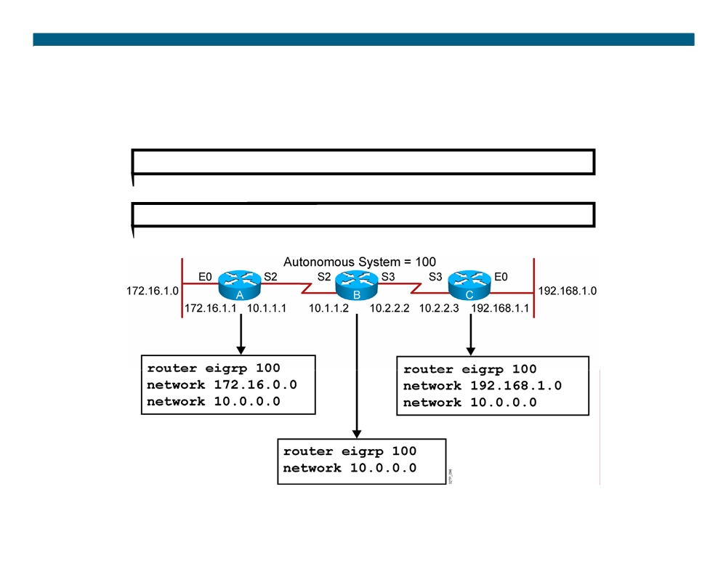
EIGRP Configuration
RouterX(config)# router eigrp autonomous-system RouterX(config-router)# network network-number
© 2007 Cisco Systems, Inc. All rights reserved.
ICND2 v1.0—5-5
The PDF files and any printed representation for this material are the property of Cisco Systems, Inc., for the sole use by Cisco employees for personal study. The files or printed representations may not be used in commercial training, and may not be distributed for purposes other than individual self-study.

Slide 6
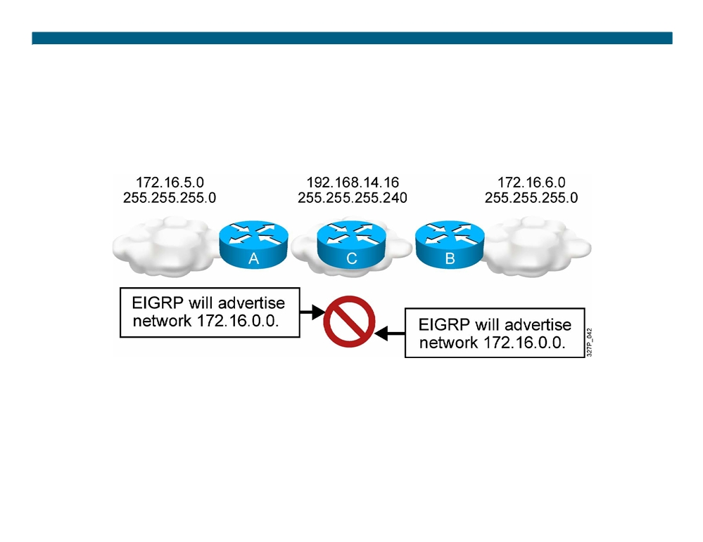
EIGRP and Discontiguous Networks Default Scenario Configuration
EIGRP, by default, does not advertise subnets and, therefore, cannot support discontiguous subnets.
© 2007 Cisco Systems, Inc. All rights reserved.
ICND2 v1.0—5-6
The PDF files and any printed representation for this material are the property of Cisco Systems, Inc., for the sole use by Cisco employees for personal study. The files or printed representations may not be used in commercial training, and may not be distributed for purposes other than individual self-study.

Slide 7
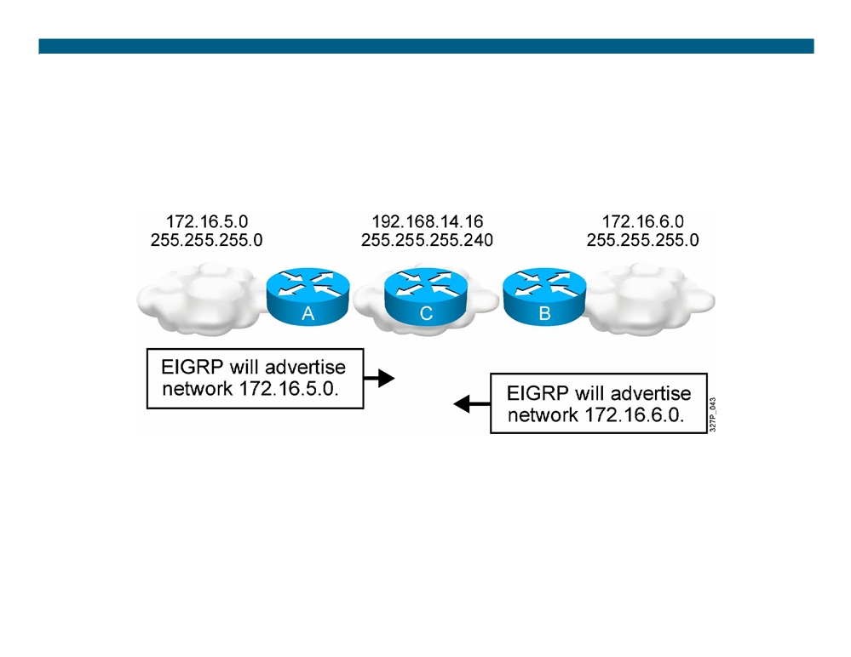
EIGRP and Discontiguous Networks with no auto-summary
EIGRP with the no auto-summary parameter can advertise subnets and, therefore, can support discontiguous subnets.
© 2007 Cisco Systems, Inc. All rights reserved.
ICND2 v1.0—5-7
The PDF files and any printed representation for this material are the property of Cisco Systems, Inc., for the sole use by Cisco employees for personal study. The files or printed representations may not be used in commercial training, and may not be distributed for purposes other than individual self-study.

Slide 8
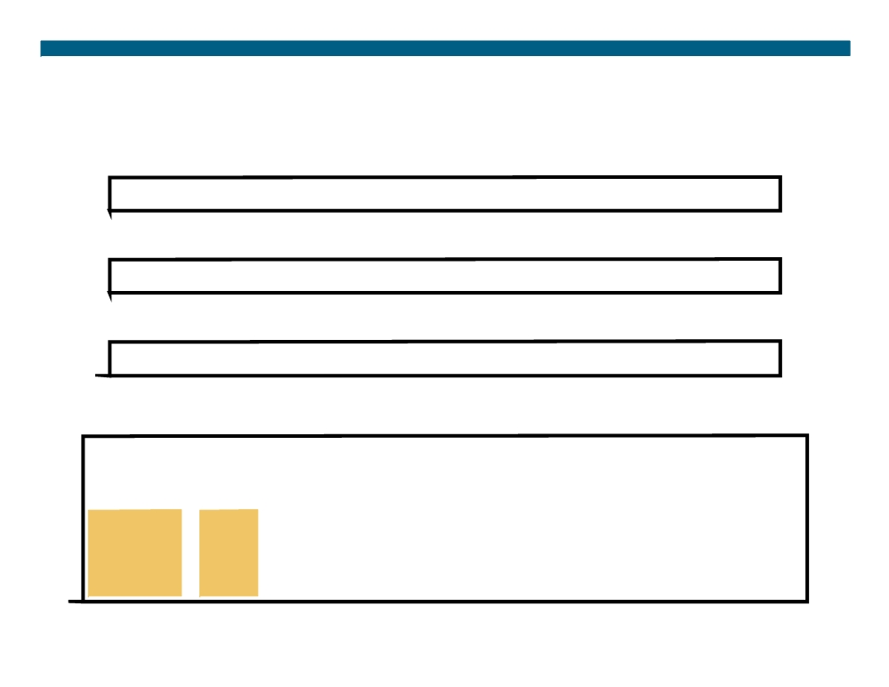
Verifying the EIGRP Configuration
RouterX# show ip route eigrp
ƒ Displays the current EIGRP entries in the routing table
RouterX# show ip protocols
ƒ Displays the parameters and current state of the active process
RouterX# show ip eigrp interfaces
ƒ Displays information about interfaces configured for EIGRP
RouterX# show ip eigrp interfaces
IP EIGRP interfaces for process 109
Xmit Queue
Mean Pacing Time Multicast Pending
Interface Peers Un/Reliable SRTT Un/Reliable Flow Timer Routes
Di0
0
0/0
0
11/434
0
0
Et0
1
0/0
337
0/10
0
0
SE0:1.16
1
0/0
10
1/63
103
0
Tu0
1
0/0
330
0/16
0
0
© 2007 Cisco Systems, Inc. All rights reserved.
ICND2 v1.0—5-8
The PDF files and any printed representation for this material are the property of Cisco Systems, Inc., for the sole use by Cisco employees for personal study. The files or printed representations may not be used in commercial training, and may not be distributed for purposes other than individual self-study.

Slide 9
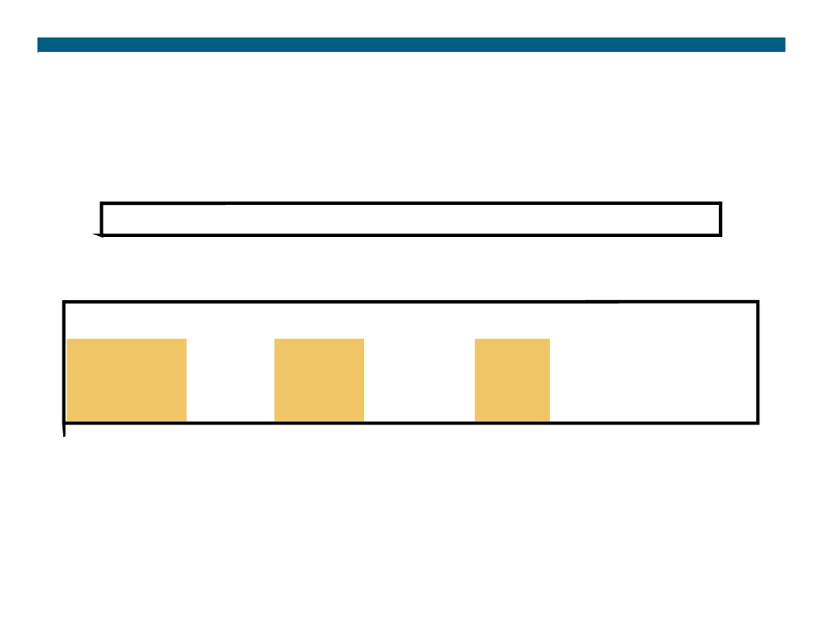
Verifying the EIGRP Configuration (Cont.)
RouterX# show ip eigrp neighbors [detail] ƒ Displays the neighbors discovered by IP EIGRP
RouterX# show ip eigrp neighbors
IP-EIGRP Neighbors for process 77
Address
Interface
Holdtime Uptime Q
Seq SRTT RTO
(secs)
(h:m:s) Count Num
(ms)
(ms)
172.16.81.28
Ethernet1
13
0:00:41
0
11
4
20
172.16.80.28
Ethernet0
14
0:02:01
0
10
12
24
172.16.80.31
Ethernet0
12
0:02:02
0
4
5
20
© 2007 Cisco Systems, Inc. All rights reserved.
ICND2 v1.0—5-9
The PDF files and any printed representation for this material are the property of Cisco Systems, Inc., for the sole use by Cisco employees for personal study. The files or printed representations may not be used in commercial training, and may not be distributed for purposes other than individual self-study.

Slide 10
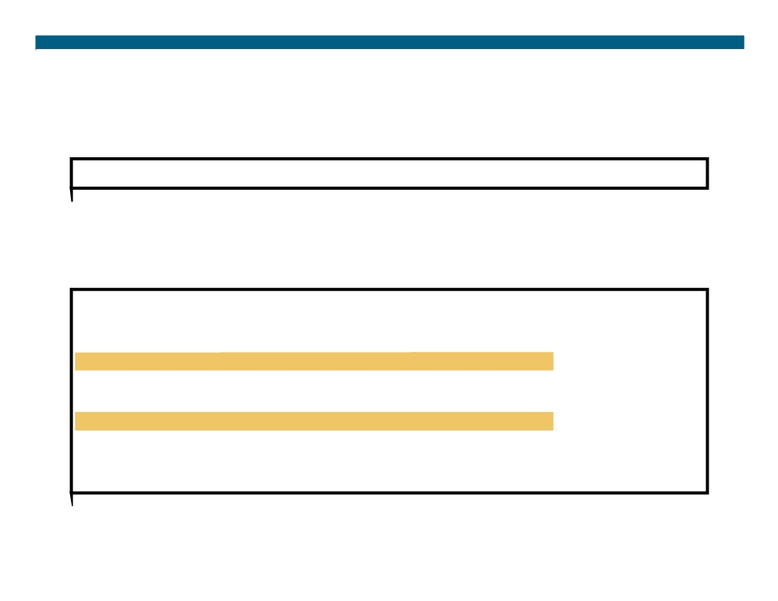
Verifying the EIGRP Configuration (Cont.)
RouterX# show ip eigrp topology [all] ƒ Displays the IP EIGRP topology table
ƒ Without the [all] parameter, shows successors and feasible successors
RouterX# show ip eigrp topology
IP-EIGRP Topology Table for process 77
Codes: P - Passive, A - Active, U - Update, Q - Query, R - Reply, r - Reply status
P 172.16.90.0 255.255.255.0, 2 successors, FD is 46251776 via 172.16.80.28 (46251776/46226176), Ethernet0 via 172.16.81.28 (46251776/46226176), Ethernet1 via 172.16.80.31 (46277376/46251776), Serial0 P 172.16.81.0 255.255.255.0, 2 successors, FD is 307200 via Connected, Ethernet1
via 172.16.81.28 (307200/281600), Ethernet1 via 172.16.80.28 (307200/281600), Ethernet0 via 172.16.80.31 (332800/307200), Serial0
© 2007 Cisco Systems, Inc. All rights reserved.
ICND2 v1.0—5-10
The PDF files and any printed representation for this material are the property of Cisco Systems, Inc., for the sole use by Cisco employees for personal study. The files or printed representations may not be used in commercial training, and may not be distributed for purposes other than individual self-study.

Slide 11
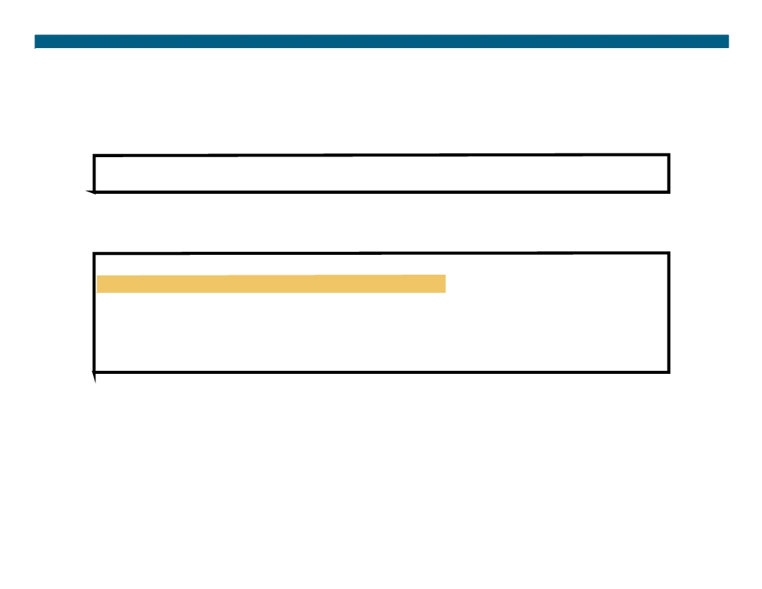
Verifying the EIGRP Configuration (Cont.)
RouterX# show ip eigrp traffic
ƒ Displays the number of IP EIGRP packets sent and received
RouterX# show ip eigrp traffic
IP-EIGRP Traffic Statistics for process 77 Hellos sent/received: 218/205
Updates sent/received: 7/23 Queries sent/received: 2/0 Replies sent/received: 0/2 Acks sent/received: 21/14
© 2007 Cisco Systems, Inc. All rights reserved.
ICND2 v1.0—5-11
The PDF files and any printed representation for this material are the property of Cisco Systems, Inc., for the sole use by Cisco employees for personal study. The files or printed representations may not be used in commercial training, and may not be distributed for purposes other than individual self-study.

Slide 12

debug ip eigrp Command
RouterX# debug ip eigrp
IP-EIGRP: Processing incoming UPDATE packet
IP-EIGRP: Ext 192.168.3.0 255.255.255.0 M 386560 - 256000 130560 SM 360960 - 256000 104960
IP-EIGRP: Ext 192.168.0.0 255.255.255.0 M 386560 - 256000 130560 SM 360960 - 256000 104960
IP-EIGRP: Ext 192.168.3.0 255.255.255.0 M 386560 - 256000 130560 SM 360960 - 256000 104960
IP-EIGRP: 172.69.43.0 255.255.255.0, - do advertise out Ethernet0/1 IP-EIGRP: Ext 172.69.43.0 255.255.255.0 metric 371200 - 256000 115200 IP-EIGRP: 192.135.246.0 255.255.255.0, - do advertise out Ethernet0/1 IP-EIGRP: Ext 192.135.246.0 255.255.255.0 metric 46310656 - 45714176 596480 IP-EIGRP: 172.69.40.0 255.255.255.0, - do advertise out Ethernet0/1 IP-EIGRP: Ext 172.69.40.0 255.255.255.0 metric 2272256 - 1657856 614400 IP-EIGRP: 192.135.245.0 255.255.255.0, - do advertise out Ethernet0/1 IP-EIGRP: Ext 192.135.245.0 255.255.255.0 metric 40622080 - 40000000 622080 IP-EIGRP: 192.135.244.0 255.255.255.0, - do advertise out Ethernet0/1
Note: EIGRP routes are exchanged only when a change in topology occurs.
© 2007 Cisco Systems, Inc. All rights reserved.
ICND2 v1.0—5-12
The PDF files and any printed representation for this material are the property of Cisco Systems, Inc., for the sole use by Cisco employees for personal study. The files or printed representations may not be used in commercial training, and may not be distributed for purposes other than individual self-study.

Slide 13

EIGRP Metric
The criteria that EIGRP uses by default to calculate its metric:
ƒ Bandwidth ƒ Delay
The optional criteria that EIGRP can be configured to use when calculating its metric:
ƒ Reliability
ƒ Load
Note: Although MTU is exchanged in EIGRP packets between neighbor routers, MTU is not factored into the EIGRP metric calculation.
© 2007 Cisco Systems, Inc. All rights reserved.
ICND2 v1.0—5-13
The PDF files and any printed representation for this material are the property of Cisco Systems, Inc., for the sole use by Cisco employees for personal study. The files or printed representations may not be used in commercial training, and may not be distributed for purposes other than individual self-study.

Slide 14
EIGRP Load Balancing
ƒ By default, EIGRP does equal-metric load balancing: - By default, up to four routes with a metric equal to the minimum metric are installed in the routing table. ƒ There can be up to 16 entries in the routing table for the same destination:
- The number of entries is configurable with the maximum-paths command.
© 2007 Cisco Systems, Inc. All rights reserved.
ICND2 v1.0—5-14
The PDF files and any printed representation for this material are the property of Cisco Systems, Inc., for the sole use by Cisco employees for personal study. The files or printed representations may not be used in commercial training, and may not be distributed for purposes other than individual self-study.

Slide 15
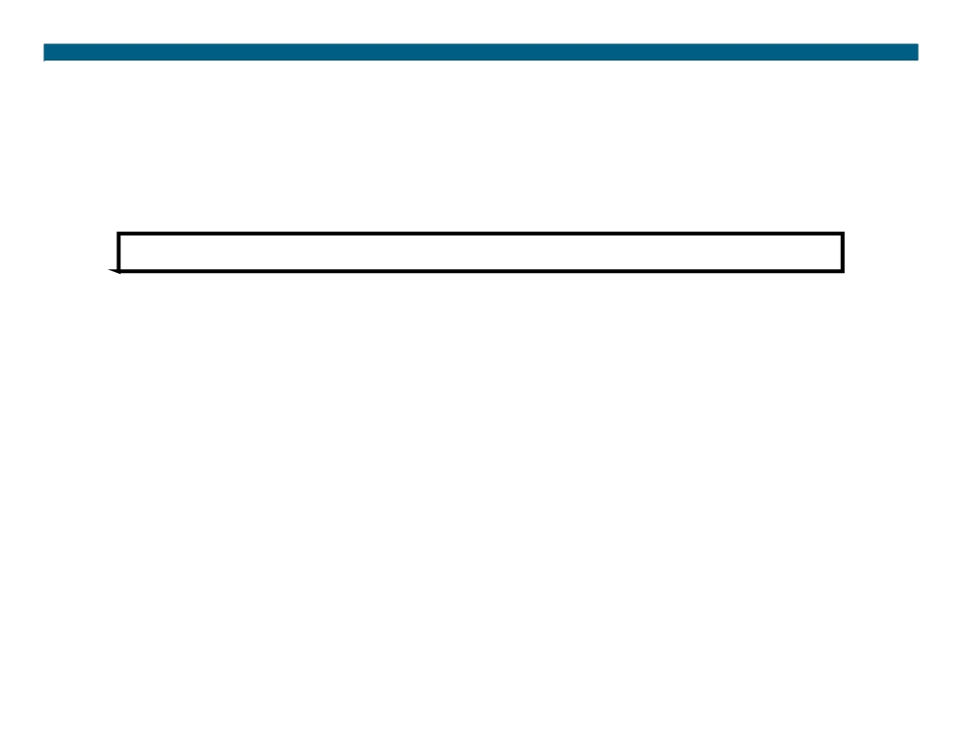
EIGRP Unequal-Cost Load Balancing
RouterX(config-router)#
variance multiplier
ƒ Allows the router to load-balance across routes with a metric smaller than the multiplier value times the minimum metric route to that destination.
ƒ The default variance is 1, which means equal-cost load balancing.
© 2007 Cisco Systems, Inc. All rights reserved.
ICND2 v1.0—5-15
The PDF files and any printed representation for this material are the property of Cisco Systems, Inc., for the sole use by Cisco employees for personal study. The files or printed representations may not be used in commercial training, and may not be distributed for purposes other than individual self-study.

Slide 16
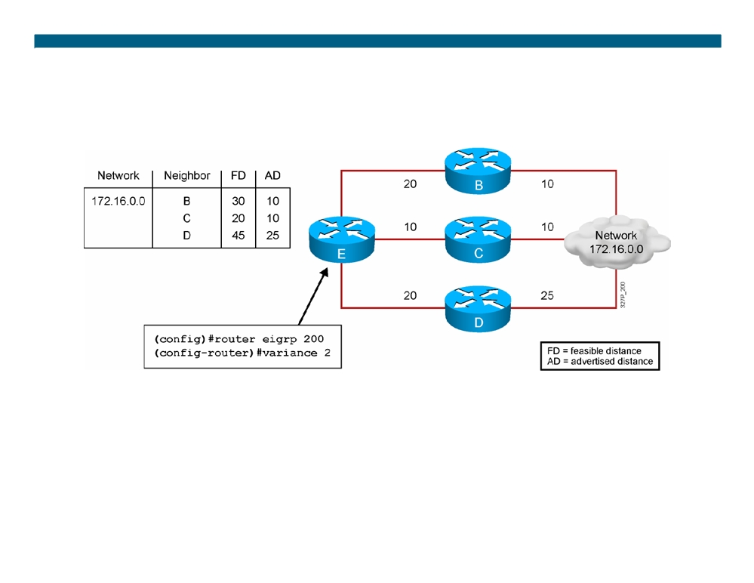
Variance Example
ƒ Router E chooses router C to route to network 172.16.0.0 because it has the lowest feasible distance of 20.
ƒ With a variance of 2, router E also chooses router B to route to network 172.16.0.0 (20 + 10 = 30) < [2 * (FD) = 40].
ƒ Router D is not considered to route to network 172.16.0.0 (because 25 > 20).
© 2007 Cisco Systems, Inc. All rights reserved.
ICND2 v1.0—5-16
The PDF files and any printed representation for this material are the property of Cisco Systems, Inc., for the sole use by Cisco employees for personal study. The files or printed representations may not be used in commercial training, and may not be distributed for purposes other than individual self-study.

Slide 17
EIGRP MD5 Authentication
ƒ EIGRP supports MD5 authentication.
ƒ The router identifies itself for every EIGRP packet it sends. ƒ The router authenticates the source of each routing update packet that it receives.
ƒ Each participating neighbor must have the same key configured.
© 2007 Cisco Systems, Inc. All rights reserved.
ICND2 v1.0—5-17
The PDF files and any printed representation for this material are the property of Cisco Systems, Inc., for the sole use by Cisco employees for personal study. The files or printed representations may not be used in commercial training, and may not be distributed for purposes other than individual self-study.

Slide 18
EIGRP MD5 Authentication Configuration Steps
1. Create the keychain, a group of possible keys (passwords). 2. Assign a key ID to each key.
3. Identify the keys.
4.(Optional) Specify the duration a key will be valid. 5. Enable MD5 authentication on the interface. 6. Specify which keychain the interface will use.
© 2007 Cisco Systems, Inc. All rights reserved.
ICND2 v1.0—5-18
The PDF files and any printed representation for this material are the property of Cisco Systems, Inc., for the sole use by Cisco employees for personal study. The files or printed representations may not be used in commercial training, and may not be distributed for purposes other than individual self-study.

Slide 19
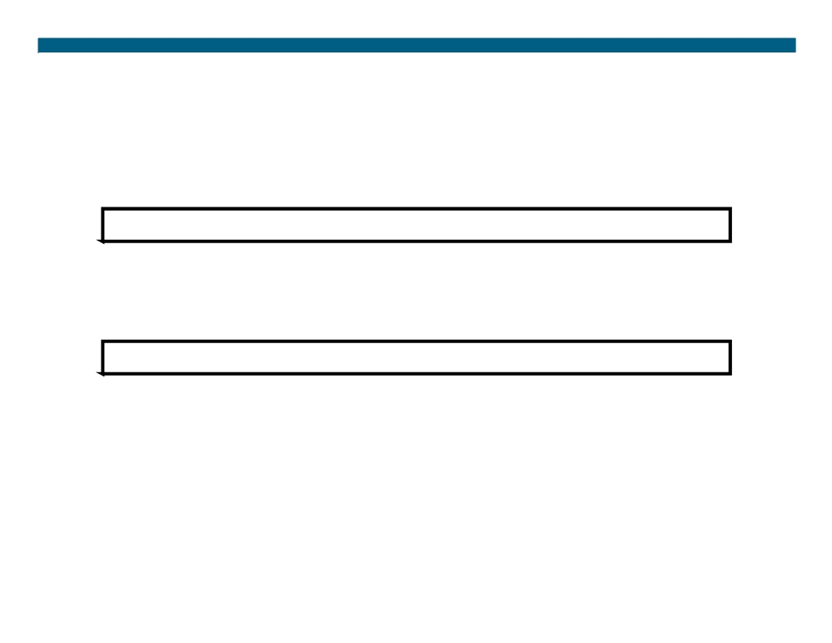
Configuring EIGRP MD5 Authentication
RouterX(config)#
key chain name-of-chain
ƒ Enters the configuration mode for the keychain
RouterX(config-keychain)#
key key-id
ƒ Identifies the key and enters the configuration mode for the key ID
© 2007 Cisco Systems, Inc. All rights reserved.
ICND2 v1.0—5-19
The PDF files and any printed representation for this material are the property of Cisco Systems, Inc., for the sole use by Cisco employees for personal study. The files or printed representations may not be used in commercial training, and may not be distributed for purposes other than individual self-study.

Slide 20
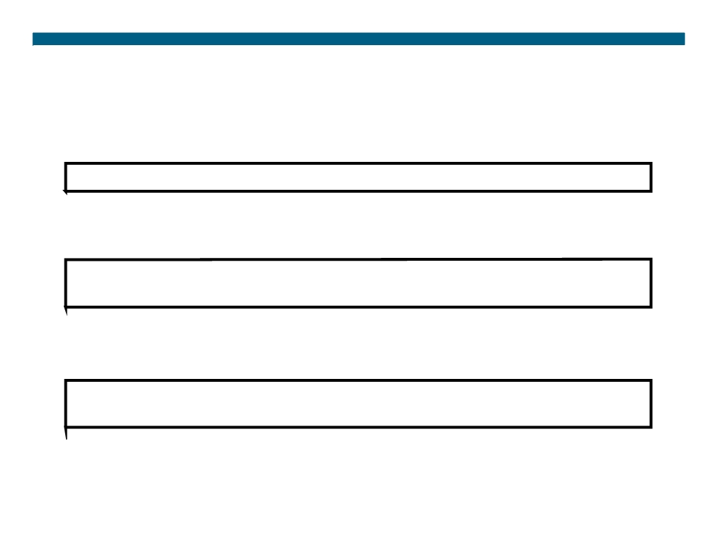
Configuring EIGRP MD5 Authentication (Cont.)
RouterX(config-keychain-key)#
key-string text
ƒ Identifies the key string (password)
RouterX(config-keychain-key)#
accept-lifetime start-time {infinite | end-time | duration seconds}
ƒ (Optional) Specifies when the key is accepted for received packets
RouterX(config-keychain-key)#
send-lifetime start-time {infinite | end-time | duration seconds}
ƒ (Optional) Specifies when the key can be used for sending packets
© 2007 Cisco Systems, Inc. All rights reserved.
ICND2 v1.0—5-20
The PDF files and any printed representation for this material are the property of Cisco Systems, Inc., for the sole use by Cisco employees for personal study. The files or printed representations may not be used in commercial training, and may not be distributed for purposes other than individual self-study.

Slide 21
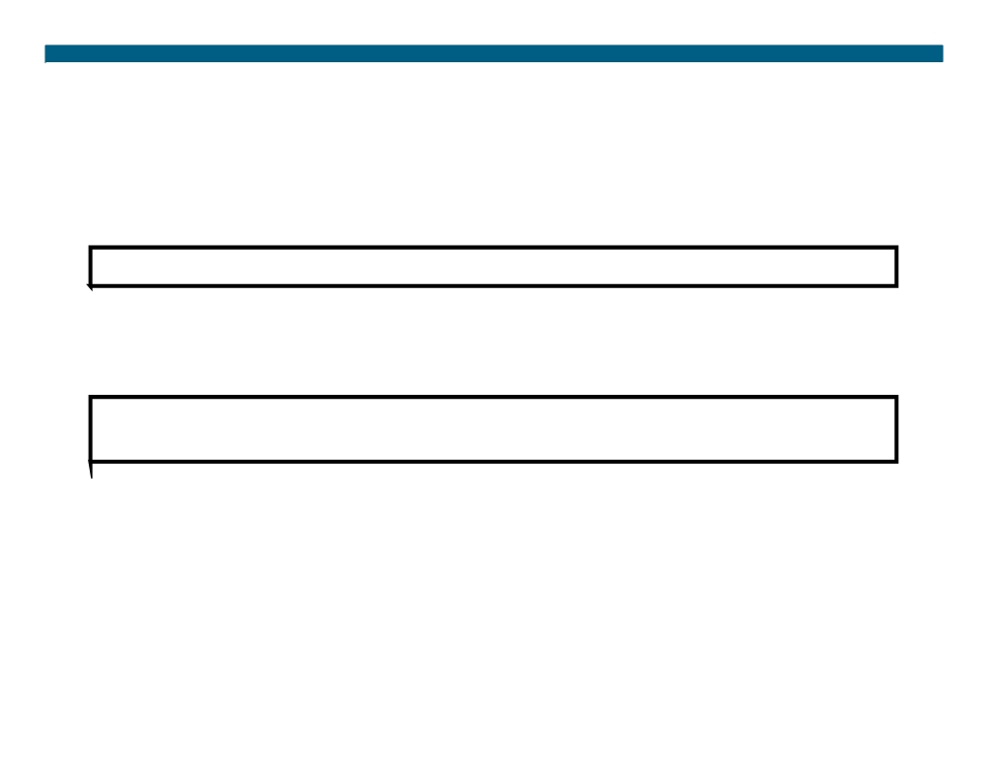
Configuring EIGRP MD5 Authentication (Cont.)
RouterX(config-if)#
ip authentication mode eigrp autonomous-system md5 ƒ Specifies MD5 authentication for EIGRP packets
RouterX(config-if)#
ip authentication key-chain eigrp autonomous-system name-of-chain
ƒ Enables authentication of EIGRP packets using the key in the keychain
© 2007 Cisco Systems, Inc. All rights reserved.
ICND2 v1.0—5-21
The PDF files and any printed representation for this material are the property of Cisco Systems, Inc., for the sole use by Cisco employees for personal study. The files or printed representations may not be used in commercial training, and may not be distributed for purposes other than individual self-study.

Slide 22
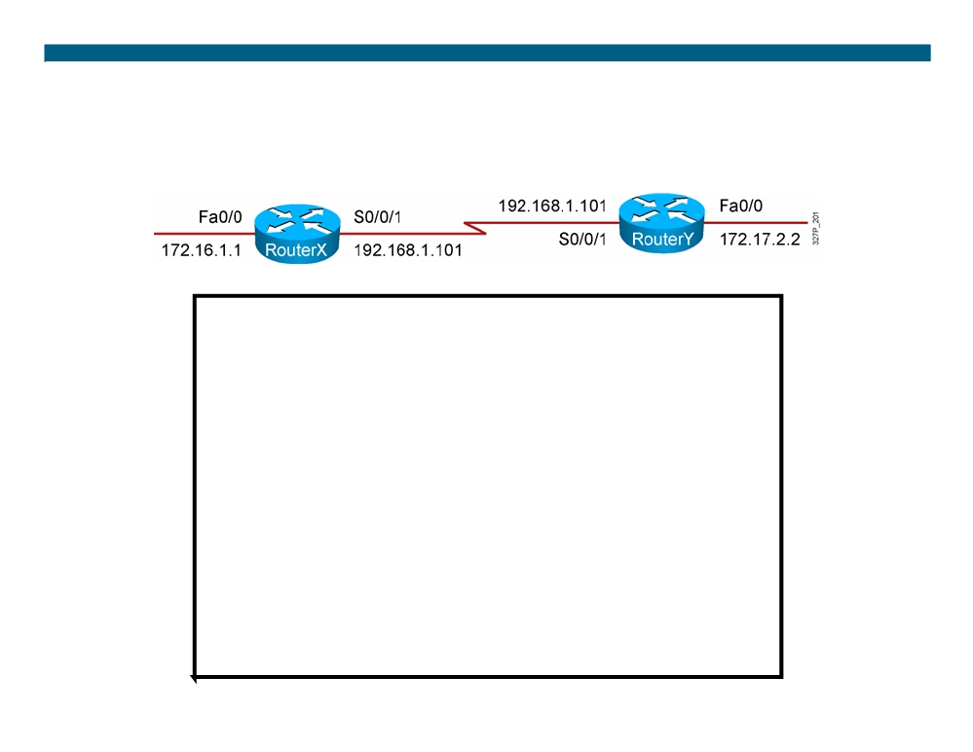
Example EIGRP MD5 Authentication Configuration
RouterX
<output omitted>
key chain RouterXchain key 1
key-string firstkey
accept-lifetime 04:00:00 Jan 1 2006 infinite send-lifetime 04:00:00 Jan 1 2006 04:01:00 Jan 1 2006 key 2
key-string secondkey
accept-lifetime 04:00:00 Jan 1 2006 infinite send-lifetime 04:00:00 Jan 1 2006 infinite <output omitted>
!
interface Serial0/0/1 bandwidth 64
ip address 192.168.1.101 255.255.255.224 ip authentication mode eigrp 100 md5
ip authentication key-chain eigrp 100 RouterXchain
© 2007 Cisco Systems, Inc. All rights reserved.
ICND2 v1.0—5-22
The PDF files and any printed representation for this material are the property of Cisco Systems, Inc., for the sole use by Cisco employees for personal study. The files or printed representations may not be used in commercial training, and may not be distributed for purposes other than individual self-study.

Slide 23
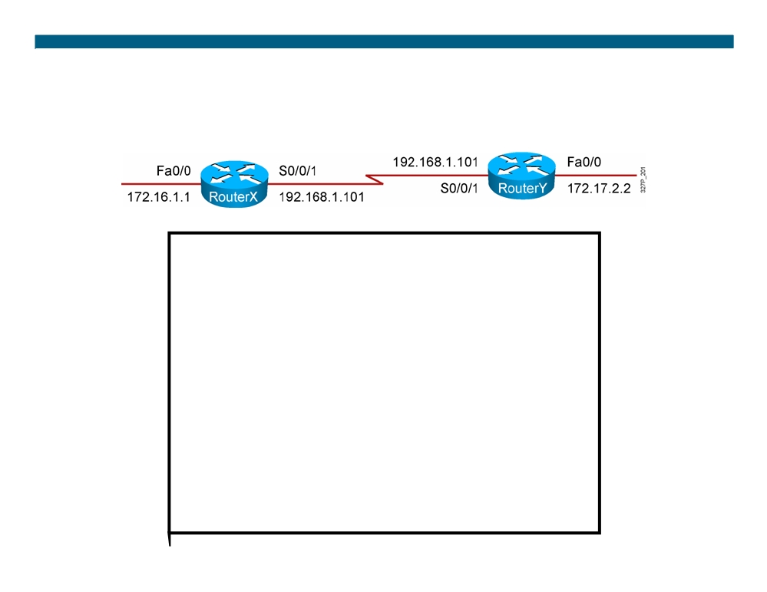
Example EIGRP MD5 Authentication Configuration (Cont.)
RouterY
<output omitted>
key chain RouterYchain key 1
key-string firstkey
accept-lifetime 04:00:00 Jan 1 2006 infinite send-lifetime 04:00:00 Jan 1 2006 infinite key 2
key-string secondkey
accept-lifetime 04:00:00 Jan 1 2006 infinite send-lifetime 04:00:00 Jan 1 2006 infinite <output omitted>
!
interface Serial0/0/1 bandwidth 64
ip address 192.168.1.102 255.255.255.224 ip authentication mode eigrp 100 md5
ip authentication key-chain eigrp 100 RouterYchain
© 2007 Cisco Systems, Inc. All rights reserved.
ICND2 v1.0—5-23
The PDF files and any printed representation for this material are the property of Cisco Systems, Inc., for the sole use by Cisco employees for personal study. The files or printed representations may not be used in commercial training, and may not be distributed for purposes other than individual self-study.

Slide 24
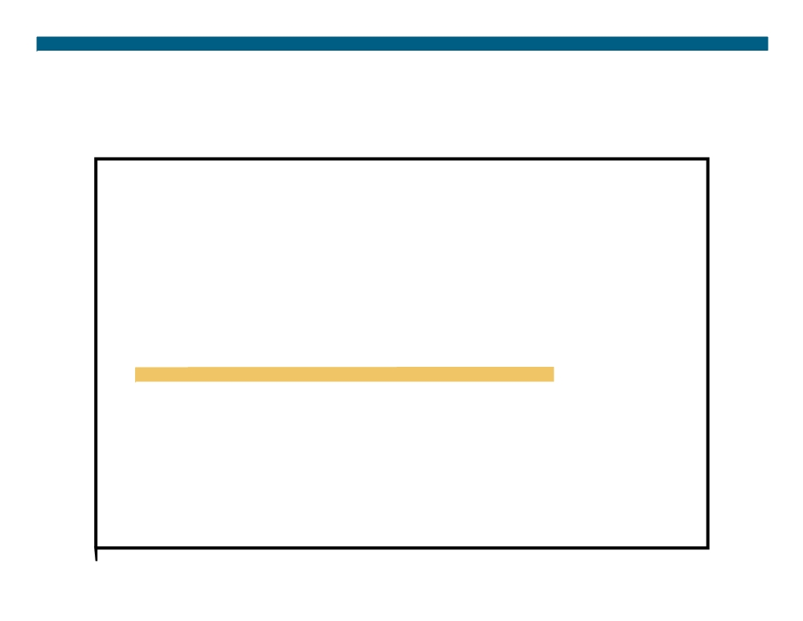
Verifying MD5 Authentication
RouterX#
*Jan 21 16:23:30.517: %DUAL-5-NBRCHANGE: IP-EIGRP(0) 100: Neighbor 192.168.1.102 (Serial0/0/1) is up: new adjacency
RouterX#show ip eigrp neighbors IP-EIGRP neighbors for process 100
H Address
Interface
Hold Uptime SRTT RTO Q Seq
(sec)
(ms)
Cnt Num
0
192.168.1.102
Se0/0/1
12 00:03:10
17
2280
0
14
RouterX#show ip route
<output omitted>
Gateway of last resort is not set
D
172.17.0.0/16 [90/40514560] via 192.168.1.102, 00:02:22, Serial0/0/1
172.16.0.0/16 is variably subnetted, 2 subnets, 2 masks
D
172.16.0.0/16 is a summary, 00:31:31, Null0
C
172.16.1.0/24 is directly connected, FastEthernet0/0
192.168.1.0/24 is variably subnetted, 2 subnets, 2 masks
C
192.168.1.96/27 is directly connected, Serial0/0/1
D
192.168.1.0/24 is a summary, 00:31:31, Null0
RouterX#ping 172.17.2.2 Type escape sequence to abort.
Sending 5, 100-byte ICMP Echos to 172.17.2.2, timeout is 2 seconds: !!!!!
Success rate is 100 percent (5/5), round-trip min/avg/max = 12/15/16 ms
© 2007 Cisco Systems, Inc. All rights reserved.
ICND2 v1.0—5-24
The PDF files and any printed representation for this material are the property of Cisco Systems, Inc., for the sole use by Cisco employees for personal study. The files or printed representations may not be used in commercial training, and may not be distributed for purposes other than individual self-study.

Slide 25
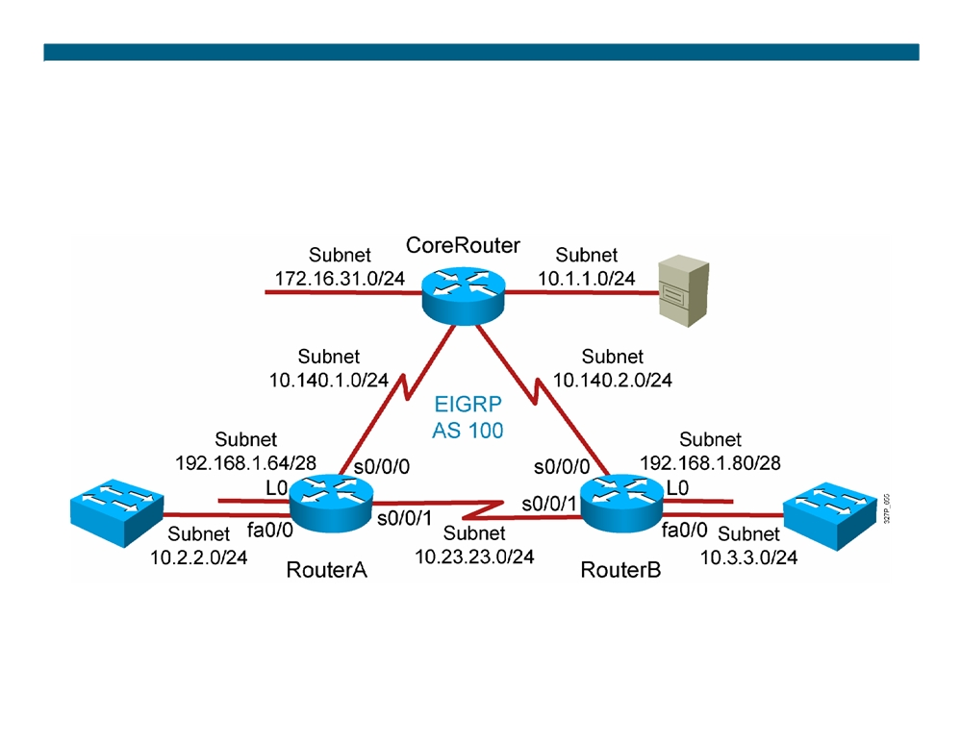
Visual Objective 5-1: Implementing EIGRP
© 2007 Cisco Systems, Inc. All rights reserved.
ICND2 v1.0—5-25
The PDF files and any printed representation for this material are the property of Cisco Systems, Inc., for the sole use by Cisco employees for personal study. The files or printed representations may not be used in commercial training, and may not be distributed for purposes other than individual self-study.

Slide 26
Summary
ƒ EIGRP is a classless, advanced distance vector routing protocol that runs the DUAL algorithm.
ƒ EIGRP requires you to configure an autonomous system number that must match on all routers to exchange routes. ƒ EIGRP is capable of load balancing across unequal-cost paths. ƒ EIGRP supports MD5 authentication to protect against unauthorized, rogue routers entering your network.
© 2007 Cisco Systems, Inc. All rights reserved.
ICND2 v1.0—5-26
The PDF files and any printed representation for this material are the property of Cisco Systems, Inc., for the sole use by Cisco employees for personal study. The files or printed representations may not be used in commercial training, and may not be distributed for purposes other than individual self-study.

Slide 27

© 2007 Cisco Systems, Inc. All rights reserved.
ICND2 v1.0—5-27 The PDF files and any printed representation for this material are the property of Cisco Systems, Inc., for the sole use by Cisco employees for personal study. The files or printed representations may not be used in commercial training, and may not be distributed for purposes other than individual self-study.

Slide 28
Troubleshooting EIGRP
EIGRP Implementation
© 2007 Cisco Systems, Inc. All rights reserved.
ICND2 v1.0—5-1
The PDF files and any printed representation for this material are the property of Cisco Systems, Inc., for the sole use by Cisco employees for personal study. The files or printed representations may not be used in commercial training, and may not be distributed for purposes other than individual self-study.

Slide 29
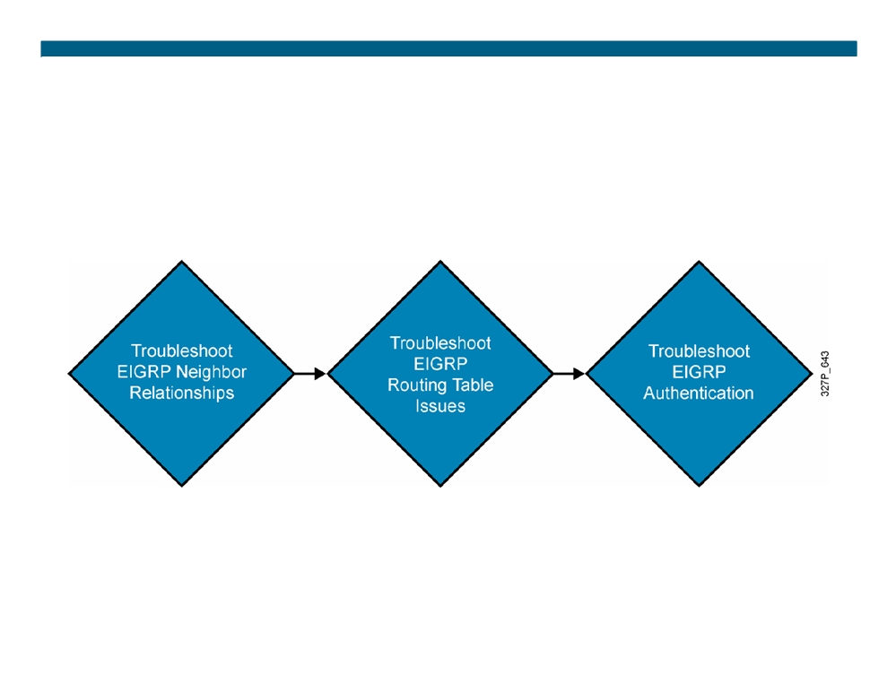
Components of Troubleshooting EIGRP
© 2007 Cisco Systems, Inc. All rights reserved.
ICND2 v1.0—5-2
The PDF files and any printed representation for this material are the property of Cisco Systems, Inc., for the sole use by Cisco employees for personal study. The files or printed representations may not be used in commercial training, and may not be distributed for purposes other than individual self-study.

Slide 30
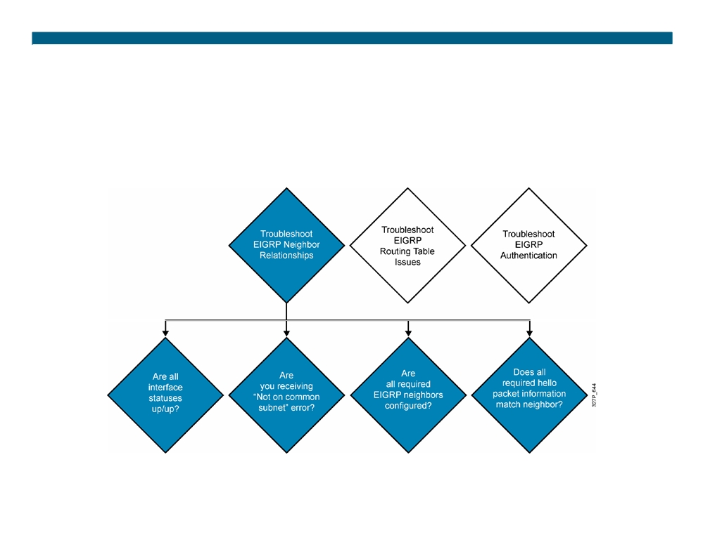
Troubleshooting EIGRP Neighbor Issues
© 2007 Cisco Systems, Inc. All rights reserved.
ICND2 v1.0—5-3
The PDF files and any printed representation for this material are the property of Cisco Systems, Inc., for the sole use by Cisco employees for personal study. The files or printed representations may not be used in commercial training, and may not be distributed for purposes other than individual self-study.

Slide 31
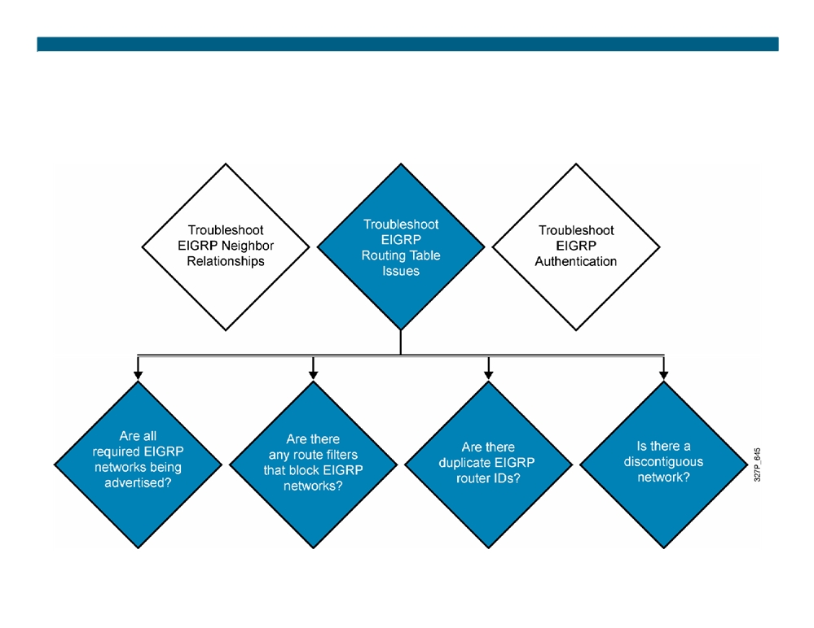
Troubleshooting EIGRP Routing Tables
© 2007 Cisco Systems, Inc. All rights reserved.
ICND2 v1.0—5-4
The PDF files and any printed representation for this material are the property of Cisco Systems, Inc., for the sole use by Cisco employees for personal study. The files or printed representations may not be used in commercial training, and may not be distributed for purposes other than individual self-study.

Slide 32

Troubleshooting EIGRP Authentication
A successful MD5 authentication between RouterX and RouterY
RouterX# debug eigrp packets
EIGRP Packets debugging is on
(UPDATE, REQUEST, QUERY, REPLY, HELLO, IPXSAP, PROBE, ACK, STUB, SIAQUERY, SIAREPLY) *Jan 21 16:38:51.745: EIGRP: received packet with MD5 authentication, key id = 1 *Jan 21 16:38:51.745: EIGRP: Received HELLO on Serial0/0/1 nbr 192.168.1.102 *Jan 21 16:38:51.745: AS 100, Flags 0x0, Seq 0/0 idbQ 0/0 iidbQ un/rely 0/0 pe erQ un/rely 0/0
RouterY# debug eigrp packets EIGRP Packets debugging is on
(UPDATE, REQUEST, QUERY, REPLY, HELLO, IPXSAP, PROBE, ACK, STUB, SIAQUERY, SIAREPLY)
RouterY#
*Jan 21 16:38:38.321: EIGRP: received packet with MD5 authentication, key id = 2 *Jan 21 16:38:38.321: EIGRP: Received HELLO on Serial0/0/1 nbr 192.168.1.101 *Jan 21 16:38:38.321: AS 100, Flags 0x0, Seq 0/0 idbQ 0/0 iidbQ un/rely 0/0 pe erQ un/rely 0/0
© 2007 Cisco Systems, Inc. All rights reserved.
ICND2 v1.0—5-5
The PDF files and any printed representation for this material are the property of Cisco Systems, Inc., for the sole use by Cisco employees for personal study. The files or printed representations may not be used in commercial training, and may not be distributed for purposes other than individual self-study.

Slide 33
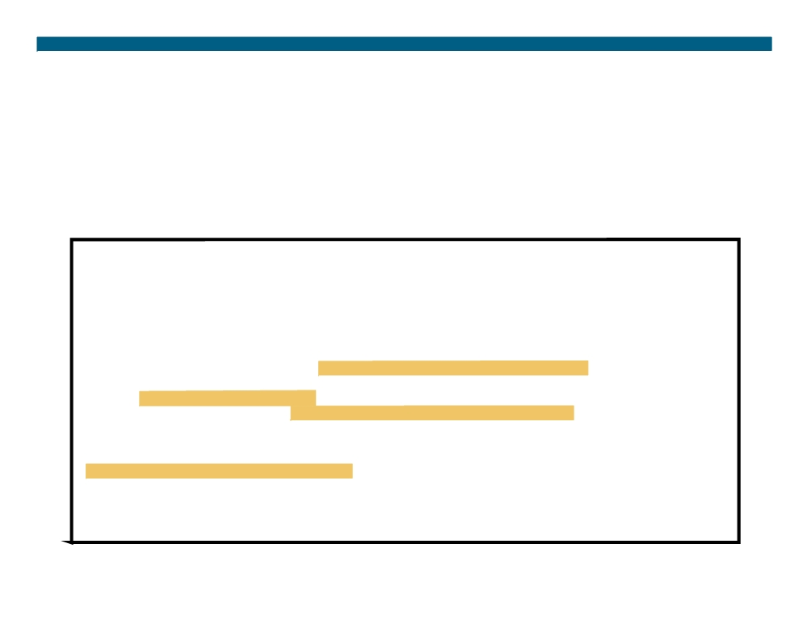
Troubleshooting EIGRP Authentication Problem
Unsuccessful MD5 authentication between RouterX and RouterY when RouterX key 2 is changed
RouterX(config-if)#key chain RouterXchain
RouterX(config-keychain)#key 2
RouterX(config-keychain-key)#key-string wrongkey
RouterY#debug eigrp packets
EIGRP Packets debugging is on
(UPDATE, REQUEST, QUERY, REPLY, HELLO, IPXSAP, PROBE, ACK, STUB, SIAQUERY, SIAREPLY) RouterY#
*Jan 21 16:50:18.749: EIGRP: pkt key id = 2, authentication mismatch *Jan 21 16:50:18.749: EIGRP: Serial0/0/1: ignored packet from 192.168.1.101, opc ode = 5 (invalid authentication)
*Jan 21 16:50:18.749: EIGRP: Dropping peer, invalid authentication *Jan 21 16:50:18.749: EIGRP: Sending HELLO on Serial0/0/1
*Jan 21 16:50:18.749: AS 100, Flags 0x0, Seq 0/0 idbQ 0/0 iidbQ un/rely 0/0 *Jan 21 16:50:18.753: %DUAL-5-NBRCHANGE: IP-EIGRP(0) 100: Neighbor 192.168.1.101 (Serial0/0/1) is down: Auth failure
RouterY#show ip eigrp neighbors IP-EIGRP neighbors for process 100 RouterY#
© 2007 Cisco Systems, Inc. All rights reserved.
ICND2 v1.0—5-6
The PDF files and any printed representation for this material are the property of Cisco Systems, Inc., for the sole use by Cisco employees for personal study. The files or printed representations may not be used in commercial training, and may not be distributed for purposes other than individual self-study.

Slide 34
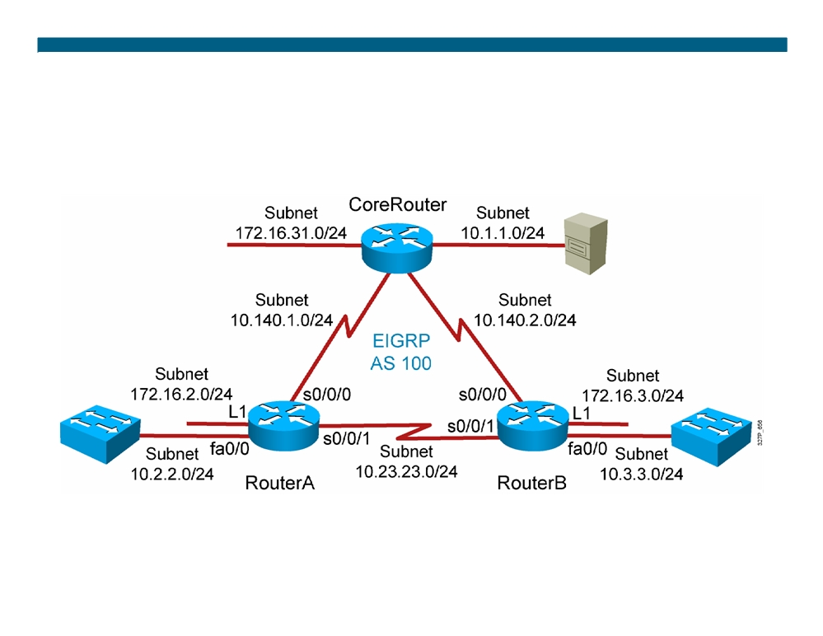
Visual Objective 5-2: Troubleshooting EIGRP
© 2007 Cisco Systems, Inc. All rights reserved.
ICND2 v1.0—5-7
The PDF files and any printed representation for this material are the property of Cisco Systems, Inc., for the sole use by Cisco employees for personal study. The files or printed representations may not be used in commercial training, and may not be distributed for purposes other than individual self-study.

Slide 35
Summary
ƒ There are several aspects of troubleshooting EIGRP, such as resolving neighbor relationships, routing table issues, and authentication problems.
ƒ Issues that can cause EIGRP neighbor problems include incorrect network commands and hello packet information mismatches. Use the command show ip eigrp neighbors to help troubleshoot these issues.
ƒ Missing EIGRP routes from the routing table may be due to route filtering or automatic summarization in discontiguous networks. Use the show ip route command to help troubleshoot these issues.
ƒ The debug eigrp packets command can help you troubleshoot MD5 authentication problems.
© 2007 Cisco Systems, Inc. All rights reserved.
ICND2 v1.0—5-8
The PDF files and any printed representation for this material are the property of Cisco Systems, Inc., for the sole use by Cisco employees for personal study. The files or printed representations may not be used in commercial training, and may not be distributed for purposes other than individual self-study.

Slide 36
© 2007 Cisco Systems, Inc. All rights reserved.
ICND2 v1.0—5-9 The PDF files and any printed representation for this material are the property of Cisco Systems, Inc., for the sole use by Cisco employees for personal study. The files or printed representations may not be used in commercial training, and may not be distributed for purposes other than individual self-study.

Slide 37
Module Summary
ƒ EIGRP is a classless routing protocol that supports VLSM. ƒ Path selection is based upon several factors. ƒ EIGRP keeps a next-best alternative path, called a feasible successor, for fast convergence.
ƒ EIGRP supports unequal-cost load balancing. ƒ EIGRP uses MD5 authentication for router authenticity. ƒ Troubleshooting EIGRP requires resolving link, neighbor, redistribution, and routing issues.
ƒ The following commands help you troubleshoot EIGRP issues: show ip eigrp neighbor, show ip eigrp topology, show ip eigrp interface, and show ip route.
© 2007 Cisco Systems, Inc. All rights reserved.
ICND2 v1.0—5-1
The PDF files and any printed representation for this material are the property of Cisco Systems, Inc., for the sole use by Cisco employees for personal study. The files or printed representations may not be used in commercial training, and may not be distributed for purposes other than individual self-study.

Slide 38
© 2007 Cisco Systems, Inc. All rights reserved.
ICND2 v1.0—5-2 The PDF files and any printed representation for this material are the property of Cisco Systems, Inc., for the sole use by Cisco employees for personal study. The files or printed representations may not be used in commercial training, and may not be distributed for purposes other than individual self-study.

